Slide 1


Slide 2
What is HADES?
A set of open source R packages
For large scale analytics
population characterization
population-level causal effect estimation
patient-level prediction.
Data → estimates, figures, tables, etc.
Interact directly with data in the Common Data Model (CDM)
Designed to support both large datasets and large numbers of analyses (e.g. for testing many hypotheses including control hypotheses, and testing many analyses design variations)

Slide 3



HADES’ place in the OHDSI toolstack
Graphical user interface
for designing analyses
Network
execution
Evidence
dissemination
Analytics
OHDSI Studies
?
ATLAS

Slide 4
HADES characteristics
Highly complex
Supporting many platforms
Need to adapt latest best practices quickly
Deep semantic requirements on the data + needs to run on databases that we don't have access to during development

Slide 5
HADES growth
Now at 18 packages (recently dropped 2)
Used in >40 studies in OHDSI in 2020 alone
Developer resources have stayed the same
Need to add developers who are
Experienced in writing R packages
Familiar with CDM and observational research
Can commit for long term (several years) to gain familiarity
Need about 1 FTE to prevent decline, 2-3 FTE to continue to growth

Slide 6
Purpose of these meetings
Coordinate between (hopefully) growing roster of developers
Decide on common practices where needed
Alignment on high-level roadmap
Drive progress

Slide 7
Versioning and releasing

Slide 8

Versioning
3.6.1
4.0.0
4.0.3
dplyr
1.0.0
SqlRender
1.6.5
1.6.7
1.6.7
DatabaseConnector
3.0.0
3.0.1
FeatureExtraction
3.0.0
3.0.1
CohortMethod
4.0.0
4.0.1
Time
Functioning set of packages
Functioning set of packages
Study XYZ
Ability to revert: renv

Slide 9
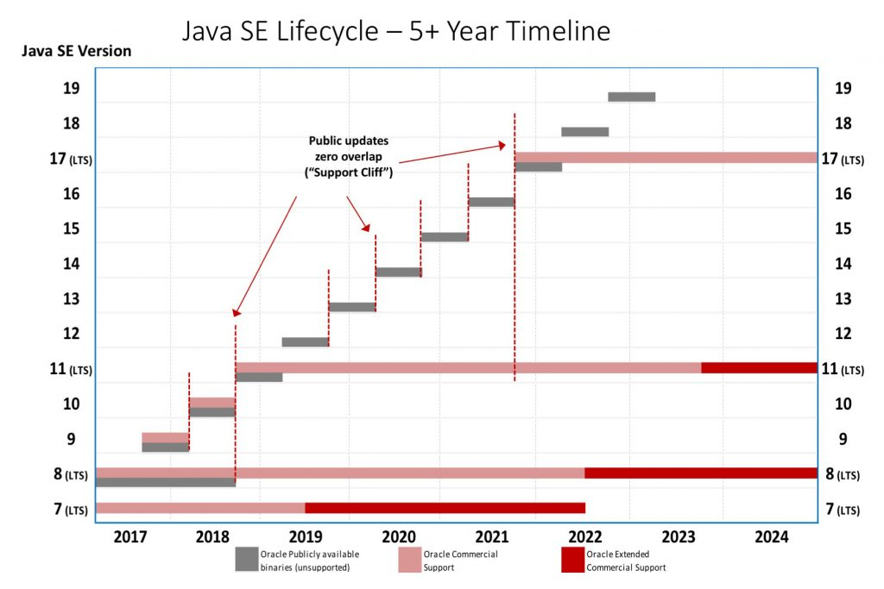
Monotonic versioning
Motivation
Avoid confusion
Avoid multiple active versions of 18 packages
Relieve developer workload
Compatibility with CRAN release processes
1.0.0
1.0.1
1.1.0
2.0.0
Not:

Slide 10
Package installation process
Historic version
Options to install
Through CRAN:
Through GitHub:
Through drat:
Latest version
install.packages("SqlRender")
or
renv
devtools::install_version(“SqlRender”,
version = “1.5.0”,
repos = "http://cran.us.r-project.org")
or
renv
remotes::install_github("ohdsi/Eunomia")
or
renv
remotes::install_github("ohdsi/Eunomia", ref = “v1.0.0")
or
renv
drat::addRepo("OHDSI")
install.packages(" Eunomia ")
install.packages("https://github.com/OHDSI/drat/raw/gh-pages/src/contrib/Eunomia_1.0.0.tar.gz",
repos = NULL)

Slide 11
Moving to CRAN
Moving a package to CRAN is hard
Requires runnable examples for all functions
Package size < 5MB

Slide 12
Moving to CRAN
Hades
GitHub only
In CRAN
PatientLevelPrediction
CohortMethod
CohortDiagnostics
MethodEvaluation
SelfControlledCohort
FeatureExtraction
SelfControlledCaseSeries
Eunomia
Eunomia is next
Can be used for examples in FeatureExtraction, …
BigKnn
Cyclops
DatabaseConnector
EmpiricalCalibration
ParallelLogger
Andromeda
SqlRender
ROhdsiWebApi
OhdsiSharing
Hydra

Slide 13
Unambiguous versions in GitHub
development
DESCRIPTION:
1.0.1
develop
release
DESCRIPTION:
1.0.1
master
Time
travis
Git tag:
v1.0.1
Pros:
Head of master is always latest released version: remotes::install_github("ohdsi/Eunomia")
Git tag guaranteed to correspond to version in DESCRIPTION: remotes::install_github("ohdsi/Eunomia", ref = “v1.0.0")
Prevents accidental installation of (buggy) develop version
Cons:
No GitHub releases
Requires discipline not to use master for development

Slide 14
Action Items
Martijn: will lobby with employer and OHDSI Steering Committee for more resources
…

