Slide 1

THEMIS Update
13-NOV-2018

Slide 2
Why have THEMIS WG?
The OMOP CDM and OMOP Vocabulary creates a representation of source data that queries/tools can be run more or less blindly and still return the correct result
Achieving this allows developing standardized tools and methods and drive quality, reproducibility and efficiency, and thus gets us closer to fulfilling the OHDSI objectives
And it does really work. Except not quite 100%. There are still a good number of issues, which despite the CDM and vocabularies the exact choice of representing a clinical event or circumstance can be ambiguous, arbitrary, clumsy.

Slide 3
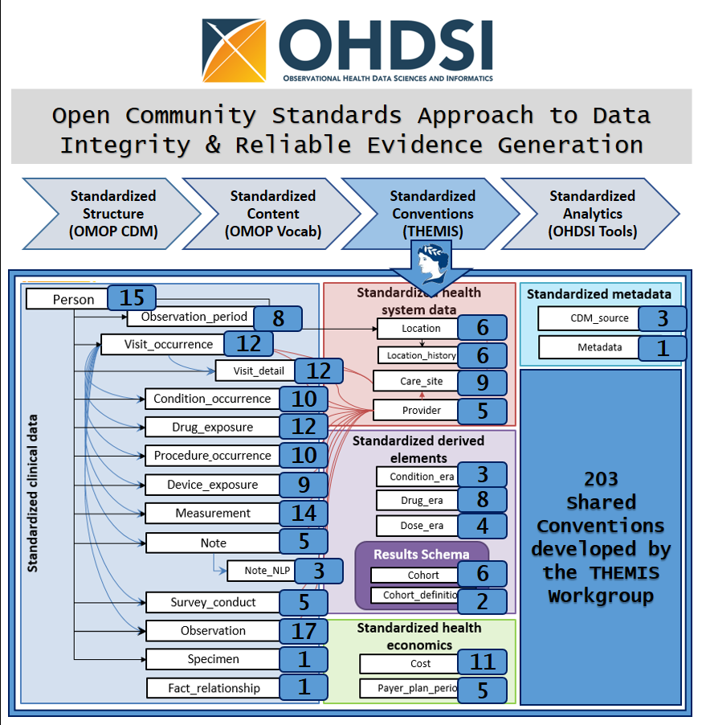

Slide 4
CDM WG versus THEMIS
CDM WG – change to the CDM
If you know exactly what you want to change to the CDM, then take it to the CDM working group
THEMIS
Making change to how we use the CDM
Standardize the use of the CDM or the ETL
Not too sure what to do, should it be a change or should it be a ETL implementation standard

Slide 5
Where were we?
F2F Kickoff – Symposium 2017
Created list of issues
F2F March 2018
Reviewed all completed issues and agreed/disagree to proposals as one group
V1.0.0 Release at Symposium 2018
New conventions are added the CDM Wiki

Slide 6
We are starting on the next release!

Slide 7
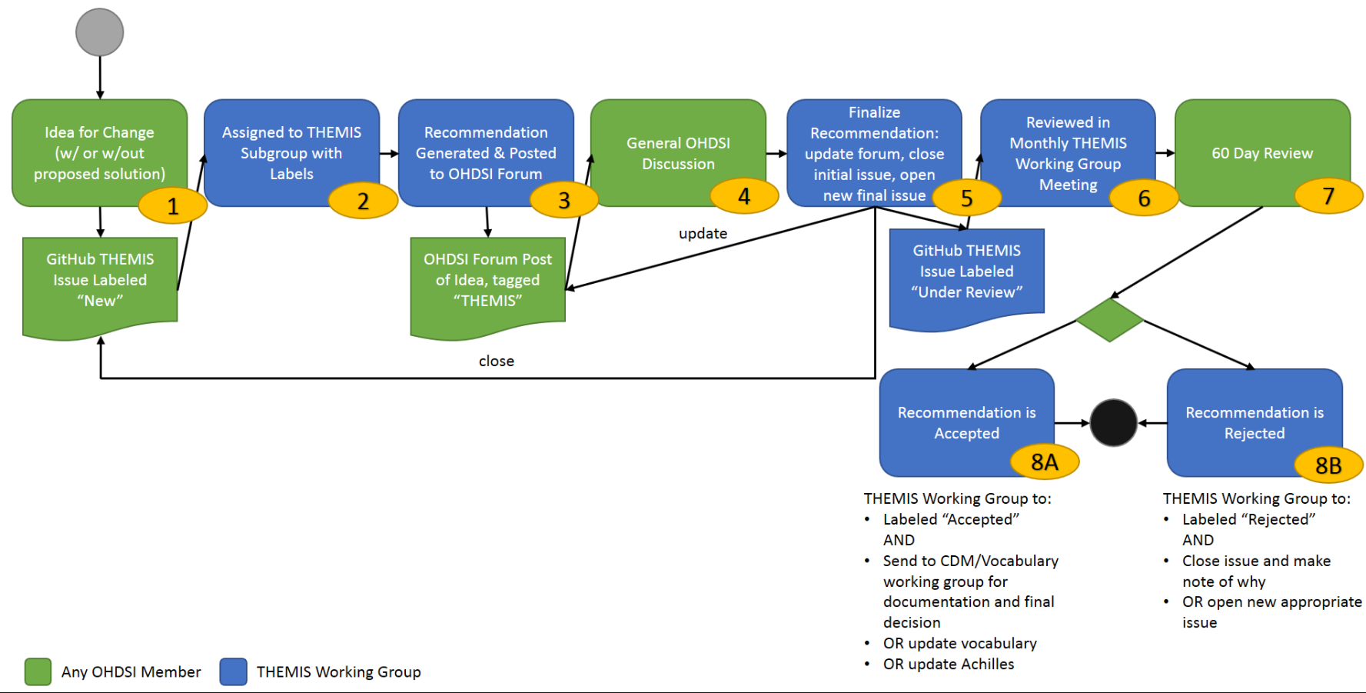
https://github.com/OHDSI/Themis

Slide 8
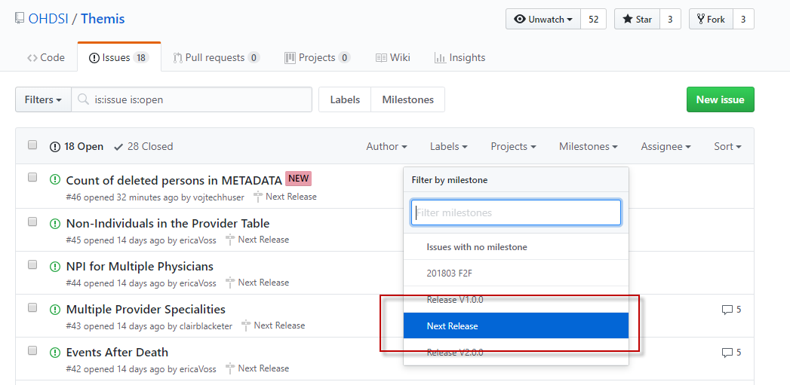
Github
https://github.com/OHDSI/Themis/issues
Anyone in the OHDSI community can propose an idea for change, with or without a solution!

Slide 9
Wiki Landing Page
http://www.ohdsi.org/web/wiki/doku.php?id=projects:workgroups:themis
Join the discussion!

