Slide 1

Open-Source Software for Observational Research

Slide 2
Link to materials
All slides and other materials are on
https://github.com/OHDSI/Tutorial-Hades

Slide 3
What is HADES?
Health Analytics Data to Evidence Suite (HADES)
Collection of 35 R packages used in almost every OHDSI study
Run directly against data in the OMOP Common Data Model (CDM)
Health care insurance claims
Electronic health records
Perform observational analyses
Characterization
Causal effect estimation
Patient-level prediction
https://ohdsi.github.io/Hades/

Slide 4
HADES design principles
Promote open science through open source
Execute directly against the OMOP CDM
Implement best practices as informed by methods research
Provide high quality software (documented, maintained, tested, validated)
Facilitate large-scale analytics, answering many questions at once
Support big data, covering hundreds of millions of lives
Enable federated analyses
Run across a wide variety of technical infrastructures

Slide 5
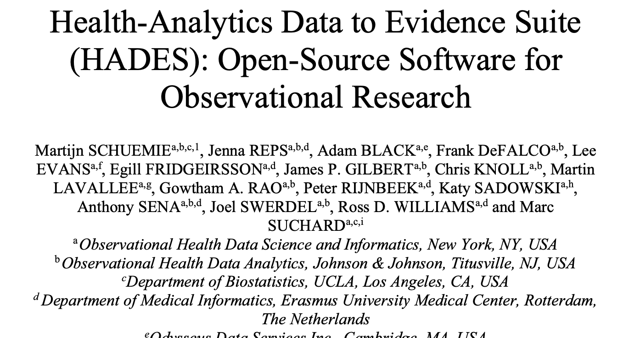
HADES paper
Our HADES paper goes deeper into HADES’ design philosophy
Please cite it when you use HADES
Schuemie M, Reps J, Black A, et al. 2024 Health-Analytics Data to Evidence Suite (HADES): Open-Source Software for Observational Research. Stud Health Technol Inform. 2024 Jan 25:310:966-970. doi: 0.3233/SHTI231108.

Slide 6
HADES – supporting packages
DatabaseConnector + SqlRender: write code once, run on all supported platforms (SQL Server, Oracle, Postgres, RedShift, BigQuery, DataBricks, Snowflake)
Andromeda: Work with data objects too big to fit in memory
ParallelLogger: extensive logging to facilitate remote debugging
Cyclops: fit very large regression models (logistic, Poisson, Cox)
DataQualityDashboard: evaluate data quality

Slide 7
HADES – cohort packages
We define a cohort as a set of persons who satisfy one or more inclusion criteria for a duration of time.
Exposure cohorts (e.g. people exposed to warfarin)
Outcome cohorts (e.g. people experiencing GI bleeding)
Cohorts of special interest (e.g. pregnant women)
Capr: Define cohorts using complex logic
PhenotypeLibrary: for storing OHDSI-approved cohort definitions
CirceR: for turning cohort definitions into SQL or human-readable text
CohortGenerator: for instantiating cohorts in a database
CohortDiagnostics and PheValuator: for evaluating cohorts

Slide 8
HADES – analytics packages
Characterization: characterizations of a target and a comparator cohort
CohortIncidence: calculate incidence rates and proportions
PatientLevelPrediction: develop and evaluate prediction models
CohortMethod and SelfControlledCaseSeries: estimate causal effects
EmpiricalCalibration: calibrate causal effect estimates based on negative controls
EvidenceSynthesis: combine causal effect estimates across databases without sharing patient-level data.

Slide 9
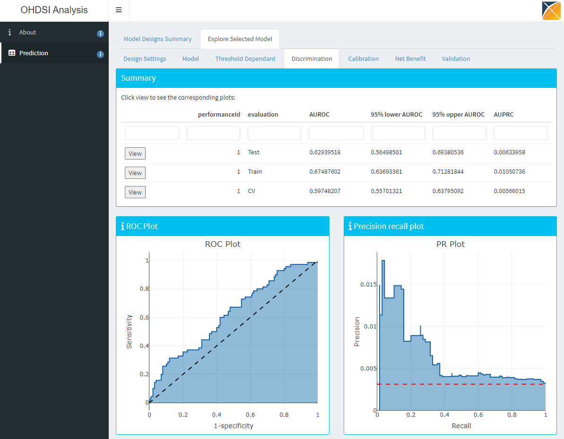

HADES analytics output
R objects possibly containing patient-level data
CSV files / database tables for sharing
Shiny apps

Slide 10



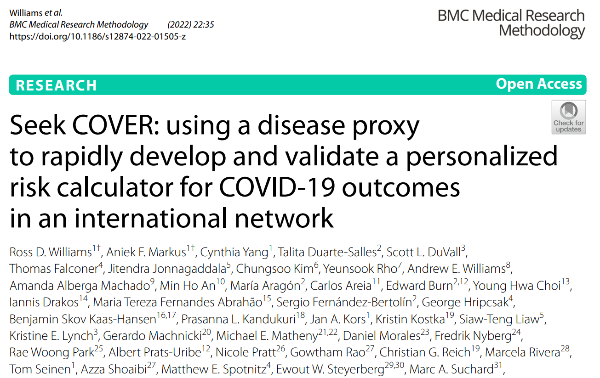
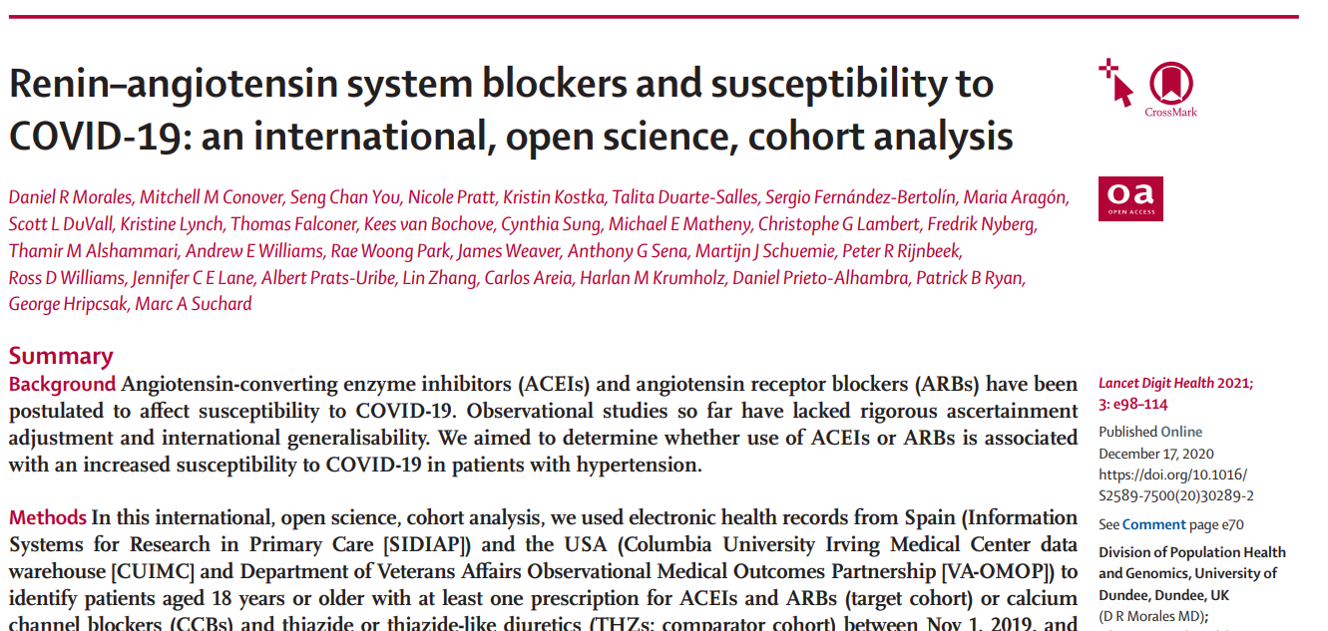
Publications using HADES
44 peer-reviewed clinical research papers
40 methods research papers
https://ohdsi.github.io/Hades/publications.html

Slide 11
Federated analyses using HADES

Slide 12


Distributed Research Network
Multiple sites with data
Hospital EHRs
Administrative Claims
Patient-level data cannot be shared
Site A
Site B
CDM
CDM
Site C
Site D
CDM
CDM

Slide 13
Distributed Research Network
Any site can lead a study
Study lead
Site A
Site B
CDM
CDM
Site C
Site D
CDM
CDM

Slide 14

Distributed Research Network
Any site can lead a study
Analysis code is developed locally
Study lead
Site A
Site B
CDM
CDM
Site C
Site D
CDM
CDM

Slide 15
Distributed Research Network
Any site can lead a study
Analysis code is developed locally
Code is distributed to study participants
Study lead
Site A
Site B
CDM
CDM
Site C
Site D
CDM
CDM

Slide 16

Distributed Research Network
Any site can lead a study
Analysis code is developed locally
Code is distributed to study participants
Results are generated (aggregated statistics)
Study lead
Site A
Site B
CDM
CDM
Site C
Site D
CDM
CDM

Slide 17
Distributed Research Network
Any site can lead a study
Analysis code is developed locally
Code is distributed to study participants
Results are generated (aggregated statistics)
Results are send back to site
Study lead
Site A
Site B
CDM
CDM
Site C
Site D
CDM
CDM

Slide 18
Current implementation
Study coordinator
Data site
Standards:
PostgreSQL, Oracle, SQL Server, RedShift, Snowflake
OMOP Common Data Model
Windows, MacOs, Linux
R

Slide 19
Current implementation
Study coordinator
Data site
Content:
R package using HADES
Renv file describing exact dependencies
Delivery:
GitHub (OHDSI-studies organization)
E.g. https://github.com/ohdsi-studies/Covid19SubjectsAesiIncidenceRate

Slide 20
Current implementation
Study coordinator
Data site
Content: zip file containing CSV (comma-separated values)
Needs to be:
Non-identifiable information
Human reviewable
Delivery:
E-mail
SFTP

Slide 21
HADES development

Slide 22
Organization
Developer guidelines.
Code style guide.
Each package has 1 or 2 maintainers.
Monthly meetings (3rd Thursday of the month, at noon Eastern Time)
Discussions on forums, Teams channel, issue trackers.
Bi-weekly open-source community calls (Wednesdays, at 11am Eastern Time).

Slide 23
Continuous integration
At each push to GitHub
Run R Check on Windows, MacOS, and Linux
Unit tests can use a set of database servers (SQL Server, PostgreSQL, Oracle, RedShift, Spark, …)
Compute code coverage
If push to main branch and higher version in DESCRIPTION, create release

Slide 24
HADES release process
development
DESCRIPTION:
1.0.1
develop
release
Branch
DESCRIPTION:
1.0.1
main
Time
GitHub Action (runs all tests)
Git tag:
v1.0.1
Pros:
Head of master is always latest released version: remotes::install_github("ohdsi/Eunomia")
Git tag guaranteed to correspond to version in DESCRIPTION: remotes::install_github("ohdsi/Eunomia", ref = "v1.0.0")
A release is guaranteed to pass all tests
Prevents accidental installation of (buggy) develop version
Cons:
Cannot use main for development

Slide 25
CRAN
Some HADES packages are in CRAN for easier install
Getting things in CRAN is hard, because
Package size <7mb
Cannot use database testing servers, but also not allowed not to have running examples / unit tests.
CRAN requires code runs on really old platforms (e.g. Java 1.5, Solaris)

Slide 26

HADES-wide release
HADES-wide release twice a year
Currently available as renv lock file, hopefully as Docker container starting next release
Release 2023Q1
Release 2023Q3
4.2.3
4.3.0
4.3.1
dplyr
1.1.0
SqlRender
1.9.1
1.9.2
1.9.3
DatabaseConnector
5.1.0
5.1.1
FeatureExtraction
3.2.0
3.3.0
CohortMethod
5.0.0
5.0.1
Time

Slide 27
Strategus

Slide 28
Strategus
Most people who would like to use HADES analytics don’t know R.
Strategus aims to have analysis specs as input (JSON), and results as output (CSV files), with (Shiny) viewers for the output (after uploading to a database).
Modular design: a study spec can list multiple modules, such as cohort generation + cohort method.
Move away from sharing code across the network to sharing study specs only (for security and ease of distribution).

Slide 29

Strategus
Analytics Specifications
Shared resources
Cohort definitions
Firewall
CohortGenerator specifications
Database meta data
CohortDiagnostics specifications
…
CohortGenerator Module
Results
JSON
Strategus
OhdsiSharing
Module
ResultsModelManager
Execution Settings
CohortDiagnostics
Module
Results
CDM schema
…
Zipped CSV
Results
Cohort tables and schema
CDM
Cohort Tables
Connection details reference
OhdsiShinyModules
ShinyAppBuilder
…
Keyring
Connection details

Slide 30
Conclusions
HADES is a suite of R packages for analyzing observational healthcare data
Thanks to the OMOP Common Data Model, HADES runs on a wide variety of data sources across the world
Open source, to promote open science (all analytics code can be shared as part of publication)
Supports federated networks, where data stay locally, and results are shared

