Slide 1

Capr
Cohort definition Application Programming in R

Slide 2
The Capr package
A language for expressing OHDSI Cohort definitions in R code
A cohort is a set of persons who satisfy one or more inclusion criteria for a duration of time
One person may belong to multiple cohorts
One person may belong to the same cohort for multiple different time periods
One person may not belong to the same cohort multiple times during the same period of time
A cohort may have zero or more members

Slide 3

Defining cohort is hard!
Please start by reading the chapter Defining Cohorts in the Book of OHDSI

Slide 4
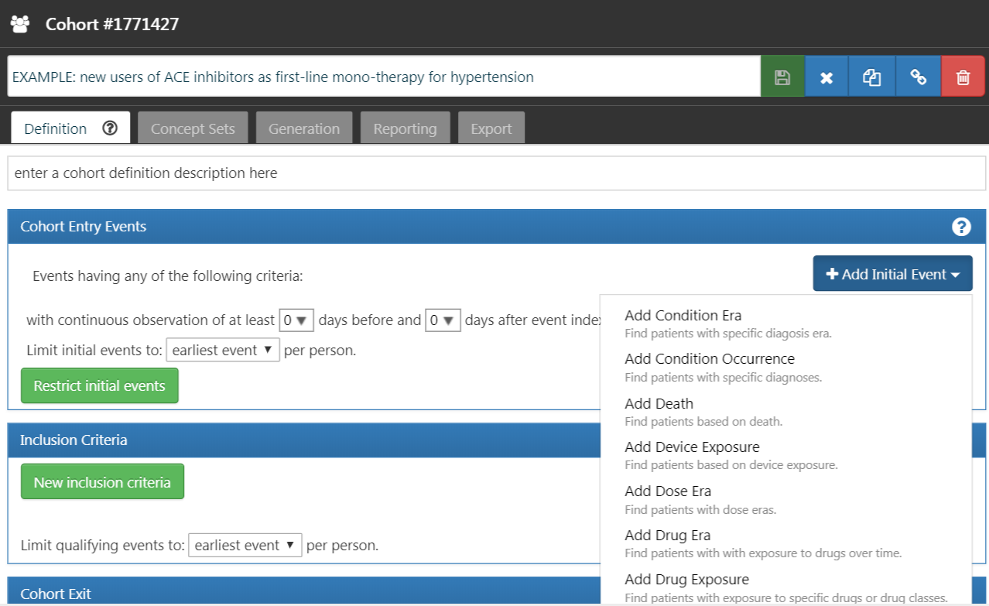




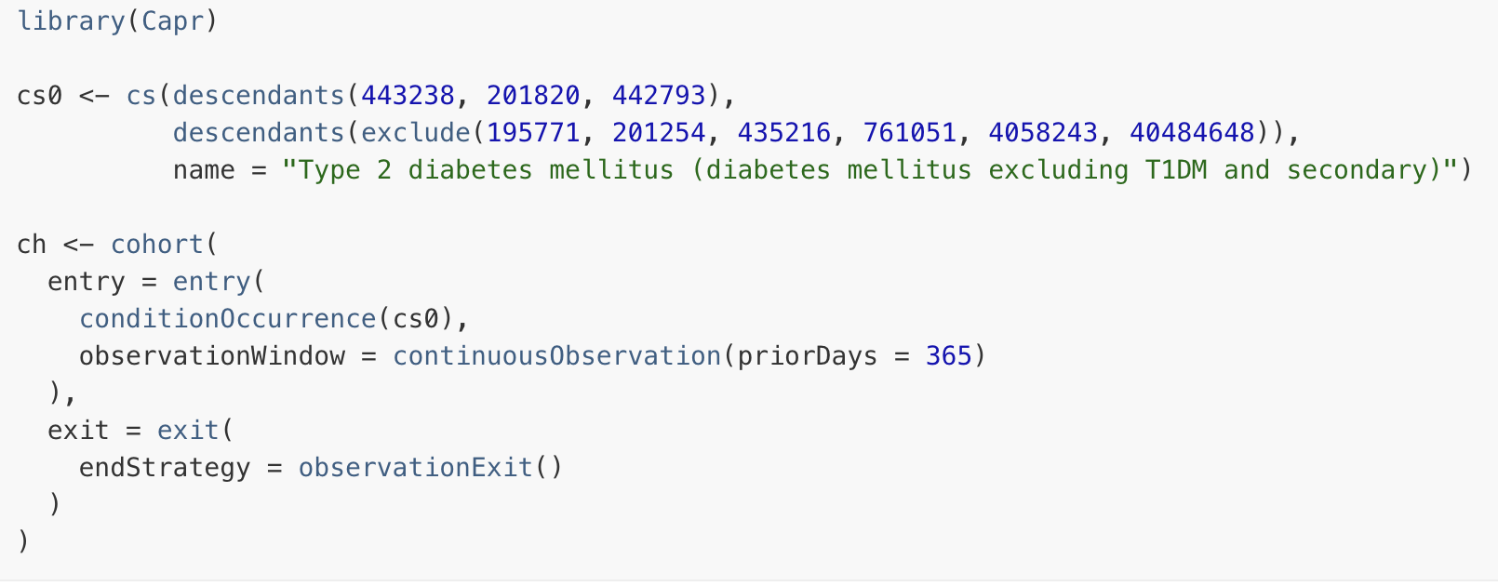
Capr, Circe, and ATLAS
ATLAS
Circe
Pretty print
Capr

Slide 5
Anatomy of a cohort definition
Drug exposure to lisinopril
Restricted to first ever
End of drug exposure to lisinopril
Allowing for 30-day gap
Initial event criteria
Cohort exit criteria
Patient A
In cohort
Time
Observation
period start
Observation
period end
Inclusion criteria
At least 365 days of prior observation
Prior diagnosis of hypertension

Slide 6
Where are my exclusion criteria?
An exclusion criterion can be framed as an inclusion criterion:
Exclude people with prior cancer
=
Include people with no prior cancer

Slide 7
Concept sets
“Exposure to lisinopril”
“Diagnosis of hypertension”
Define which standard concepts you mean by these words

Slide 8


Concept sets
According to Athena, the concept ID for the ingredient lisinopril is 1308216
We want to include all drugs containing lisinopril (all descendants of lisinopril)

Slide 9
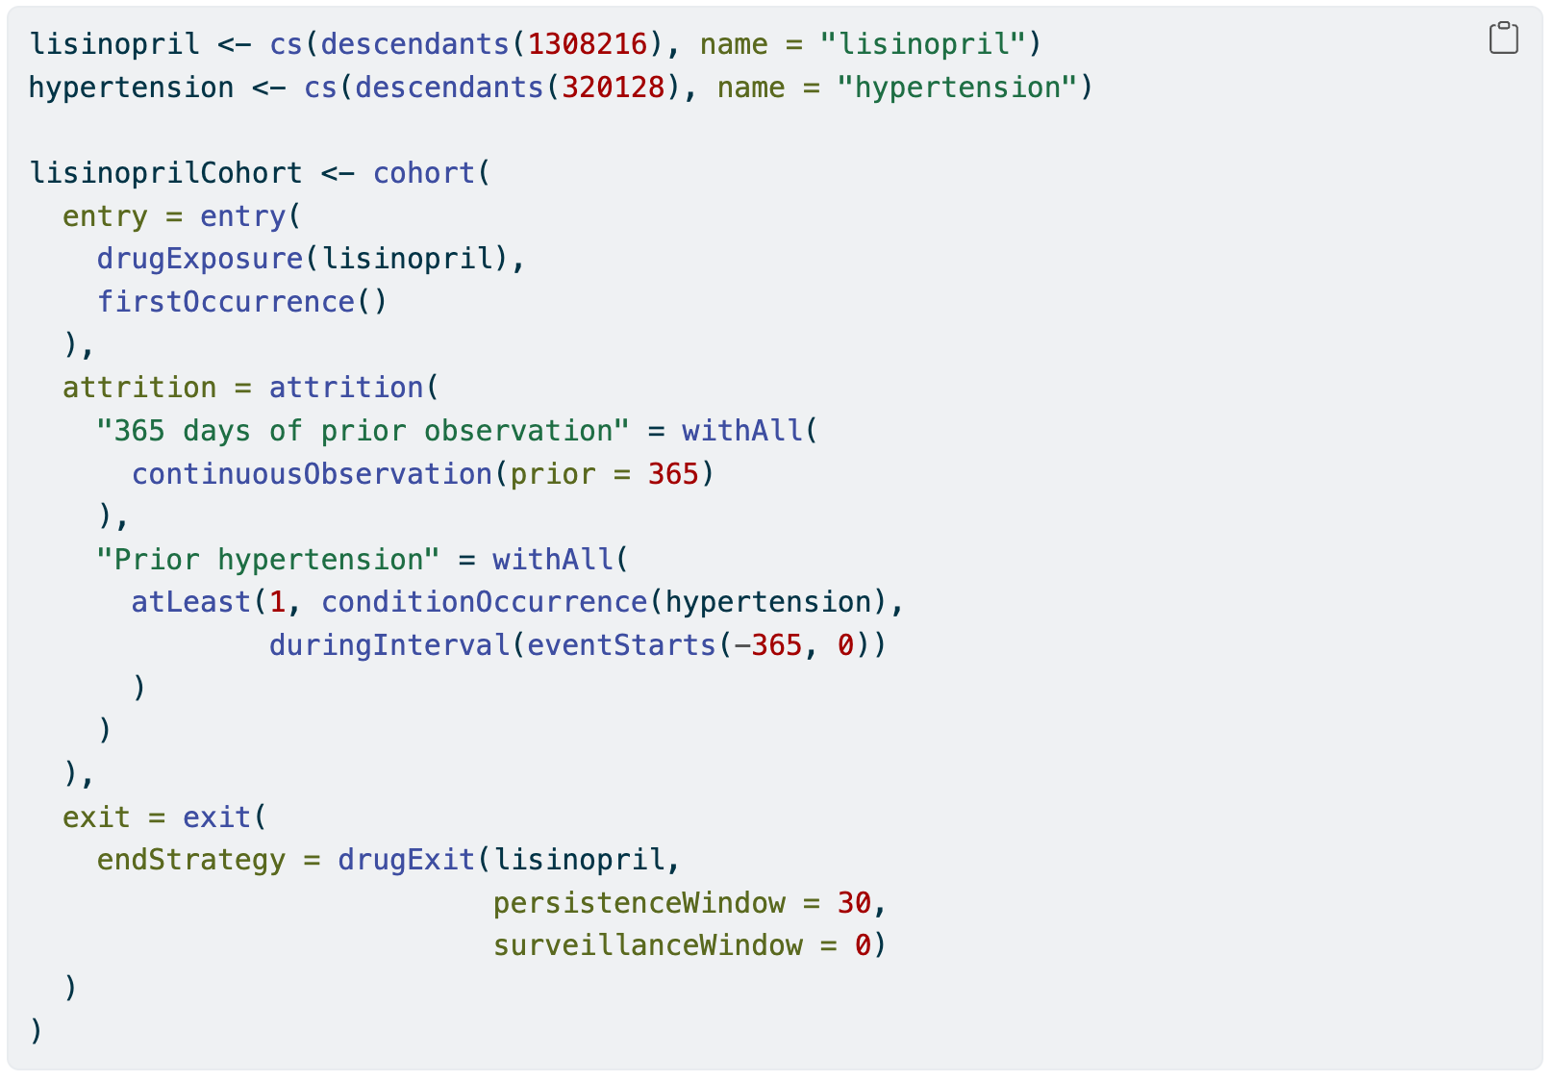
Full cohort definition

Slide 10
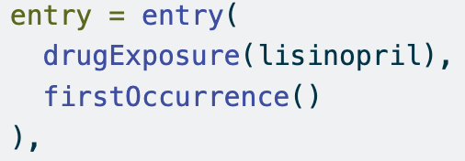
Entry event
Search the drug_exposure table in the Common Data Model

Slide 11
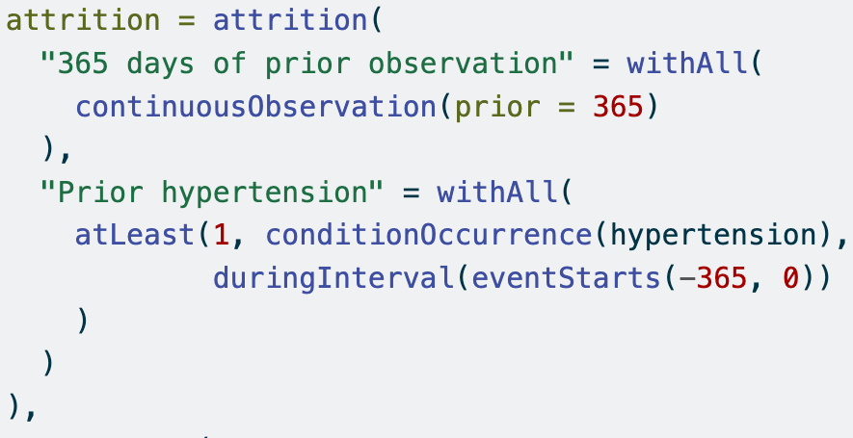
Inclusion criteria

Slide 12
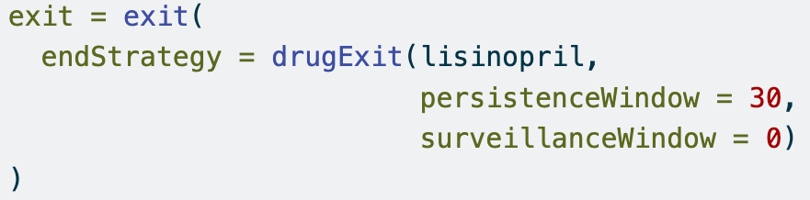
Exit criterion
Entry
Exit
Drug exposure
Drug exposure
Drug exposure
Time
Persistence window
Persistence window
Surveillance window

Slide 13
Try it yourself!
Follow the instructions in the tutorial
https://github.com/OHDSI/Tutorial-Hades

