Slide 1
Strategus
Automated execution of HADES packages

Slide 2

What is the Strategus framework?
Characterization
Cohort diagnostics
Cohort features
Incidence rates
Time-to-event
Dechallenge / rechallenge
Patient-level prediction
Population-level effect estimation
Comparative cohort
Self-controlled case-series (SCCS)
Standardized analytics
Standardized inputs
Standardized execution
Standardized outputs
design choices → JSON
Strategus
csv → results model

Slide 3
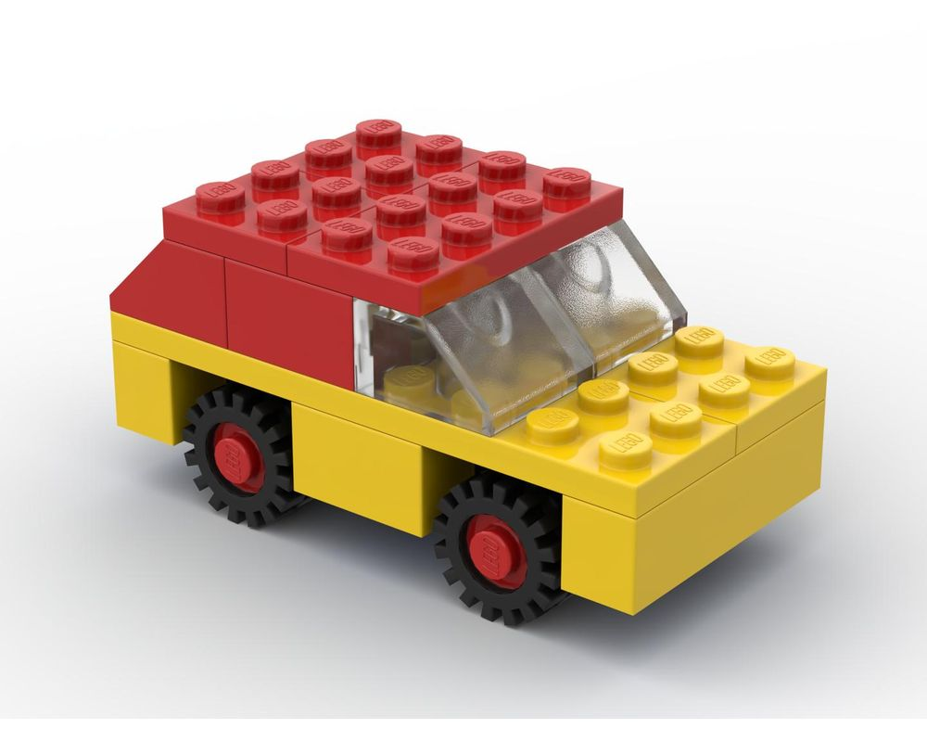
What is the Strategus framework?
Cohort Generator
Cohort Incidence
Cohort Diagnostics
Characterization
CohortMethod
Self Controlled Case Series
Evidence Synthesis
Building up standardized analytics one lego at a time.
Patient Level Prediction
Deep Patient Level Prediction

Slide 4
What is the Strategus framework?
Strategus modules can be combined to accommodate various study designs.
Patient Level Prediction
Self Controlled Case Series
CohortMethod
Deep Patient Level Prediction
Characterization
Patient Level Prediction
Patient Level Prediction
Cohort Incidence
Cohort
Incidence
Cohort Incidence
Cohort Incidence
Cohort Diagnostics
Cohort Generator
Cohort Generator
Cohort Generator
Cohort Generator

Slide 5

Strategus
Analytics Specifications
Shared resources
Cohort definitions
Firewall
CohortGenerator specifications
Database meta data
CohortDiagnostics specifications
…
CohortGenerator Module
Results
JSON
Strategus
OhdsiSharing
Module
ResultsModelManager
Execution Settings
CohortDiagnostics
Module
Results
CDM schema
…
Zipped CSV
Results
Cohort tables and schema
CDM
Cohort Tables
Connection details reference
OhdsiShinyModules
ShinyAppBuilder
…
Keyring
Connection details

Slide 6
Upcoming changes
A web application for designing studies
Currently: calling R functions across various R packages and source files
Removing dependency on keyring
Moving away from per-module renv lock files
Container for execution

Slide 7
Try it yourself!
Follow the instructions in the tutorial
https://github.com/OHDSI/Tutorial-Hades

