Slide 1
Threats to the validity of study results
Martijn Schuemie PhD
Janssen Research and Development

Slide 2
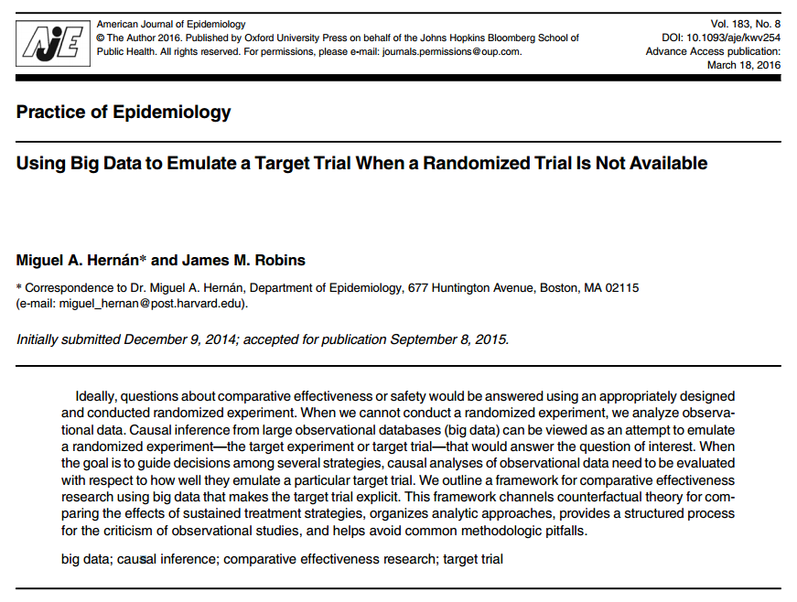
Design an observational study like you would a randomized trial
Protocol components to emulate:
Eligibility criteria
Treatment strategies
Assignment procedures
Follow-up period
Outcome
Causal contrasts of interest
Analysis plan

Slide 3
Error in randomized trials
True effect size
Estimated effect size
Relative risk
Random error
Error
Bigger study
True effect size
Estimated effect size
Relative risk
Random error

Slide 4
Error in observation studies
True effect size
Estimated effect size
Relative risk
Error
Systematic error
Random error
Confounding
Misclassification (Measurement error)
Selection bias (generalizability)

Slide 5
Error in observational studies
True effect size
Estimated effect size
Relative risk
Error
Systematic error
Random error
Bigger study
True effect size
Estimated effect size
Random error
Relative risk
Systematic error

Slide 6
Types of systematic error
Confounding
Misclassification (Measurement error)
Selection bias (generalizability)

Slide 7
Confounding
C
A
Effect of interest
RR=???
Y
U
A = Exposure
Y = Outcome
C = Confounder (observed and modeled)
U = Unobserved (or mismodeled) confounder

Slide 8
Confounding
Age
Coffee
Effect of interest
RR=???
Cancer
Smoking

Slide 9
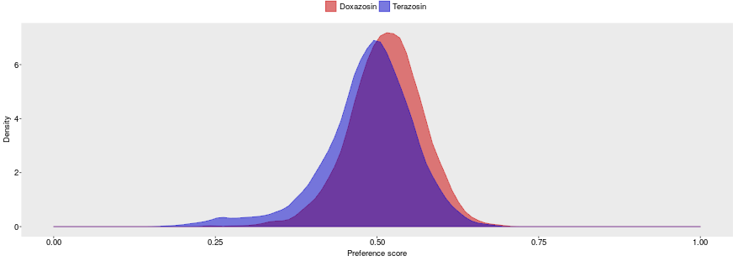
How to asses confounding?
Propensity score distribution
Good

Slide 10
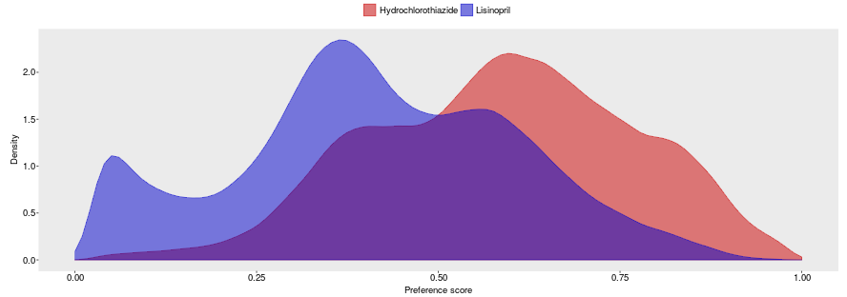
How to asses confounding?
Propensity score distribution
OK

Slide 11
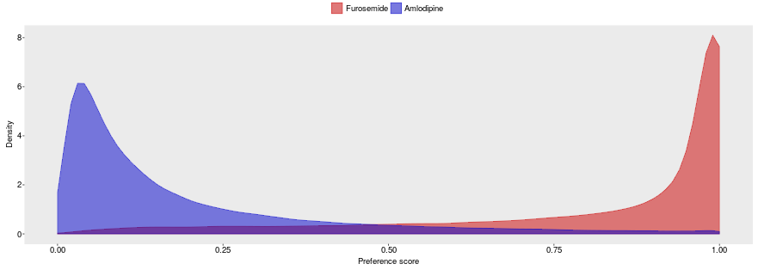
How to asses confounding?
Propensity score distribution
Bad

Slide 12
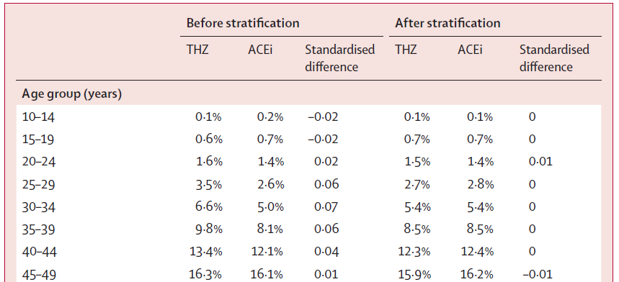
How to asses confounding?
Propensity score distribution
Covariate balance

Slide 13
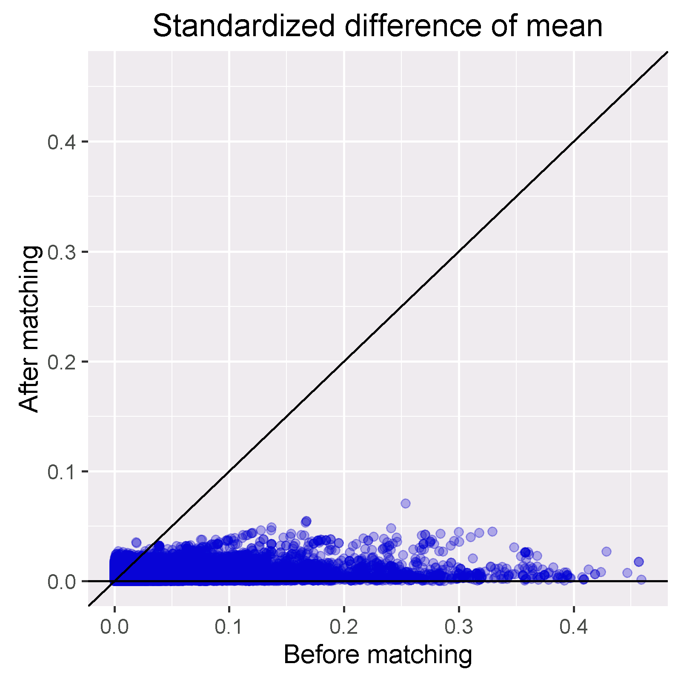
How to asses confounding?
Propensity score distribution
Covariate balance

Slide 14
Measurement error
C
A = Exposure
Y = Outcome
C = Confounder
U = Unobserved confounder
A
Effect of interest
RR=???
Y
U
A* = Proxy for exposure
Y* = Proxy for outcome
A*
Effect we observe
Y*
C* = Proxy for confounder
C*

Slide 15
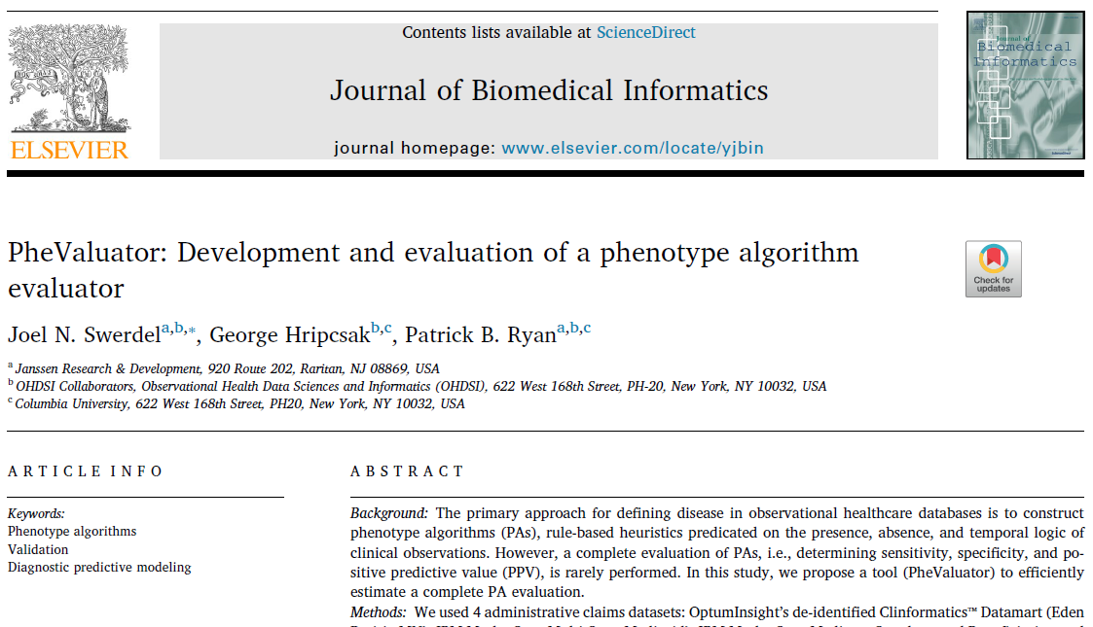
How to assess measurement error?
Covariate summary for exposures?
Operating characteristics for outcome phenotype
Sensitivity
Specificity
Positive predictive value

Slide 16
Selection bias and generalizability
C
A = Exposure
Y = Outcome
C = Confounder
U = Unobserved confounder
A
Effect of interest
RR=???
Y
U
A# = Non-random sample of exposure
A#
Effect we observe

Slide 17
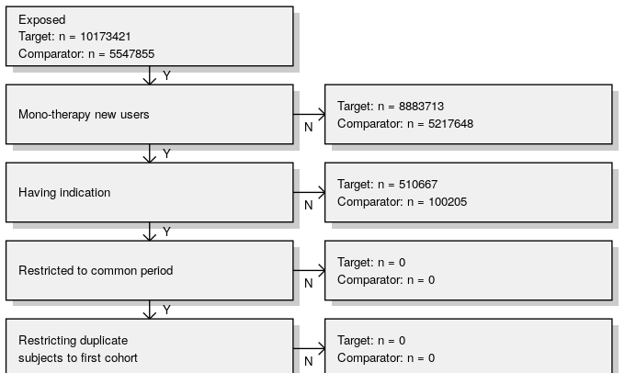
How to asses selection bias?
Attrition table

Slide 18
How to address these challenges?
Think really hard during study design and hope we get it right
Equivocate in our summary of findings with a paragraph in the Discussion that reads:
“This study has several limitations. First, since this study relied on claims data, we had no data on <unobserved confounders>. Second, while we adjusted for <observed confounders>, residual confounding cannot be ruled out. Third, there is a potential for outcome misclassification… Fourth, there is a potential for duplicate person-years between <databases>. Lastly, as the mean follow-up was <short>, long-term effects may need to be further examined.” (Kim et al., Arthritis & Rheumatology, 2017)
Perform diagnostic analyses that attempt to detect if residual error may still be present
Quantify magnitude of residual error and calibrate statistics

Slide 19
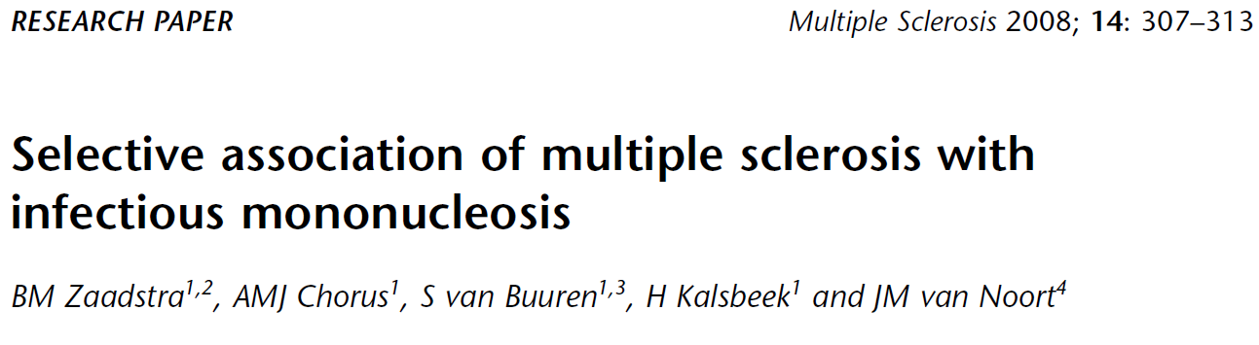
Examples of negative controls
Infectious
mononucleosis
?
Multiple sclerosis
Rubella
?
Measles
?

Slide 20
Example of a negative control
Odds ratio:
Infectious
mononucleosis
2.22 *
Multiple sclerosis
Rubella
1.31 *
Measles
1.42 *
* P < .05

Slide 21
Example of a negative control
Odds ratio:
Infectious
mononucleosis
2.22 *
Multiple sclerosis
Rubella
1.31 *
Measles
1.42 *
Negative controls:
A broken arm
1.10
Concussion
1.23 *
Tonsillectomy
1.25 *
* P < .05

Slide 22
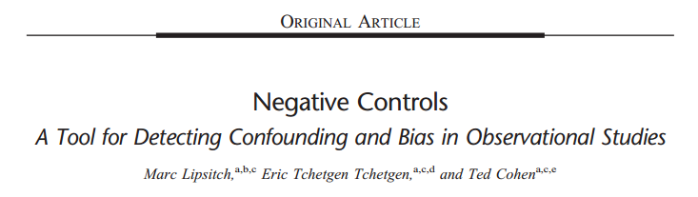
Lipsitch et al. 2010
Two types of controls:
Outcome controls: Same exposure, different outcome
Exposure controls: Same outcome, different exposures
The ideal negative control has identical confounding
In reality, this may be only approximate
“Subject matter knowledge is required for the choice of negative controls”

Slide 23
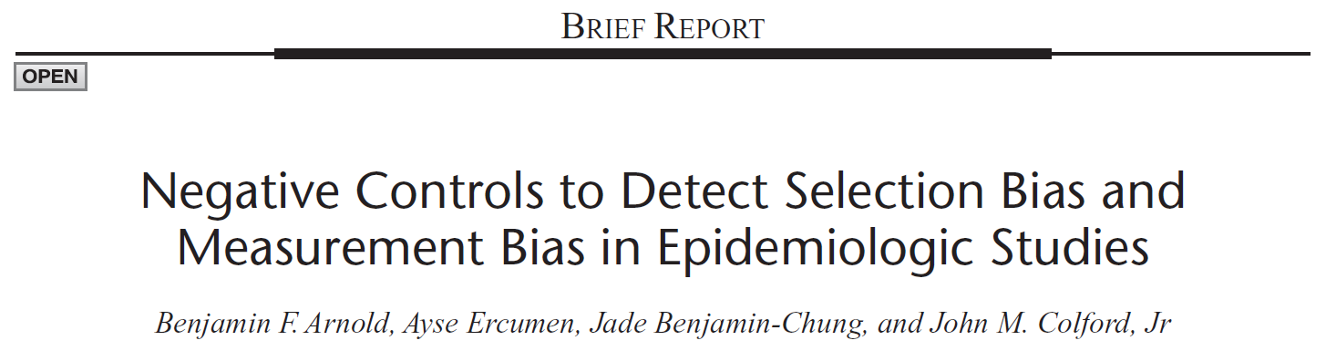

Arnold et al. 2016
Negative controls can detect
Confounding
Selection bias
Measurement bias
Negative controls can be used in:
observational or RCT
prospective or retrospective
case control or cohort

Slide 24
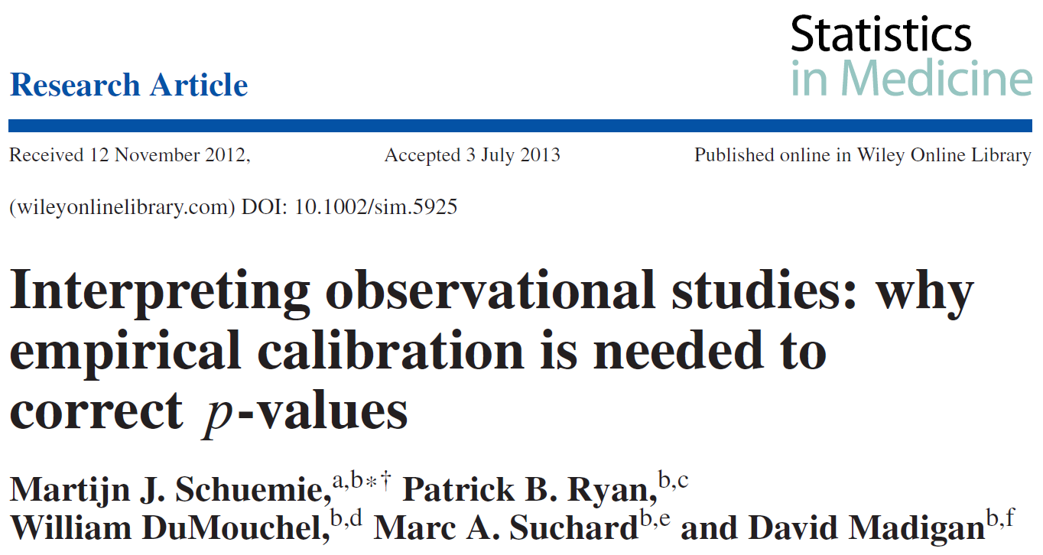
Schuemie et al. 2013
Use large number of negative controls (n > 25)
Estimate empirical null distribution
Compute calibrated p-value, accounting for
Random error
Systematic error

Slide 25
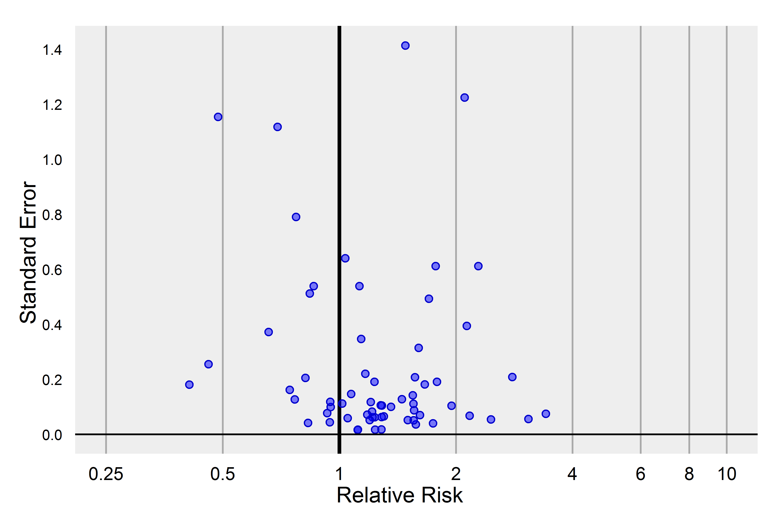
Empirical calibration

Slide 26
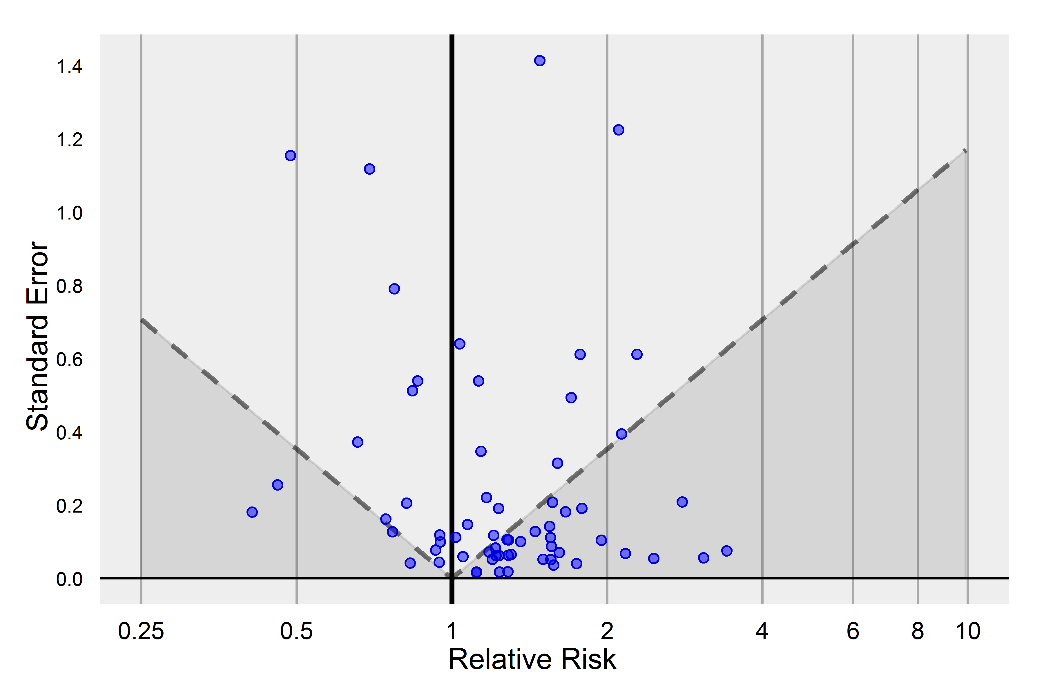
Empirical calibration
55% of negative controls have p < .05
(Expected: 5%)

Slide 27
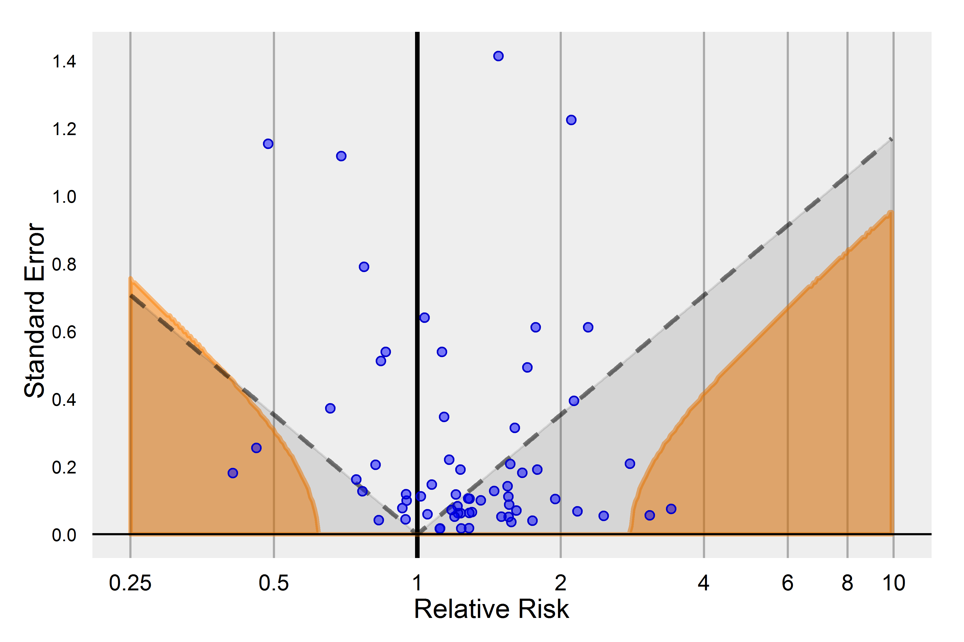
Empirical calibration
Estimates in the orange area have p < .05
(empirical null)
6% of negative controls have calibrated p < .05
(Expected: 5%)

Slide 28
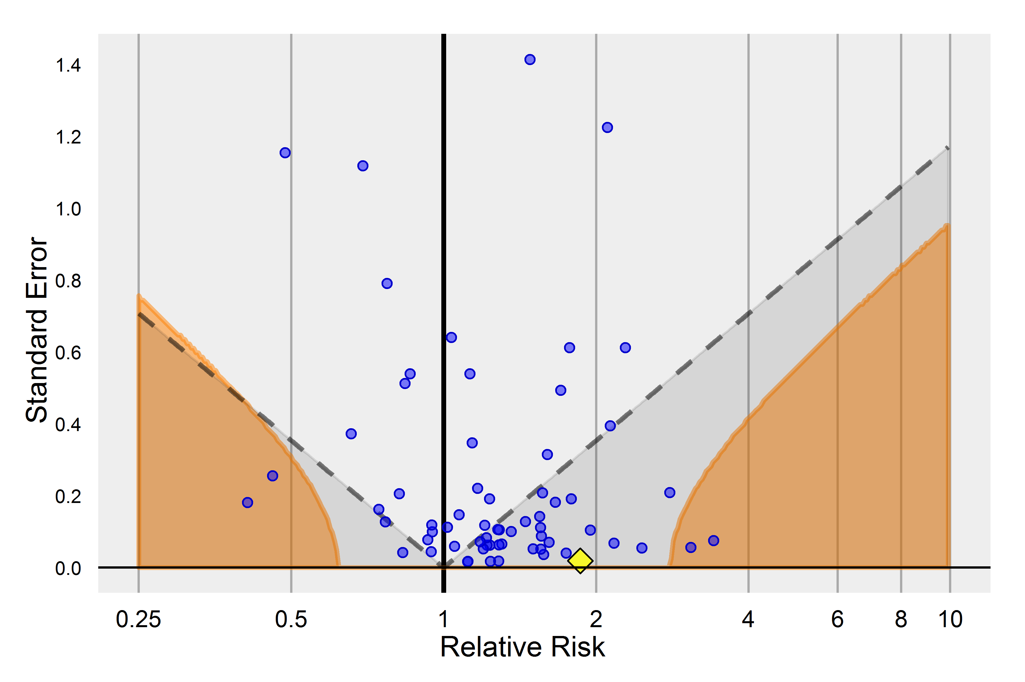
Empirical calibration
Estimate was significant before calibration, but no different from negative controls

Slide 29
Empirical calibration workflow
Hypothesis:
exposure A → outcome B
Negative controls for A and/or B
Identify negative controls
Design analysis
Analysis design
(data + overall design + analysis plan)
Estimates + SEs for negative controls
Perform analysis for negative controls
Perform analysis for A → B
Fit null distribution
Estimate + SE for A → B
Null distribution
Compute calibrated p
Compute p
Uncalibrated p
Calibrated p

Slide 30
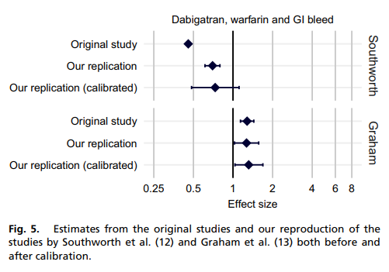

Schuemie et al. 2018
Extends empirical calibration for confidence intervals

Slide 31
Summary
Many threads to validity in observational studies
Confounding
Misclassification (Measurement error)
Selection bias (generalizability)
Traditionally, these are merely mentioned in the discussion, and assumed to be solved by clever thinking
In OHDSI, we instead advocate the use of diagnostics
Covariate balance
PheValuator
Negative controls
…

