Slide 1
Dissecting a cohort study
17 September 2019
Bethesda, MD
Martijn Schuemie
Janssen R&D, UCLA

Slide 2
Part 1

Slide 3
Exercise #1
Graham et al. (2015) Circulation
“Cardiovascular, bleeding and mortality risks in elderly Medicare patients treated with dabigatran or warfarin for nonvalvular atrial fibrillation”
Team up into groups of 4
Identify
Target
Comparator
Outcome
Time at risk
Model

Slide 4
T and C cohorts
Elderly (>= 65) Medicare beneficiaries (A, B and D) with nonvalvular atrial fibrillation who initiated therapy with dabigatran (T) or warfarin (C)
Is this correct?

Slide 5
Inclusion criteria
All patients who:
Have any inpatient or outpatient AF or atrial flutter ICD9 codes
Filled at least 1 prescription for either drug between Oct 19, 2010 - Dec 31, 2012
Index date: first prescription date

Slide 6
Exclusion criteria
All patients who:
Have < 6 months of Medicare enrollment before index date
Were < 65
Received prior treatment (when?) with NOAC or warfarin
Were in a skilled nursing facility on index date (why?)
Were in hospice on index date (why?)
Had a hospitalization “that extended beyond the index dispensing date”
Undergoing dialysis (when?)
Were kidney transplant recipients
Had diagnoses of valvular disease, DVT, PE, joint replacement during baseline 6 months

Slide 7
Outcomes
Stroke
Major gastrointestinal and intracranial bleeding
Acute myocardial infarction
Mortality

Slide 8
Time at risk
Follow-up starts on index date + 1 and censored at:
Medicare disenrollment
> 3 day gap in anticoagulant supply RX fill for a different anticoagulant
Start of hospice
Initation of dialysis or kidney transplant
Admission to nursing facility
End of study

Slide 9
Part 2

Slide 10
Exercise #2
Go back to Graham’s paper
Discuss:
What threats are there to the validity of the study results?
How do Graham et al. address these threads?

Slide 11
Confounding
Using propensity score model: Logistic regression with “initiated dabigatran” as outcome and predictors:
Sociodemographics
Prescriber characteristics
Baseline comorbidities
“Other potentially relevant variables”
1:1 ratio, greedy matching
Balance assessment via:
Standardized mean difference (target: <= 0.1)

Slide 12
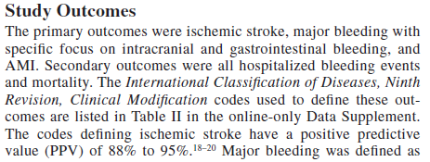
Measurement error
Sensitivity and specificity of the outcome measures?

Slide 13
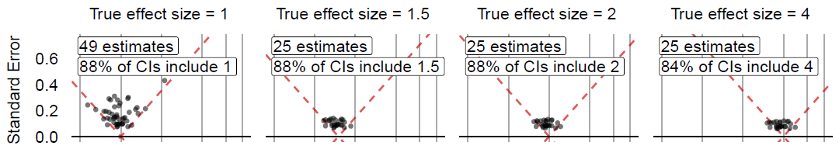
Overall systematic error
Negative controls could show amount of residual bias

