Slide 1
Walkthrough of implementing a cohort study using OHDSI tools
17 September 2019
Bethesda, MD
Jamie Weaver MS MPH
Janssen Research and Development

Slide 2


Slide 3
What is the design used by Graham et al?
Input parameter | Design choice
Target cohort (T) | dabigatran new users with prior atrial fibrillation
Comparator cohort (C) | warfarin new users with prior atrial fibrillation
Outcome cohort (O) | Ischemic stroke
Time-at-risk | 1 day after cohort start → cohort end
Model specification | 1:1 propensity score-matched univariable conditional Cox proportional hazards

Slide 4
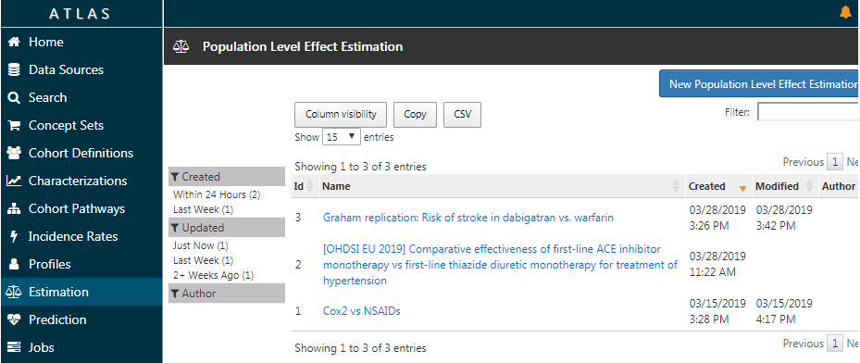
Click-a-long
ATLAS: https://plee.ohdsitutorials.amazingawsdemos.com/#/home (no login required)
RStudio: https://rstudio.plee.ohdsitutorials.amazingawsdemos.com/ (login required)
Create your own estimation study!

Slide 5
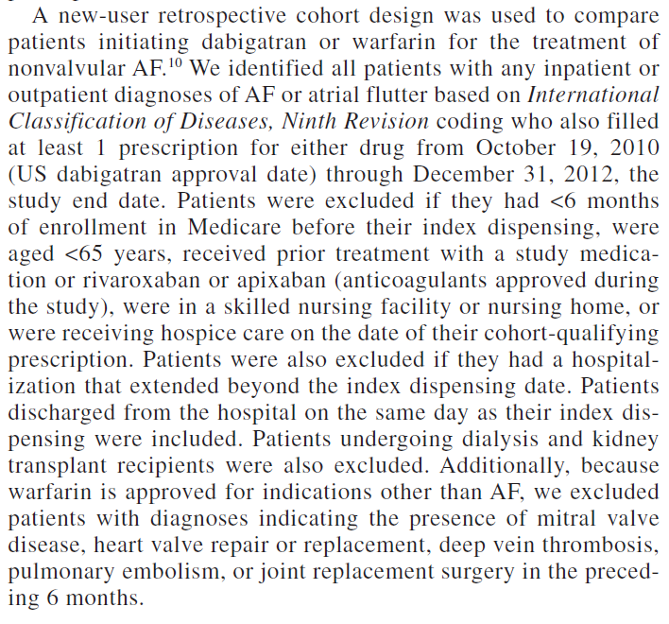
Graham et al. description of the cohort(s)

Slide 6
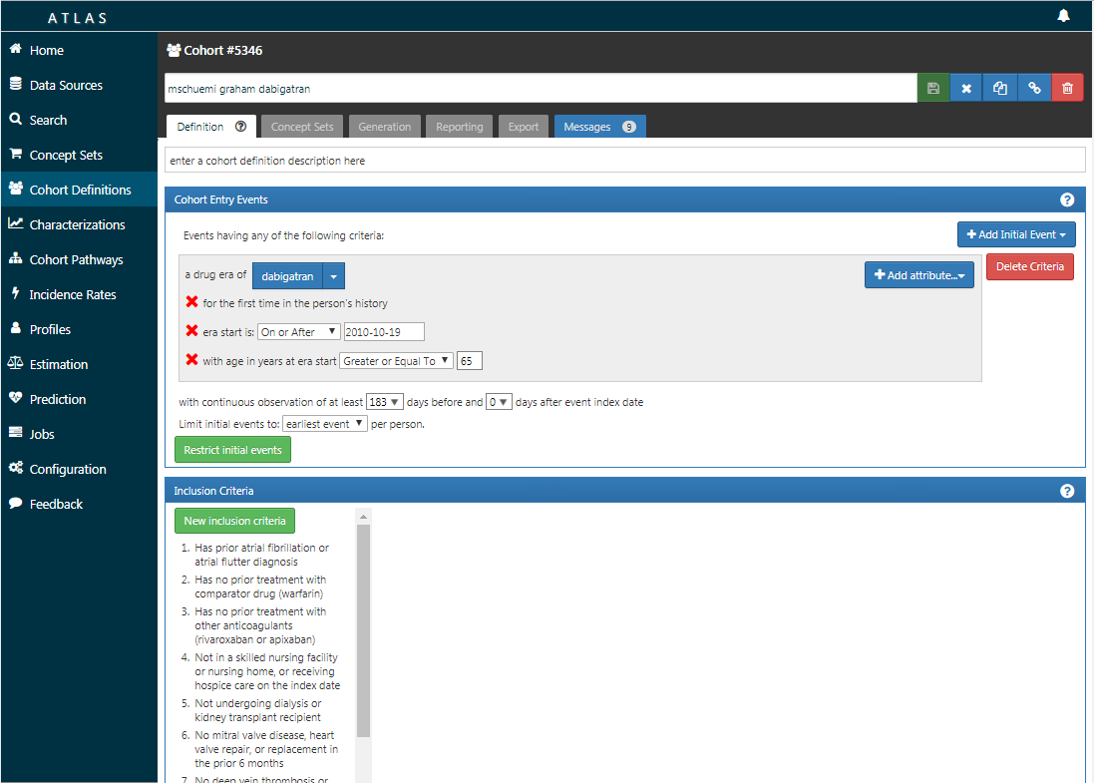
Graham et al. replication: Designing the target cohort in ATLAS

Slide 7
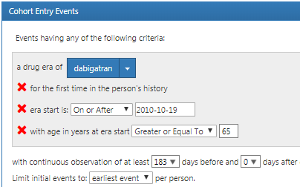
Graham et al. replication: Designing the target cohort in ATLAS

Slide 8
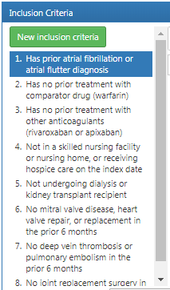
Graham et al. replication: Designing the target cohort in ATLAS

Slide 9
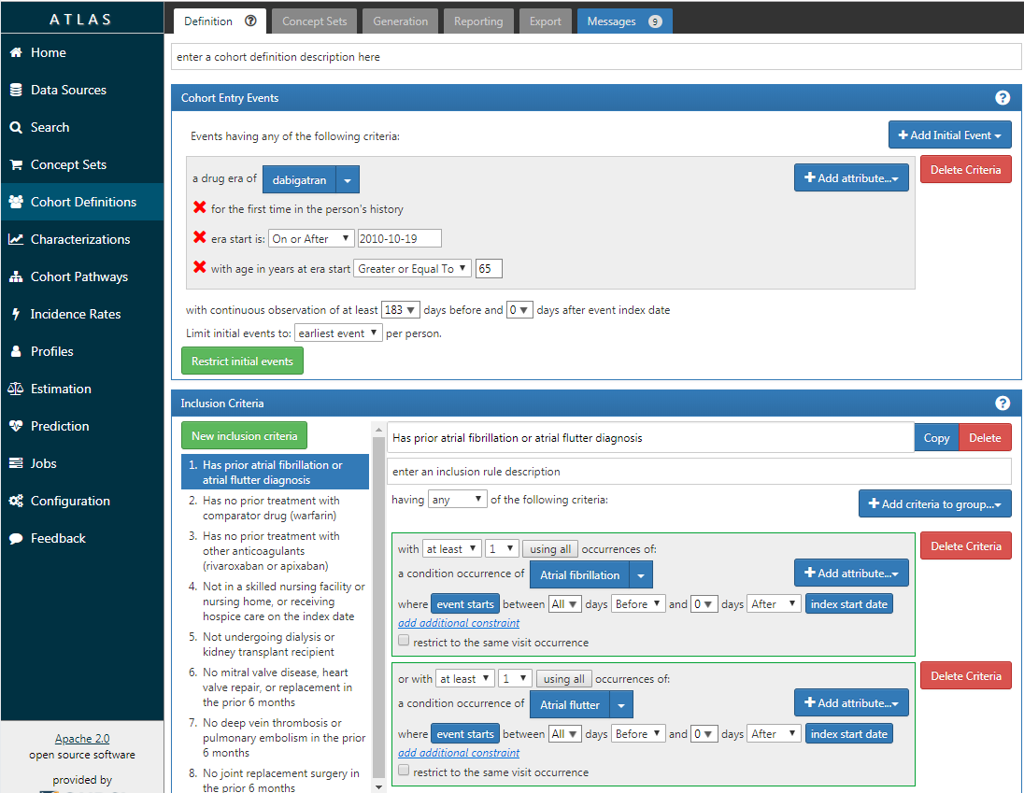
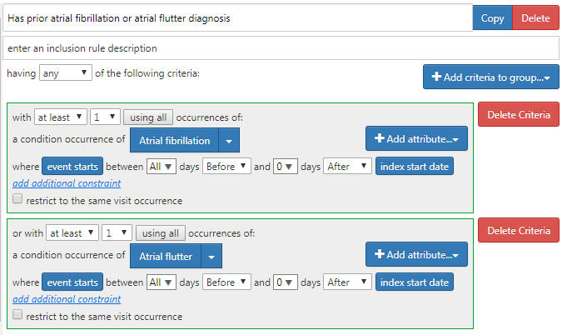
Graham et al. replication: Designing the target cohort in ATLAS

Slide 10
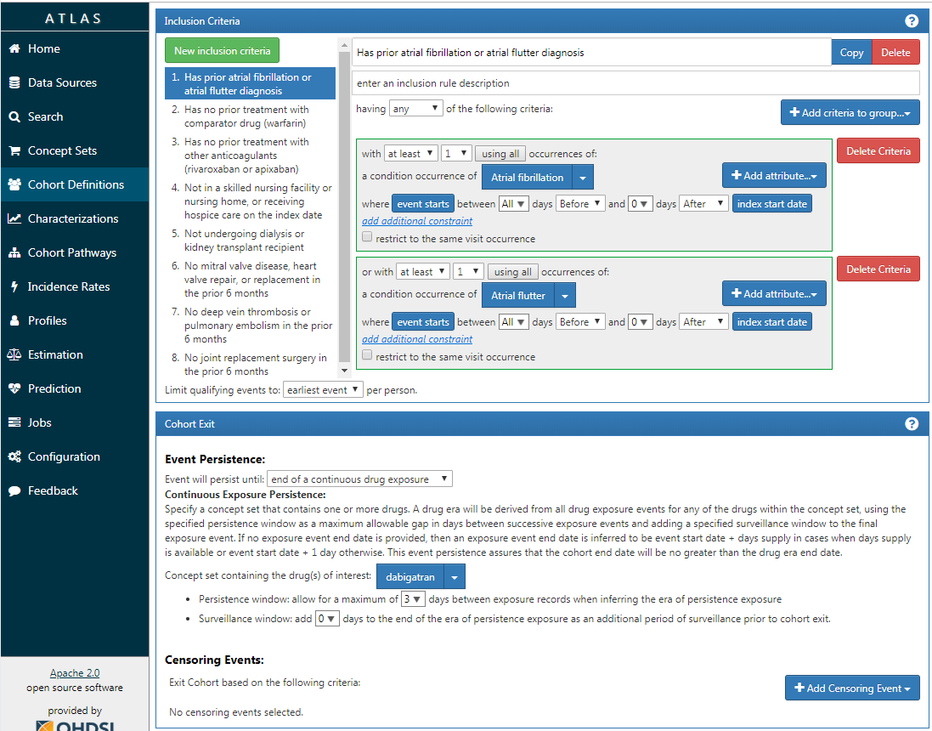
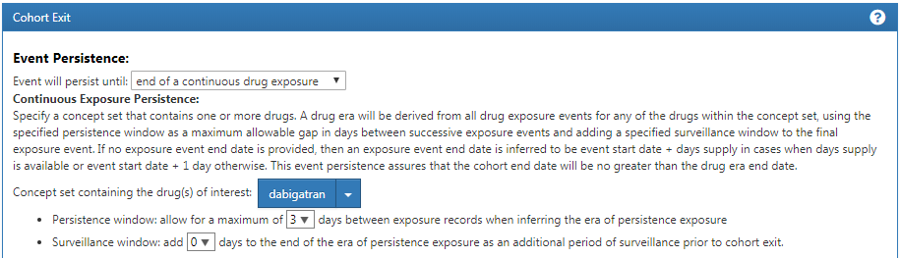
Graham et al. replication: Designing the target cohort in ATLAS

Slide 11
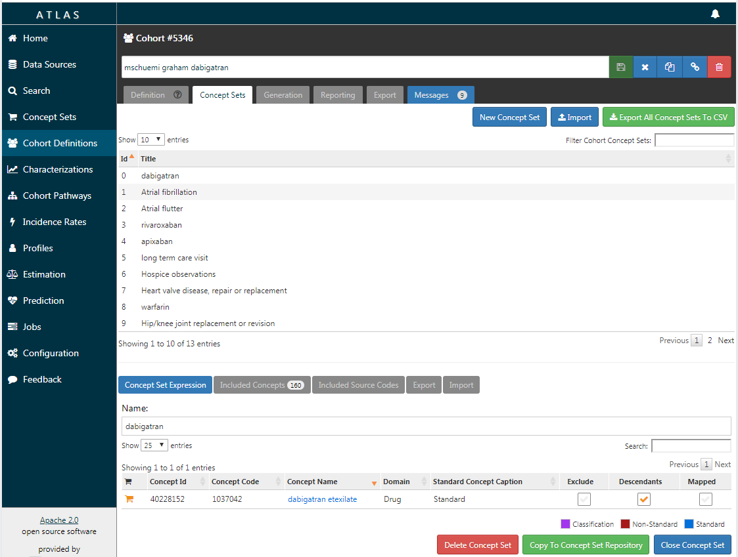
Graham et al. replication: Designing the target cohort in ATLAS
Every entity referenced the cohort definition needs to a complete definition of concepts and associated source codes

Slide 12
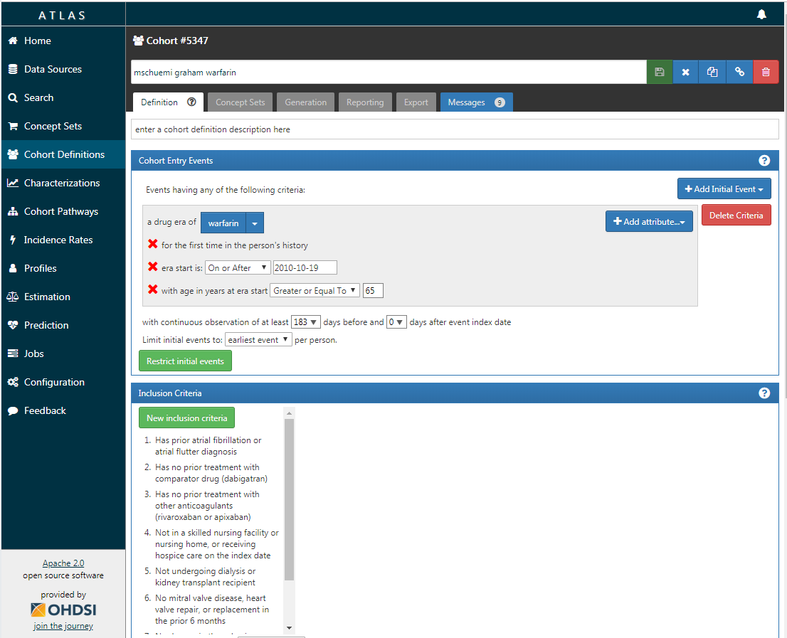
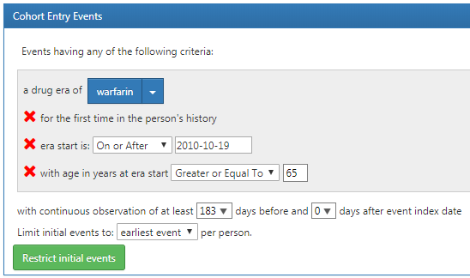
Graham et al. replication: Designing the target cohort in ATLAS

Slide 13
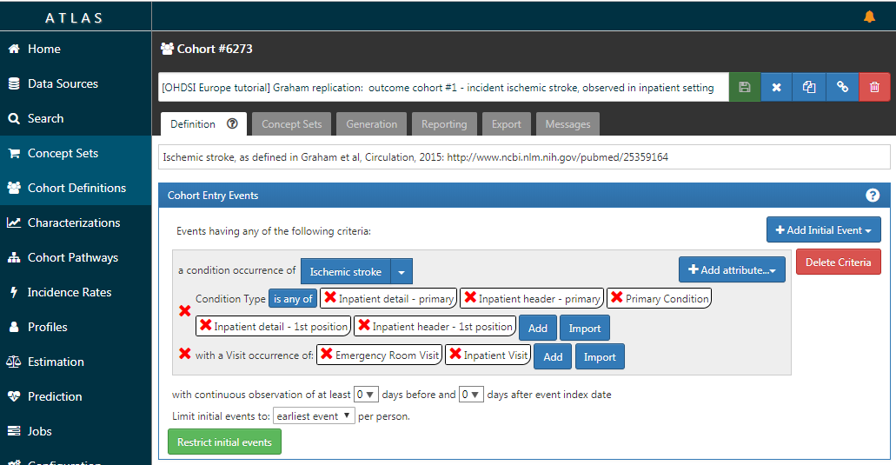
Graham et al. replication: Designing the outcome cohort in ATLAS

Slide 14
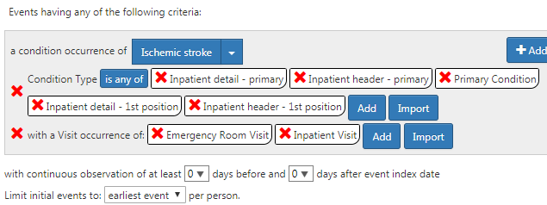
Graham et al. replication: Designing the outcome cohort in ATLAS

Slide 15
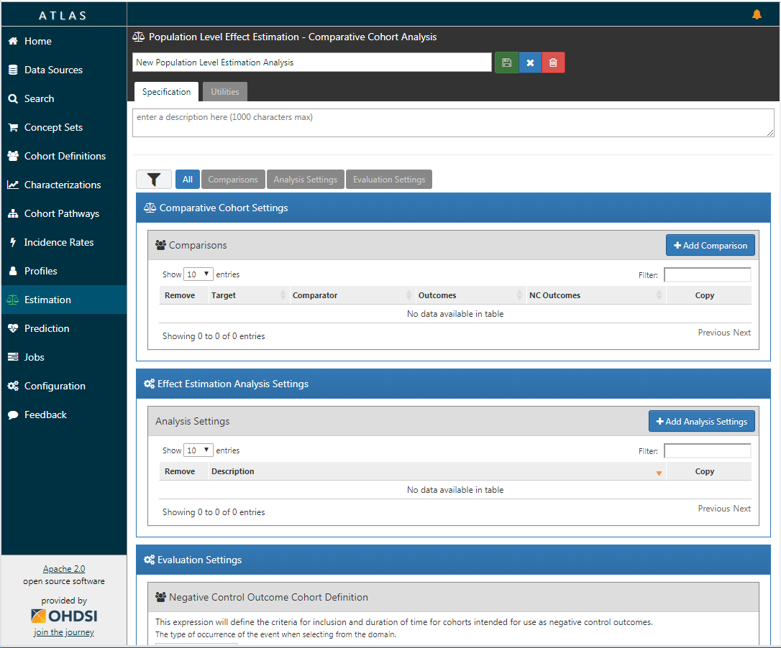
Graham et al. replication: Designing the study in ATLAS

Slide 16
Graham et al. replication: Designing the study in ATLAS

Slide 17
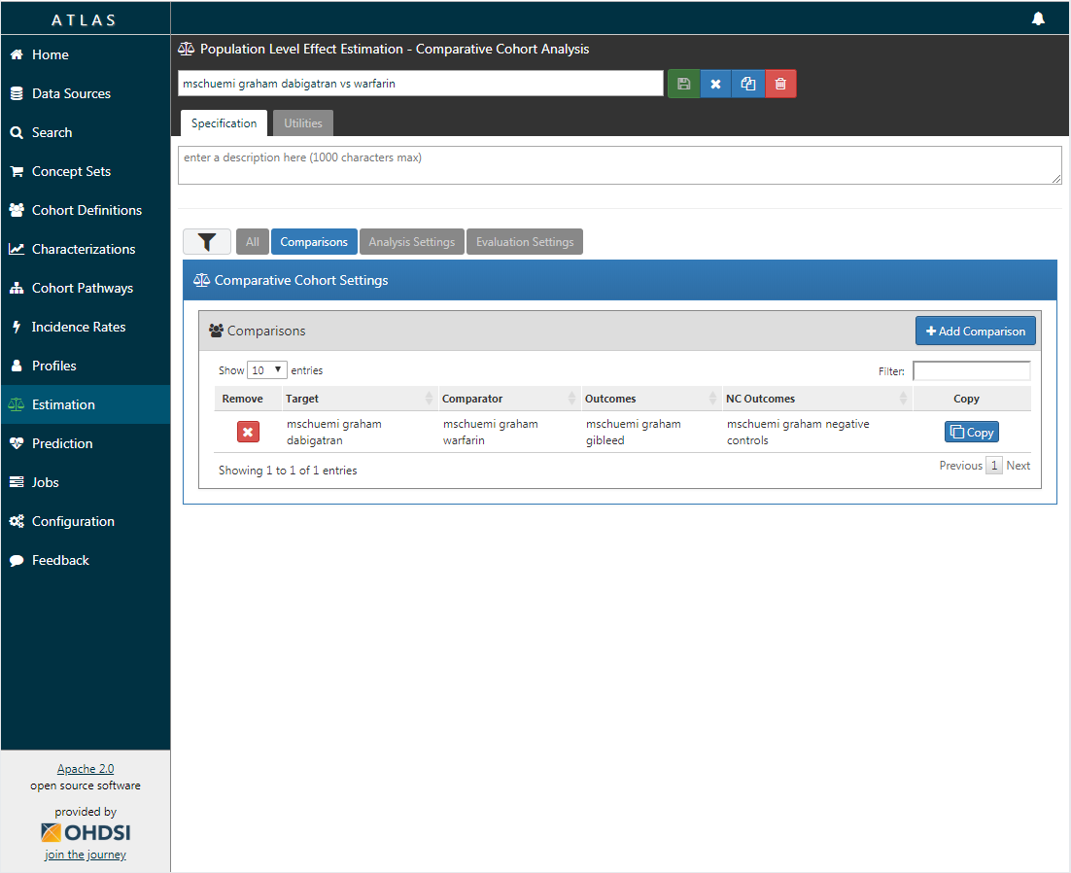
Graham et al. replication: Specifying the comparison

Slide 18
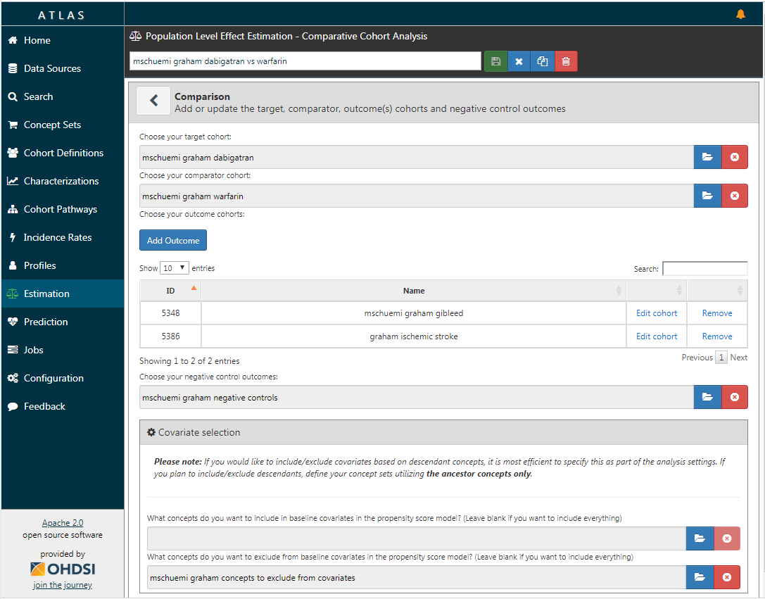
Graham et al. replication: Specifying the comparison

Slide 19
Graham et al. replication: Specifying the comparison

Slide 20
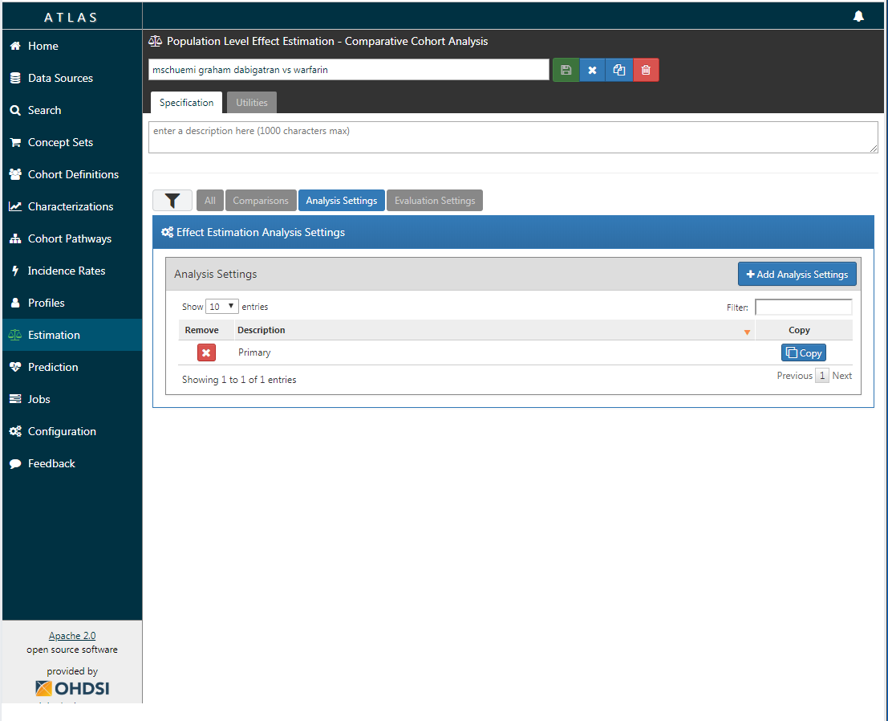
Graham et al. replication: Specifying the analysis settings

Slide 21
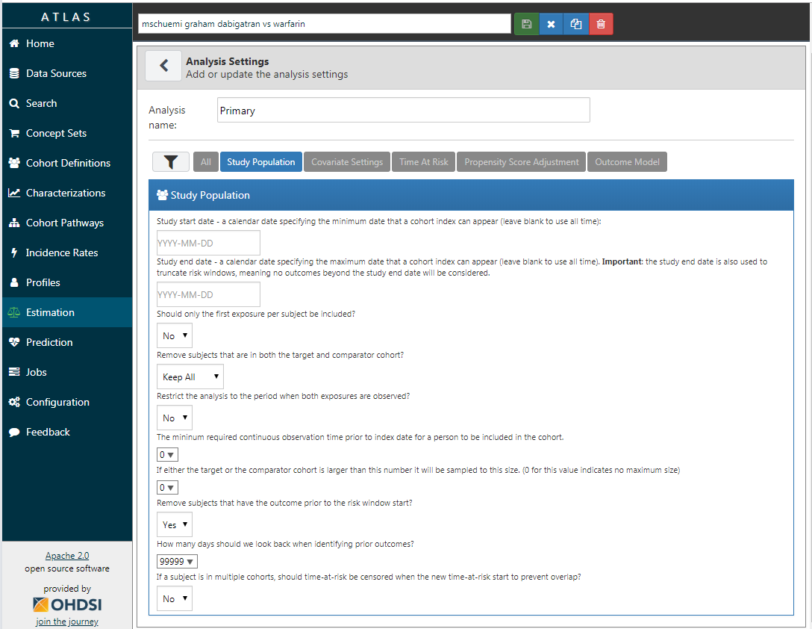
Graham et al. replication: Specifying the analysis settings

Slide 22

Graham et al. replication: covariates for confounding adjustment

Slide 23
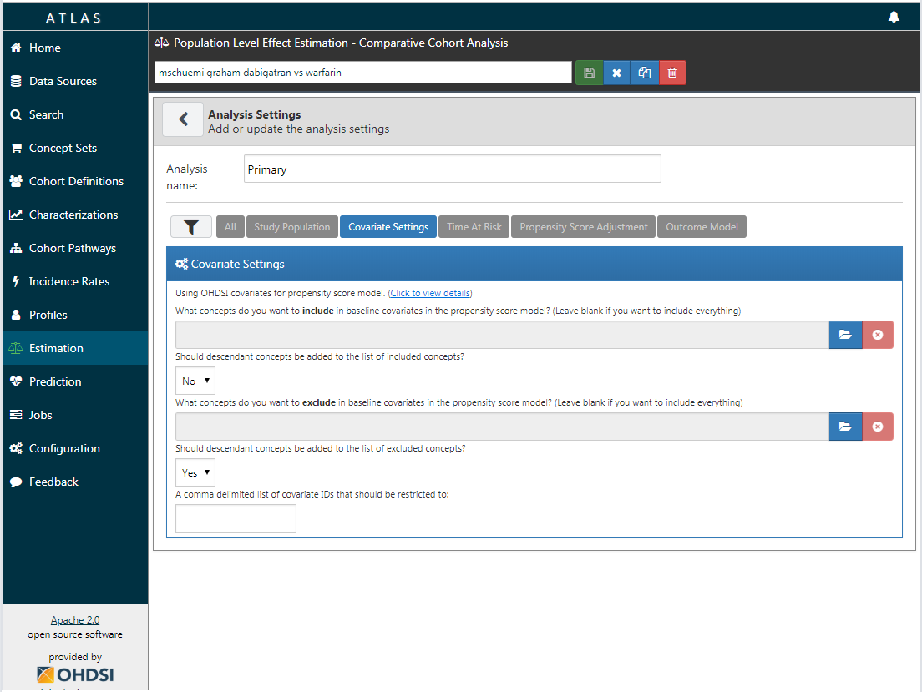
Graham et al. replication: covariates for confounding adjustment

Slide 24
Graham et al. replication: covariates for confounding adjustment

Slide 25
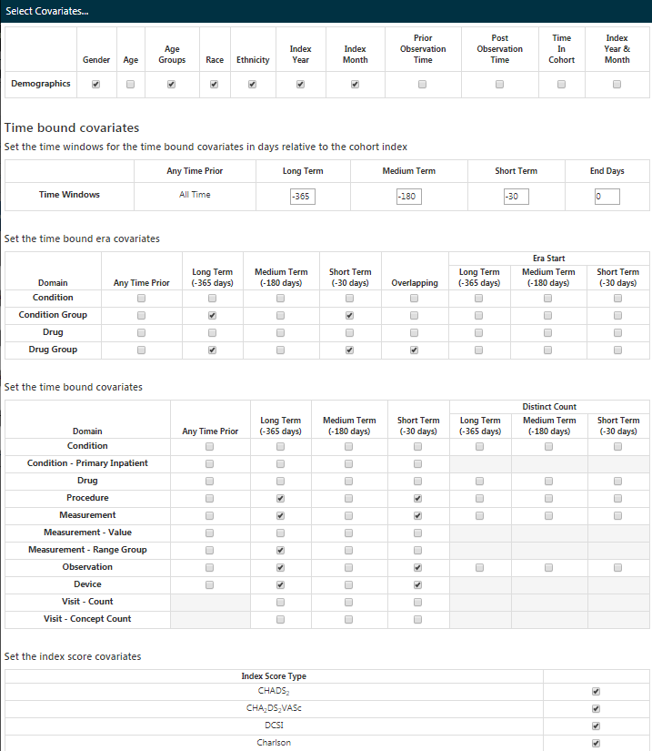
Graham et al. replication: covariates for confounding adjustment
Leverages FeatureExtraction package
Default settings create covariates for all drug and condition group concepts, and procedure, measurement, observation, and device exposure concepts during 2 lookback window
Defaults also include demographics and 4 risk indexes

Slide 26
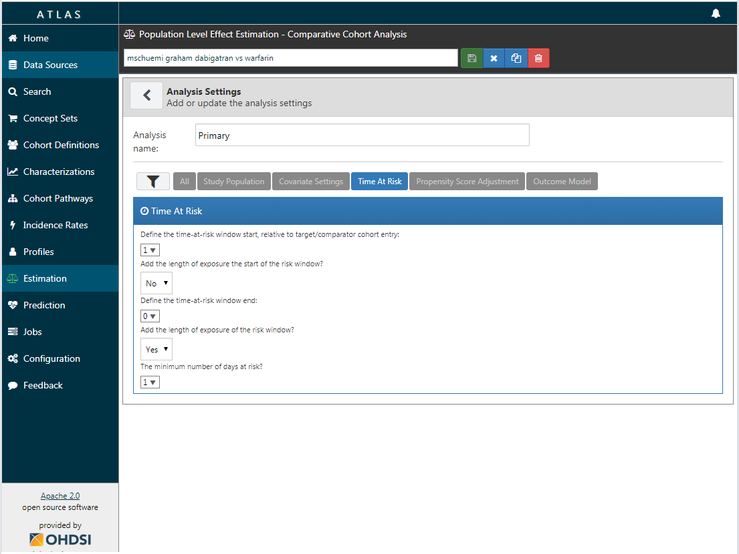

Graham et al. replication: specifying time-at-risk

Slide 27
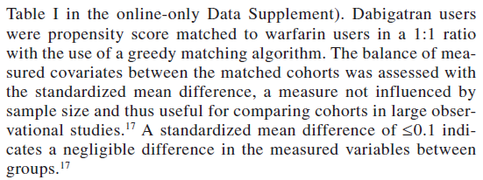
Graham et al. replication: specifying the propensity score model

Slide 28
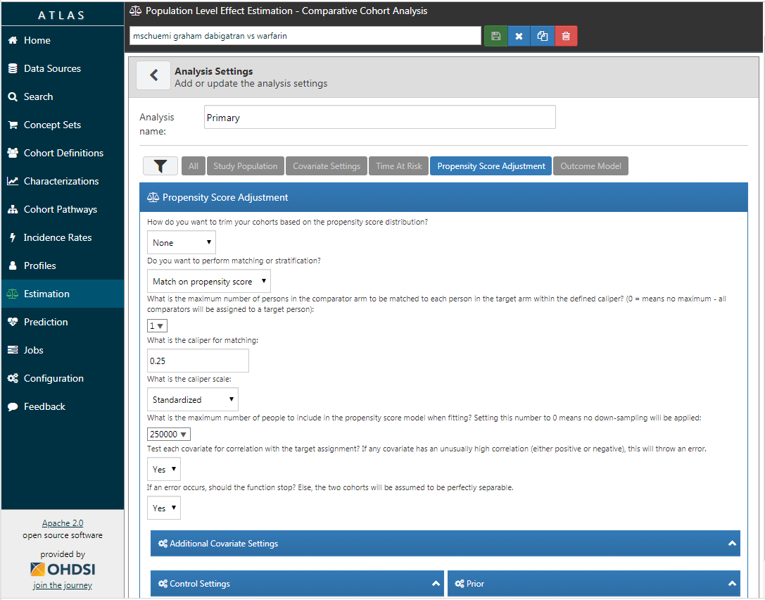
Graham et al. replication: specifying the propensity score model

Slide 29
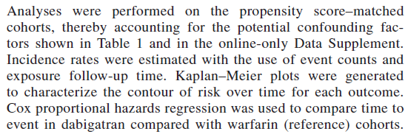
Graham et al. replication: specifying the outcome model

Slide 30
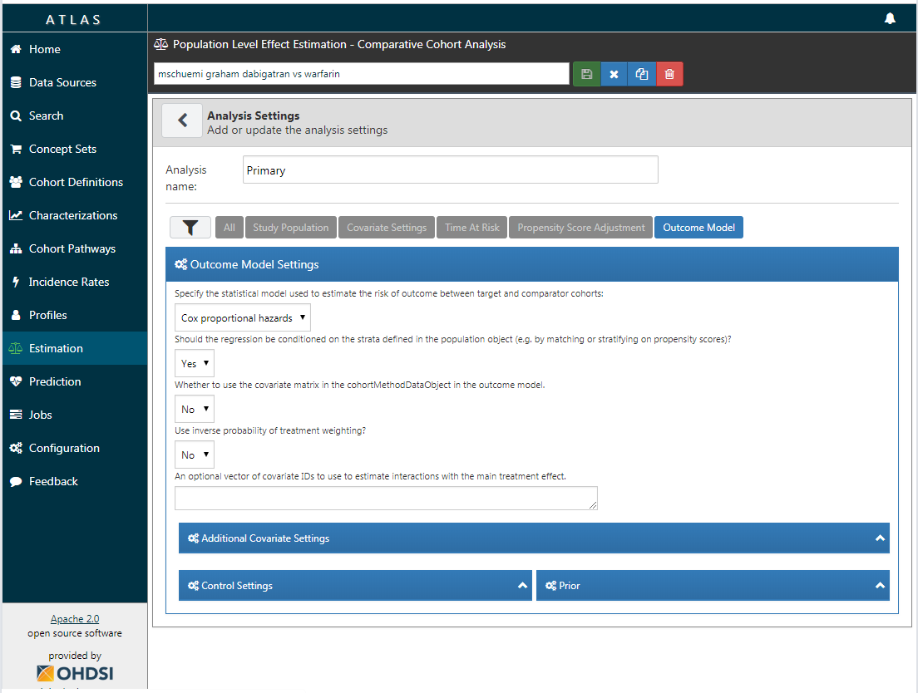
Graham et al. replication: specifying the outcome model

Slide 31
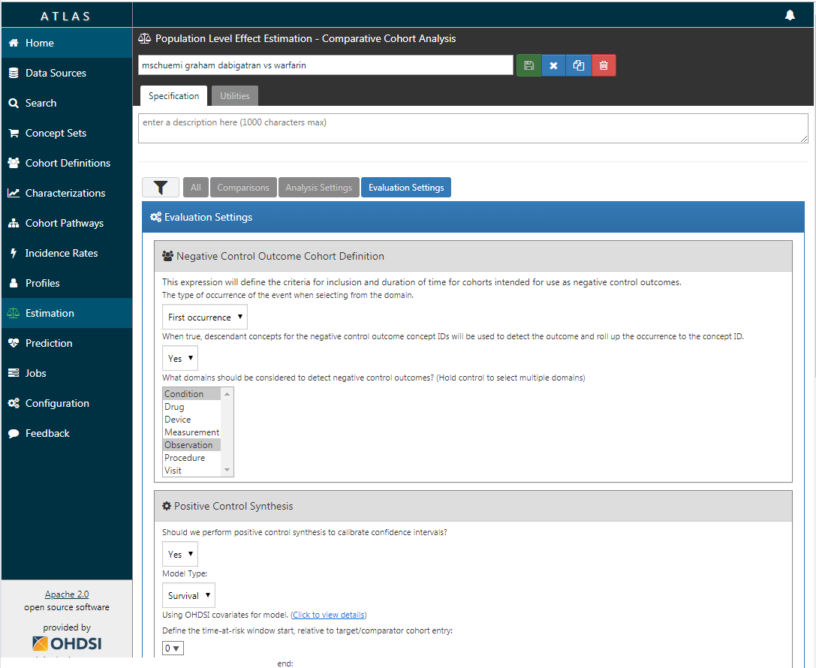
Graham et al. replication: specifying the evaluation settings

Slide 32
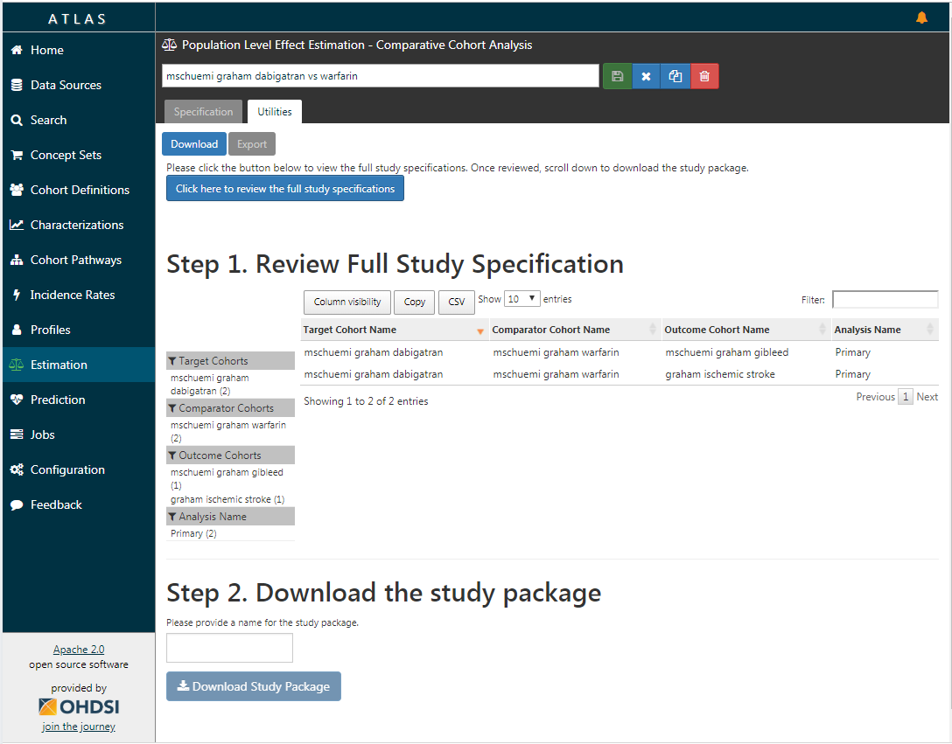
Graham et al. replication: exporting the study package for execution

Slide 33
Anatomy of the study package
Execution code
Cohorts
Main execution code
JSON definitions
SQL definitions
Negative controls
Negative control concepts
SQL template
Positive controls
Shiny app to view results
Positive control settings
Analysis settings
Target-comparator-outcomes
Analysis definitions

Slide 34
Anatomy of the study package
Execution code
Cohorts
inst/cohorts
inst/sql
R
Main execution code
JSON definitions
SQL definitions
Negative controls
inst/settings
inst/sql
Negative control concepts
SQL template
Positive controls
inst/shiny
inst/settings
Shiny app to view results
Positive control settings
Analysis settings
inst/settings
inst/settings
Target-comparator-outcomes
Analysis definitions

Slide 35
How to install?
Build and run in R-Studio
Open package
Own machine: unzip, double-click .Rproj file
R-Studio Server: upload zip, click .Rproj file
Install dependencies (see readme)
‘Build’ → ‘Install and Restart’
Build from GitHub
Unzip and put in GitHub repo
Install dependencies (see readme)
Install with devtools::install_github

Slide 36
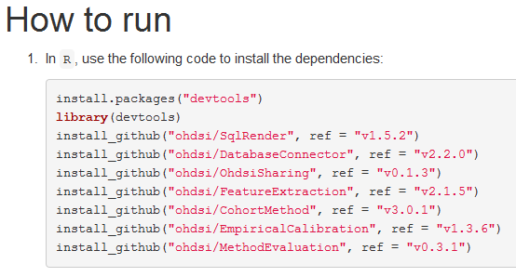
Installing dependencies
Source: readme.md

Slide 37
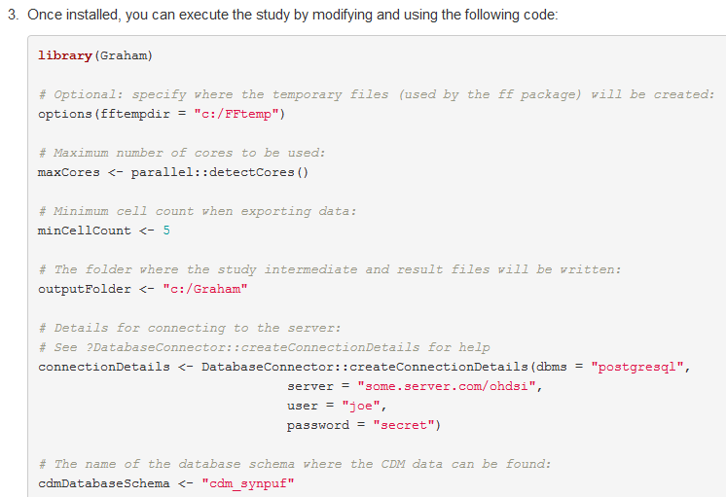
Running package
Source: readme.md

Slide 38
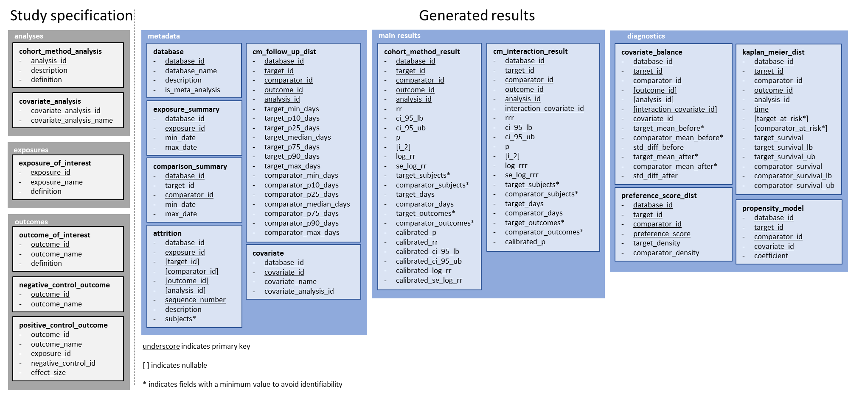
Export data model
Can be shared:
Aggregated, so no patient-level data
Minimum cell count enforced
Saved as CSV, so easily reviewable
Zipped for convenience
See vignette at https://github.com/ohdsi/SkeletonComparativeEffectStudy for details

Slide 39
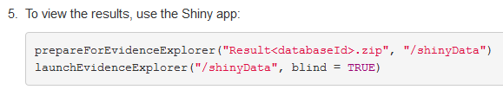
Launching the Shiny app
Source: readme.md

Slide 40
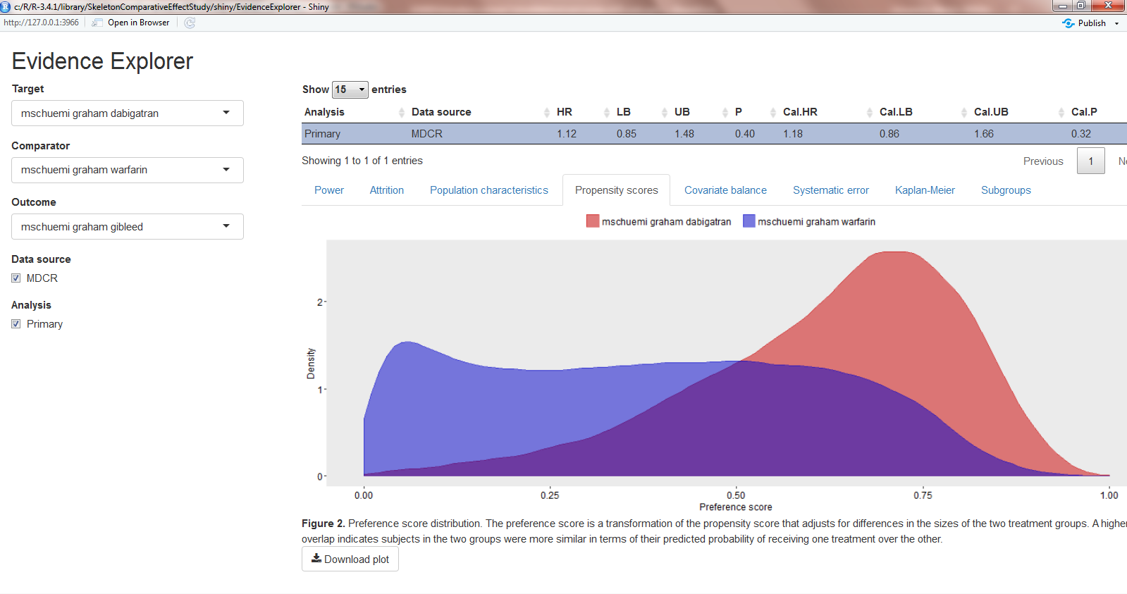
Evidence Explorer

Slide 41
Concluding remarks
CohortMethod package + R offer large flexibility
80% of studies are ‘cookie-cutter’ design, supported by ATLAS
For remaining 20%, will need to modify code generated by ATLAS

