Slide 1
Population-Level Effect Estimation Applications to Generate Reliable Real-World Evidence
George Hripcsak
Martijn Schuemie
Linying Zhang
Tara Anand

Slide 2
Population-level effect estimation—causal inference methods for comparative effectiveness and safety surveillance—enables researchers to understand how exposure to medical interventions are expected to impact health outcomes. In this tutorial, students will learn how to design causal inference studies and how to apply tools (such as CohortMethod) and practices (such as objective diagnostics) developed by the OHDSI community to ensure the evidence generated is reliable.

Slide 3
Agenda
Time |  | Title | Faculty
1:00 | 1:30 | Estimation in observational research | George Hripcsak
1:30 | 2:15 | Drawing causal conclusions from observational data | Linying Zhang
2:15 | 2:45 | Interactive session on study design | Martijn Schuemie
2:45 | 3:00 | Break
3:00 | 3:30 | Cohort method and diagnostics | Tara Anand
3:30 | 4:00 | Meta-analysis and negative controls | Martijn Schuemie
4:00 | 5:00 | Study execution: cohort building, Strategus, interpret | Linying Zhang

Slide 4

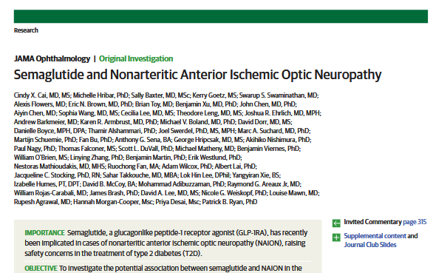
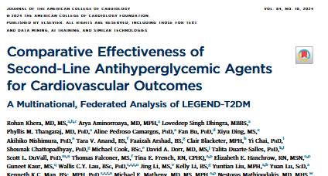
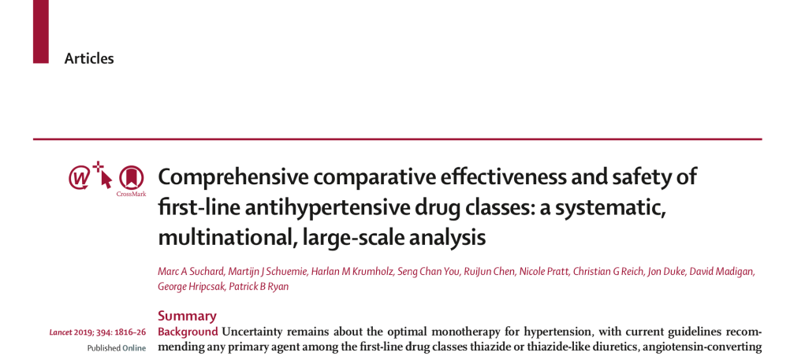

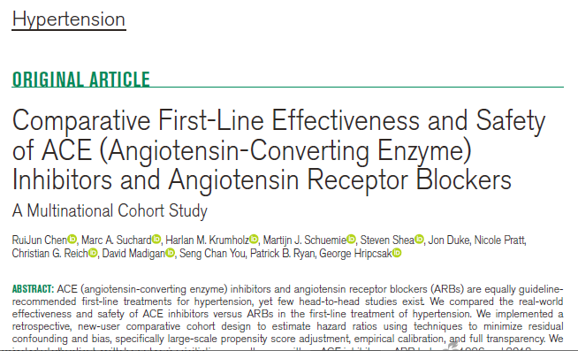
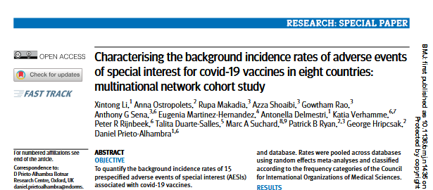
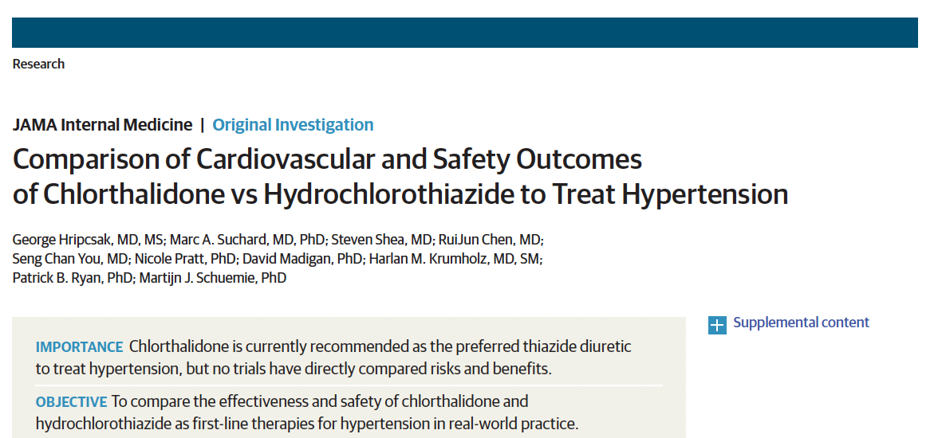
OHDSI is succeeding in publication and impact
World’s top journals
Changing guidelines
Affecting 100’s of millions of patients

Slide 5
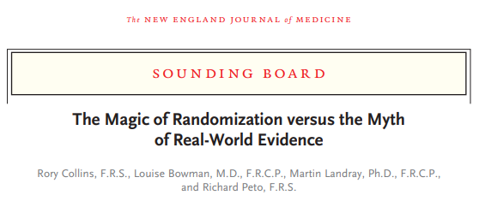
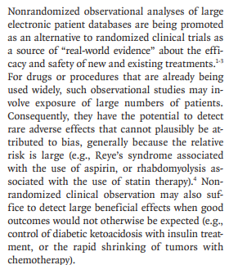
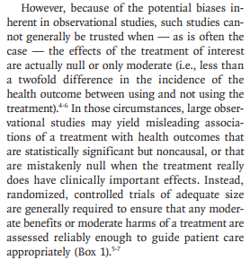
But the field remains skeptical

Slide 6
Tutorial goal
How does OHDSI address this skepticism
OHDSI has created an incredible platform for efficient creation of reliable evidence
Introduction to what that platform aims to do and how to use it
Complements Book of OHDSI, EHDEN Academy, summer schools, etc.

Slide 7
Desired attributes for reliable evidence
Desired attribute | Question | Researcher | Data | Analysis |  | Result
Repeatable | Identical | Identical | Identical | Identical | = | Identical
Reproducible | Identical | Different | Identical | Identical | = | Identical
Replicable | Identical | Same or different | Similar | Identical | = | Similar
Generalizable | Identical | Same or different | Different | Identical | = | Similar
Robust | Identical | Same or different | Same or different | Different | = | Similar
Calibrated | Similar (controls) | Identical | Identical | Identical | = | Statistically consistent

Slide 8
OHDSI’s 10 LEGEND Principles for generating reliable evidence
LEGEND will generate evidence at a large scale
Dissemination of the evidence will not depend on the estimated effects
LEGEND will generate evidence using a prespecified analysis design
LEGEND will generate evidence by consistently applying a systematic process across all research questions
No thumb on the scale
LEGEND will generate evidence using best practices
LEGEND will include empirical evaluation through the use of control questions
LEGEND will generate evidence using open-source software that is freely available to all
LEGEND will not be used to evaluate new methods
LEGEND will generate evidence across a network of multiple databases
LEGEND will maintain data confidentiality; patient-level data will not be shared between sites in the network
Schuemie JAMIA 2020

Slide 9
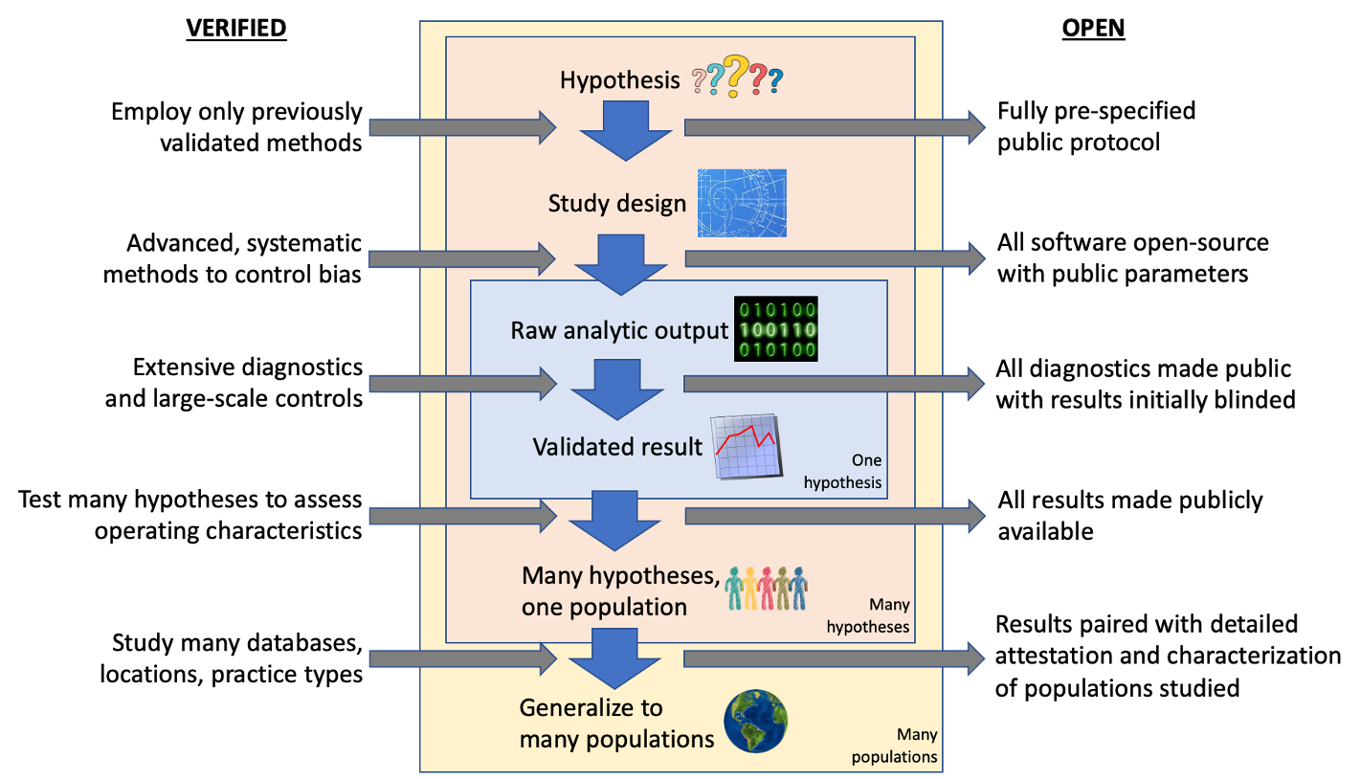
Verified and open

Slide 10
Engineering open science systems that build trust into the real-world evidence generation and dissemination process
‘System’ required elements:
Required phenotypes
Analysis specifications
Decision thresholds
Distributed data network, standardized to common data model
Network coordination
Data quality evaluation
Research question
Database diagnostics
Pass
Fail
Phenotype development and evaluation
Cohort definitions
Cohort diagnostics
Pass
STOP
Fail
Analysis reliability evaluation
Analysis design choices
Study diagnostics
Pass
STOP
System characteristics:
Standardized procedures with defined inputs and outputs
Analysis packages implementing scientific best practices consistently applied across all data partners, generating consistent output for network synthesis
Reproducible outputs generated by open-source analysis libraries developed and validated with verifiable unit-test coverage
Pre-specified and objective decision thresholds for go/no go criteria
Measurable operating characteristics of system performance
Fail
STOP
Final unblinded results
Interface for exploration

Slide 11
Current status quo in observational research makes it challenging to build trust in evidence
Does the study provide an unbiased effect estimate?
Are the findings generalizable to the population of interest?
methodological concerns
data quality?
measurement error?
methods bias?
Write Protocol
Curate
data
Select cohorts
Implement analysis
Disseminate evidence
Is the evidence reliable? (Review biased by results)
ETL
correct?
logic
correct?
programming correct?
Review Protocol
technical concerns
Can the study be fully reproduced?
Does the analysis actually do what the protocol said it would do?
from 11Jan2022 OHDSI call

Slide 12






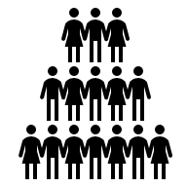

Why get an answer that differs from the truth
Population – are you measuring the population you hoped to measure
Diversity
Population differences
Systematic error
Errors in measurement or analysis – are you measuring the thing you think you are
Differences in approach
Random error
Random variation – how precisely you can measure an effect
Sample size

Slide 13
Hierarchy of populations
external population (wish to generalize to)
External validity (diversity)
target population (what you tried to sample)
Internal validity (systematic error)
actual population (what you sampled)
Statistical inference (random error)
study population (your actual subjects)

Slide 14
Validity
Statistical inference
is there an association
p-value < 0.05
Internal validity
are the conclusions (cause and effect) valid within the setting of the study
prophylactic antibiotic reduced infection rate by 30%
External validity (generalizability)
can the conclusions be applied in other settings
we can expect a reduction in other populations

Slide 15
Statistical inference
Conclude association, not causation
Avoid invalid inferences
type I and II errors
assumptions of the analysis
independence
distribution
OHDSI does
large network studies
proper statistical inference

Slide 16
Internal validity
Extent to which a study is free from design biases that threaten the interpretation of the results
Causal relationships
observed changes attributed to intervention and not to other possible causes
OHDSI does
proper study design
confounding control
diagnostics
network studies

Slide 17
External validity (generalizability)
Extent to which the results of the study generalize beyond the setting in which the study was conducted
careful when generalizing beyond the actual study population
study includes only cases with pathology report
database does not include cases in population of interest
OHDSI does
large network studies

Slide 18
Evidence OHDSI seeks to generate from observational data
WHAT - Clinical characterization
Natural history: Who has diabetes, and who takes metformin?
Quality improvement: What proportion of patients with diabetes experience complications?
WHY - Population-level estimation
Safety surveillance: Does metformin cause lactic acidosis?
Comparative effectiveness: Does metformin cause lactic acidosis more than glyburide?
WHO - Patient-level prediction
Precision medicine: Given everything you know about me, if I take metformin, what is the chance I will get lactic acidosis?
Disease interception: Given everything you know about me, what is the chance I will develop diabetes?

Slide 19
Population-level estimation
Does intervention A cause outcome Y
Compared to what?
Intervention B – e.g., comparative cohort
Not giving A – e.g., self-controlled case series

Slide 20

New-user cohort design comparing two drugs
How do you know the two groups are comparable so that differences in outcome are due to the drugs?
Total population
Outcome
Target cohort
Comparator
cohort

Slide 21
Randomized controlled trial
Randomize so that the two groups differ only in treatment assignment
Total population
Outcome
Target cohort
Randomization
Comparator
cohort

Slide 22
Observational research
Drug might be given to sicker patient because it is thought to be safer
Total population
Outcome
Target cohort
Comparator
cohort

Slide 23

Observational research
Adjust the groups or analysis so that the two groups are comparable
Total population
Outcome
Target cohort
Comparator
cohort

Slide 24
On-going example for interactive sessions
We will exploit our experience in hypertension treatment
Huge impact worldwide
Angiotensin converting enzyme inhibitors (ACEi) versus Angiotensin receptor blockers (ARB)
Thought to be interchangeable on effectiveness
Only ACEi had placebo-controlled trials
ARB thought to be safer (esp. cough, angioedema)

Slide 25
On-going example
Renin-angiotensin-aldosterone system
Block the creation of angiotensin II (ACEi)
Block the binding of angiotensin II (ARB)
Relaxes blood vessels and lowers blood pressure
We will compare ACEi and ARB as treatments for essential hypertension
Outcomes
Acute myocardial infarction – effectiveness
Angioedema – safety

Slide 26
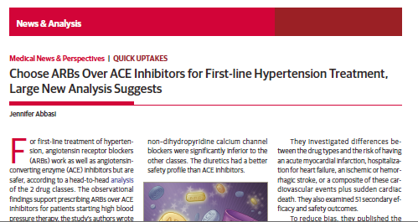
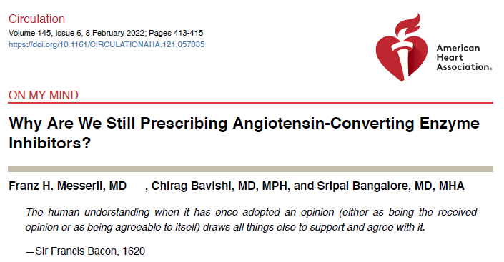
OHDSI experience on this hypothesis ACEi versus ARB for hypertension
Suchard Lancet 2019 https://pmc.ncbi.nlm.nih.gov/articles/PMC6924620/
Chen Hypertension 2021 https://www.ahajournals.org/doi/10.1161/HYPERTENSIONAHA.120.16667

Slide 27
Phenotyping

Slide 28
Engineering open science systems that build trust into the real-world evidence generation and dissemination process
‘System’ required elements:
Required phenotypes
Analysis specifications
Decision thresholds
Distributed data network, standardized to common data model
Network coordination
Data quality evaluation
Research question
Database diagnostics
Pass
Fail
Phenotype development and evaluation
Cohort definitions
Cohort diagnostics
Pass
STOP
Fail
Analysis reliability evaluation
Analysis design choices
Study diagnostics
Pass
STOP
System characteristics:
Standardized procedures with defined inputs and outputs
Analysis packages implementing scientific best practices consistently applied across all data partners, generating consistent output for network synthesis
Reproducible outputs generated by open-source analysis libraries developed and validated with verifiable unit-test coverage
Pre-specified and objective decision thresholds for go/no go criteria
Measurable operating characteristics of system performance
Fail
STOP
Final unblinded results
Interface for exploration

Slide 29
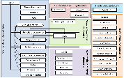

Common data model can enable standardized analytics across a distributed data network
Source 1 raw data
Source 1 CDM
Open-source analysis code
Electronic health records
Source 2 raw data
Source 2 CDM
Transformation to common data model
Administrative claims
Open evidence
Source 3 raw data
Source 3 CDM
Clinical data

Slide 30
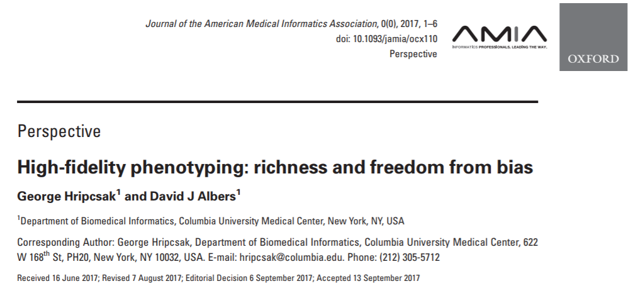
Defining ‘phenotype’
A phenotype is a specification of an observable, potentially changing state of an organism (as distinguished from the genotype, derived from genetic makeup).
The term phenotype can be applied to patient characteristics inferred from electronic health record (EHR) data.
The goal is to draw conclusions about a target concept based on raw EHR data, claims data, or other clinically relevant data.
Phenotype algorithms – ie, algorithms that identify or characterize phenotypes – may be generated by domain experts and knowledge engineers, or through diverse forms of machine learning to generate novel representations of data.

Slide 31
OHDSI’s definition of ‘cohort’
Cohort = a set of persons who satisfy one or more inclusion criteria for a duration of time
Cohort definition = the specification for how to identify a cohort

Slide 32
Challenge
We have diagnosis codes, so what is the problem?
Need a heart attack (myocardial infarction), look it up
OMOP 4329847 SNOMED 22298006
Myocardial infarction

Slide 33

Meaning
PERRLA
Pupils equal, round, reactive to light and accommodation
Myocardial infarction (MI) vs rule-out MI

Slide 34
Missing
Data are mostly missing
Sampled when sick
Implicit information
Pertinent negatives by attending vs CC3

Slide 35
Noisy
As low as 50% accuracy (Hogan JAMIA 1997)

Slide 36
Phenotype (cohort) definition
Accommodate failings (properties) of clinical data
Repeat codes to prove it is real
Alternate sources of information (condition, drug, lab, procedure)
Turn a series of raw observations into a clinical concept

Slide 37
What we HAVE? Observational data for a single person
Type 2 Diabetes Mellitus
Condition
Hyperlipidemia
Essential Hypertension
Acute myocardial infarction
Metformin
Drug
Atorvastatin
Lisinopril
Atenolol
Hemoglobin A1c
Measurement
8.2
7.8
7.5
7.9
Total cholesterol
200
185
Systolic blood pressure
120
120
125
Body Mass Index
38
40
Observation Time
Notes:
Good: Hyperlipidemia, AMI
Sensitivity error: Obesity
Sepcificity error: Hypertension
Index date misclassiciation: T2DM

Slide 38
What we WANT? Longitudinal health status for a single person
Type 2 Diabetes Mellitus
Type 2 diabetes mellitus
Condition
Hyperlipidemia
Hyperlipidemia
Essential Hypertension
Acute myocardial infarction
AMI
Metformin
Drug
Metformin use
Atorvastatin
Atorvastatin use
Lisinopril
Atenolol
Hemoglobin A1c
Measurement
8.2
7.8
7.5
7.9
Total cholesterol
200
185
Systolic blood pressure
120
120
125
Body Mass Index
38
40
Obesity
Observation Time

Slide 39
Potential errors from inference in disease phenotyping from condition records alone
Type 2 Diabetes Mellitus
Type 2 diabetes mellitus
Condition
Hyperlipidemia
Hyperlipidemia
Essential Hypertension
Hypertension
Acute myocardial infarction
AMI
Specificity Error (false positive): Inferring disease when it doesn’t truly exist
Index date misclassification: Incorrectly assigning disease start and end
Drug
Metformin
Metformin use
Atorvastatin
Atorvastatin use
Lisinopril
Atenolol
Sensitivity Error: (False negative): Failing to infer disease that does exist
Hemoglobin A1c
Measurement
8.2
7.8
7.5
7.9
Total cholesterol
200
185
Systolic blood pressure
120
120
125
Body Mass Index
38
40
Obesity
Observation Time

Slide 40
Reduce measurement error: OHDSI phenotyping pipeline
Phenotype library, literature
Prior work review
ATLAS, PHOEBE
Creating comprehensive concept set representing clinical idea
ATLAS, CapR, APHRODITE
Creating cohorts of patients that satisfy inclusion and exclusion criteria
Cohort diagnostics
Examining cohorts
PheValuator, KEEPER
Computing phenotype performance metrics
Phenotype library
Storing phenotypes

Slide 41
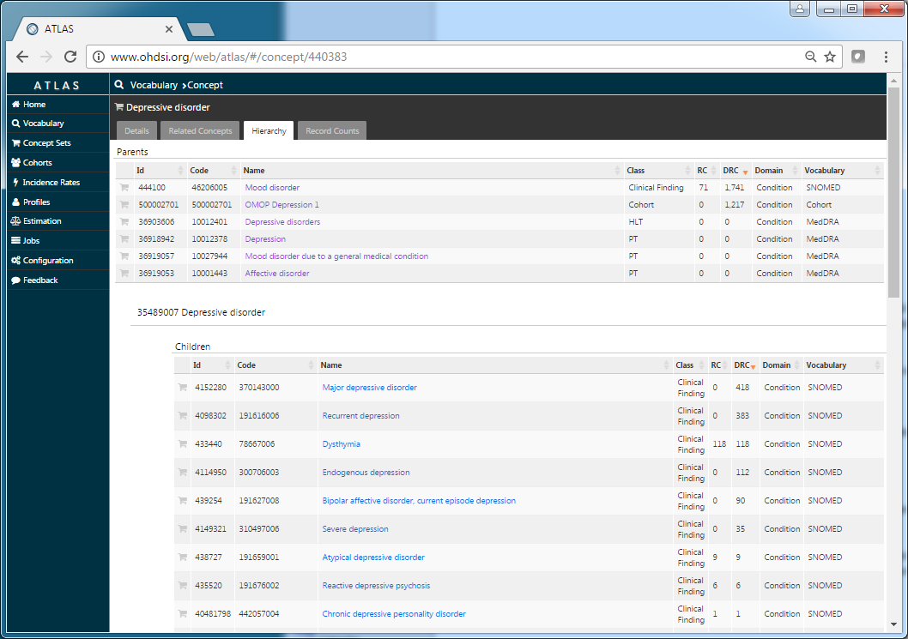
ATLAS tool: Search vocabulary
What coded terms do I need to create a cohort
Tied to the database: what terms are used
Especially important for someone else’s database
4329847 Myocardial infarction

Slide 42
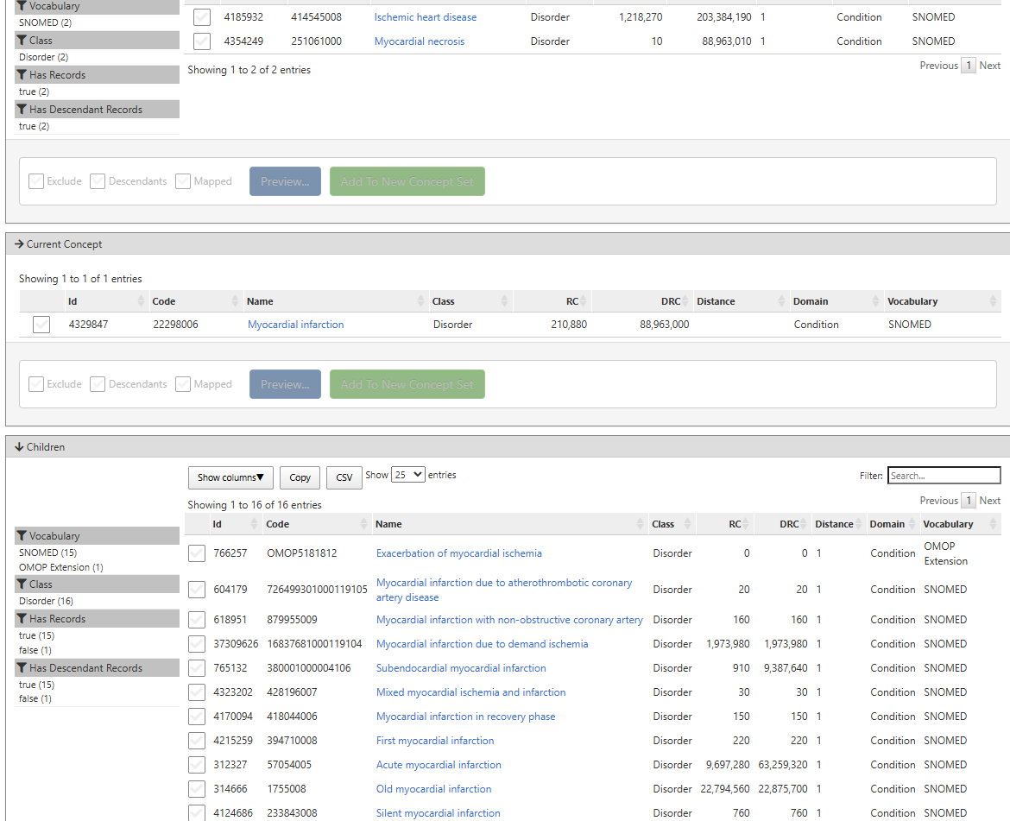
ATLAS tool: Exploit the hierarchy
Classification hierarchy pulls related more-specific terms
May adjust your target
4329847 Myocardial infarction
312327 Acute myocardial infarction
765132 Subendocardial myocardial infarction
…

Slide 43
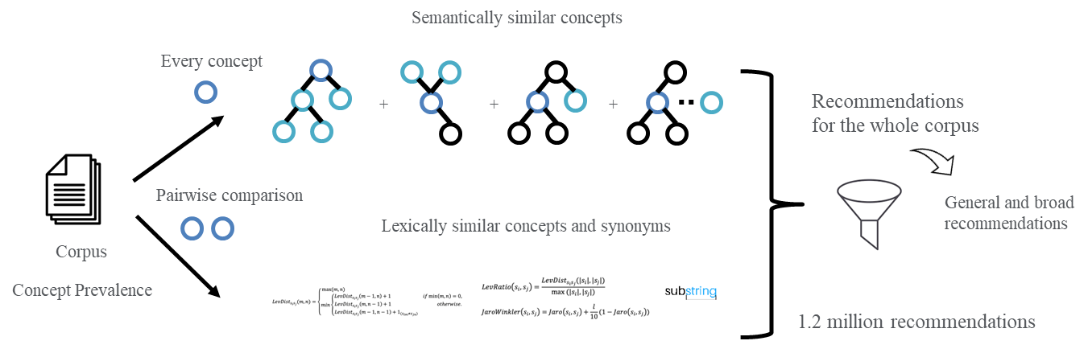
Concept set assistance: PHOEBE (PHenotype Observed Entity Baseline Endorsements)
How to find other codes you might want (not in the hierarchy):
Ask everyone in the world, how often does every clinical concept happen in your medical center
Use that knowledge base to find related terms:
Hierarchy ancestors and descendants
Lexical matches to elsewhere in the tree
RWD co-occurrence
Ostropolets AMIA 2021

Slide 44
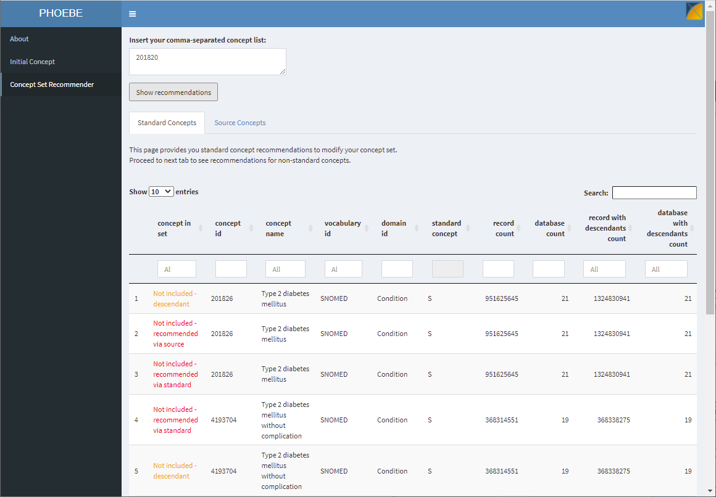
Concept set assistance: PHOEBE (PHenotype Observed Entity Baseline Endorsements)
 |  | eMERGE | PPV | PHOEBE | PPV
Diabetes type I | CUMC | 22,146 | 0.34 | 22,250 | 0.34
 | MDCD | 204,533 | 0.13 | 207,060 | 0.13
 | MDCR | 185,874 | 0.10 | 181,712 | 0.11
Diabetes type II | CUMC | 39763 | 0.49 | 60713 | 0.47
 | MDCD | 506,992 | 0.20 | 425,730 | 0.23
 | MDCR | 386,265 | 0.27 | 2,172,925 | 0.37
identify more patients
capture them early on in the course of the disease
4124687 Cardiac rupture due to and following acute myocardial infarction
Ostropolets AMIA 2021

Slide 45
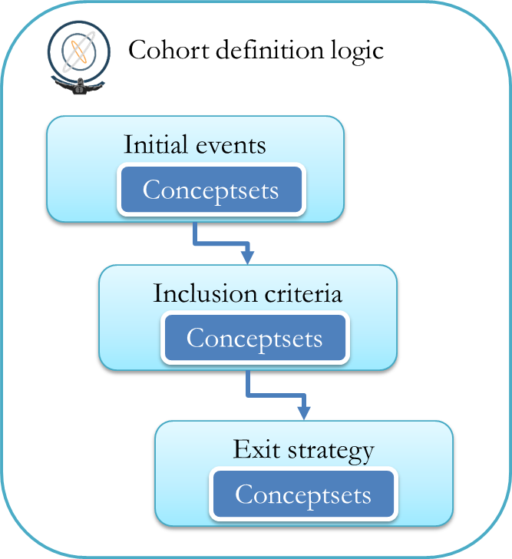
ATLAS: phenotype logic
Optimized for observational research
Time series: who and when (vs classification)
Triggering event
Inclusion criteria like drug indication
Exit criteria
Observation period

Slide 46
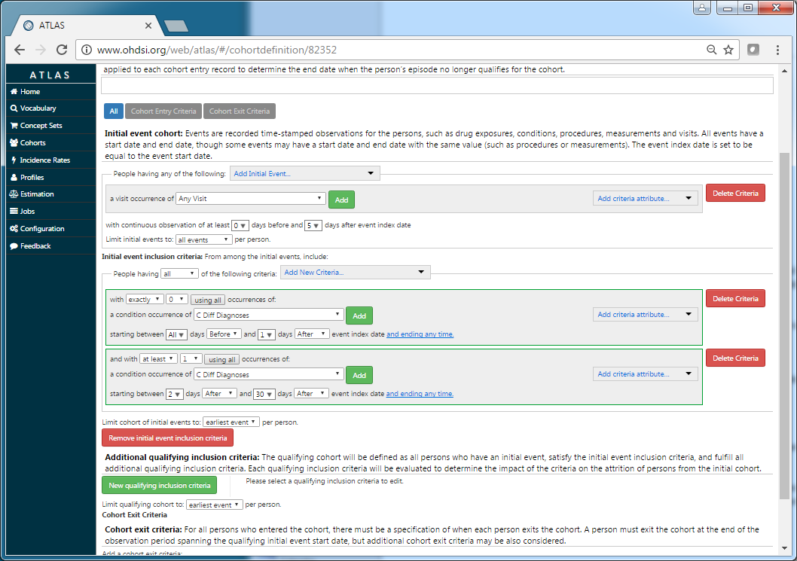
ATLAS: phenotype logic
Optimized for observational research
Assume a complex definition – Linearized AND-OR group
Look for at least two myocardial infarction codes
Index event
Inclusion criteria
Exit criteria

Slide 47
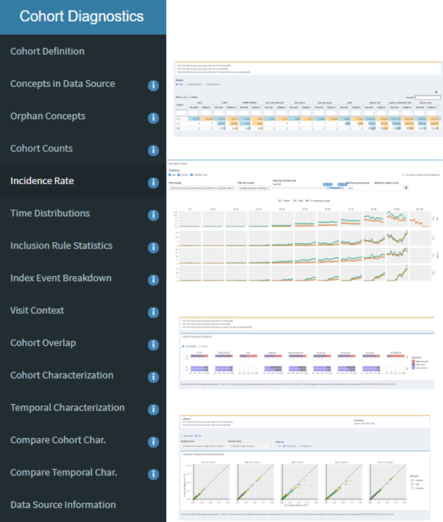
Phenotype evaluation
Cohort diagnostics
Characterization
Look at properties of the phenotype
Age, sex, year, …

Slide 48
Phenotype evaluation
Chart review
Does the algorithm identify cases accurately
Can’t check the whole database
Check cases it finds
Somehow get all positive cases and see how many it misses
A ton of work

Slide 49
Phenotype evaluation
Knowledge-Enhanced Electronic Profile Review system (KEEPER)
Facilitate chart review
Summarize chart structured data relevant to phenotype
Twice as fast, more consistent among reviewers, as accurate
Demographics and visit details | Presentation | Prior conditions and treatments | Diagnostic procedures | Laboratory tests | Competing diagnoses | Treatment | Complications
Male, 46 yo; Visit: emergency room and hospitalization (3 days) | Abdominal pain; Acute appendicitis; Large liver; Umbilical hernia without obstruction AND without gangrene | Abdominal pain (day -71); Abdominal pain (day -1); | Computed tomography, abdomen and pelvis; with contrast(day 0); | Leukocytes (abnormal, high, day 0); Neutrophils (normal, day 0); Neutrophils/100 leukocytes (abnormal, high, day 0) |  | Appendectomy (day 23); metronidazole (3 days) | Acute gangrenous appendicitis (day 23); Acquired absence of organ (day 23)

Slide 50
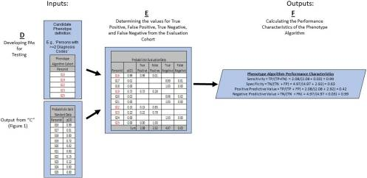
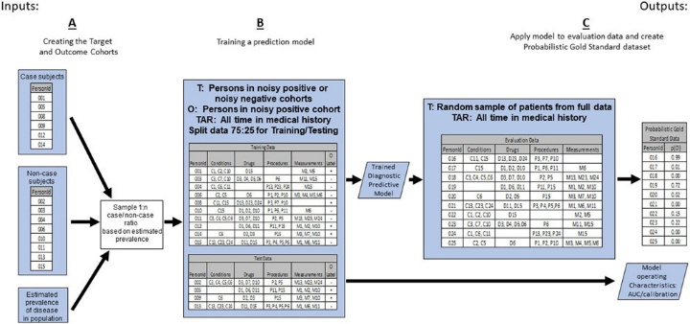
Phenotype evaluation
Phevaluator
Machine learning to automate sensitivity, specificity
Train on highly sensitive and highly specific alternate phenotypes
Swerdel JBI 2019

Slide 51
Phenotype
Share successful phenotypes in the phenotype library

Slide 52
Drawing causal conclusions from observational data
Linying Zhang

