Slide 1
CohortMethod Implementation and Diagnostics
Tuesday, October 7, 2025

Slide 2
Indication (total) Population
Outcome Population
Target Cohort
Comparator Cohort
Notes:
For estimation we do a comparative effectiveness study. We are comparing two cohorts

Slide 3
1. Cohort Definitions
Indication (total) Population
Outcome Population
Target Cohort
Comparator Cohort

Slide 4
1. Cohort Definitions
Indication (total) Population
Outcome Population
Target Cohort
Comparator Cohort
2. Timing/Analysis Specification

Slide 5
1. Cohort Definitions
Indication (total) Population
Outcome Population
Target Cohort
Comparator Cohort
3. Method to address confounding
2. Timing/Analysis Specification

Slide 6
Workflow
Define (indication) target, comparator, and outcome cohorts
Define Analysis specification
Leverage large-scale propensity score and run analysis
Evaluate Diagnostics
ATLAS/CapR DownloadCohorts.R
CreateAnalysisSpecification.R
StrategusCodeToRun.R
Rshiny App

Slide 7
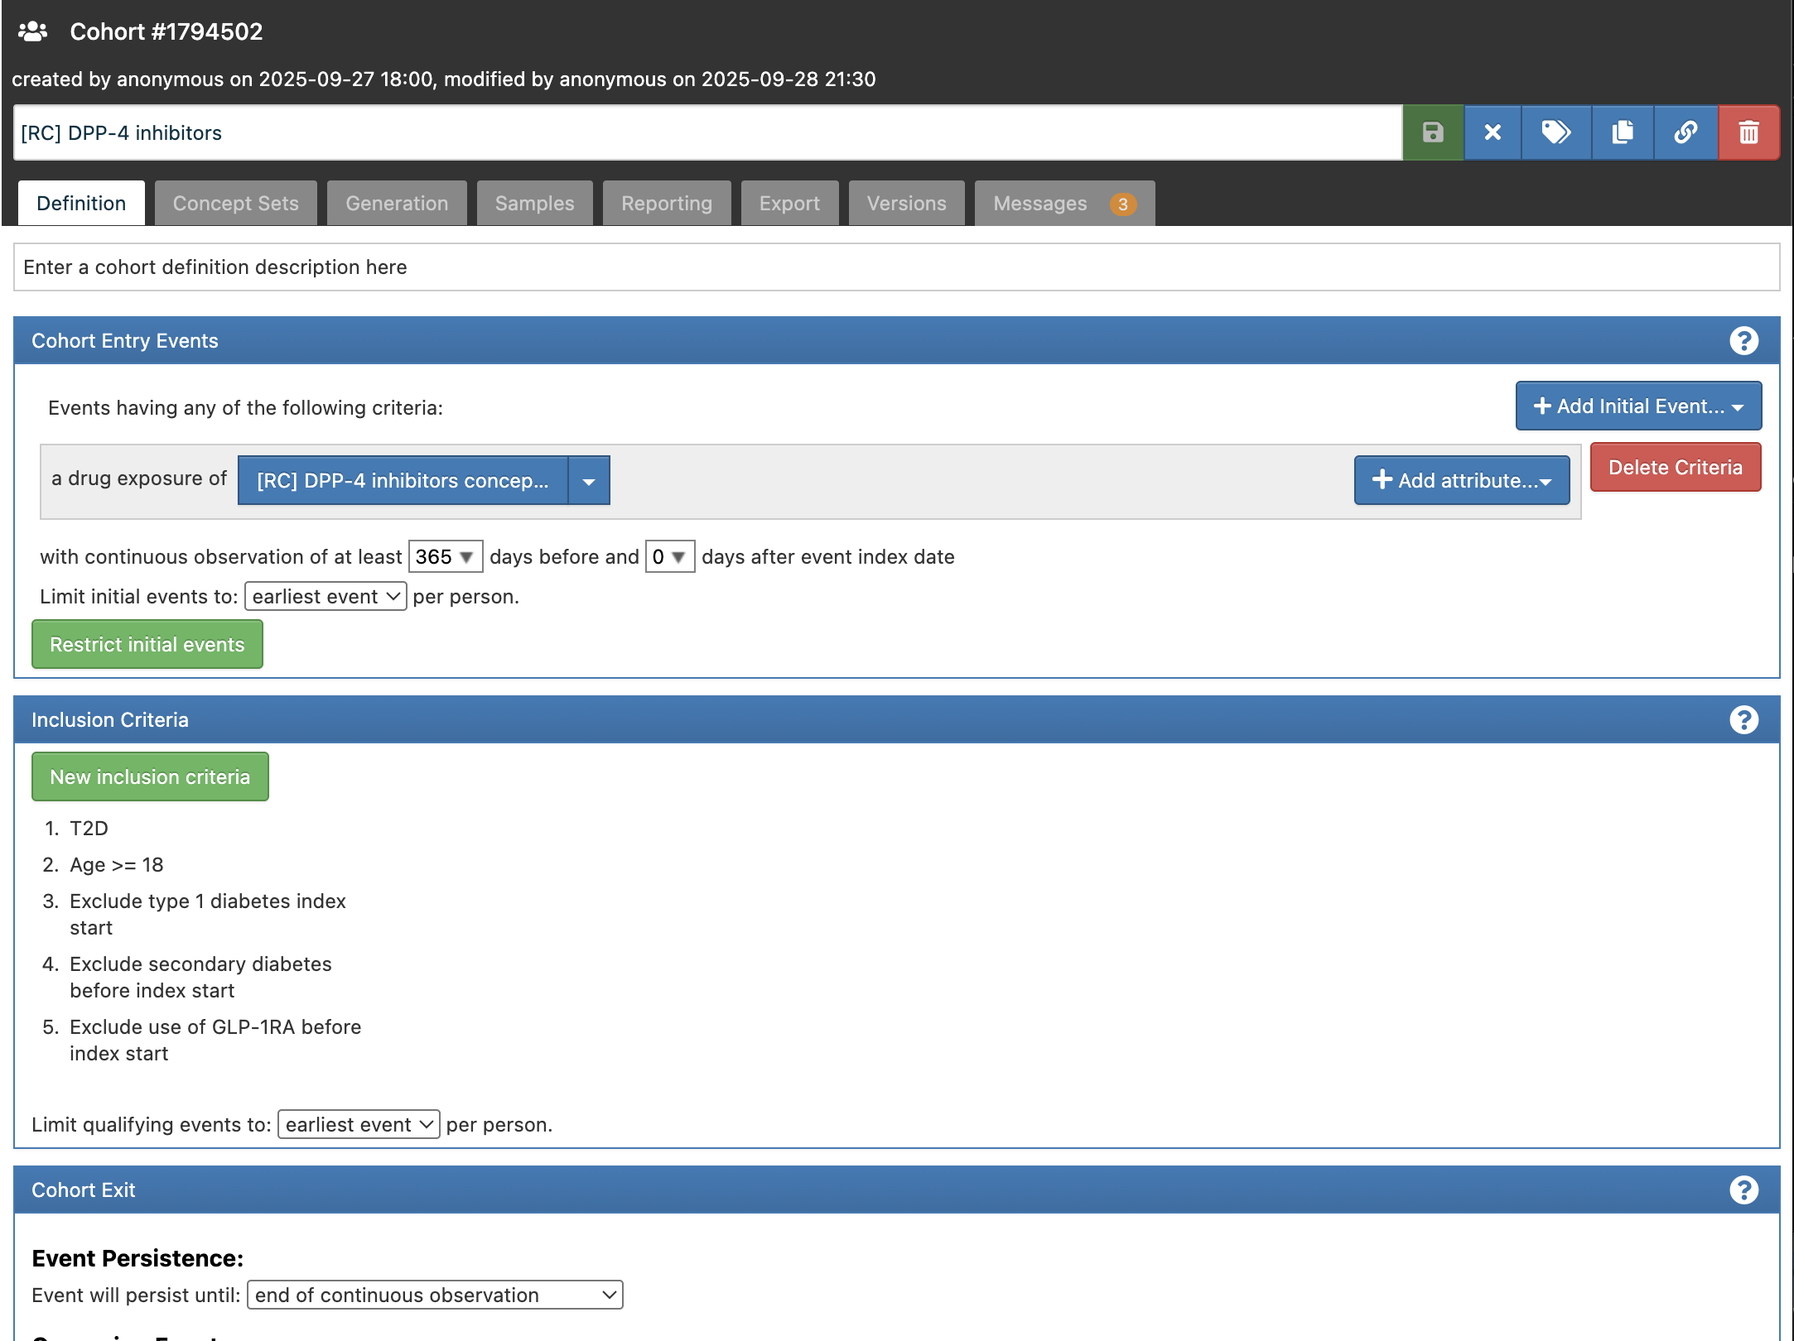
Define cohorts

Slide 8
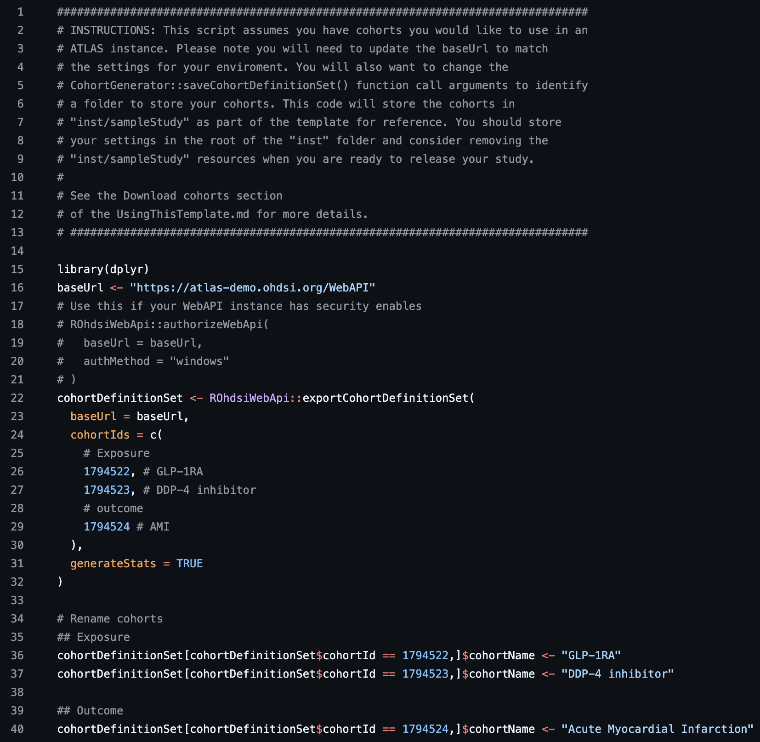
Define cohorts
DownloadCohorts.R

Slide 9
Analysis Specification
How do the target, comparator, and outcome cohorts relate to one another?
Design decisions to address sources of bias
Restrict to common period
Remove duplicate subjects
Outcome clean window
Time at risk
PS Settings
Outcome model
Other data refinement

Slide 10
Restrict to common period
Resticts study to period when both treatments are on the market
Study period
Target observed
Comparator observed
First cohort entry in comparator cohort
First cohort entry in target cohort
Last cohort start in comparator cohort
Last cohort start in target cohort

Slide 11
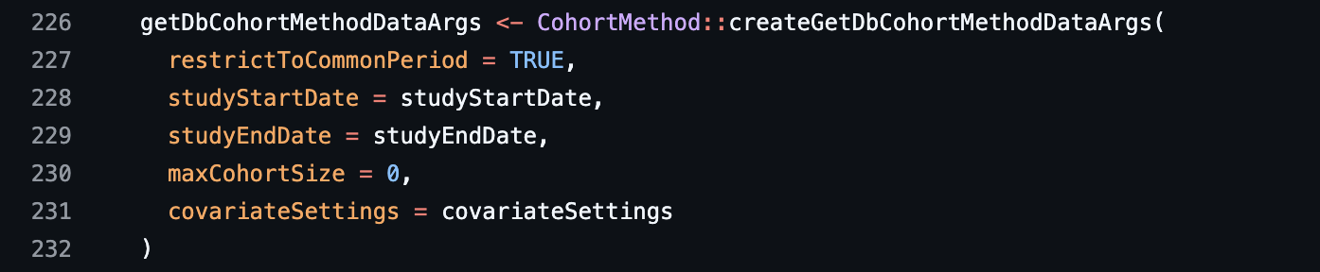
Restrict to common period
CreateAnalysisSpecification.R

Slide 12
Remove duplicate subjects
Input person
Target cohort
Comparator cohort
Time
Remove all
Time
Target cohort
Comparator cohort
Keep all
Time
Target cohort
Keep first
Time
Target
Comparator cohort
Keep all + censor at new risk window
Time

Slide 13
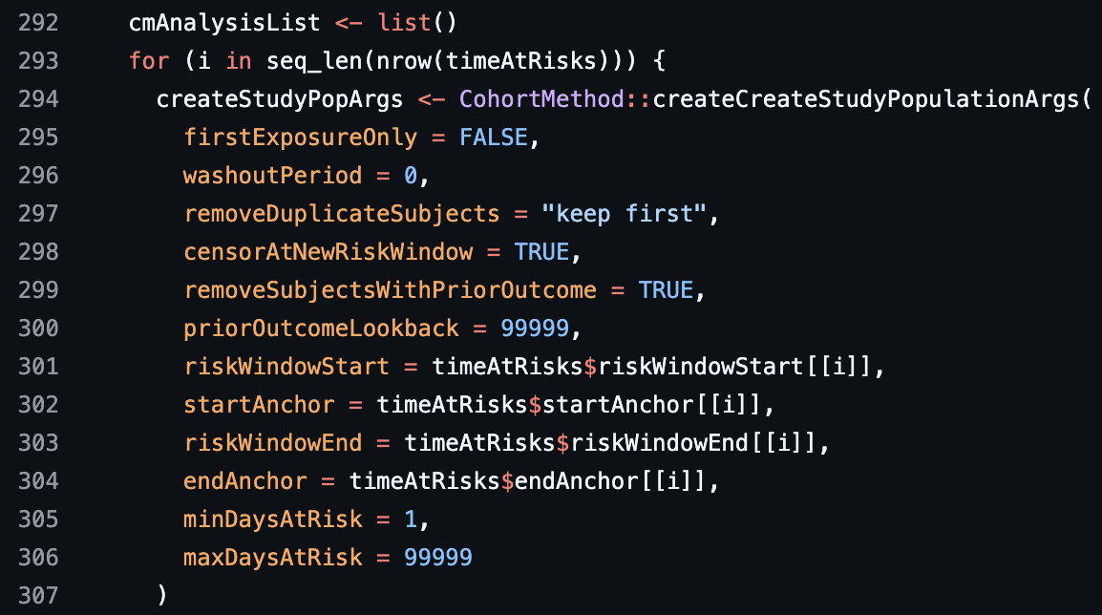
Remove duplicates
CreateAnalysisSpecification.R

Slide 14
Time-at-risk: when might the outcome occur
Target cohort
Observation period
Risk Window start | startAnchor | Risk Window end | endAnchor
1 | cohort start | 0 | cohort end
1 | cohort start | 30 | cohort start
1 | cohort start | 99999 | cohort start
Time at risk
Time at risk
Time at risk
Cohort start + 30 days
Cohort start
Cohort end
Observation end

Slide 15
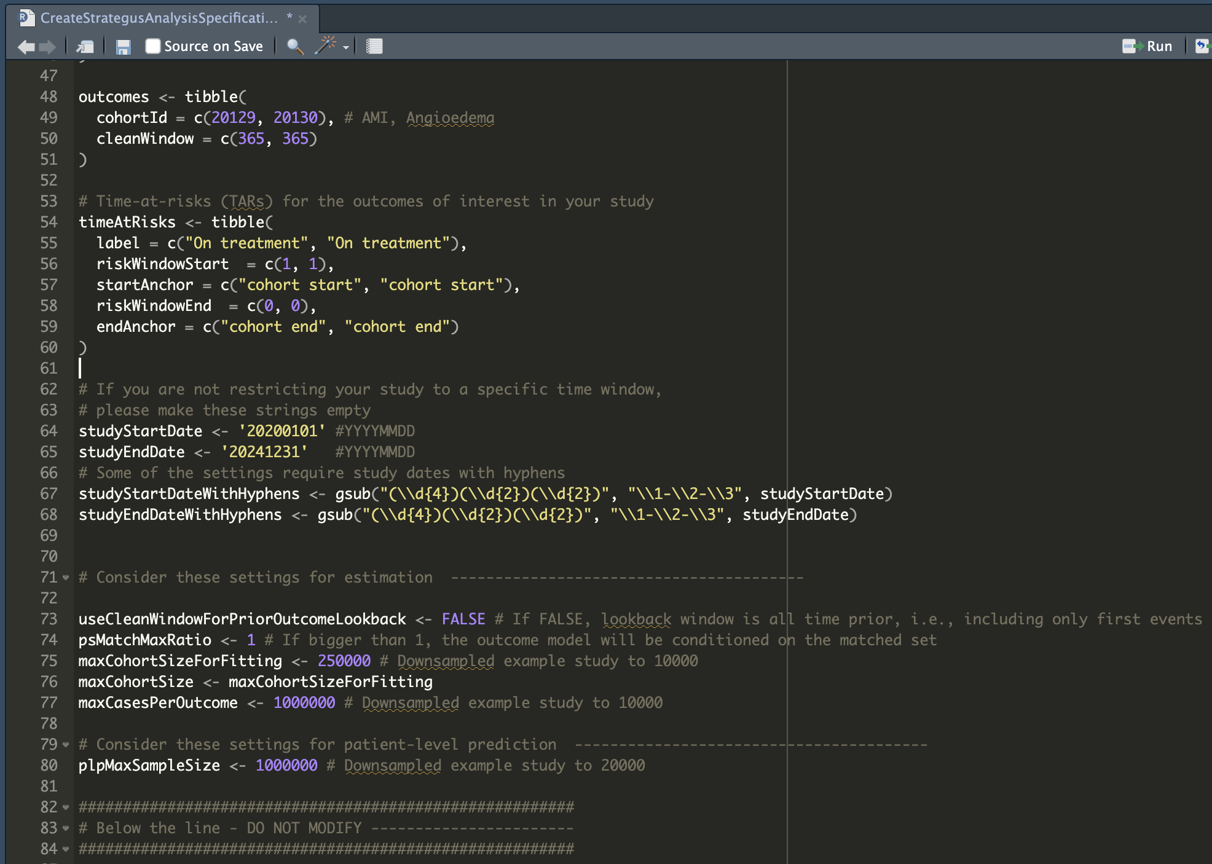
CreateAnalysisSpecification.R
Define time-at-risk

Slide 16
Outcome lookback window and cohort clean window
Immortal time
Clean window
Outcome
Target or comparator
Index date
To avoid immortal time:
At least remove anyone who has the outcome during clean window prior to index
Alternatively:
Remove anyone who has the outcome any time prior
Notes:
Ex: heart attack

Slide 17
Define outcome clean window and lookback
CreateAnalysisSpecification.R

Slide 18
Propensity score (PS)
The propensity score is the probability of receiving the treatment, conditional on a set of baseline characteristics
$P\left( treatment \right| X)=f({ β}_{0}$ + $β_{1}x_{1}$ + $β_{2}x_{2}$ + $β_{3}x_{3}$ + … )
Intercept
Charlson Comorbidity Index
Prior GERD
Age

Slide 19
Using the PS
Stratification or matching
only compare subjects to subjects with a similar PS
Match 1-to-1 or 1-to-N (best if different sample sizes)
Weighting
reweigh target and comparator persons to approximate same population

Slide 20
Which variables go into the PS model?
Traditional: hard thinking by expert
High-Dimensional PS: rank many variables (e.g. all drugs, conditions) by correlation with exposure (and maybe outcome), pick top n
(Unstable)
Large-Scale PS: put everything (demographics, all drugs, all drug classes, all conditions, all disease classes, all procedures, all observations, all severity indexes) in a regularized regression

Slide 21
Concepts to exclude (from PS and balance)
LSPS: include all concepts (drugs, procedures, etc.) at and before baseline
This would include the target and comparator drugs themselves, which would make the propensity model perfectly predictive
We therefore must explicitly remove the target and comparator (drug) concept from the covariates
We sometimes also must exclude other concepts… (injection devices for GLP-1, administratively linked concepts)

Slide 22
How do I know which concepts to remove?
Always exclude the target and comparator concepts
We have defined a standard list of additional concepts to exclude
Data driven approaches:
Comparator selection tool https://data.ohdsi.org/ComparatorSelectionExplorer/
CohortDiagnostics cohort comparisons
CohortMethod error for high correlation
CohortMethod propensity model
Exclude says DON’T adjust for it
If it also affects the outcome, that would be very bad
Only instruments

Slide 23
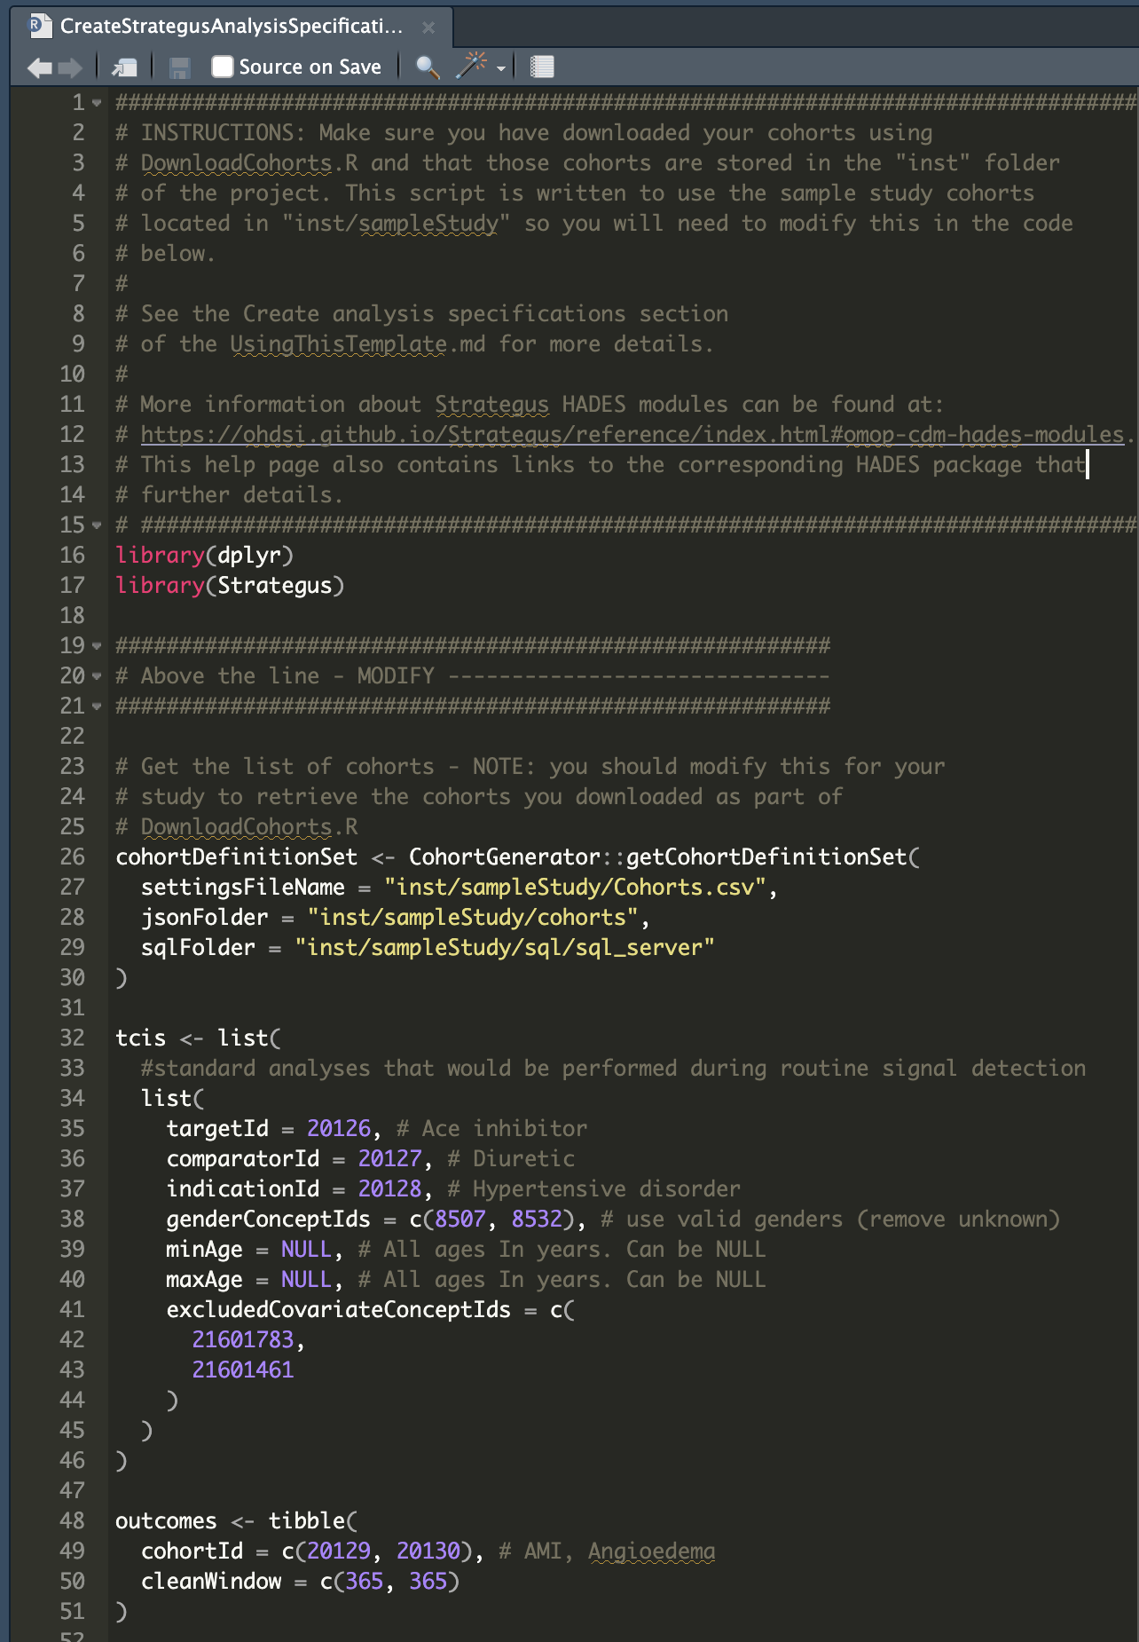
Covariates excluded from PS
CreateAnalysisSpecification.R

Slide 24
PS Settings
CreateAnalysisSpecification.R

Slide 25
Types of outcome models
Logistic
Did the outcome occur yes/no?
Poisson
How many times did the outcome occur?
Cox
What was the time to the first outcome or end of observation?
Conditional or non-conditional (Logistic, Poisson, Cox)
stratify by PS strata or matched sets

Slide 26
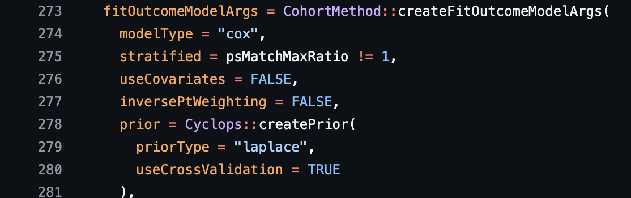
Define outcome model
CreateAnalysisSpecification.R

Slide 27
Data refinement
CreateAnalysisSpecification.R

Slide 28
Data cleaning
CreateAnalysisSpecification.R

Slide 29
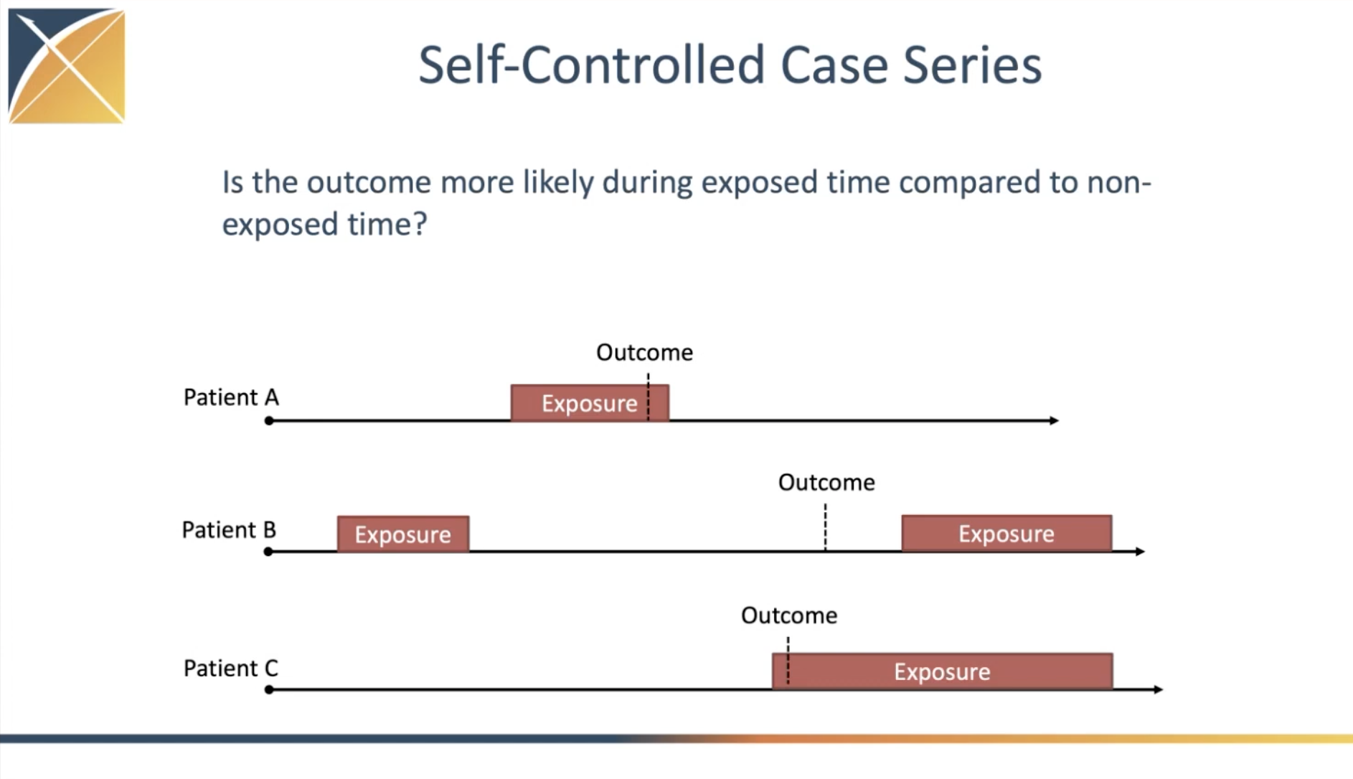

Slide 30
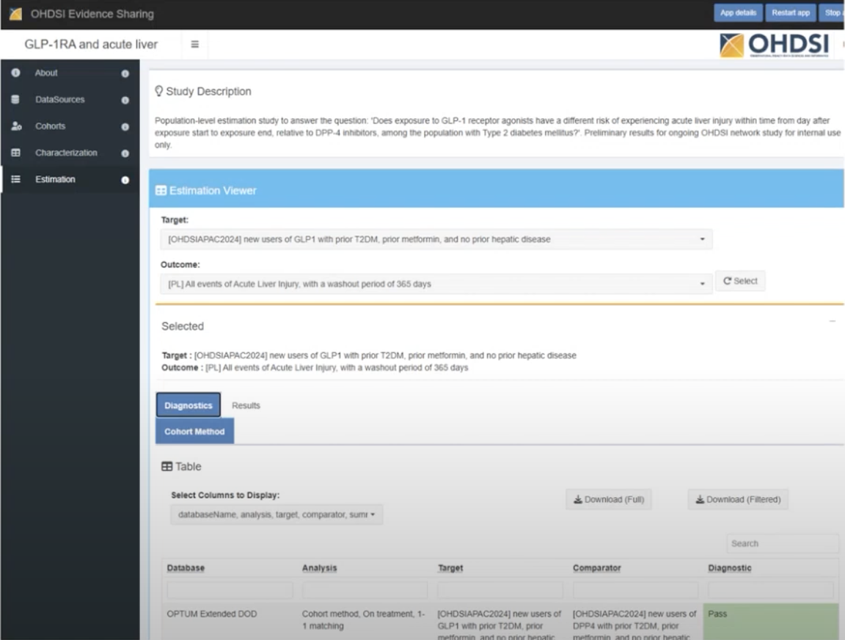

Slide 31
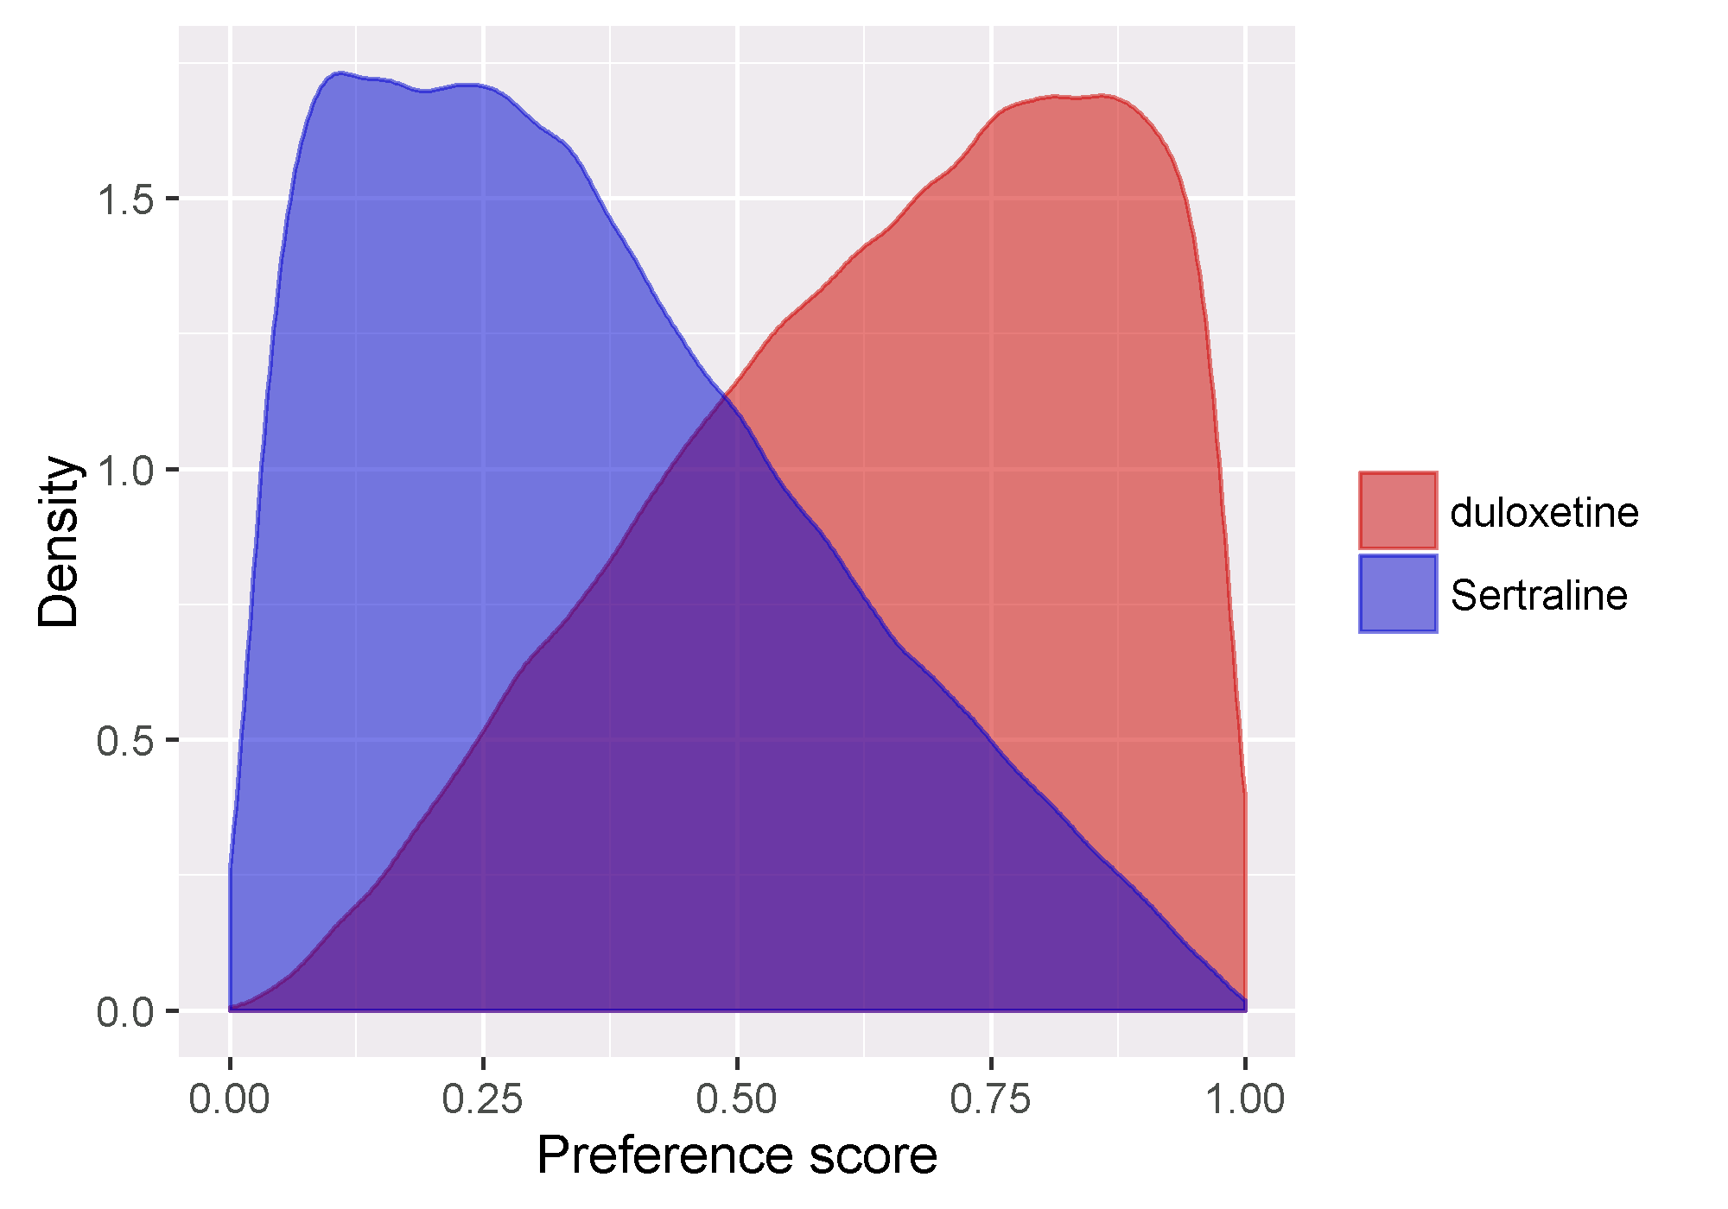
Diagnostic #1: equipoise
How similar are the two exposure cohorts?
If too small, the two cohorts are too incomparable (e.g., hard to find matched pairs) and the estimate can be unreliable.
Rule: Equipoise > 0.5
At least half of the exposure cohorts fell within a preference score range of 30% to 70%.
Walker et al. Comparative Effectiveness Research.2013.

Slide 32
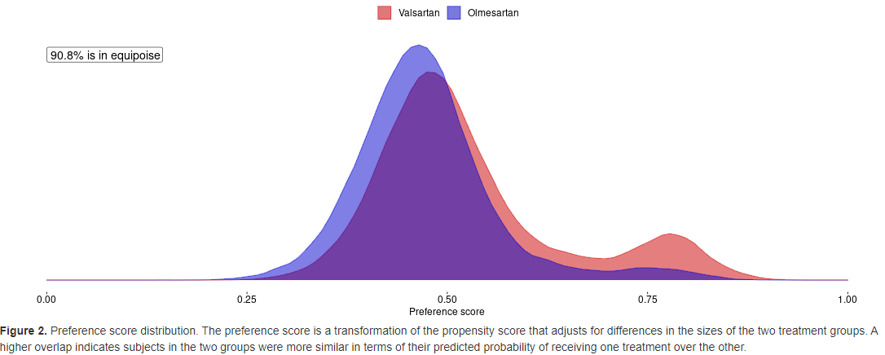
Diagnostic #1: equipoise
Good: T = valsartan
C = olmesartan
DB = CCAE
Even with >40,000 patients on each drug, large-scale propensity score model could not meaningfully discriminate between the two treatments; >90% of persons in ‘empirical equipoise’ with a preference score between 0.3 and 0.7

Slide 33
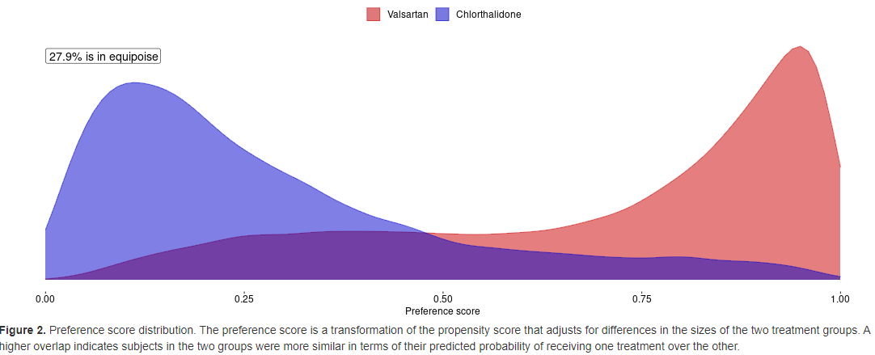
Diagnostic #1: equipoise
Bad: T = valsartan
C = chlorthalidone
DB = CCAE
Baseline characteristics can clearly discriminate most new users of valsartan vs. chlorthalidone; <30% of persons in ‘empirical equipoise’ with a preference score between 0.3 and 0.7

Slide 34
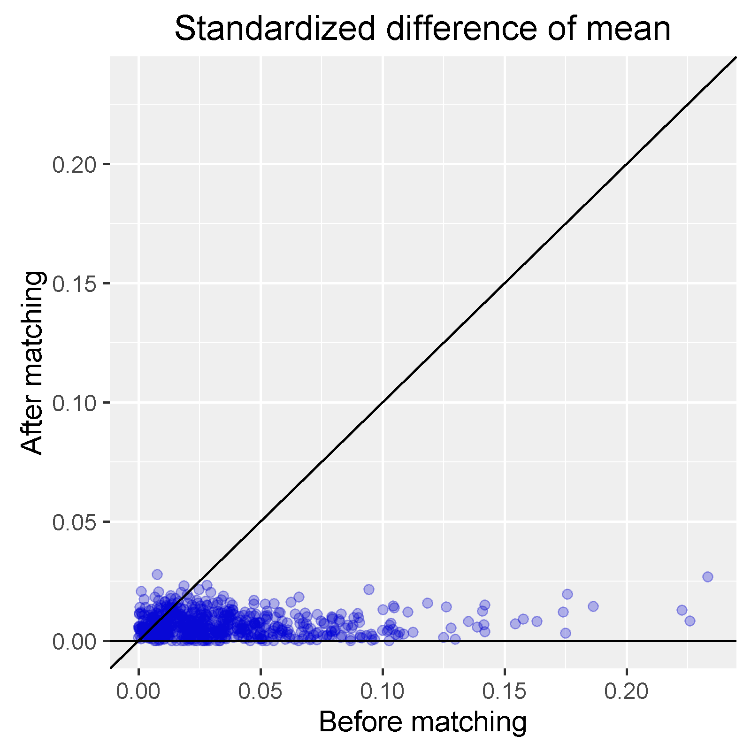
Diagnostic #2: Covariate balance
How similar are the covariate means between the two exposure cohorts?
If too large after adjustment, then there is risk of residual bias
A standardized mean difference of ≤0.1 indicates a negligible difference.
Assess balance of all ~50,000 covariates

Slide 35
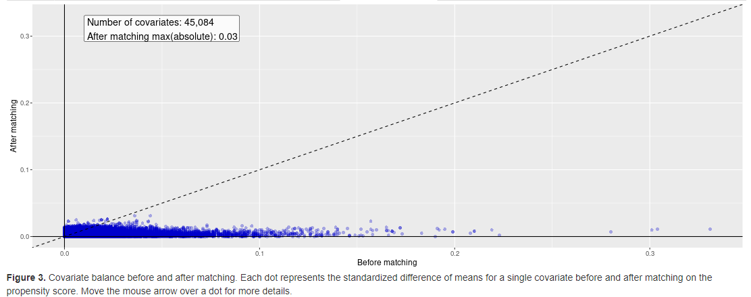
Diagnostic #2: Covariate balance
Good: T = amlodipine
C = atenolol
A = PS matching, on-treatment
DB = CCAE
>45,000 baseline covariates evaluated, many with SMD > 0.1 before matching, but after matching all covariates have SMD <= 0.03
Slide credit: OHDSI Global Symp 2022 Plenary

Slide 36
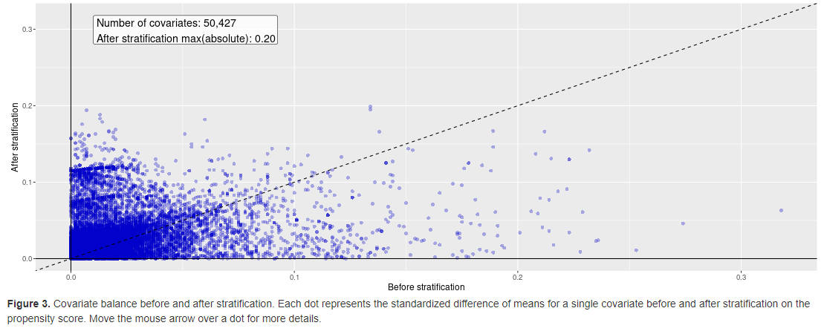
Diagnostic #2: Covariate balance
Bad: T = candesartan
C = atenolol
A = PS stratification, on-treatment
DB = CCAE
>50,000 baseline covariates evaluated, many with SMD > 0.1 before stratification. After stratification, many covariates have higher SMD than pre-stratification, many covariates with SMD > 0.1
Slide credit: OHDSI Global Symp 2022 Plenary

Slide 37
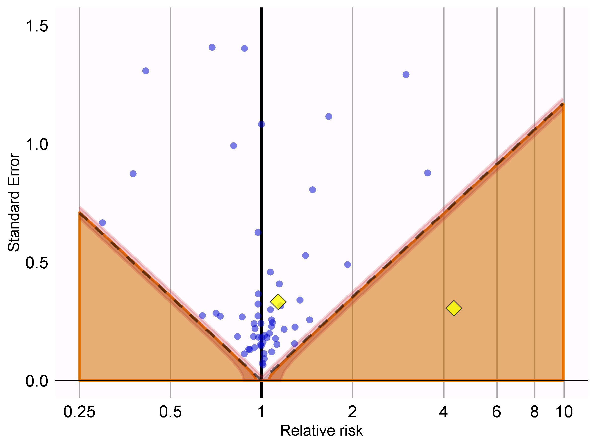
Diagnostic #3: Expected absolute systematic error (EASE)
Can be estimated using negative controls
Negative controls: exposure-outcome pairs where the relative risk is believed to be 1.
e.g., ingrown nails
OHDSI employs 50-100 negative control outcomes (NCOs)
If too many are positive, then systematic error is operative
Can be used to generate synthetic positive controls
1 NCO
significant (false positive)
Schuemie et al. PNAS. 2018
Notes:
Figure 18.6: P-value calibration: estimates below the dashed line have a conventional p < 0.05. Estimates in the shaded area have calibrated p < 0.05. The narrow band around the edge of the shaded area denotes the 95% credible interval. Dots indicate negative controls. Diamonds indicate outcomes of interest.

Slide 38
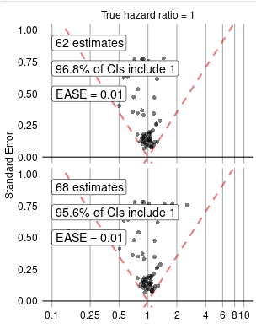
Diagnostic #3: Expected absolute systematic error (EASE)
Good: T = hydrochlorothiazide
C = chlorthalidone
O = acute myocardial infarction
A = PS stratification, on-treatment
DB = CCAE
Little residual bias observed (EASE=0.01), so calibration has very little impact on effect estimate (HR=1.54 → HR=1.51)
Slide credit: OHDSI Global Symp 2022 Plenary

Slide 39
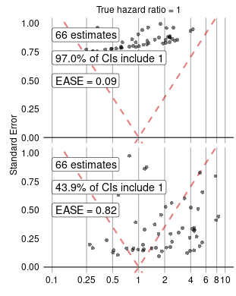
Diagnostic #3: Expected absolute systematic error (EASE)
Bad: T = furosemide
C = labetalol
O = acute myocardial infarction
A = PS stratification, on-treatment
DB = CCAE
Substantial positive bias and variance observed (EASE=0.82), so calibration has substantial impact on effect estimate (HR=5.55, p<0.01 → HR=2.86, p<0.20)
Slide credit: OHDSI Global Symp 2022 Plenary

Slide 40
Diagnostic #4: Minimum detectable relative risk (MDRR)
Statistical power of a hypothesis test -> probability of detecting an effect if a true effect exists (1-Type II error)
Sample size cannot be adjusted for observational studies
Power analyses reformulated as: ‘given the available data, what effect size would the analysis be able to detect?’

Slide 41
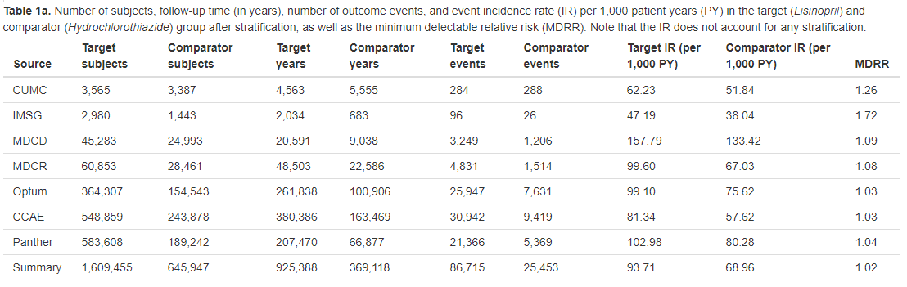
Diagnostic #4: Minimum detectable relative risk (MDRR)
Good: T = lisinopril
C = hydrochlorothiazide
O = cough
All databases have MDRR < 1.75 (ability to detect 75% increased risk if present), and 5 databases have MDRR < 1.1 (ability to detect 10% increased risk)
Slide credit: OHDSI Global Symp 2022 Plenary

Slide 42
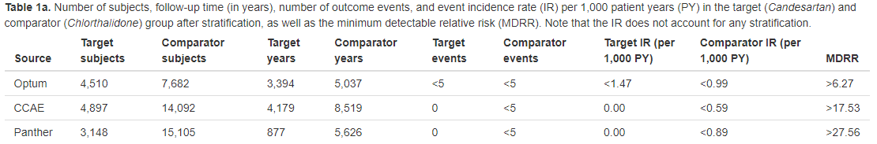
Diagnostic #4: Minimum detectable relative risk (MDRR)
Bad: T = candesartan
C = chlorthalidone
O = rhabdomyolysis
All databases have MDRR > 6 (underpowered to detect 600% increased risk if present), and two databases have MDRR > 15 <5 cases in target and comparator
Slide credit: OHDSI Global Symp 2022 Plenary

