Slide 1
Meta-analysis and negative controls

Slide 2







AGENDA
13:00 – 13:30 | Estimation in observational research
13:30 – 14:15 | Drawing causal conclusions from observational data
14:15 – 14:45 | Interactive session on study design
14:45 – 15:00 | Break
15:00 – 15:30 | Cohort method and diagnostics
15:30 – 16:00 | Meta-analysis and negative controls
16:00 – 17:00 | Study execution: cohort building, Strategus, interpret

Slide 3
Meta-analysis

Slide 4


Distributed Research Network
Multiple sites with data
Hospital EHRs (Electronic Health Records)
Administrative Claims
Patient-level data cannot be shared
Each site uses the Common Data Model (CDM)
Site A
Site B
CDM
CDM
Site C
Site D
CDM
CDM

Slide 5
Distributed Research Network
A site can lead a study
Study lead
Site A
Site B
CDM
CDM
Site C
Site D
CDM
CDM

Slide 6

Distributed Research Network
A site can lead a study
Analysis code is developed locally
Study lead
Site A
Site B
CDM
CDM
Site C
Site D
CDM
CDM

Slide 7
Distributed Research Network
A site can lead a study
Analysis code is developed locally
Code is distributed to study participants
Study lead
Site A
Site B
CDM
CDM
Site C
Site D
CDM
CDM

Slide 8

Distributed Research Network
A site can lead a study
Analysis code is developed locally
Code is distributed to study participants
Results are generated (aggregated statistics)
Study lead
Site A
Site B
CDM
CDM
Site C
Site D
CDM
CDM

Slide 9
Distributed Research Network
A site can lead a study
Analysis code is developed locally
Code is distributed to study participants
Results are generated (aggregated statistics)
Results are sent back to lead site
Study lead
Site A
Site B
CDM
CDM
Site C
Site D
Traditional meta-analysis can introduce bias when counts are small or zero, so OHDSI has developed a method based on likelihood profiles
CDM
CDM

Slide 10
Distributed Research Network
Data sites share shape of likelihood
Study lead
Site A
Site B
CDM
CDM
Site C
Site D
CDM
CDM

Slide 11
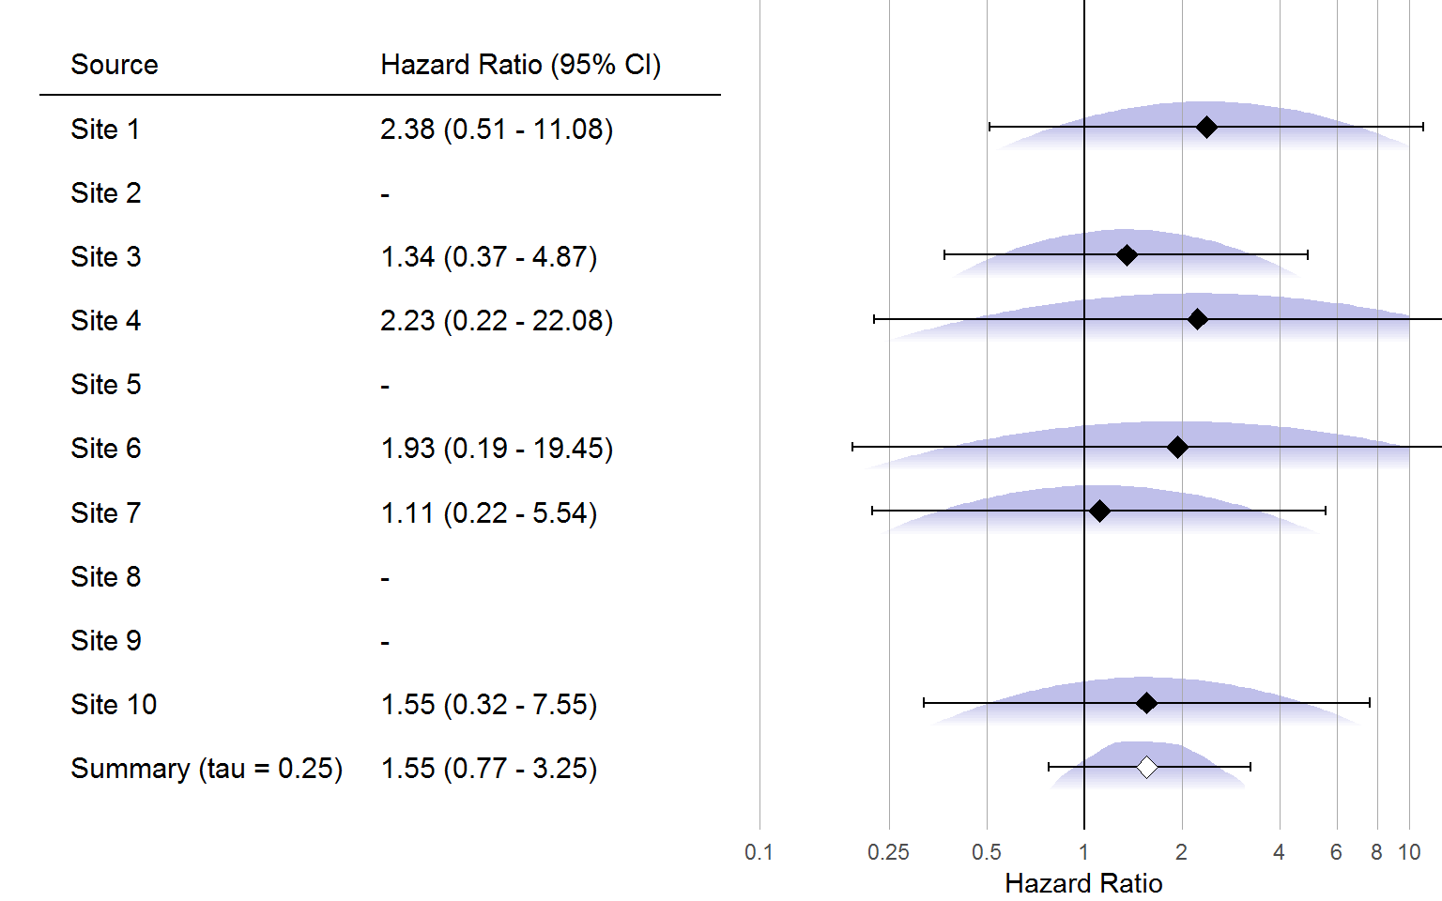
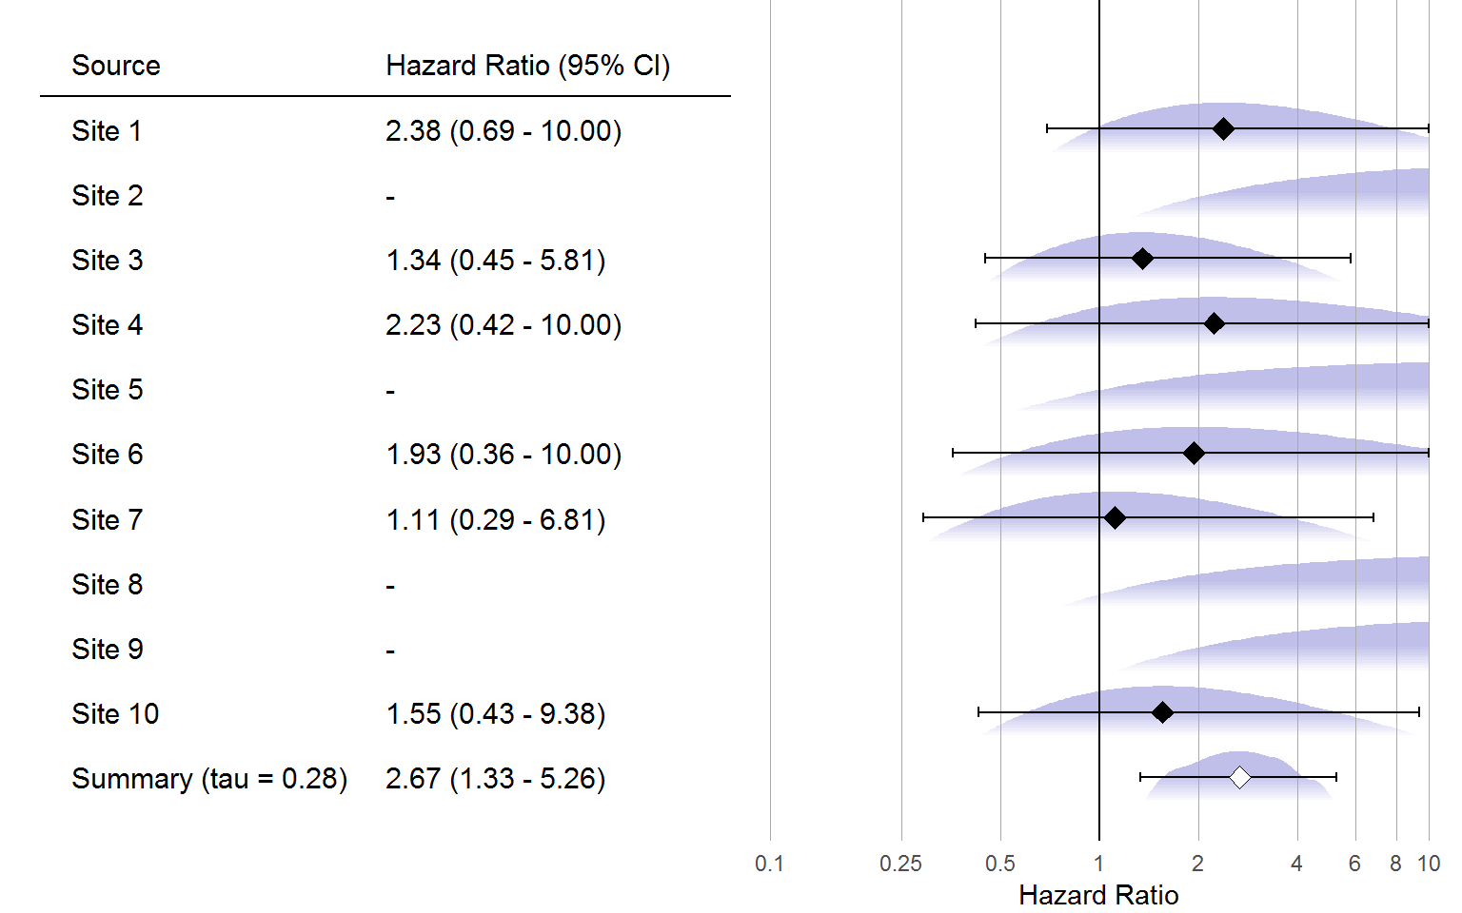
Avoiding bias due to small and zero counts
Traditional meta-analysis
Meta-analysis using likelihood profiles

Slide 12
Negative controls

Slide 13
What is a negative control?
A negative control is an exposure-outcome pair where we know a priori there’s no causal relationship
We typically define negative controls relative to a causal question of interest (e.g. ‘does exposure A cause outcome Y’?):
Negative exposure control: Z does not cause Y
Negative outcome control: A does not cause W
Z
A
Y
W
X
X

Slide 14
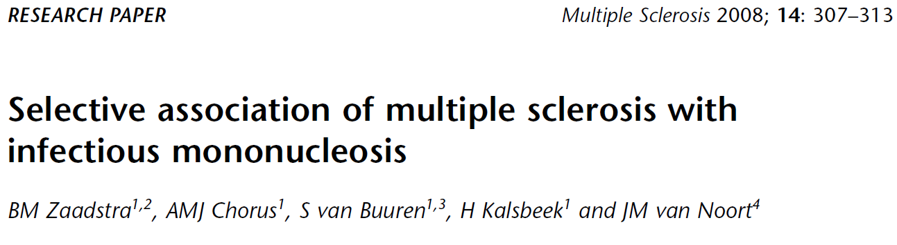
Examples of negative controls
Infectious
mononucleosis
?
Multiple sclerosis
Rubella
?
Measles
?

Slide 15
Example of a negative control
Odds ratio:
Infectious
mononucleosis
2.22 *
Multiple sclerosis
Rubella
1.31 *
Measles
1.42 *
* P < .05

Slide 16
Example of a negative control
Odds ratio:
Infectious
mononucleosis
2.22 *
Multiple sclerosis
Rubella
1.31 *
Measles
1.42 *
Negative controls:
A broken arm
1.10
Concussion
1.23 *
Tonsillectomy
1.25 *
* P < .05

Slide 17
What is a negative control?
A negative control is an exposure-outcome pair where we know a priori there’s no causal relationship
We typically define negative controls relative to a causal question of interest (e.g. ‘does exposure A cause outcome Y’?):
Negative exposure control: Z does not cause Y
Negative outcome control: A does not cause W
Some add: Shares exact same unmeasured confounding U, while assuming perfect control over measured confounders C
U
C
Z
A
Y
W
X
X

Slide 18
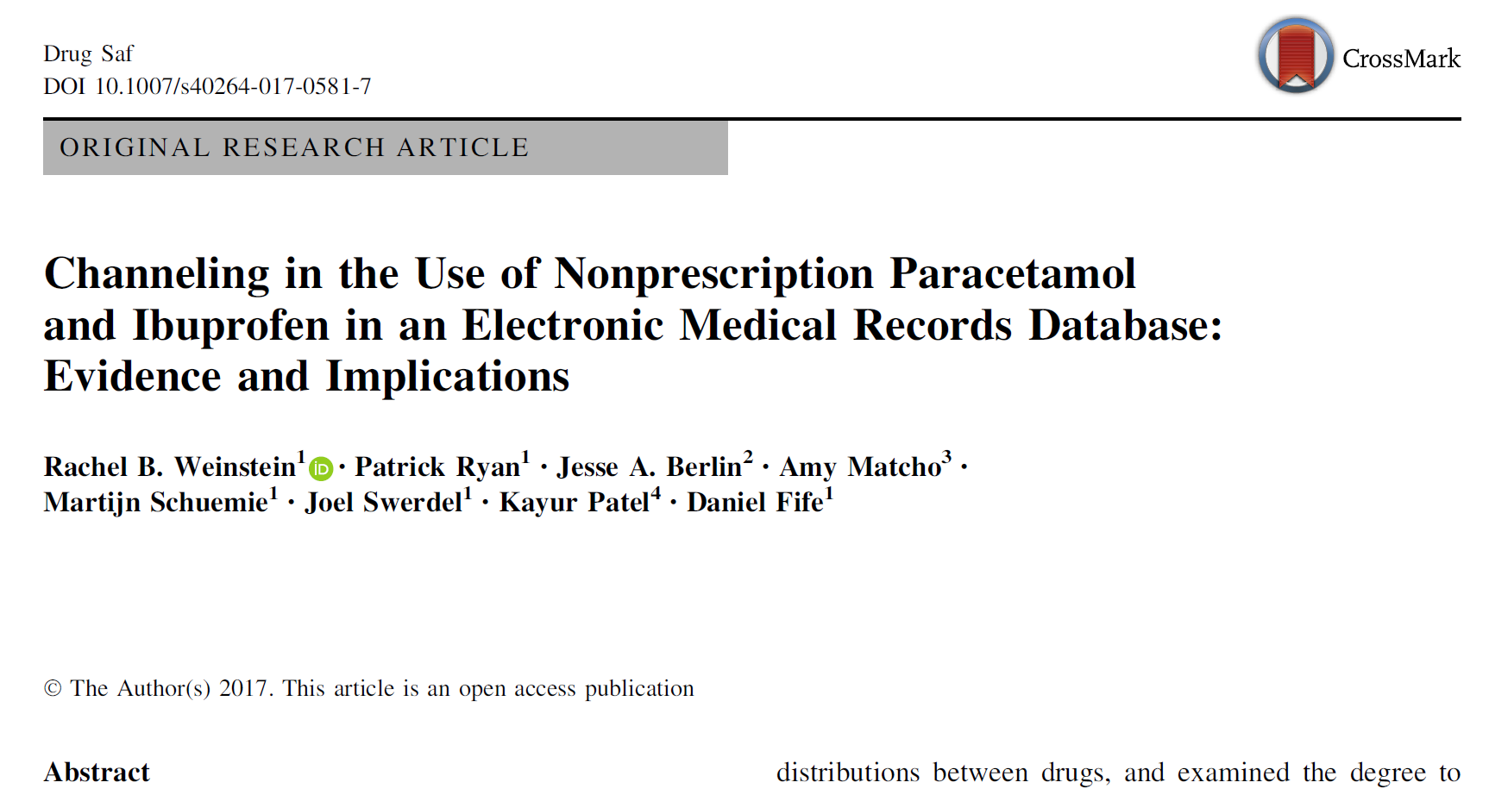
Problems with requiring identical (unmeasured) confounding
Confounding structure is largely unknown
Any two experts will disagree, and both will likely miss important confounders
We are seldom powered to measure it (outcome often too rare)
Unlikely that such a perfect negative control exists
U
C
Z
A
Y
W
X
X

Slide 19
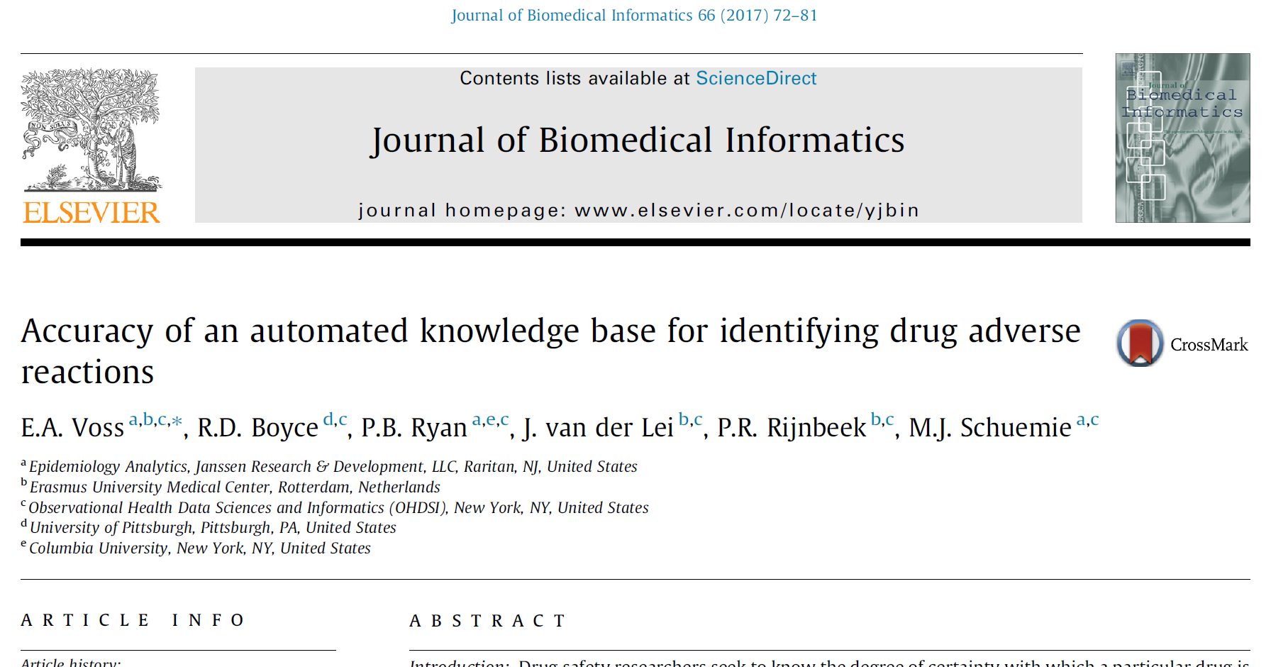
Identifying sets of negative controls is easy when you don’t require identical confounding
Primary criteria: no casual effect
Negative control exposure: Z does not cause Y
Negative control outcome: A does not cause W
Candidate negative controls: exposure → outcome relationships which have:
No evidence in published literature (co-occurrence in PubMed abstracts/MeSH indexing)
No evidence in FDA structured product labeling (drug is neither indicated for nor has warning or adverse reaction listed for outcome on any label on DailyMed)
No disproportionality analysis alert (ex: PRR>2) from FAERS spontaneous adverse event reporting
Absence of evidence of effect doesn’t mean evidence of absence, but it can serve as a useful proxy
Candidate list can be generated automatically using OHDSI’s Common Evidence Model via ATLAS, but then undergo manual review to remove questionable candidates
Z
A
Y
W
X
X

Slide 20
Avoiding subjectivity
To avoid investigator bias, negative controls should be
Prespecified
Not allowed to change the set after viewing the results
Blinded
Not allowed to spin stories after seeing ‘outliers’

Slide 21
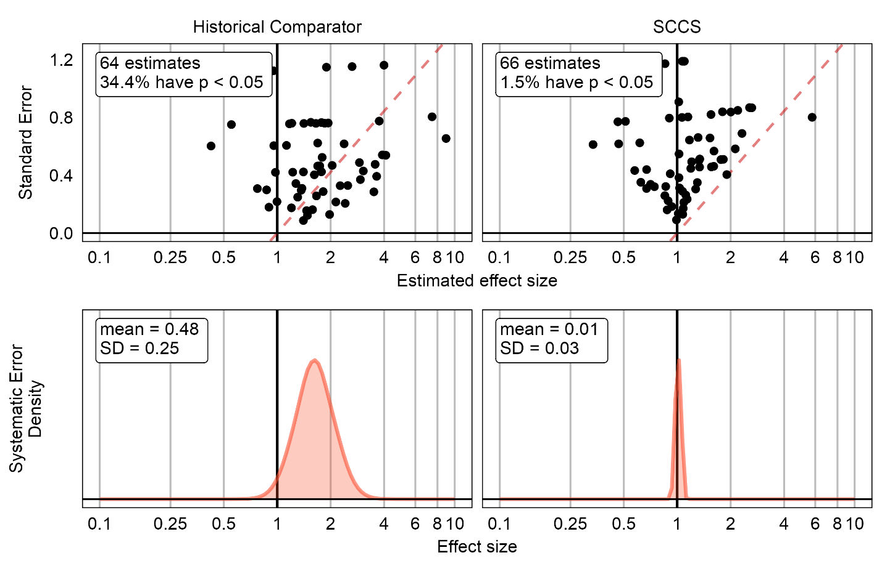
What can we do with a large set of negative controls? (with unknown confounding)
Would you trust a method that shows consistent large bias on a large set of negative controls?
(even if the confounding structure might not be the same)

Slide 22
Quantifying systematic error
Any single negative control comes with uncertainty (confidence interval)
With many negative controls we can estimate a systematic error distribution: the spread of negative control estimates that cannot be explained by random error

Slide 23
Quantifying systematic error
Expected Absolute Systematic Error (EASE) summarizes this distribution
We use a prespecified EASE threshold (EASE < 0.25) for go – no go decisions for our studies
EASE = 0.49 (0.39-0.62)
EASE = 0.04 (0.01-0.11)

Slide 24
Could we do more with negative controls?
Suppose our method passed our pre-specified threshold
We could express our remaining uncertainty about systematic error in our statistics
Standard error
Estimated effect size
Systematic Error
Density
Effect size
EASE = 0.04 (0.01-0.11)

Slide 25
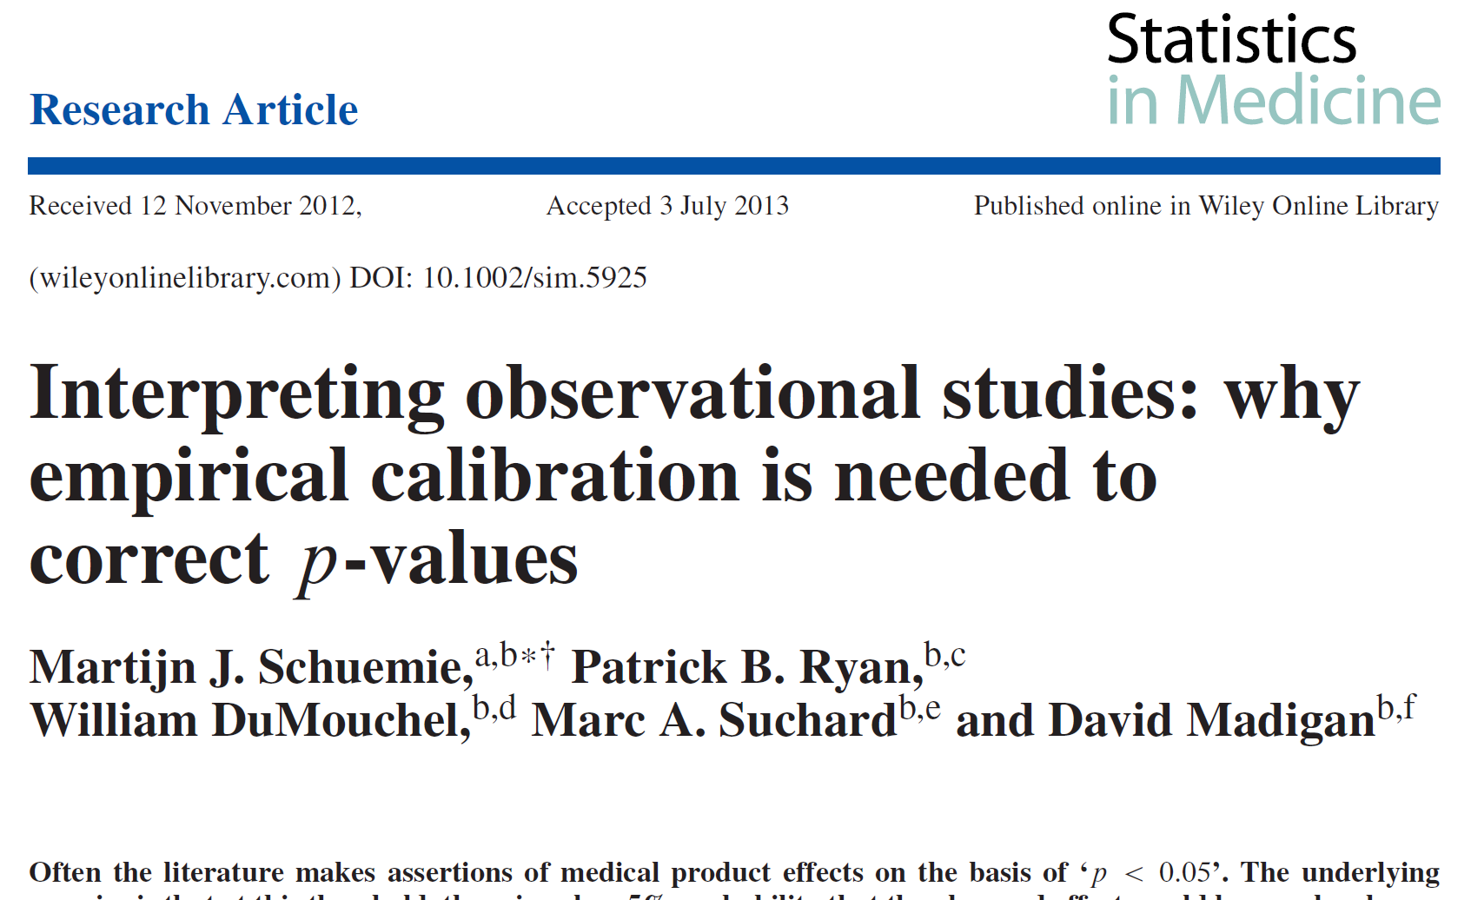
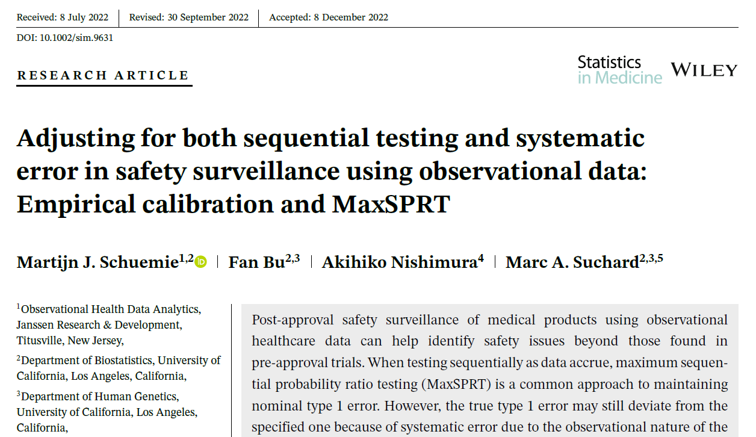

Empirical calibration
A probability distribution for systematic error (derived from negative controls) can be integrated in
P-values
Confidence intervals
MaxSPRT critical values

Slide 26
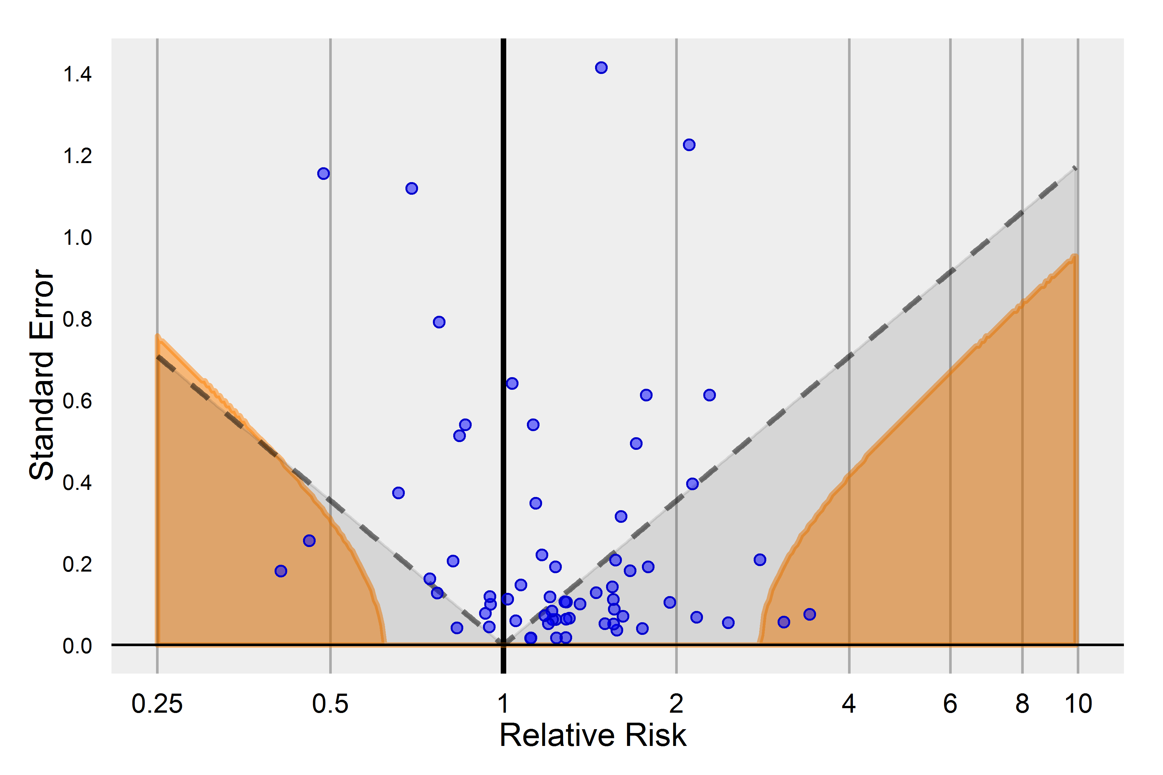
P-value calibration
Estimates below the dashed line are significant using the traditional p-value
Estimates in the orange area are significant using the calibrated p-value
Intuition: only for estimates outside the range of negative controls (where the null is true) should we reject the null

Slide 27
Summary
When combining evidence across a distributed network of databases, we use meta-analysis to avoid having to share patient-level data
OHDSI tools avoid bias from small and zero counts
OHDSI uses a ‘distributional’ approach to negative controls, using many controls with unknown confounding
This is much more convenient than trying to find the perfect control
OHDSI tools use negative controls both as diagnostics and for calibration

