Slide 1
Study execution: Cohort building, Strategus, results interpretation
Linying Zhang

Slide 2







AGENDA
13:00 – 13:30 | Estimation in observational research
13:30 – 14:15 | Drawing causal conclusions from observational data
14:15 – 14:45 | Interactive session on study design
14:45 – 15:00 | Break
15:00 – 15:30 | Cohort method and diagnostics
15:30 – 16:00 | Meta-analysis and negative controls
16:00 – 17:00 | Study execution: cohort building, Strategus, interpret

Slide 3
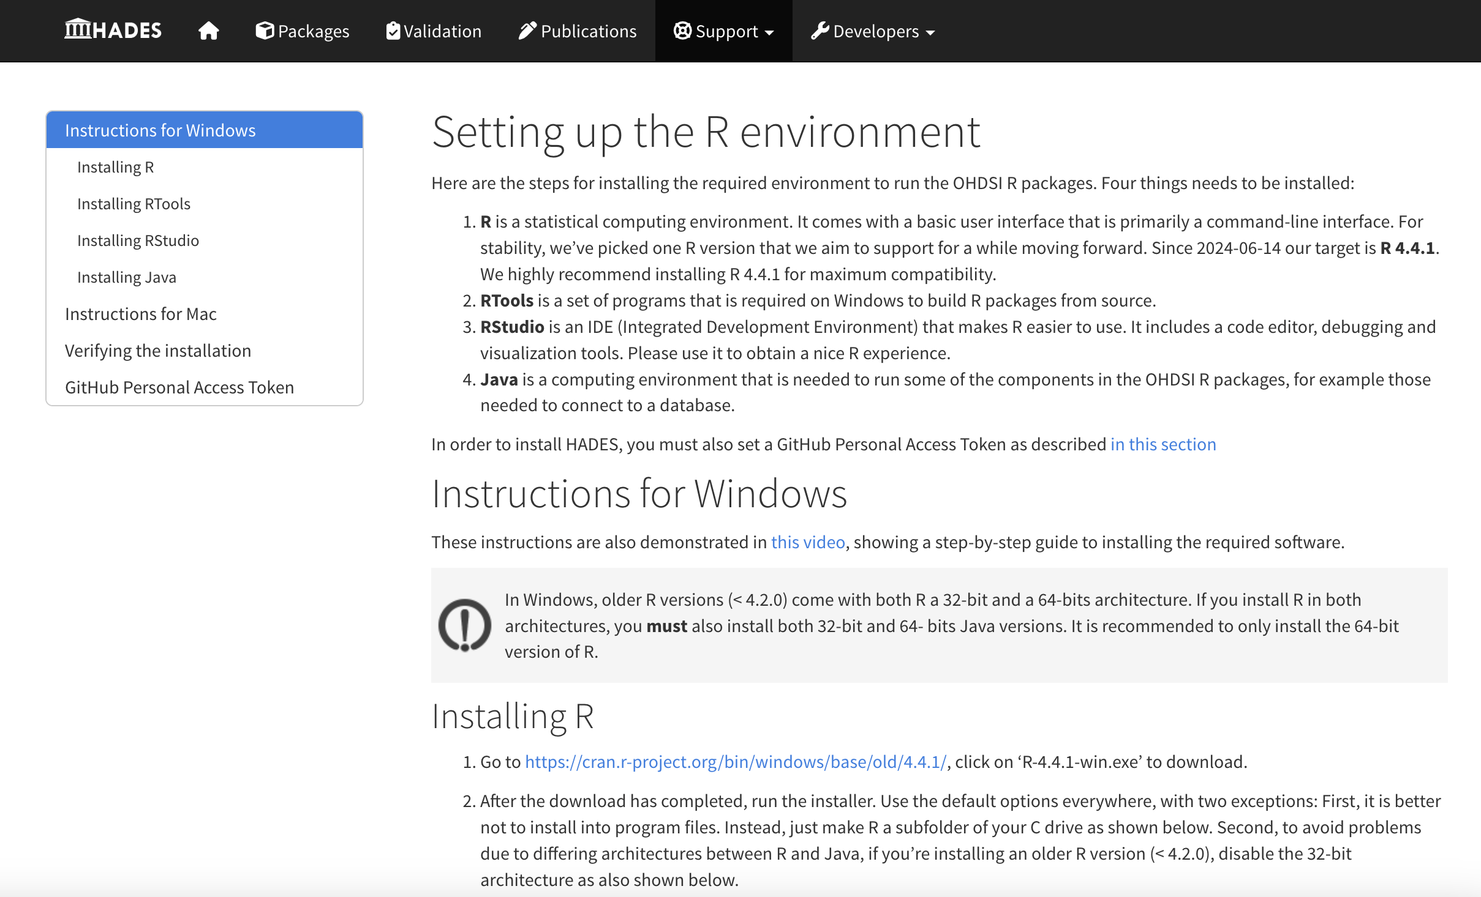
Environment setup
Follow HADES R Setup guide to configure your environment.
R 4.4.1
RTools
Rstudio
Java
GitHub Personal
Access Token (PAT)
R.4.4.1 installation
Mac: https://cran.rstudio.com/bin/macosx/big-sur-arm64/base/
Windows: https://cran.rstudio.com/bin/windows/base/old/

Slide 4
Download the Strategus study template
The official study template is at:
https://github.com/ohdsi-studies/StrategusStudyRepoTemplate
For this tutorial, we will use a slightly modified template at
https://github.com/causailab/pleTutorialOhdsi2025

Slide 5
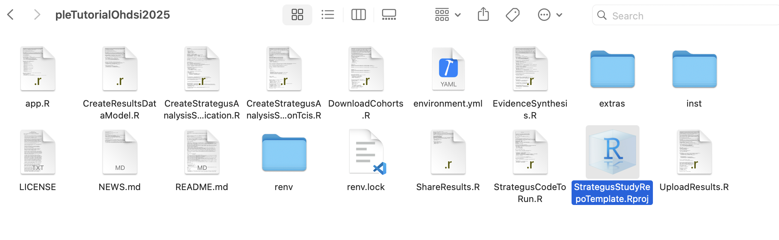
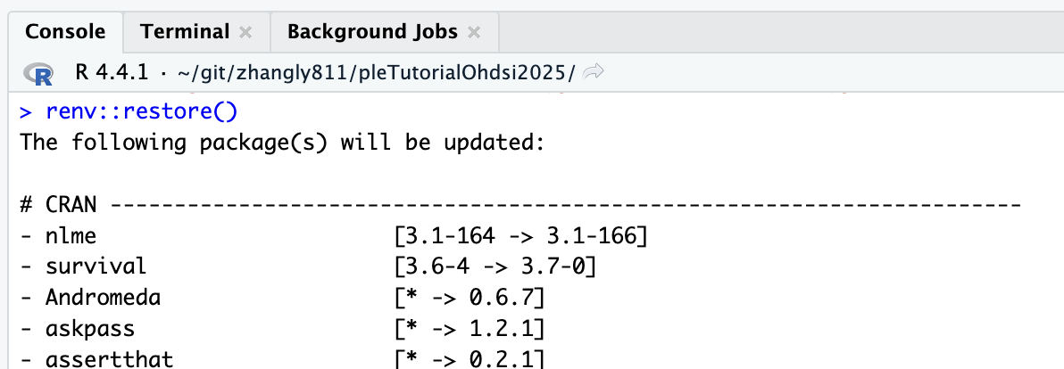
Step 1: Launch the project
Open the project by double clicking “StrategusStudyRepoTemplate.Rproj”
Run renv::restore() in Rstudio
Takes 10-30mins to complete

Slide 6
Step 2: Create target and comparator cohorts
New users of GLP-1RAs -> “index date”
limit to earliest exposure per person (“index date”)
with continuous observation of 365 days before index date
Inclusion criteria:
who are >= 18 years old
having type 2 diabetes mellitus prior to index date
No type 1 diabetes mellitus prior to index date
No condition occurrences of secondary diabetes mellitus
No prior DPP4 inhibitor exposure
No prior SGLT-2 inhibitor exposure
No prior SU exposure
No prior other anti-diabetic exposure
Having prior metformin use
No prior insulin use or combo initiation
https://atlas-demo.ohdsi.org/

Slide 7
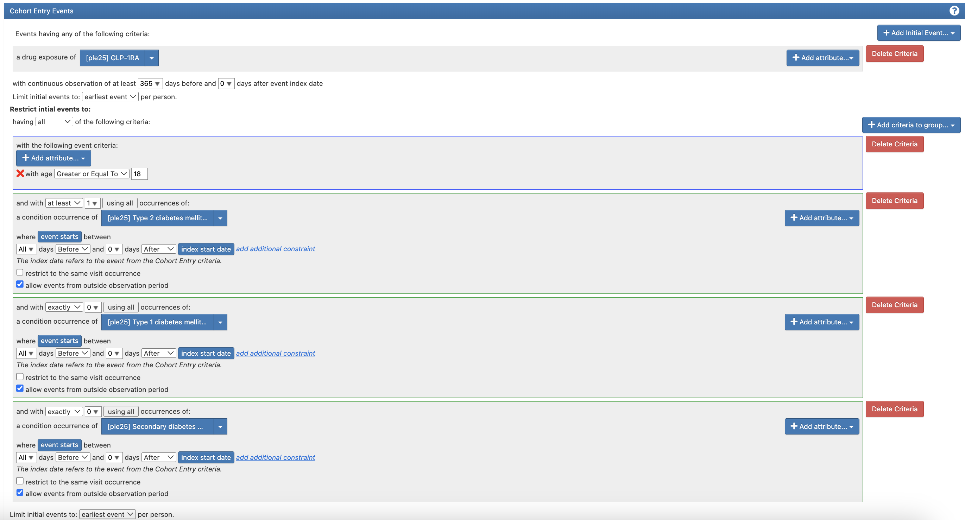

Slide 8
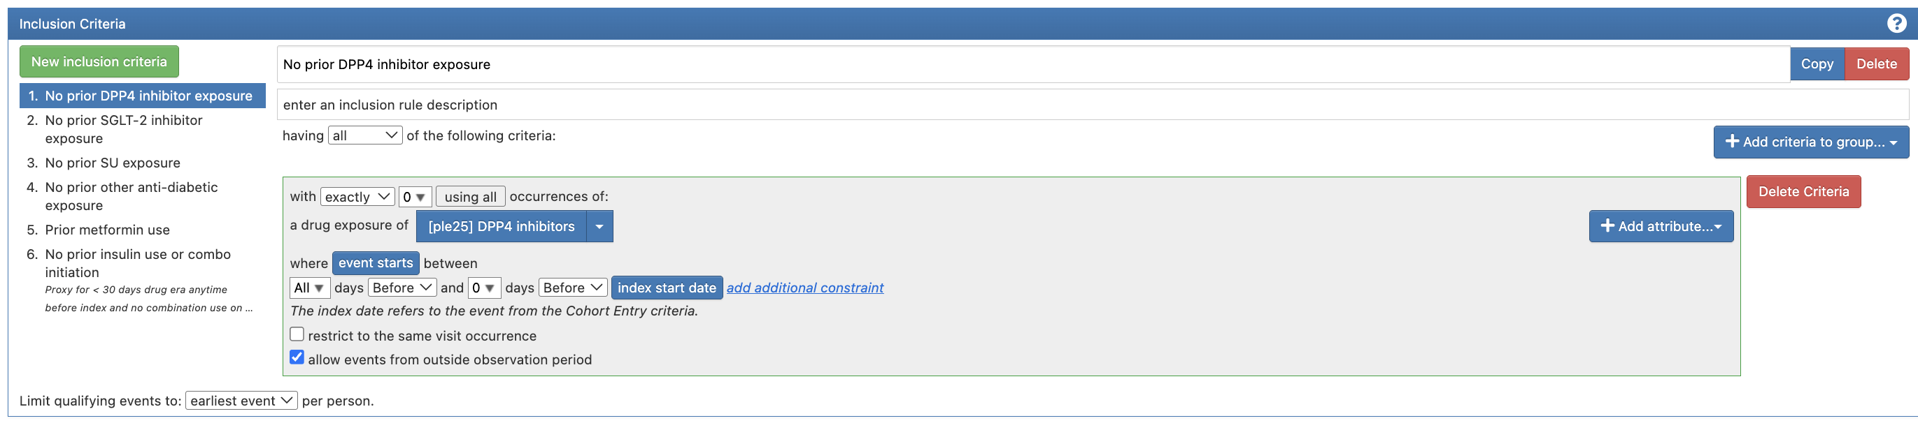

Slide 9
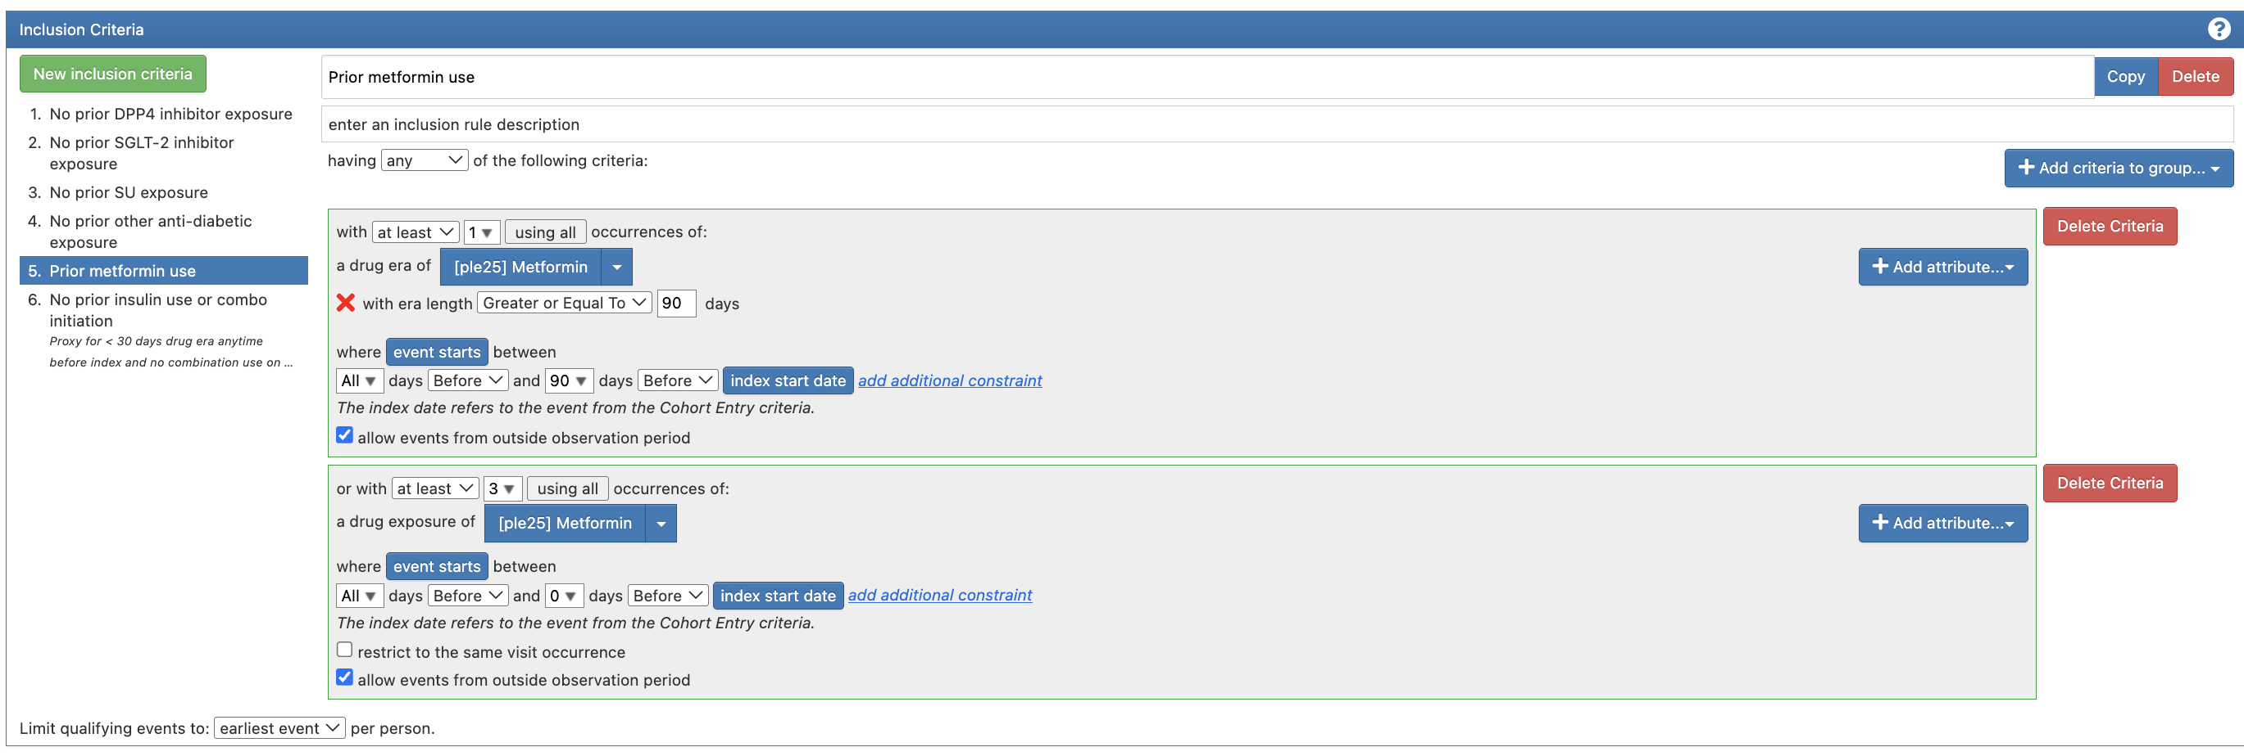

Slide 10
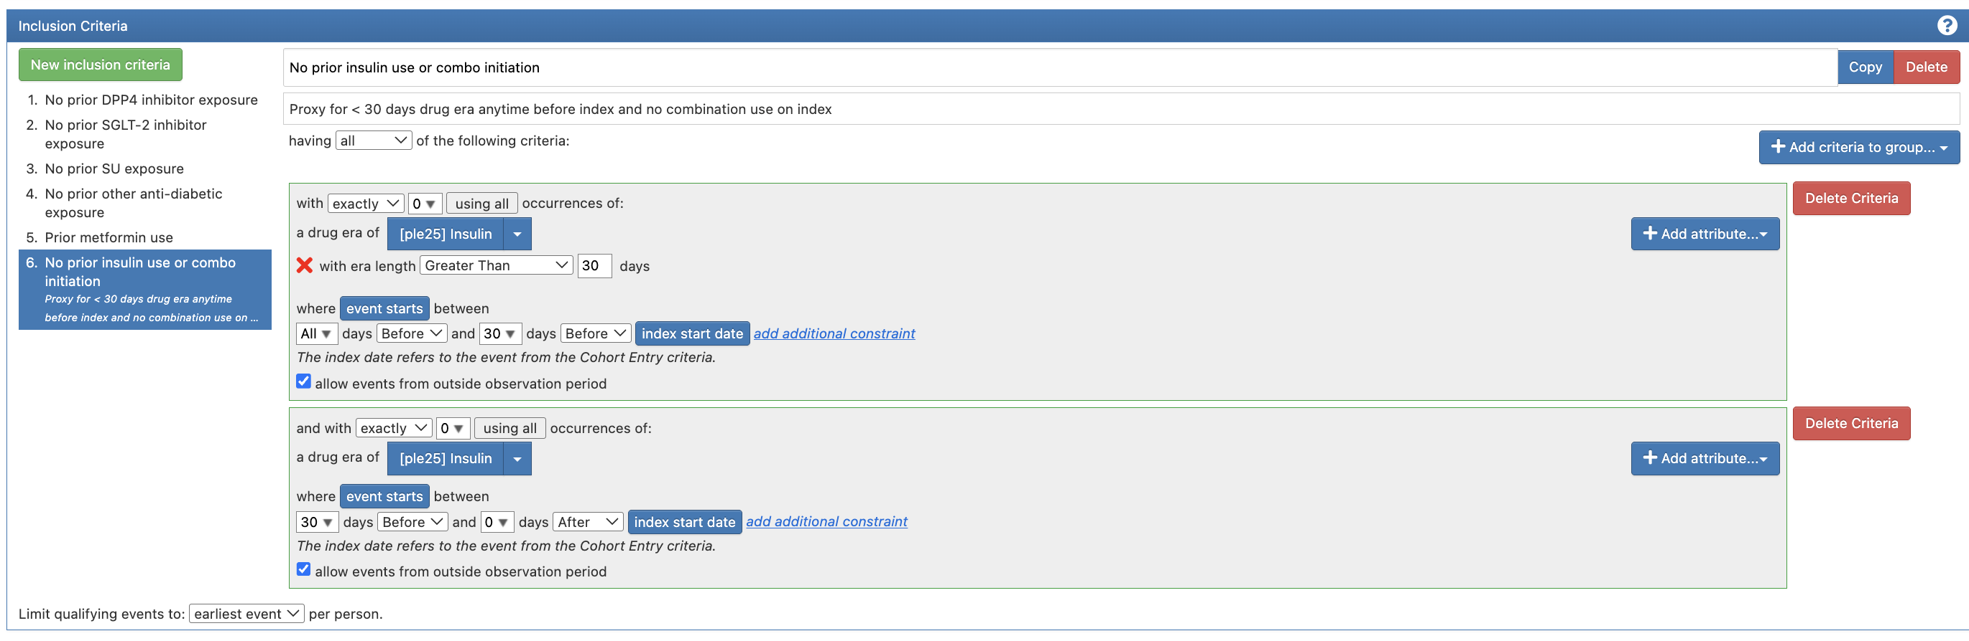

Slide 11
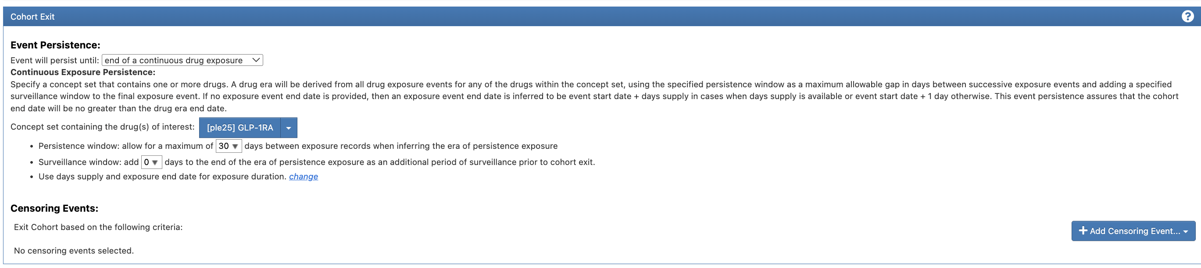

Slide 12
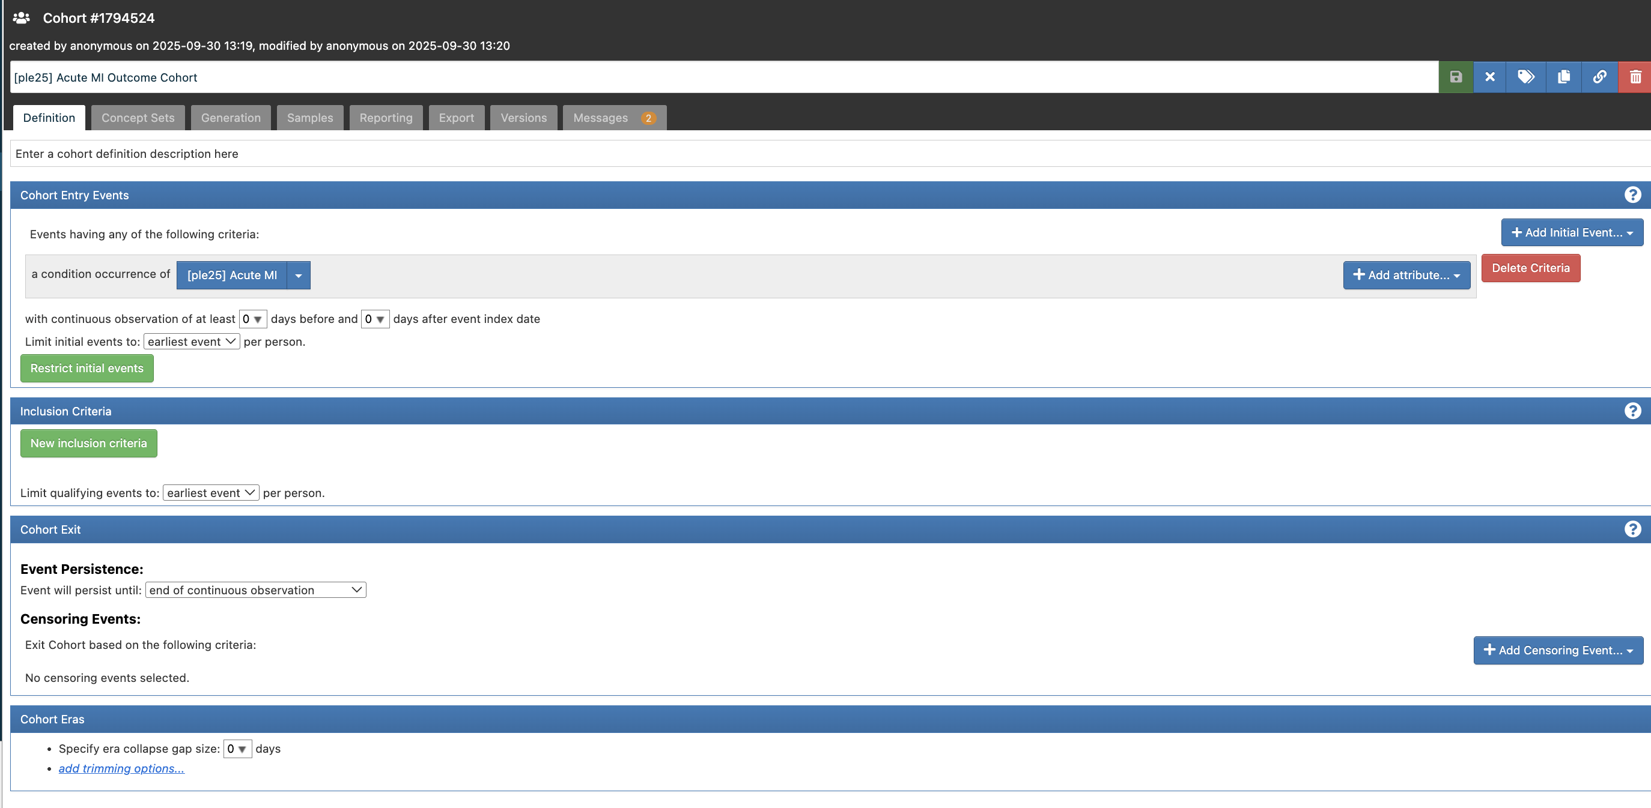
Step 2: Create outcome cohort

Slide 13
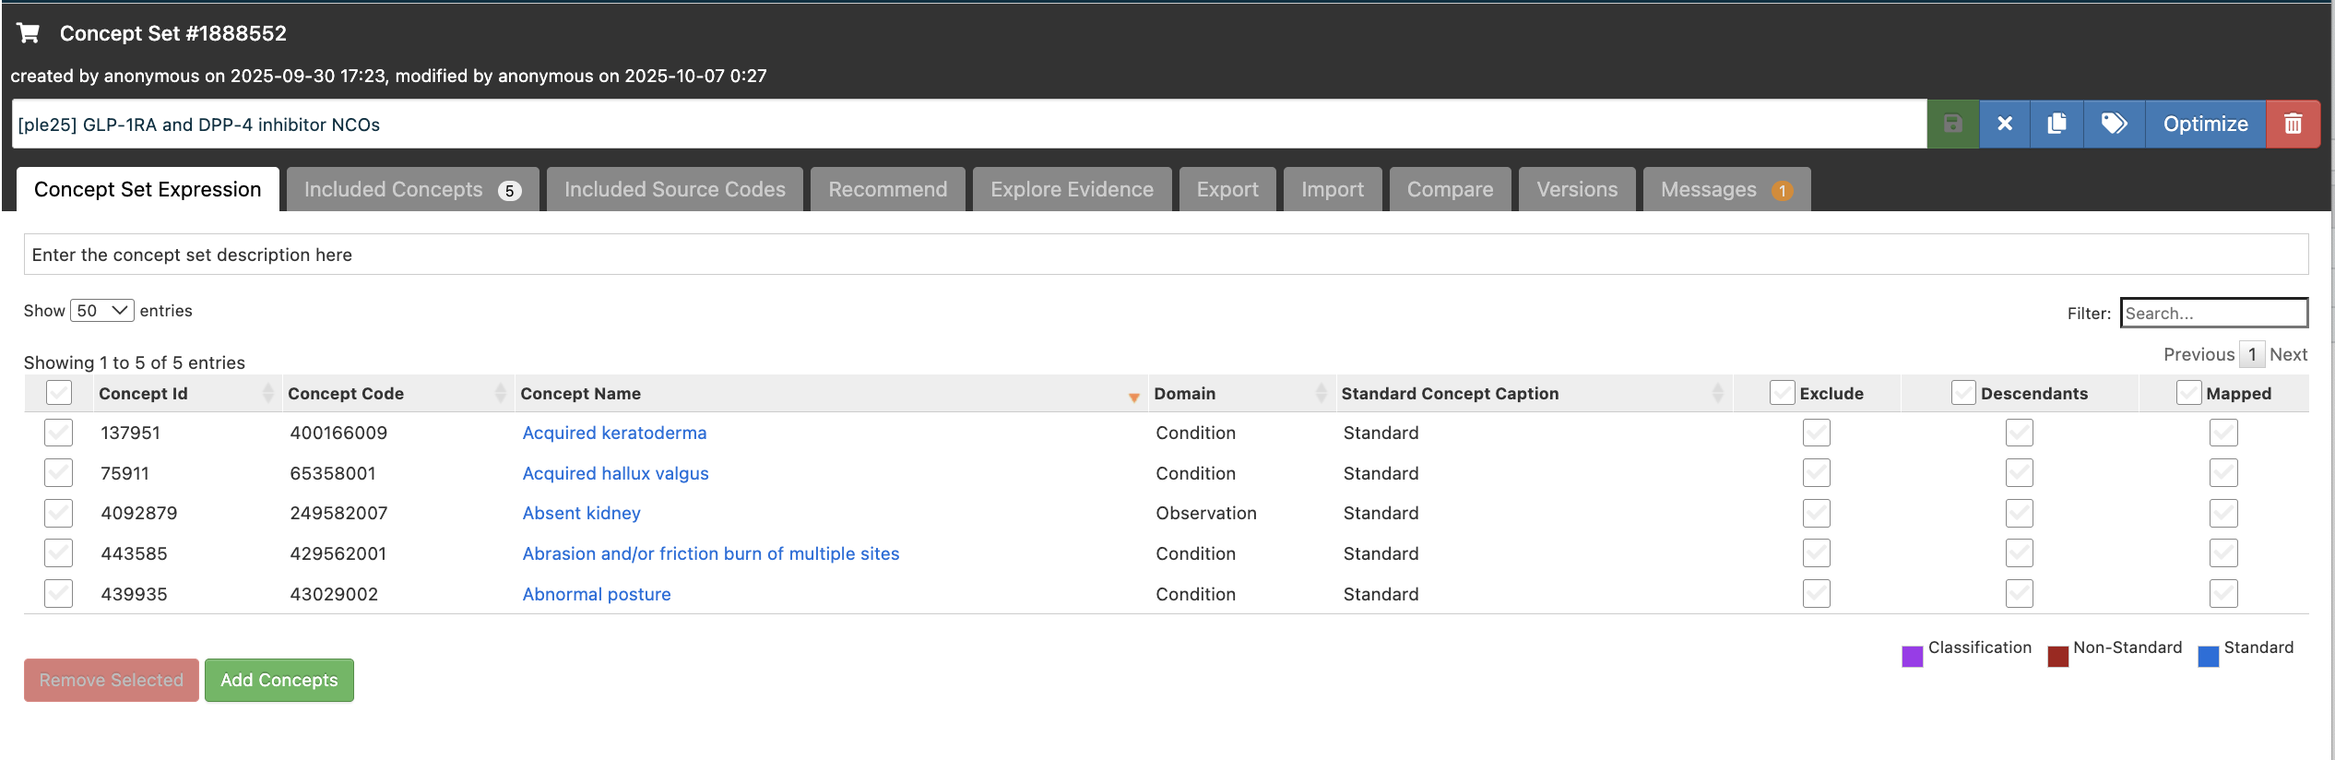
Step 3: Create negative control outcomes concept set

Slide 14
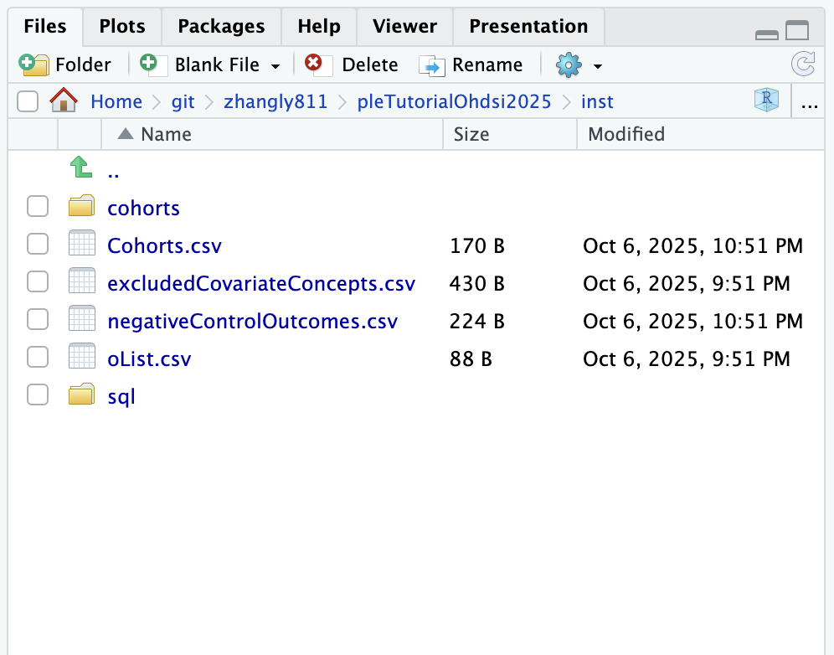
Step 4: Download cohorts
Open DownloadCohorts.R
Change the T/C/O and negativeControlOutcome cohort IDs
Run DownloadCohorts.R
Output:

Slide 15
Step 5: Create cmTcList.csv
Manually create the following table
Save the file under inst/
Name the file cmTcList.csv
target_cohort_id | target_cohort_name | target_concept_id | comparator_cohort_id | comparator_cohort_name | comparator_concept_id
1 | GLP-1RA | 1123618 | 2 | DDP-4 inhibitor | 21600783

Slide 16
Step 6: Create analysis specifications
Open CreateStrategusAnalysisSpecificationTcis.R
Modify
Run

Slide 17
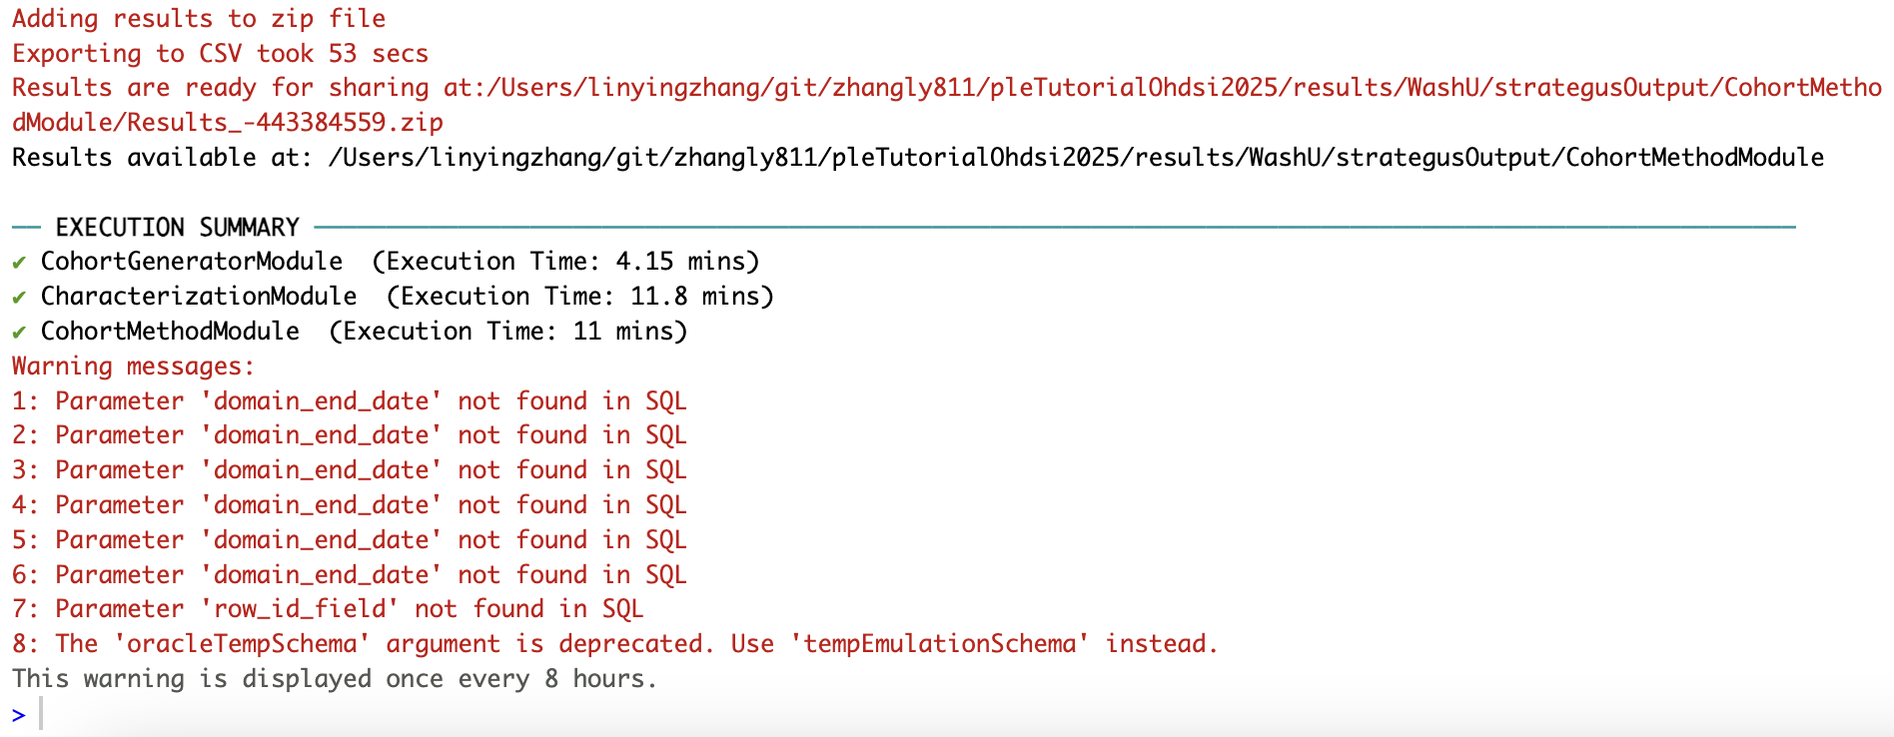
Step 7: Run the study
Open StrategusCodeToRun.R
Specify database/schema info
Create connection details
Run StrategusCodeToRun.R

Slide 18
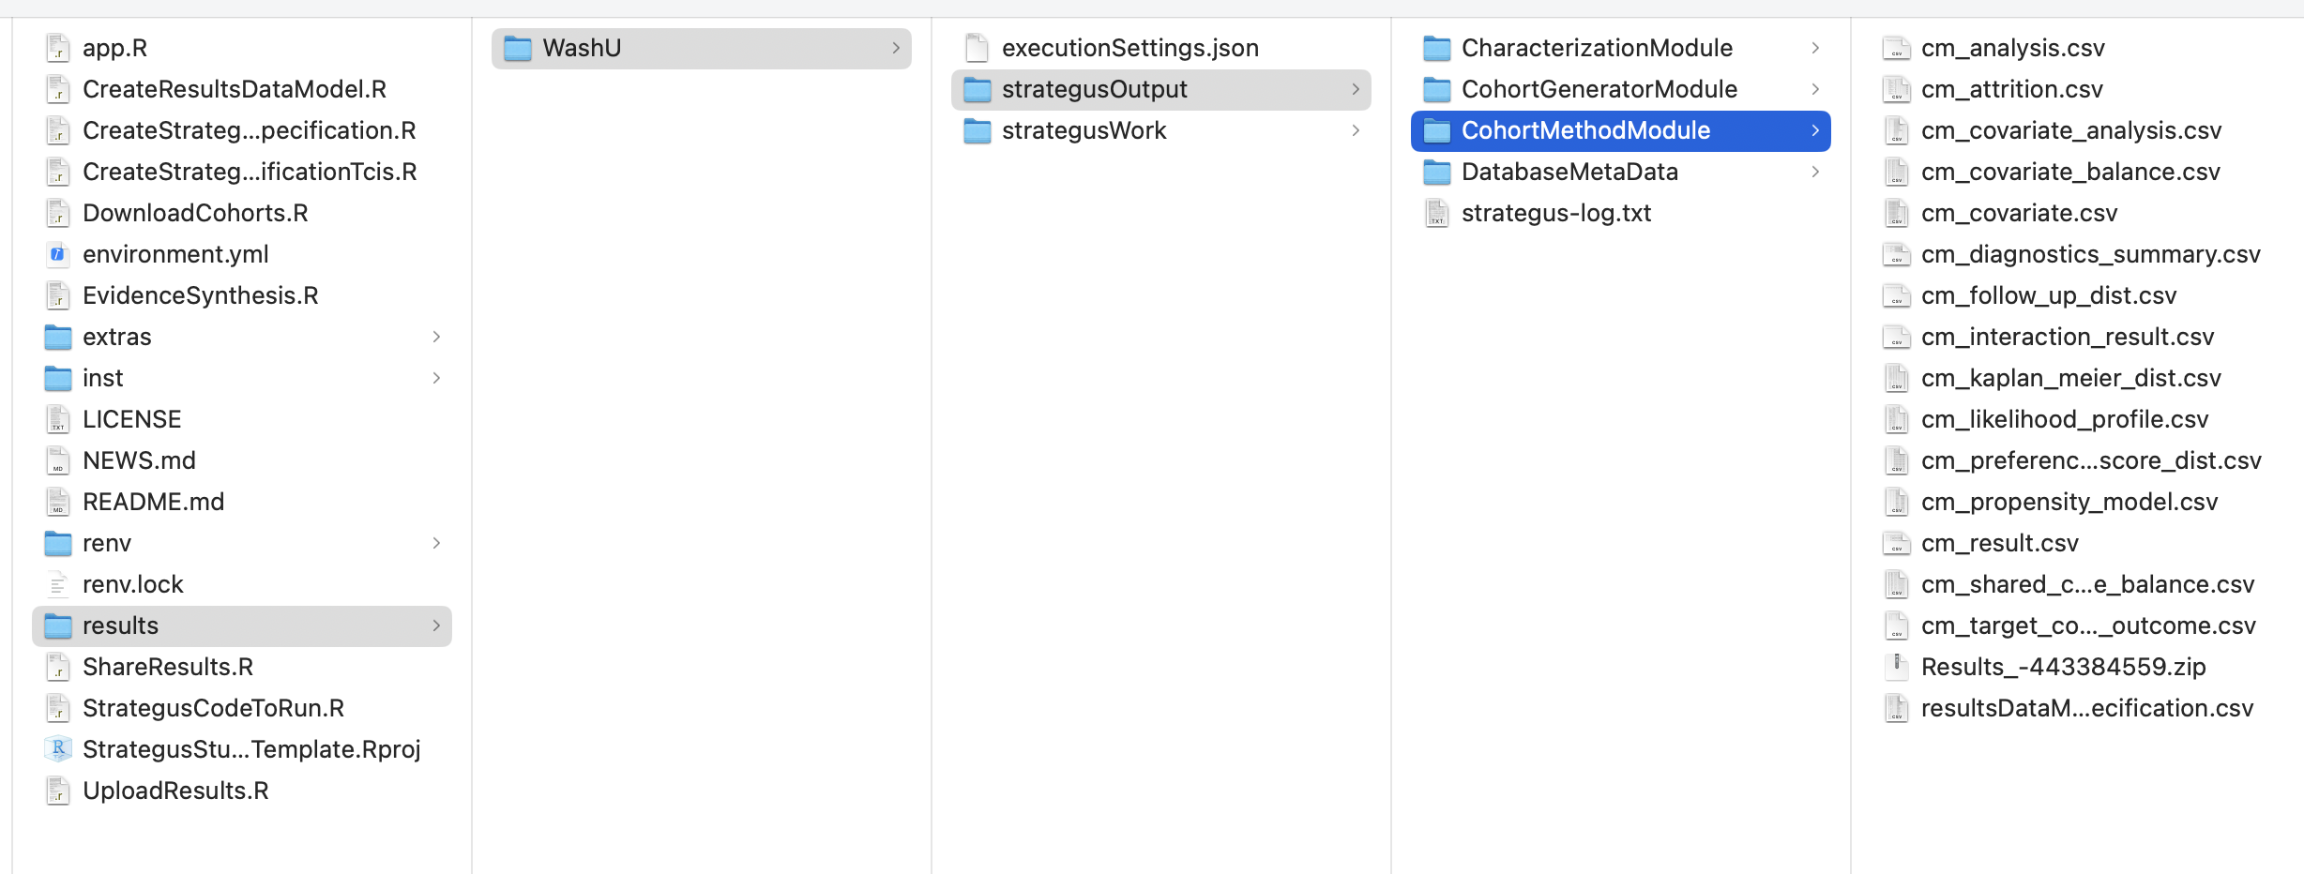
Step 8: Interpret results

Slide 19
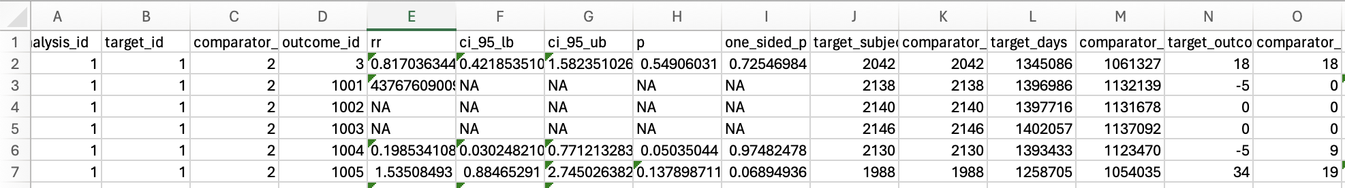
Step 8: Interpret results

