Slide 1
NCRMP Hawaiian Islands Report Card: Benthic Indicators

Slide 2
Report Card Benthic Indicators Benthic cover
-Implement the use of coral, CCA, and macroalgal cover as part of the benthic indicators
Data sets:
MHI = 2013 (2016)
NWHI = 2011-2015 (2016)

Slide 3
HAWAIIAN ARCHIPELAGO BENTHIC COVER
CORAL COVER
CORAL | Grade | Score
> = 40 | A | 90 - < 100
40 - < 30 | B | 80 - < 90
30 - < 20 | C | 70 - < 80
20 - < 10 | D | 60 - < 70
< 10 | F | < 60
CCA COVER
CCA | Grade | Score
> = 20 | A | 90 - < 100
20 - < 10 | B | 80 - < 90
10 - < 5 | C | 70 - < 80
5 - < 2 | D | 60 - < 70
< 2 | F | < 60
MALG | Grade | Score
< = 5 | A | 90 - < 100
5 - < 10 | B | 80 - < 90
10 - < 20 | C | 70 - < 80
20 - < 30 | D | 60 - < 70
30 - < 40 | F | < 60
MACROALGAL COVER

Slide 4
HAWAIIAN ARCHIPELAGO
CORAL COVER
Island | CORAL | Score | Grade
Maro | 21.47 | 71.47 | C-
Lisianski | 20.09 | 70.09 | C-
Hawaii | 19.25 | 69.25 | D
Maui | 18.38 | 68.38 | D
French Frigate | 17.85 | 67.85 | D
Molokai | 16.26 | 66.26 | D
Lanai | 15.32 | 65.32 | D
Oahu | 9.27 | 55.64 | F
Layson | 5.83 | 35.00 | F
Kauai | 4.89 | 29.34 | F
Kure | 4.42 | 26.52 | F
PHR | 2.17 | 13.04 | F
Niihau | 1.88 | 11.29 | F
Midway | 1.60 | 9.62 | F
CORAL | Grade | Score
> = 40 | A | 90 - < 100
40 - < 30 | B | 80 - < 90
30 - < 20 | C | 70 - < 80
20 - < 10 | D | 60 - < 70
< 10 | F | < 60

Slide 5
HAWAIIAN ARCHIPELAGO
CCA COVER
Island | CCA | Score | Grade
Lisianski | 10.34 | 80.34 | B-
PHR | 8.76 | 77.52 | C+
French Frigate | 8.50 | 77.00 | C+
Maro | 8.45 | 76.90 | C
Hawaii | 7.38 | 74.76 | C
Kure | 4.72 | 69.07 | D
Midway | 4.47 | 68.23 | D
Laysan | 3.66 | 65.52 | D
Niihau | 2.53 | 61.77 | D
Maui | 1.95 | 58.59 | F
Kauai | 1.92 | 57.57 | F
Lanai | 1.88 | 56.52 | F
Molokai | 1.50 | 45.09 | F
Oahu | 1.43 | 42.93 | F
CCA | Grade | Score
> = 20 | A | 90 - < 100
20 - < 10 | B | 80 - < 90
10 - < 5 | C | 70 - < 80
5 - < 2 | D | 60 - < 70
< 2 | F | < 60

Slide 6
HAWAIIAN ARCHIPELAGO
MACROALGAL COVER
Island | MALG | Score | Grade
Niihau | 1.64 | 100.00 | A+
Kauai | 2.01 | 100.00 | A+
Hawaii | 2.43 | 100.00 | A+
Molokai | 3.34 | 96.66 | A
Maui | 4.45 | 92.21 | A-
Lanai | 8.25 | 83.49 | B-
Oahu | 9.08 | 81.85 | B-
French Frigate | 9.41 | 81.17 | B-
Midway | 10.79 | 79.21 | C+
Kure | 13.09 | 76.91 | C
Lisianski | 14.19 | 75.81 | C
Maro | 15.58 | 74.42 | C
PHR | 28.00 | 62.00 | D
Laysan | 34.30 | 34.18 | F
MALG | Grade | Score
< = 5 | A | 90 - < 100
5 - < 10 | B | 80 - < 90
10 - < 20 | C | 70 - < 80
20 - < 30 | D | 60 - < 70
30 - < 40 | F | < 60

Slide 7
Benthic indicators: Hawaiian Islands
Coral populations
Juvenile density
Adult density
Partial mortality – old dead
Generic richness - corals

Slide 8
Benthic StRS surveys Hawaiian Islands

Slide 9
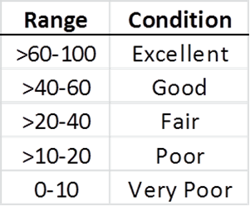
Benthic indicator: Juvenile density
Total scleractinians
GOAL: Select the most abundant and ecologically important species
Scores: Bins within range of data for each category (e.g. American Samoa)
Mean scores to be used to develop grades
Notes:
The use of the selected taxon provides information about existing coral populations and incorporates a mechanism to determine about how coral populations are changing over time (fluctuations in one or more of the most abundant or important taxon).

Slide 10
2015 Benthic REA surveys StRS sites
Island # of sites
OFU / OLO 31
ROS 29
SWA 18
TAU 21
TUT - North 41
TUT - South 48

Slide 11
Benthic indicator: Juvenile density
Total scleractinians, 15 genera, and 5 species
Selected: most abundant and consistent ID (species)
Three separate categories: all, genera and species, and total scleractinians
Scores: 20% bins within range of data for each category
Mean score to be used to develop grades

Slide 12
Benthic indicator: Juvenile density
Issues:
Scaling the grades appropriately
Low density not always bad
– especially where adult density high
and amount of space available is low
Notes:
Issues at the species level for some species = not always easy to ID to species

Slide 13
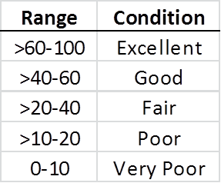
Benthic indicator: Juvenile density MHI 2013
Excellent
Good
Fair
Poor
Very poor

Slide 14
Benthic indicator: Juvenile density MHI 2016
Excellent
Good
Fair
Poor
Very poor

Slide 15
Benthic indicator: Juvenile density NWHI 2014-2015
Excellent
Good
Fair
Poor
Very poor

Slide 16
Benthic indicator: Juvenile density
Issues:
Scaling the grades appropriately
Low density not always bad
– especially where adult density high
and amount of space available is low
Notes:
Issues at the species level for some species = not always easy to ID to species

Slide 17
Benthic indicator: Adult density
Same methodology as juveniles
Total scleractinians
GOAL: Select the most abundant and ecologically important species
Scores: Bins within range of data for each category
Mean scores to be used to develop grades

Slide 18
Benthic indicator: Adult density
Rationale : The use of the selected taxon provides information about existing coral populations and incorporates a mechanism to determine about how coral populations are changing over time (fluctuations in one or more of the most abundant or important taxon).

Slide 19
Benthic indicator: Adult density MHI 2013
Excellent
Good
Fair
Poor
Very poor

Slide 20
Benthic indicator: Adult density MHI 2016
Excellent
Good
Fair
Poor
Very poor

Slide 21
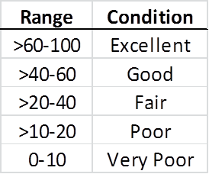
Benthic indicator: Adult density NWHI 2014-2015
Excellent
Good
Fair
Poor
Very poor

Slide 22
Benthic indicator: Partial mortality
Mean percent of old dead partial mortality, adult coral colonies (≥ 5 cm)
Total scleractinians (Goal: Selected species)
Scores: 20% bins within range of data for each category – Max set at 30% (A. Samoa)
Mean scores to be used to develop grades

Slide 23
Benthic indicator : Partial mortality Range max 30% MHI 2013
Very poor
Poor
Fair
Good
Excellent

Slide 24
Benthic indicator : Partial mortality Range max 30% MHI 2016
Very poor
Poor
Fair
Good
Excellent

Slide 25
Benthic indicator : Partial mortality Range max 30% NWHI 2014-2015
Very poor
Poor
Fair
Good
Excellent

Slide 26
Benthic indicator : Generic richness
*

Slide 27
Benthic indicators: Next steps
Island or sub-island?
For islands with multiple reef zones, should we include all reef zone or fore reef only?
What to species to use? – common across island range or island-specific?
Thresholds – use existing time series to set thresholds rather than simply using the range of the survey? (e.g. American Samoa)
Diversity metric?

Slide 28
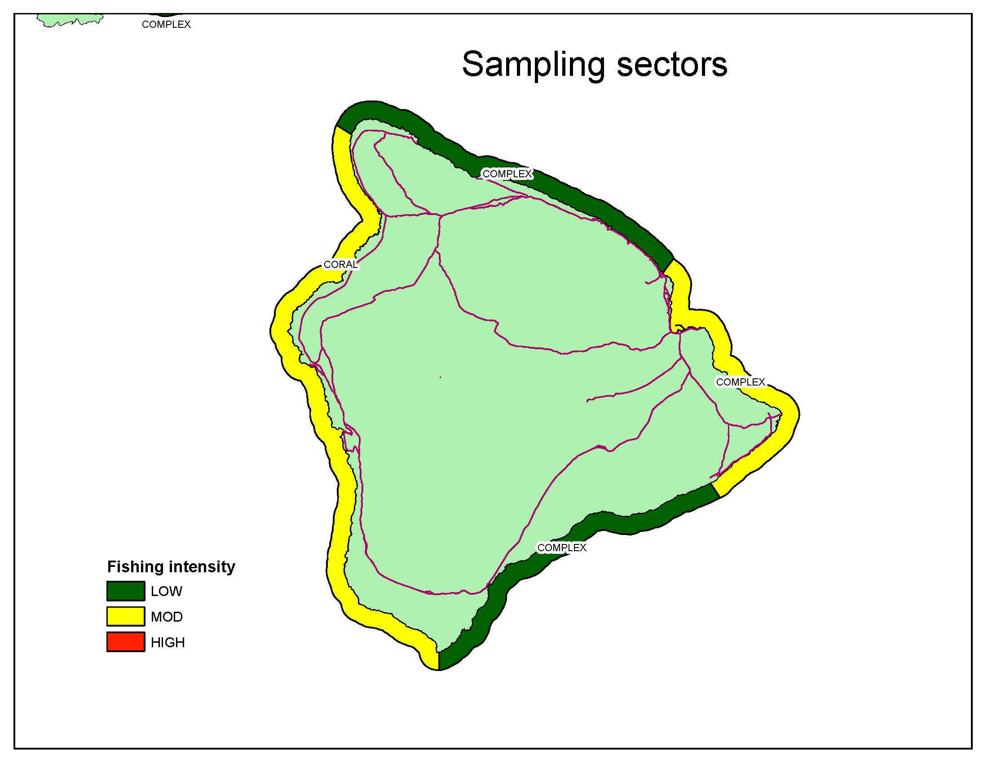

Slide 29
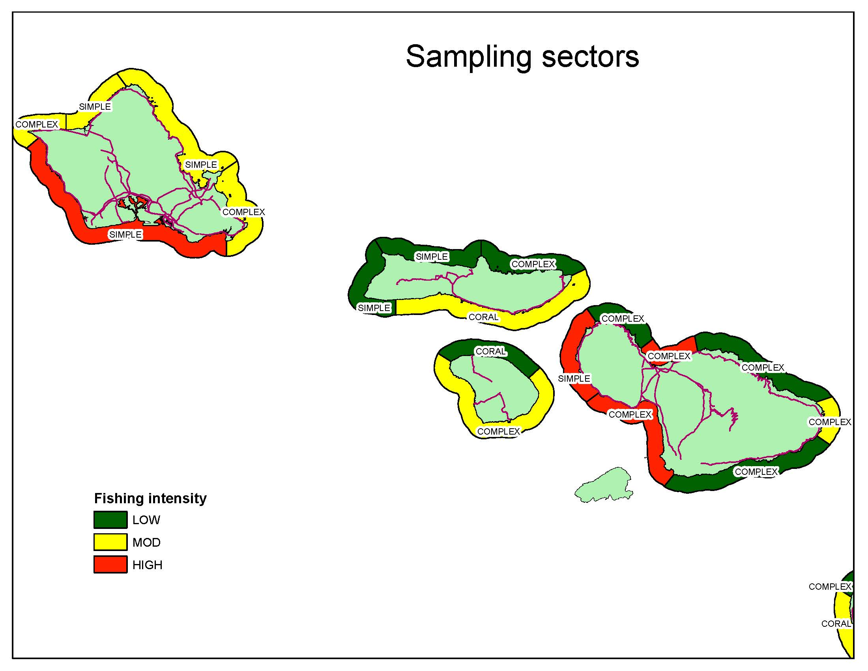

Slide 30
