Slide 1
Before we begin....
Any questions, comments, concerns?
Goals from last week?
Goals for next week?

Slide 2
Today's Plan
1-2 pm
Last week's assignment
2-3 pm
Overview of workflow
Overview of OHI theory and scores
3-Finish pm
Work as a team on OHI assignment

Slide 3
Part 1
A super brief overview of our workflow!

Slide 4
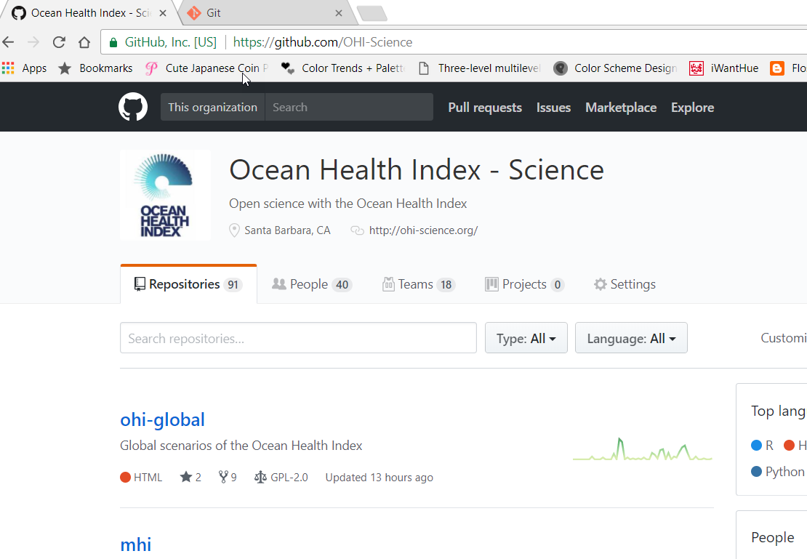


Week 2: Part 1
A super brief overview of our workflow!
Nearly all the files we use to calculate the global OHI are located on Github under the OHI-Science organization
Git A version control system used to track changes in files and coordinate work
GitHub A web-based hosting service for Git. Github allows us to seamlessly collaborate on projects and is what we use to make our code and data available to the public in real time!

Slide 5
Week 2: Part 1
A super brief overview of our workflow!
There are many repositories (a.k.a. "repos"), but the 3 that we use for OHI global are:
ohiprep R scripts and intermediate data we use to prepare the data for the OHI global toolbox
ohi-global The models and data used to calculate the global OHI scores
ohicore The general functions used to calculate OHI pressures, resilience, and scores

Slide 6
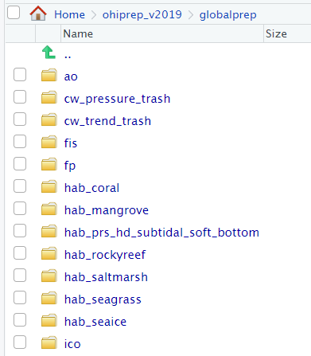
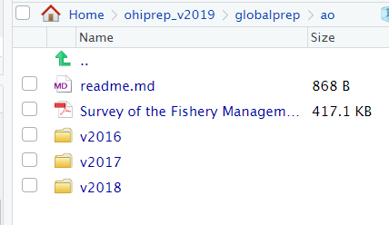
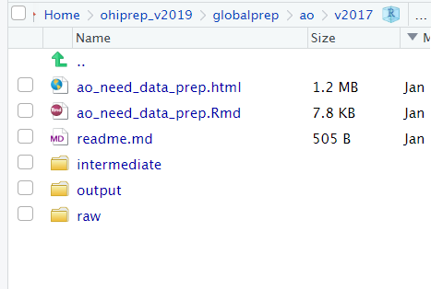
Week 2: Part 1
A super brief overview of our workflow!
ohiprep_v2019/globalprep
Files used to prepare data for the toolbox
Folder heirarchy
> Folders for the individual goals, pressures, and resilience variables (e.g., ao, fis)
> Folders for assessment years (e.g., v2017).
> Data and processing files:
R/Rmd scripts for data processing
README.md files describing the data
folder for intermediate data (int)
folder for final data (data, output)
other stuff
CRITICAL: All data is prepared using R/Rmd files!
No data prep is done by hand or in Excel
Mistakes are too easy to make and often impossible to trace
Work is not replicable
Example data prep script (from Jamie):
http://ohi-science.org/ohiprep_v2019/globalprep/prs_oa/v2017/create_oa_layer.html

Slide 7
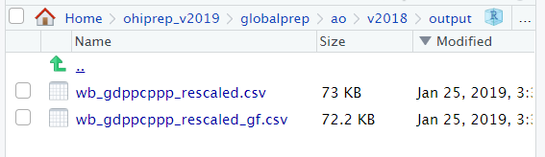
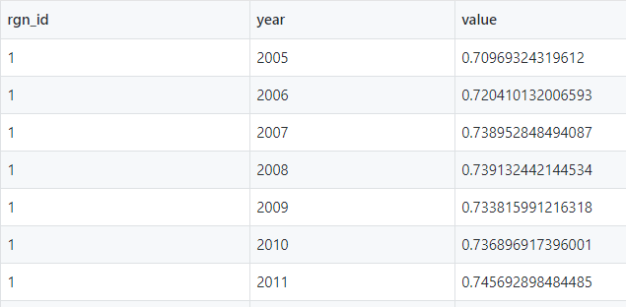
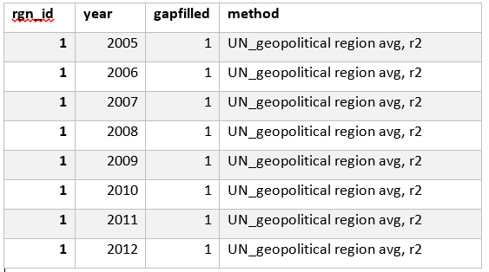
Week 2: Part 1
A super brief overview of our workflow!
Final datasets for toolbox
Artisanal opportunities: need data
ohiprep_v2019/globalprep
data used to calculate scores
data to keep track of gapfilling
A document describing our data organization:
http://ohi-science.org/ohiprep_v2019/Reference/SOP_dataOrganization/dataOrganization_SOP.html

Slide 8
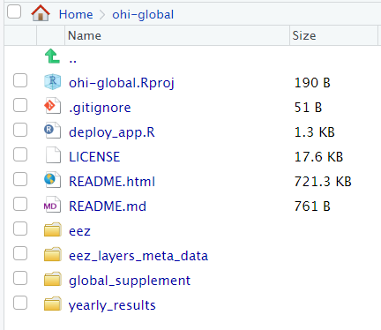
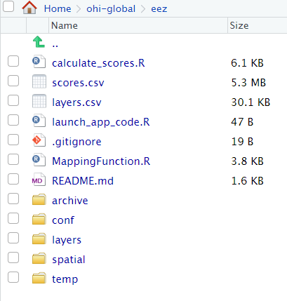
Week 2: Part 1
A super brief overview of our workflow!
ohi-global
Models and data used to calculate the global Ocean Health Index
The Highlights
eez = folder with global models and data
> layers = all data layers used in the models (data are copied from
ohiprep, using paths located in: eez_layers_meta_data/layers_eez_base.csv)
> conf = models and supplementary data used to calculate goal status, trend,
pressure and resilience
> calculate_scores.R = script to run the toolbox to calculate scores
> scores.csv = output from running the toolbox (includes all dimension scores for
each goal and country)
eez_layers_meta_data = Several csv files describing data layers
global_supplement = Files used to create OHI methods document,
yearly_results = Reporting on results of OHI assessments

Slide 9
Week 2: Part 1
A super brief overview of our workflow!
ohicore
An R package with the generic functions used to create special OHI objects and calculate scores
Functions include:
CalculatePressuresAll
CalculateResilienceAll
All regional OHI assessments use this package....not just OHI global!

Slide 10
Part 2
Theory and models of the Ocean Health Index

Slide 11
Week 2: Part 2
Theory and models of the Ocean Health Index
What is the Ocean Health Index?
The Ocean Health Index is a framework that provides a comprehensive assessment of ocean health!
Human-centric
Measures the health of resources that are directly important to humans
Rewards the sustainable extraction of resources from the ocean
Adaptable
Can be applied to smaller spatial scales
Models can be adapted to better match the needs of different regions
Comprehensive
Nearly 100 datasets are used to estimate Index scores
Combines lots of data (status, pressures, resilience, etc.) and indicators in a clever way to obtain a comprehensive view of ocean health

Slide 12
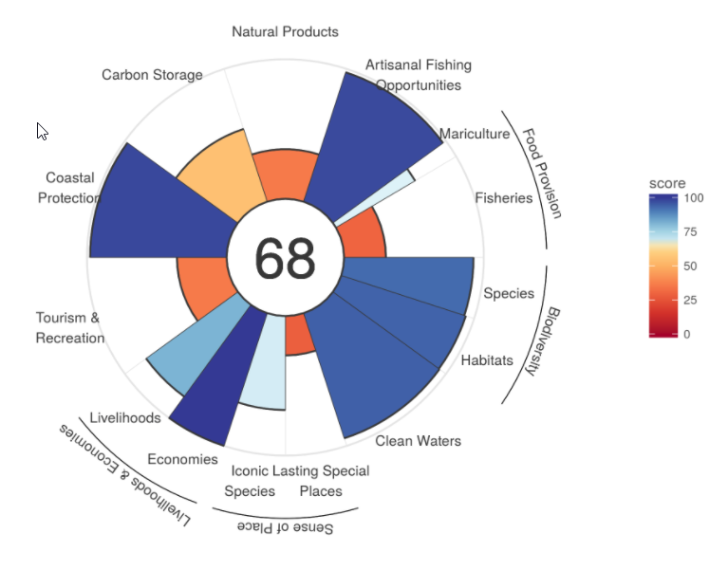
Week 2: Part 2
Theory and models of the Ocean Health Index
Breakdown of Index scores
Regional Index score
Overall measure of how well a region is managing the resources we want and need from the ocean based on performance of 10 goals

Slide 13

Week 2: Part 2
Theory and models of the Ocean Health Index
Breakdown of Index scores
What does the score measure???
Current state of the goal relative to some desired reference point
current status
goal score
trend
Average of current status
and predicted future status in 5 years
pressures
future status
An estimate of the goal's future status in 5 years, based:
current status
recent changes in status (i.e., trend),
factors that threaten goal (i.e., pressure)
factors that preserve and protect goal (i.e., resilience)
resilience

Slide 14
Week 2: Part 2
Theory and models of the Ocean Health Index
Getting familiar with the OHI
Your Mission
Work together to answer the questions in this worksheet:
https://rawgit.com/OHI-Science/ohi-global/draft/global_supplement/exercises/exercise1.html
All the information you need should be in the OHI global method document:
https://raw.githack.com/OHI-Science/ohi-global/published/global_supplement/Supplement.html
Slack me if you have questions or want any hints! I will check in every once in a while to see how you are doing! We will discuss this assignment next week!
We will reconvene around 3 to discuss last week's assignment.

