Slide 1
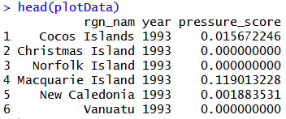
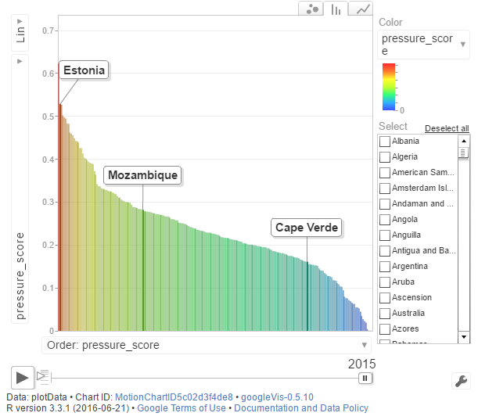
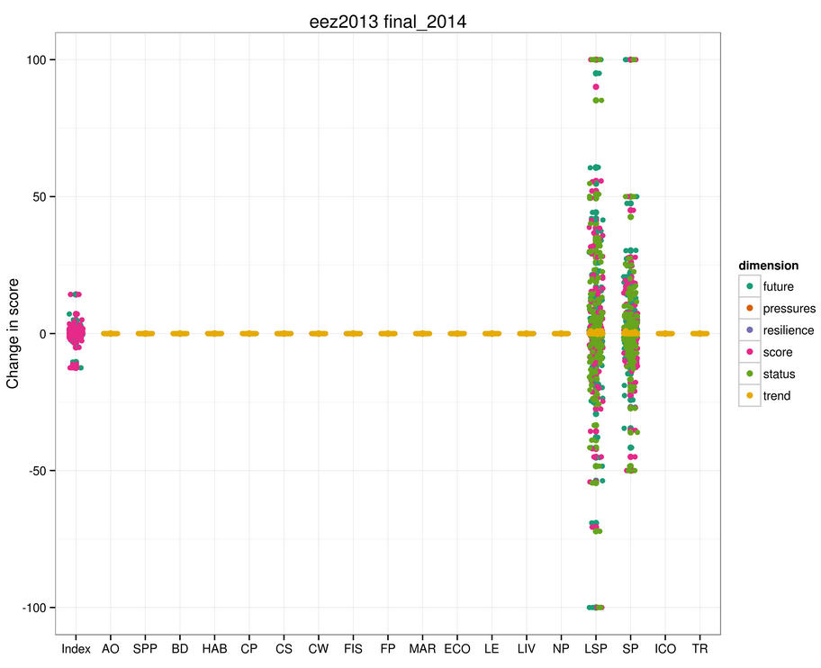
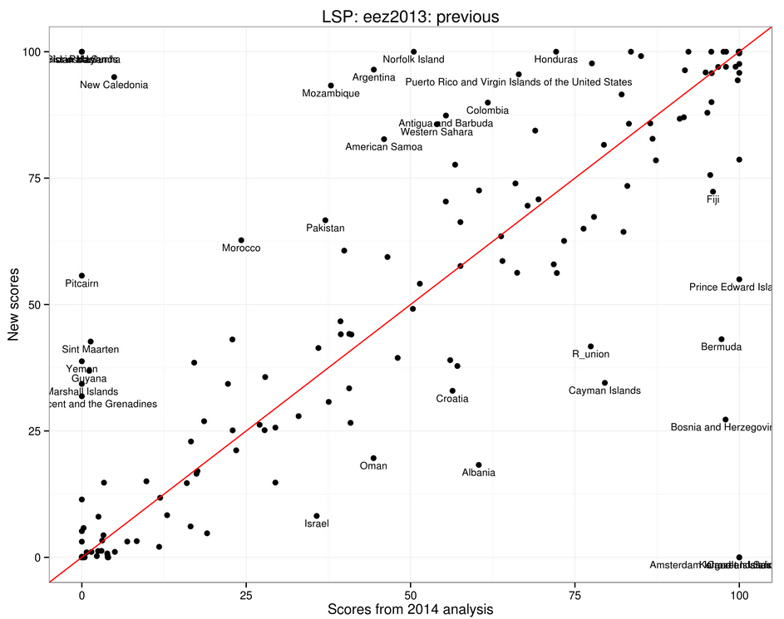
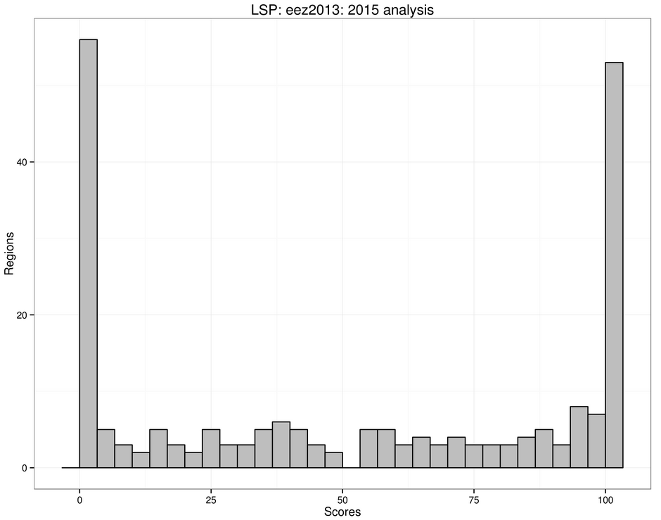
1. Prepare data/models and check
Changes to data layers
My most common checks
hist()
summary()
dim()
table()
plot(old_data, new_data)
Questions
Does range/distribution seem reasonable?
Does the number of NA values make sense?
Correct sample size (i.e., length of data)?
Common Problems
Be especially neurotic after joins (check sample size, NAs)!
Compare distribution of NA values between old/new data!
Changes to functions
Put a browser() at start of the function in functions.R. This will stop the calculations at this point, then walk through the function to make sure everything is going well.
A GoogleVis plot is good for visualizing multiple years of data
Arrange data like this
library(googleVis)
Motion = gvisMotionChart(plotData,
idvar="rgn_nam",
timevar="year")
plot(Motion)
print(Motion, file = file.path(save_loc, 'slr.html'))
2. Run OHIcore functions and visualize scores
Check
Did the files you expect to change actually change?
Check the scores diff file to see if changes make sense.
Review warning() messages.
Future
Current visualization is bad at detecting changes to missing data (which is a common mistake). Make a function to do this.
How do scores change across goals?
Currently in ohicore, but needs to be updated for ohi+ repositories
change_plot(repo = "ohi-global",
scenario = "eez2013",
commit = "previous", # can also use sha, e.g., "e30e7a4"
fileSave = "name_of_plot")
saves interactive html figure to: changePlot_figures
To find sha values:
Can use git2r package: git2r::commits(git2r::repository(repo2))
Can also just look it up on github.com
Can read csv files from previous commits in Github (git2r package):
read_git_csv(org/repo, sha, path)
read_git_csv("OHI-Science/ohi-global", "9627676", "eez2014/scores.csv"
How do scores change within a goal/dimension?
Currently in ohiprep/src/R/VisGlobal.R (planning to move to ohicore)
Regions >1 sd from mean difference are labeled
scatterPlot(repo = "ohi-global", scenario = "eez2013",
commit = "previous",
goal = "LSP",
dim = "status",
fileSave = "LSPstatus")
Distribution of scores within a goal/distribution
Currently in ohiprep/src/R/VisGlobal.R (planning to move to ohicore)
goalHistogram(repo = "ohi-global",
scenario = "eez2013",
goal="LSP",
dim="score", fileSave="LSP_trend_data_update")
Checklist for ohi assessment
Update "layer" spreadsheet
Pull ohi-global and ohiprep
3. Document and share
Check that branch is correct
Run Calculate_scores_all.R
I have an ongoing github issue to: 1) document changes to data/models, 2) describe effects on scores, 3) describe outliers and explain why they are outliers.
Check diffs of scores.csv to see if changes make sense
Visualize data
Commit/Push ohi-global
Post changes on github for review

