Slide 1
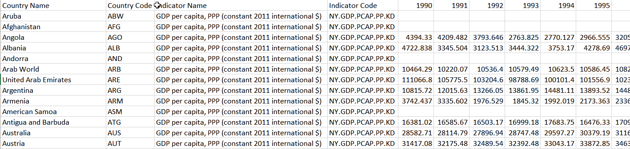
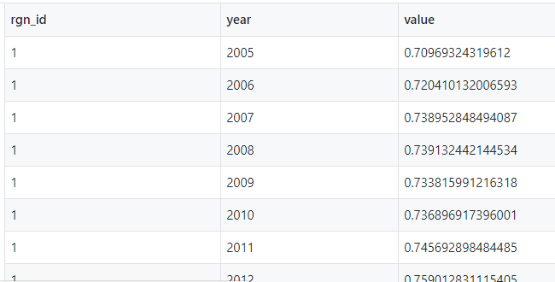
Exercise (25 min)
Read:
If PPPpcGDP is 1 (i.e., a very economically secure region) and Opportunity is 1 (i.e., lots of opportunity), what is AO status?
What if PPPpcGDP is 1 and Opportunity is 0.1 (low opportunity), what is AO status?
What does this information reveal about this goal?
2. The data from World Bank looks like this: OHI Toolbox format looks like this:
https://rawgit.com/OHI-Science/ohi-global/draft/global_supplement/Supplement.html#51_artisanal_opportunities
What challenges/steps do you anticipate?
3. Questions?

Slide 2
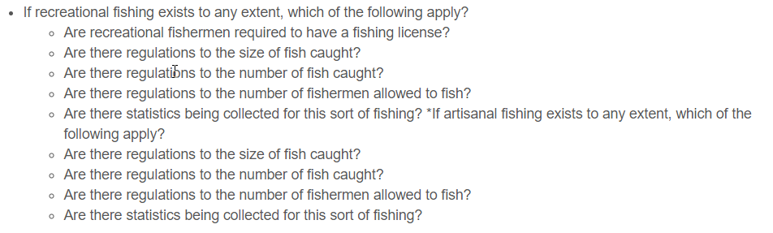
Artisanal opportunities: Overview
https://rawgit.com/OHI-Science/ohi-global/draft/global_supplement/Supplement.html#51_artisanal_opportunities
Opportunity for artisanal (i.e., small scale) fishing when there is economic need
2 components:
economic need: GDP adjusted by purchasing power parity, World Bank
access to recreational fishing: Mora et al., 2009

Slide 3
Artisanal opportunities: Overview
If there is no need (i.e., high PPPpcGDP) then the score will be high regardless of opportunity.
Opportunity becomes increasingly important as economic security decreases.

Slide 4
Artisanal opportunities: Data prep
https://rawgit.com/OHI-Science/ohiprep/master/globalprep/ao/v2017/ao_need_data_prep.html
Challenges:
Gapfilling. Some regions have data, but not for all years. We use the values from the region's previous years of data to gapfill missing years. Many regions do not have data! We use UN Geopolitical regions to estimate these.
Data need to be rescaled so values are between 0-1
Country names need to be converted into OHI regions
A gapfilling dataframe also needs to be saved

Slide 5
Artisanal opportunities: Data prep
https://rawgit.com/OHI-Science/ohiprep/master/globalprep/ao/v2017/ao_need_data_prep.html
When preparing data:
Go through each line of code to understand what is happening and that everything is correct. This means breaking down dplyr chains and evaluating each step.
Use summary, unique, dim, length commands as well as figures to explore the data at different stages.
Check that the distribution of NA values makes sense (one of the most common mistakes) and that the size of the dataframe makes sense at each step.
Don't assume everything is correct! There may have been changes to source data that throw off previous code. We may have made a mistake. And even if there aren't mistakes, there is usually room for improvement.

Slide 6
Exercise 1: AO dataprep
https://rawgit.com/OHI-Science/ohiprep_v2018/master/globalprep/ao/v2017/ao_need_data_prep.html
I will walk through the following
How to set up a new folder for this year's assessment
How I painstakingly walk through a dataprep script
You will then:
Walk through at your own pace: OHI-Science/ohiprep_v2018/globalprep/ao/v2018/ao_need_data_prep.Rmd
Make any comments/edits etc. to make the data prep file more clear
Commit, but do NOT push changes
Together we will:
Push changes and resolve merge conflicts

