Slide 1
1. What is the difference between a goal’s “status” and “score”?
The “status” dimension is a component of the goal’s overall “score”. Status is current performance of the goal relative to some reference point. The score takes into account status and likely future status (which is current status modified by trend, pressure, and resilience).
SIDE NOTE: When I first started, I was working on calculating the OHI for Fiji. I was so focused on the status calculations that when I finished I thought I was done. I told everyone I had finished the "scores". Then I had to scramble to actually finish the scores!

Slide 2
2. If a region’s food provision goal has the following values, what would its food provision score be?
Predicted future status: 80
Current status: 60
70 (average of the future and current status)

Slide 3
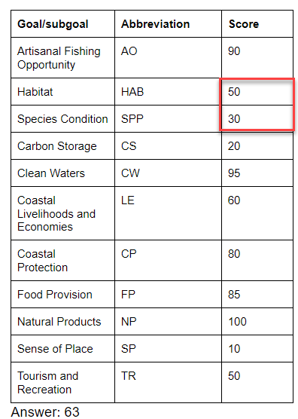
3. Given the following data, what would this region’s Index score be?
This was a bit of a trick question. If you answered: 60.91, you did not first average the subgoals for Biodiversity (Habitat and Species Condition).
Subgoal scores for Biodiversity, Coastal Livelihoods and Economies, and Sense of Place are averaged. For Food Provision, a weighted average of the subgoals is used (Mariculture and Fisheries), with weights being the tonnes of harvest for each subgoal.
NOTE: The abbreviations for subgoals have 3 letters while goals have 2 letters.
Need to be averaged first!

Slide 4
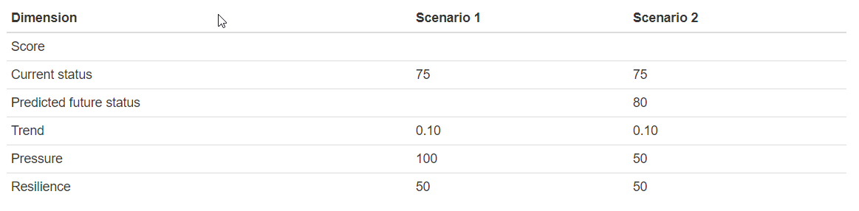
4. Fill in the missing values.
NOTE: Pressure and resilience must be multiplied by 0.01. Trend and status are not modified. I think we should probably change the way report trend (or, alternatively, pressures/resilience) so they are treated consistently.
71.3
77.5
67.65
How did a pressure change from 100 to 50 affect the final score? Was this a larger or smaller effect than you would have expected?

Slide 5
5. Provide the metadata for each variable (using “score” as an example)
NOTE: This takes some exploring of the data through R,
walk through using these functions to understand the structure of data:
summary()
str()
table()
unique()
length()

Slide 6
Variable | Metadata
goal | Factor Abbreviations corresponding to: 10 OHI goals (AO, BD, CS, CW, LE, CP, FP, NP, SP, TR) 8 OHI subgoals (HAB, SPP, LIV, ECO, FIS, MAR, ICO, LSP) and Index (when region_id = 0): Global Index score Index (when region_id != 0): Regional Index score
dimension | Factor Dimensions of an OHI assessment: future, pressures, resilience, score, status, trend
region_id | integer (0-250) 220 regions of the global assessment + 0 = Global 213 = Antarctica, blank
score | numeric Ranges from 0-100 for all dimensions, except trend (-1 to 1)
year | integer assessment years: 2012-2017

Slide 7
6. B/Bmsy scores greater than 1 indicate the stock is doing well! Given this, why are B/Bmsy scores > 1.05 penalized (i.e., stock status score is less than 1)?
In this case, fishery scores are penalized because B/Bmsy values >1 indicate this resource is not being used to its full potential.
However, the penalties for underharvesting are not as great as the penalties for overharvesting.
NOTE: We are considering further reducing the underharvesting penalties in the 2018 assessment

Slide 8
7. Given the following economic data, should the missing (i.e., NA) values be estimated? If so, how?
rgn_id | data
1 | 72
2 | 74
3 | 80
4 | 70
5 | NA
6 | NA
7 | 71
8 | 75
9 | 76
10 | 76
If these data do not exist because they are not relevant to the region, it makes sense to leave them blank. For example, if these regions are uninhabited!
Otherwise, every effort should be made to estimate these missing data! Possible methods, include:
The crudest (but often fine) approach is to use the average of the regions that are available. This approach can be improved by using averages of closely related regions (geographic and/or social/political)
Often, you can find other variables that are correlated with these data and use this information to make a predictive model. But make sure there is actually a statistical relationship before using a complicated model!

Slide 9
7. Given the following economic data, should the missing (i.e., NA) values be estimated? If so, how?
rgn_id | data
1 | 72
2 | 74
3 | 80
4 | 70
5 | NA
6 | NA
7 | 71
8 | 75
9 | 76
10 | 76
super_rgn | % poverty
1 | 10
1 | 12
2 | 5
1 | 12
1 | 15
2 | 3
1 | 16
2 | 6
2 | 2
2 | 4
If these data do not exist because they are not relevant to the region, it makes sense to leave them blank. For example, if these regions are uninhabited!
Otherwise, every effort should be made to estimate these missing data! Possible methods, include:
The crudest (but often fine) approach is to use the average of the regions that are available. This approach can be improved by using averages of closely related regions (geographic and/or social/political)
Often, you can find other variables that are correlated with these data and use this information to make a predictive model. But make sure there is actually a statistical relationship before using a complicated model!

Slide 10
8. What is the reference point for the Lasting Special Places subgoal?
30% of coastal waters and land are protected.
If a region has ≥ 30% of their coastal waters and land protected they will receive a perfect status score of 100!
NOTE: As you go through functions.R, feel free to add comments that describe calculations. This file is not as well documented as it could be!
In R, text that is preceeded by:
#
is ignored!

Slide 11
9. The trend for the Tourism and Recreation goal for the United States is -0.15. Describe what this means.
In the next 5 years, TR is predicted to decrease by 15%.

Slide 12
10. What assumptions are we making by using this formulation of trend to calculate the likely future status?
Future performance is predicted by past performance!
If there is a lot of uncertainty, the trend estimate may be misleading
Can you think of any scenarios when we would not use 5 years of data to estimate trend?
Sometimes the data is not available and we have to use fewer years of data (or, different methods altogether)
Sometimes estimates are more accurate when multiple years of data are used. For example, with climate there may be shorter and longer term trends and we want to capture the longer term trends. There may be outliers that we want to exclude (catastrophic events, etc.)

Slide 13
11. Pressure
How many climate change pressures are there?
4:
UV radiation
Sea level rise
ocean acidification
seat surface temperatures
Which is more important: Ecological or Social pressures?
They are weighted equally (even though most goals have more ecological pressures acting on them)

Slide 14
11. Pressure
Which pressure layers affect the clean water goal?
Nearshore chemical pollution (po_chemicals_3nm)
Nearshore nutrient pollution (po_nutrients_3nm)
Trash pollution (po_trash)
Pathogen pollutin (po_pathogens)
Lack of social progress (ss_spi)
Lack of governance (ss_wgi)
Some goals, like Coastal Protection have multiple "elements". Why?
Pressures effect the habitats (sea ice, marsh, mangrove, seagrass) that provide coastal protection differently. This allows us to apply the correct pressures depending on the specific habitats within a region.

