Slide 1
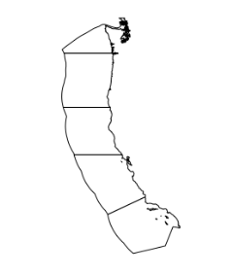
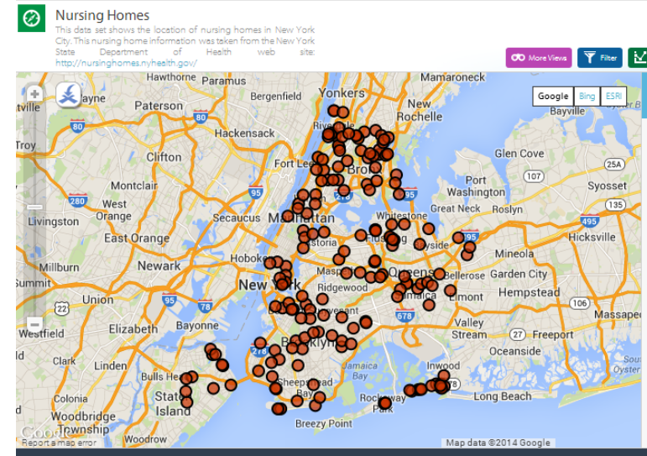
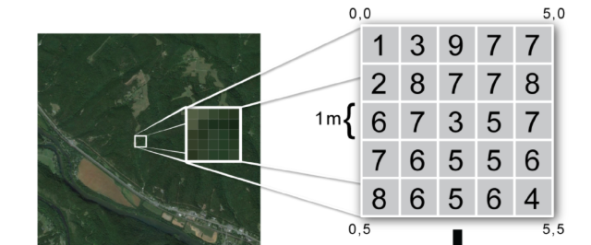
Types of spatial information
Vector: Points/Lines/Polygons
(e.g., Shapefile)
Gridded:
Raster
(e.g., GeoTiff)

Slide 2
Spatial data | R package | Description
Vector (points/lines/polygons) | sp | Spatial object format and functions for spatial vector data; spatial vector data is formatted as a nested list.
 | rgeos | Function for performing spatial vector operations on sp spatial data, such as buffer and intersect.
 | sf** | Simple feature: replacing sp for reading/manipulating spatial vector data in R (what we will primarily use); replacing sp and rgeos, but still developing; spatial data is formatted as a dataframe.
Raster | raster** | Reading, writing, manipulating, transforming, analyzing and modeling of raster data. We use this for about 99.99% of our raster manipulation.
 | fasterize | Used to convert vector data into a raster (much better than the raster::rasterize function). Requires sf shapefile.
Coordinate reference systems | rgdal** | Provides bindings to Frank Warmerdam’s Geospatial Data Abstraction Library (GDAL) (>= 1.6.3, < 2) and access to projection/transformation operations from the PROJ.4 library; used by all spatial data formats!
**load these packages when working with spatial files

Slide 3
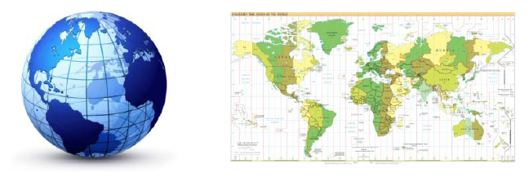
Working with Coordinate Reference Systems
Life would be easier if we could just use 3D globes to visualize the world....but paper and computer screens are much more convenient!
This introduces the need for coordinate reference systems (a.k.a. "projection")
for more info: https://mazu.nceas.ucsb.edu/rstudio/files/ohiprep_v2019/Reference/OverviewCoordinateReferenceSystems.pdf

Slide 4
Working with Coordinate Reference Systems
When spherical data is flattened...it always loses information!
It is impossible to flatten a round object without distortion, and this results in trade‐offs between area, direction, shape, and distance. For example, there is a trade‐off between distance and direction because both features can not be simultaneously preserved.
There is no "best" projection, but some projections are better suited to different applications.

Slide 5
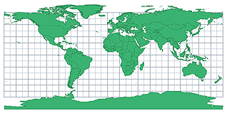
Working with Coordinate Reference Systems
Common Coordinate Reference Systems
Lat/Long
Probably most common for global data
Used by Google Earth
Considered to be "unprojected"
Pros: Easy and common!
Cons:
Greatly exaggerates area at the poles
(why Greenland looks huge!!!)
Raster cells are not the same size (raster cells at the equator represent the largest area)
Not locally accurate (not great for field work when you need accuracy in the meter range)

Slide 6
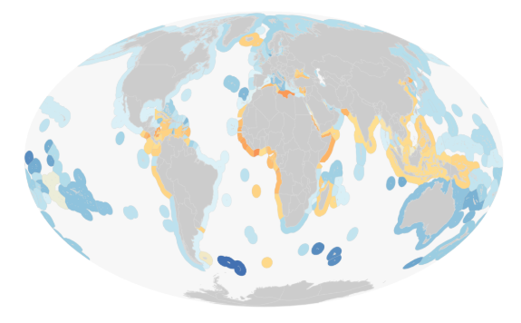
Working with Coordinate Reference Systems
Common Coordinate Reference Systems
Mollweide
What we typically use for OHI global assessments
Pros: Area is accurately represented
Cons:
Direction is not accurately represented
Some challenges to working with/ not common

Slide 7
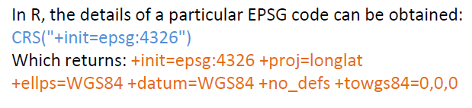
Working with Coordinate Reference Systems
If you have used ArcGIS you may have been able to ignore CRS because it often takes care of this in the background. But for R, you need some understanding of CRS because working files must have the same projection!
In R, the rgdal package is used to manage CRS.
proj4string
The notation used to describe the CRS from the PROJ.4 project:
+init=epsg:4121 +proj=longlat +ellps=GRS80 +datum=GGRS87 +no_defs +towgs84=‐199.87,74.79,246.62
EPSG codes
A particular CRS can also be referenced by its
EPSG code, which looks like this: epsg:4121

Slide 8
Working with Coordinate Reference Systems in R
To do | Type of spatial data | Description
Assign CRS to spatial data; or modify the attributes such that the CRS is not changed but makes it consistent with another spatial object. | Vector shapefile (sp) (points/lines/polygons) | proj4string(x) <- CRS("+init=epsg:28992") or, type in the PROJ.4 attributes proj4string(x) <- CRS("+proj=utm +zone=10 +datum=WGS84") or, from another spatial file proj4string(x) <- CRS(proj4string(OtherData))
 | Vector simplefeature (sf) (points/lines/polygons) | st_crs(x) <- 28992 st_crs(x) <- "+proj=longlat +datum=WGS84 +no_defs"
 | Raster | projection(x) <- CRS("+init=epsg:28992)
Transform from one CRS to another | Vector shapefile (sp) (points/lines/polygons) | newData <- spTransform(x, CRS("+init=epsg:28992")
 | Vector simplefeature (sf) (points/lines/polygons) | newData <- st_transform(x, 28992)
 | Raster | newData <- projectRaster(x, CRS("+init=epsg:28992")
Retrieve CRS | Vector shapefile (sp) (points/lines/polygons) | proj4string(x)
 | Vector simplefeature (sf) (points/lines/polygons) | st_crs(x)
 | Raster | projection(x)

Slide 9
Jamie's presentation on sf and rasters:
https://github.com/jafflerbach/spatial-analysis-R

Slide 10
OHI common file
Used in almost all data prep scripts....
But in particular, it makes data prep requiring spatial analyses a bit easier.

