Slide 1
Uncertainty
Indicators are increasingly used to measure environmental systems
CRITICISM: Most fail to measure and describe uncertainty
- natural variation in data
- measurement error
- inadequate models
- poor selection of reference points
(Burgess et al. in review, for description of uncertainty)

Slide 2
Gapfilling
A major source of uncertainty for OHI global
We are not alone:
A recent review of indicators revealed that none provided “an easy insight into which particular data have been imputed…”
(Burgess et al. in review)

Slide 3
Gapfilling
Mission: improve our approach to gapfilling

Slide 4
Today's Discussion Plan
What is gapfilling?
How to:
track gapfilling
select among candidate models
use cross-validation to estimate error
estimating uncertainty of OHI scores
OHI global gapfilling results

Slide 5
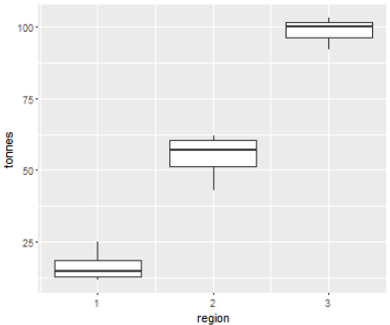
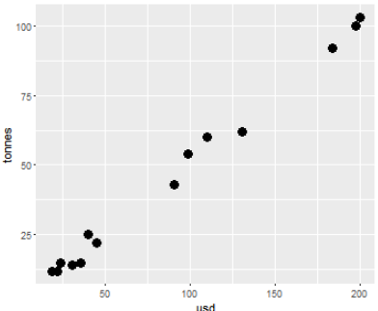
What is gapfilling?
Region | tonnes
1 | 15
2 | 12
3 | 14
4 | 22
5 | 25
6 | 60
7 | 15
8 | 103
9 | 92
10 | 62
11 | 12
12 | 43
13 | 100
14 | 54
Region | tonnes
1 | 15
2
3 | 14
4 | 22
5 | 25
6 | 60
7 | 15
8
9 | 92
10
11 | 12
12 | 43
13 | 100
14
Georegion | USD
1 | 24
1 | 22
1 | 31
1 | 45
1 | 40
2 | 110
1 | 36
3 | 200
3 | 184
2 | 131
1 | 19
2 | 91
3 | 198
2 | 99

Slide 6
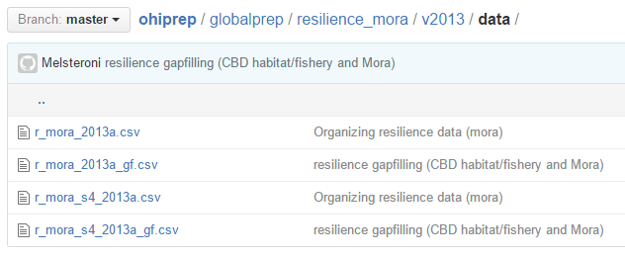
Tracking gapfilling
Gapfill info
gapfilled (yes/no) method
error
ID info
mirrors data layer
Corresponding gapfilling dataset for every data layer
Region | tonnes
1 | 15
2 | 12
3 | 14
4 | 22
5 | 25
6 | 60
7 | 15
8 | 103
9 | 92
10 | 62
11 | 12
12 | 43
13 | 100
14 | 54
Region | gapfilled | method | error
1 | 0
2 | 1 | lm_usd
3 | 0
4 | 0
5 | 0
6 | 0
7 | 0
8 | 1 | lm_usd
9 | 0
10 | 1 | lm_usd
11 | 0
12 | 0
13 | 0
14 | 1 | lm_usd
(even if there was no gapfilling)

Slide 7
Selecting the model
Region | tonnes
1 | 15
2
3 | 14
4 | 22
5 | 25
6 | 60
7 | 15
8
9 | 92
10
11 | 12
12 | 43
13 | 100
14
Georegion | USD
1 | 24
1 | 22
1 | 31
1 | 45
1 | 40
2 | 110
1 | 36
3 | 200
3 | 184
2 | 131
1 | 19
2 | 91
3 | 198
2 | 99
Model | R² | AIC | BIC | cross-val (loo)
tonnes ~ Georegion | 0.965 | 69.8 | 70.7 | 5.9
tonnes ~ USD | 0.992 | 54.6 | 55.6 | 2.7
tonnes ~ Georegion + USD | 0.993 | 56.48 | 57.7 | 2.8
Can also be used to estimate error!!

Slide 8
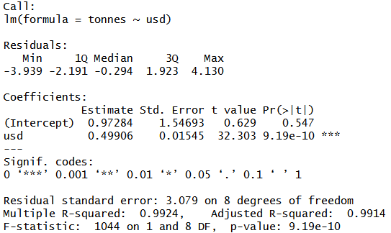
Cross-validation: estimating error
Error is provided in the model output. Why use cross-validation?
Overly optimistic because the data used to create the model are also used to estimate performance.
Cross-validation uses different data to create and test models.

Slide 9
Cross-validation: estimating error
observed
(tonnes ~ USD)
predicted
Region | tonnes
1 | 15
2
3 | 14
4 | 22
5 | 25
6 | 60
7 | 15
8
9 | 92
10
11 | 12
12 | 43
13 | 100
14
Georegion | USD
1 | 24
1 | 22
1 | 31
1 | 45
1 | 40
2 | 110
1 | 36
3 | 200
3 | 184
2 | 131
1 | 19
2 | 91
3 | 198
2 | 99
tonnes
--
--
--
--
Leave-one-out method
STEP 1 Model parameters estimated using the data (training data) minus one case (testing data)
13.0
STEP 2 Model is applied to to the testing data to predict its value

Slide 10
Cross-validation: estimating error
observed
(tonnes ~ USD)
predicted
Region | tonnes
1 | 15
2
3 | 14
4 | 22
5 | 25
6 | 60
7 | 15
8
9 | 92
10
11 | 12
12 | 43
13 | 100
14
Georegion | USD
1 | 24
1 | 22
1 | 31
1 | 45
1 | 40
2 | 110
1 | 36
3 | 200
3 | 184
2 | 131
1 | 19
2 | 91
3 | 198
2 | 99
tonnes
--
16.4
--
--
--
Leave-one-out method
STEP 1 Model parameters estimated using the data (training data) minus one case (testing data)
13.0
STEP 2 Model is applied to to the testing data to predict its value
STEP 3 Loop through all the cases

Slide 11
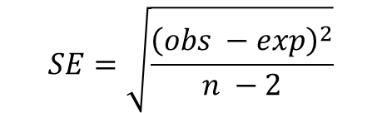
Cross-validation: estimating error
observed
predicted
Region | tonnes
1 | 15
2
3 | 14
4 | 22
5 | 25
6 | 60
7 | 15
8
9 | 92
10
11 | 12
12 | 43
13 | 100
14
Georegion | USD
1 | 24
1 | 22
1 | 31
1 | 45
1 | 40
2 | 110
1 | 36
3 | 200
3 | 184
2 | 131
1 | 19
2 | 91
3 | 198
2 | 99
tonnes
--
16.4
24.0
21.3
55.9
19.2
--
92.6
--
10.1
45.7
100.0
--
Leave-one-out method
STEP 1 Model parameters estimated using the data (training data) minus one case (testing data)
13.0
STEP 2 Model is applied to to the testing data to predict its value
STEP 3 Loop through all the cases
STEP 4 Estimate prediction error:
$$SE=\sqrt{\frac{{\left(obs −exp\right)}^{2}}{n −2}}$$

Slide 12
Simulations to predict score error
Step 1: Simulate data for gapfilled values
12.7 + rnorm(mean= 0, sd = 2.8)
Step 2: Calculate OHI scores
Step 3: Repeat 1000s of times to get simulated data that can be used to calculate confidence intervals around OHI scores.
Region | tonnes
1 | 15
2 | 12.7
3 | 14
4 | 22
5 | 25
6 | 60
7 | 15
8 | 101.2
9 | 92
10 | 67.1
11 | 12
12 | 43
13 | 100
14 | 50.0
Region | gapfill | method | error | rand
1 | 0 |  | 0 | 15
2 | 1 | lm_usd | 2.8 | 11.4
3 | 0 |  | 0 | 14
4 | 0 |  | 0 | 22
5 | 0 |  | 0 | 25
6 | 0 |  | 0 | 60
7 | 0 |  | 0 | 15
8 | 1 | lm_usd | 2.8 | 99.8
9 | 0 |  | 0 | 92
10 | 1 | lm_usd | 2.8 | 64.6
11 | 0 |  | 0 | 12
12 | 0 |  | 0 | 43
13 | 0 |  | 0 | 100
14 | 1 | lm_usd | 2.8 | 47.6

Slide 13
OHI global gapfilling
Currently we do not have error estimates for our data
But we estimate the percent contribution of gapfilled data to scores given where gapfilling occurs and the weighted contribution of each dataset to scores

Slide 14
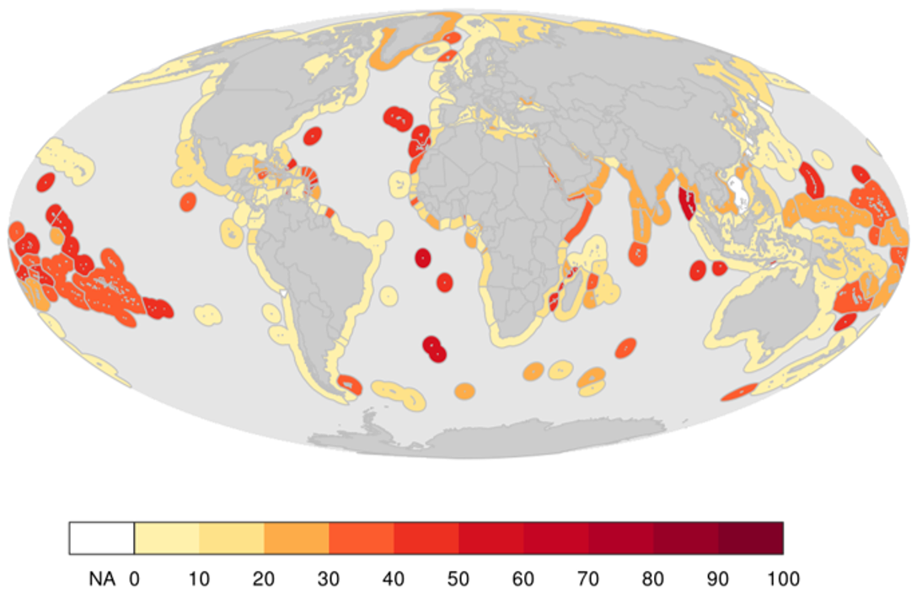
OHI global gapfilling

Slide 15
OHI global gapfilling
Break it down by region and goal

