Slide 1

Resilience in the Ocean Health Index
By Melanie Frazier
2016

Slide 2
Notes: Likely future state is mostly predicted using the trend in status during the past 5 years. Trend is our most direct way of predicting likely future state and is given the most weight. These values show that trend is 2x more important than resilience/pressure. However, resilience and pressure incorporate additional information that might not be captured by trend. If the resilience and pressure scores are equal, they cancel each other out and trend is the only component used to estimate future state. For today's discussion, we are going to take a closer look at resilience.
Components of an OHI goal score
(10 goal scores calculated for each region)
status
score
trend
= average of status
and future state)
future state
resilience
= status[1 +
0.67*trend +
0.33*(resilience - pressure)]
pressure

Slide 3
Resilience: a definition
Measure of factors that protect systems
- ecological integrity
- governance
- societal institutions
Has a positive effect on goal scores
Role in OHI
Predict future condition by incorporating additional
information beyond that provided by the recent trend

Slide 4
Resilience: components
Notes: Resilience is has a social and ecological component, which are equally weighted. A social resilience factor used in the global OHI was the Worldwide Governance Indicators.
Worldwide Governance Indicators (WGI)
Describes processes internal to a community that affect resilience (quality of life, social norms and community institutions that influence resource use and management, etc.)
social
resilience
ecological

Slide 5
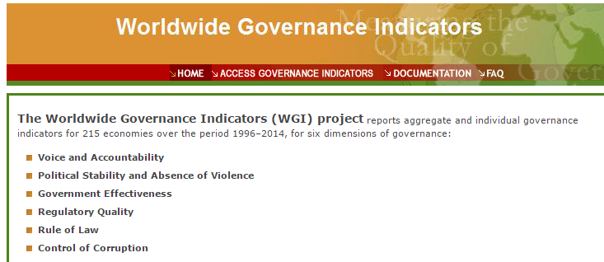
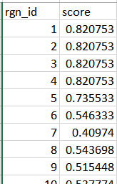
Notes: The WGI measures 6 dimensions of government for each country. We averaged the scores of the 6 WGI dimensions for each global reporting region. The final data layer includes the region id and the WGI score.
Resilience: Social: WGI
data layer
Average scores of 6 WGI dimensions for each global reporting region

Slide 6
Notes: The ecological component is made up of ecological integrity and regulatory sub-components which are equally weighted.
Resilience: components
Worldwide Governance Indicators (WGI)
social
ecological integrity
resilience
Species condition
ecological
Describes ecological factors that buffer environmental pressures
(species diversity, species condition)
regulatory

Slide 7
Notes: CITES = Convention on International Trade in Endangered Species of Wild Fauna and Flora
Resilience: components
Worldwide Governance Indicators (WGI)
social
ecological integrity
resilience
Species condition
ecological
Fisheries manag effect
Artisanal fish manag
CITES Signatories
Mariculture Sustainability Index
Alien species control (Conv on Biol Div, CBD)
Mariculture regs (CBD)
Tourism sustain effort (CBD)
Habitat regs (CBD)
Water regs (CBD)
regulatory
Describe regulatory factors that address ecological pressures
(rules, regulations, laws, institutional measures)

Slide 8

Resilience: Regulatory: CBD survey: Tourism
CBD survey
Country responses to survey on the implementation of the CBD used to obtain various resilience layers

Slide 9
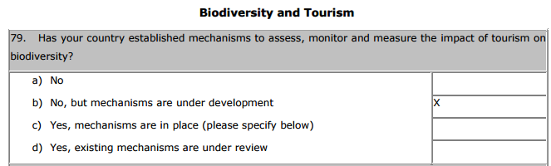
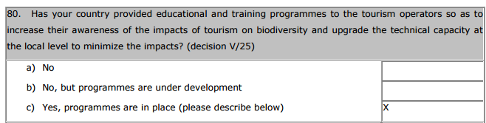
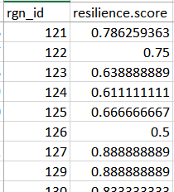
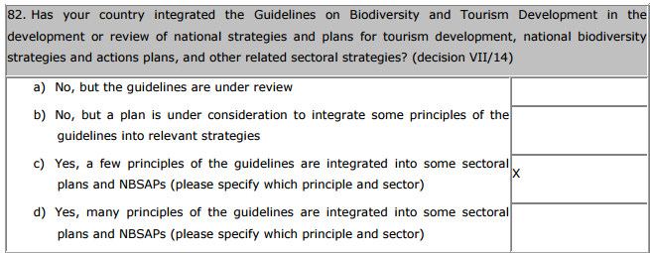
Resilience: Regulatory: CBD survey: Tourism
Notes: Brazil responses
Tourism Sustainability Effort
aggregate responses for each country to get resilience layer
Brazil

Slide 10
Notes:
Resilience: matrix
Resilience matrix
Worldwide Governance Indicators (WGI)
social
ecological integrity
resilience
Species condition
ecological
Fisheries manag effect
Artisanal fish manag
CITES Signatories
Mariculture Sustainability Index
Alien species control (Conv on Biol Div, CBD)
Mariculture regs (CBD)
Tourism sustain effort (CBD)
Habitat regs (CBD)
Water regs (CBD)
regulatory
Resilience measures aren't relevant to all goals
Need a "resilience matrix"!

Slide 11
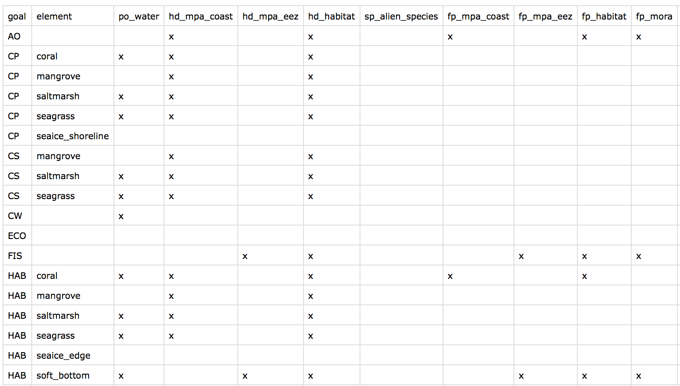
Resilience: Matrix
Notes:
Describes relationship between resilience layers and goals

Slide 12
Resilience: Matrix
Notes:
Assigning resilience to goals
goal specific
  - mariculture regulations paired with mariculture goal
pressure specific goals impacted by a particular stressor are assigned a resilience factor for regulations that are relevant to the pressure
    if FIS, AO, MAR, and NP are impacted by invasive species, then a resilience factor describing ballast water discharge/hull fouling regulations would be relevant to these goals

Slide 13
Notes: WGI is relevant to all goals
Resilience: matrix
Resilience matrix
Worldwide Governance Indicators (WGI)
social
ecological integrity
resilience
Species condition
ecological
Fisheries manag effect
Artisanal fish manag
CITES Signatories
Mariculture Sustainability Index
Alien species control (Conv on Biol Div, CBD)
Mariculture regs (CBD)
Tourism sustain effort (CBD)
Habitat regs (CBD)
Water regs (CBD)
regulatory
Example: Resilience layers used to calculate Iconic Species resilience

Slide 14
Notes:
Resilience: weights
weights
Resilience matrix
Worldwide Governance Indicators (WGI)
social
ecological integrity
resilience
Species condition
ecological
Fisheries manag effect
Artisanal fish manag
CITES Signatories
Mariculture Sustainability Index
Alien species control (Conv on Biol Div, CBD)
Mariculture regs (CBD)
Tourism sustain effort (CBD)
Habitat regs (CBD)
Water regs (CBD)
regulatory
Contribution of resilience factors to resilience score depends on how they are weighted

Slide 15
Resilience: Weights
Notes:
Resilience weights can reflect different considerations
Governance (global)
  Do institutional structures exist? (weight = 1)
  Clear processes for implementation? Effectiveness at meeting stated objectives? (weight = 2)
Downweighting related resilience data (Antarctica)
  UNEP gap report and UNFCCC Kyoto are both related to reducing carbon emissions and were given weights of 0.5 (other weights were 1)

Slide 16
Notes:
Resilience: weights
weights
model
Resilience matrix
Worldwide Governance Indicators (WGI)
social
ecological integrity
resilience
Species condition
ecological
Fisheries manag effect
Artisanal fish manag
CITES Signatories
Mariculture Sustainability Index
Alien species control (Conv on Biol Div, CBD)
Mariculture regs (CBD)
Tourism sustain effort (CBD)
Habitat regs (CBD)
Water regs (CBD)
regulatory
Some additional models describing how to to combine the resilience data layers and components (ohicore functions).

