Slide 1
{'bath': {0: 'dependent', 1: 'independent'},
'conti': {0: 'dependent', 1: 'independent'},
'dependent_independent': {0: 'dependent', 1: 'independent'},
'dress': {0: 'dependent', 1: 'independent'},
'dressing': {0: 'dependent', 1: 'independent'},
'ethnicity': {0: 'non_hisp', 1: 'hisp'},
'exhaust': {0: False, 1: True},
'feed': {0: 'dependent', 1: 'independent'},
'ffp_status': {0: 'frail', 1: 'prefrail', 2: 'robust'},
'fina': {0: 'dependent', 1: 'independent'},
'house': {0: 'dependent', 1: 'independent'},
'laun': {0: 'dependent', 1: 'independent'},
'living_situation': {0: 'alone',
1: 'with_spouse',
2: 'with_family',
3: 'with_others'},
'marital_status': {0: 'married',
1: 'divorced',
2: 'widowed',
3: 'separated',
4: 'never_married',
5: 'unknown'},
'meds': {0: 'dependent', 1: 'independent'},
'phys_act': {0: False, 1: True},
'prep': {0: 'dependent', 1: 'independent'},
'race': {0: 'am_in_al_na',
1: 'asian',
2: 'black',
3: 'na_ha_pa_is',
4: 'white',
5: 'unknown'},
'sex': {0: 'f', 1: 'm'},
'shop': {0: 'dependent', 1: 'independent'},
'shopping': {0: 'dependent', 1: 'independent'},
'slow': {0: False, 1: True},
'tele': {0: 'dependent', 1: 'independent'},
'telephone': {0: 'dependent', 1: 'independent'},
'toilet': {0: 'dependent', 1: 'independent'},
'toileting': {0: 'dependent', 1: 'independent'},
'transf': {0: 'dependent', 1: 'independent'},
'transp': {0: 'dependent', 1: 'independent'},
'weak': {0: False, 1: True},
'wt_loss': {0: False, 1: True},
'yes_no': {0: False, 1: True}}
Data mapping dictionary
Notes:
pulled from MDE clinical data.xlsx

Slide 2
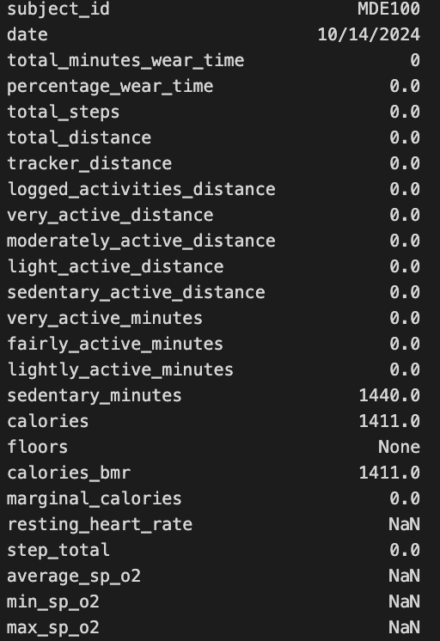
The device was on, but not worn?
This will be treated as no activity.
The calory should just be basal metabolic rate.

Slide 3
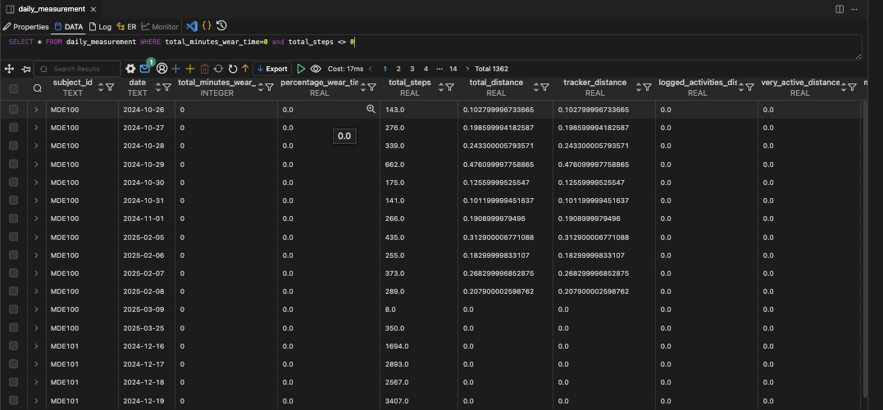
total_minutes_wear_time may not be a reliable marker for device usage

Slide 4
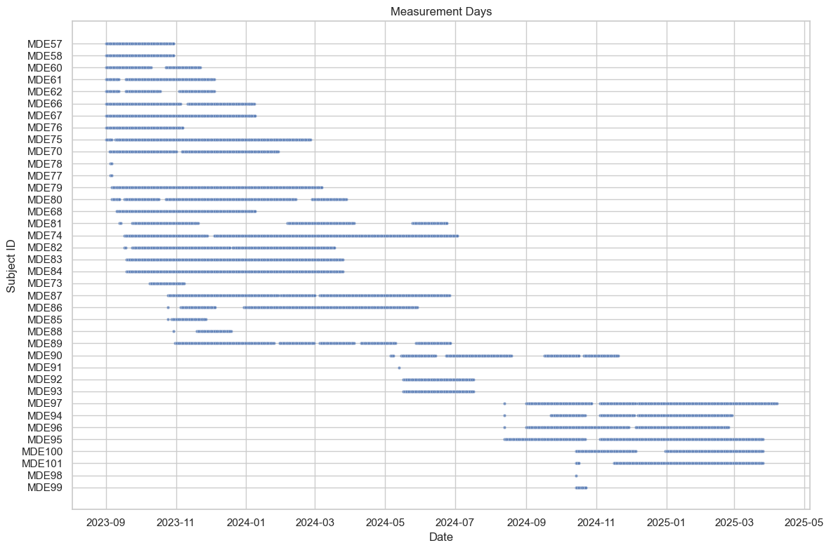
subject_id | measured_days
MDE74 | 286
MDE87 | 242
MDE95 | 214
MDE97 | 213
MDE89 | 211
MDE83 | 189
MDE84 | 189
MDE86 | 184
MDE80 | 184
MDE79 | 184
MDE82 | 178
MDE75 | 177
MDE96 | 173
MDE90 | 154
MDE81 | 150
MDE94 | 146
MDE70 | 144
MDE100 | 139
MDE101 | 135
MDE67 | 131
MDE66 | 125
MDE68 | 122
MDE61 | 90
MDE62 | 74
MDE60 | 71
MDE76 | 68
MDE92 | 62
MDE93 | 62
MDE57 | 60
MDE58 | 60
MDE85 | 32
MDE88 | 32
MDE73 | 31
MDE99 | 10
MDE77 | 2
MDE78 | 2
MDE91 | 1
MDE98 | 1
Days that the measurement was taken.
# of subjects = 38
4

Slide 5
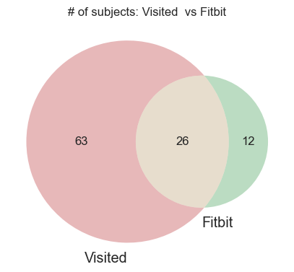
Patients that took the measurement, but not present in the visit (MDE clinical data.xlsx)
{'MDE100', 'MDE101', 'MDE90', 'MDE91', 'MDE92', 'MDE93', 'MDE94', 'MDE95', 'MDE96', 'MDE97', 'MDE98', 'MDE99'}
Notes:
I could only include subjects who have both clinical visit measurements and corresponding Fitbit activity tracker data (n=26)

Slide 6
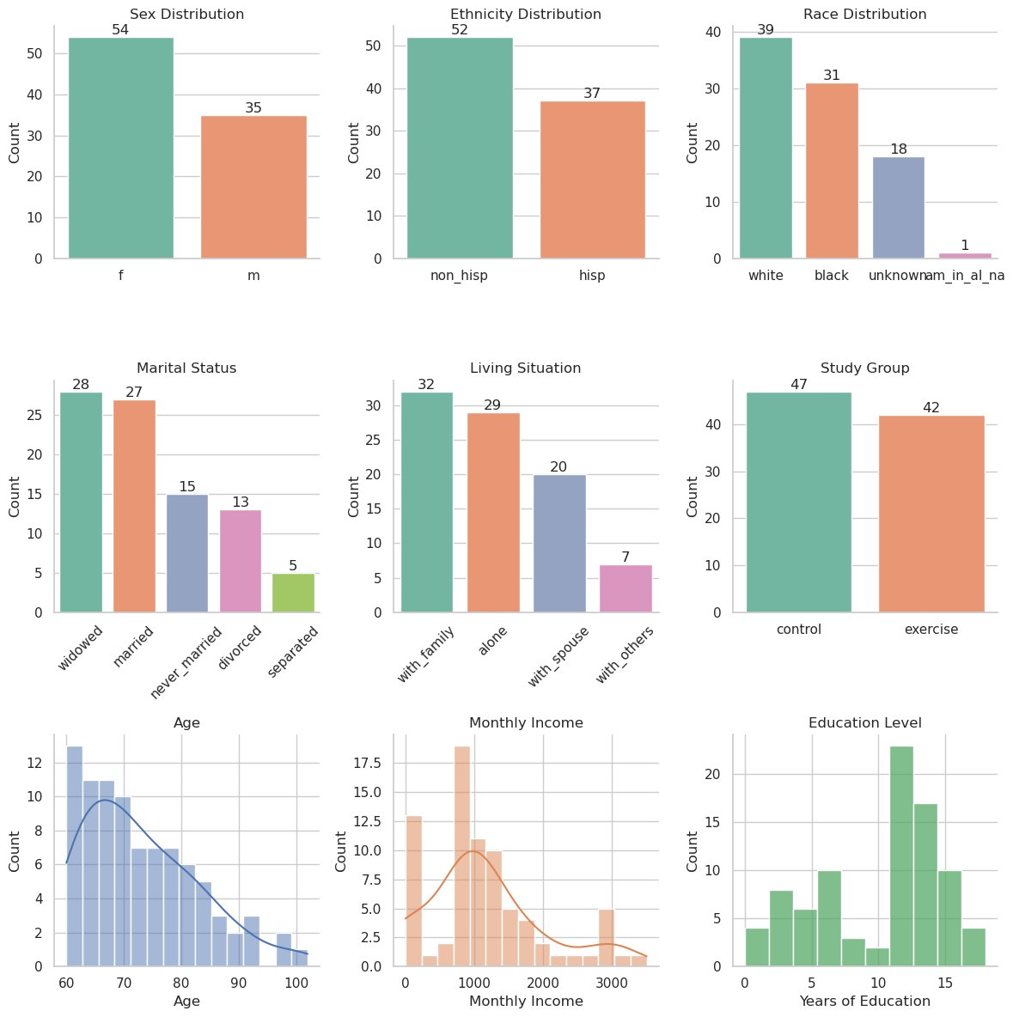
Subject demographics
Notes:
pulled from MDE clinical data.xlsx

