Slide 1
{'bath': {0: 'dependent', 1: 'independent'},
'conti': {0: 'dependent', 1: 'independent'},
'dependent_independent': {0: 'dependent', 1: 'independent'},
'dress': {0: 'dependent', 1: 'independent'},
'dressing': {0: 'dependent', 1: 'independent'},
'ethnicity': {0: 'non_hisp', 1: 'hisp'},
'exhaust': {0: False, 1: True},
'feed': {0: 'dependent', 1: 'independent'},
'ffp_status': {0: 'frail', 1: 'prefrail', 2: 'robust'},
'fina': {0: 'dependent', 1: 'independent'},
'house': {0: 'dependent', 1: 'independent'},
'laun': {0: 'dependent', 1: 'independent'},
'living_situation': {0: 'alone',
1: 'with_spouse',
2: 'with_family',
3: 'with_others'},
'marital_status': {0: 'married',
1: 'divorced',
2: 'widowed',
3: 'separated',
4: 'never_married',
5: 'unknown'},
'meds': {0: 'dependent', 1: 'independent'},
'phys_act': {0: False, 1: True},
'prep': {0: 'dependent', 1: 'independent'},
'race': {0: 'am_in_al_na',
1: 'asian',
2: 'black',
3: 'na_ha_pa_is',
4: 'white',
5: 'unknown'},
'sex': {0: 'f', 1: 'm'},
'shop': {0: 'dependent', 1: 'independent'},
'shopping': {0: 'dependent', 1: 'independent'},
'slow': {0: False, 1: True},
'tele': {0: 'dependent', 1: 'independent'},
'telephone': {0: 'dependent', 1: 'independent'},
'toilet': {0: 'dependent', 1: 'independent'},
'toileting': {0: 'dependent', 1: 'independent'},
'transf': {0: 'dependent', 1: 'independent'},
'transp': {0: 'dependent', 1: 'independent'},
'weak': {0: False, 1: True},
'wt_loss': {0: False, 1: True},
'yes_no': {0: False, 1: True}}
Data mapping dictionary
Notes:
pulled from MDE clinical data.xlsx

Slide 2
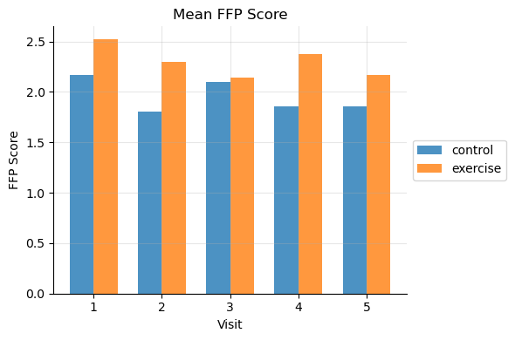
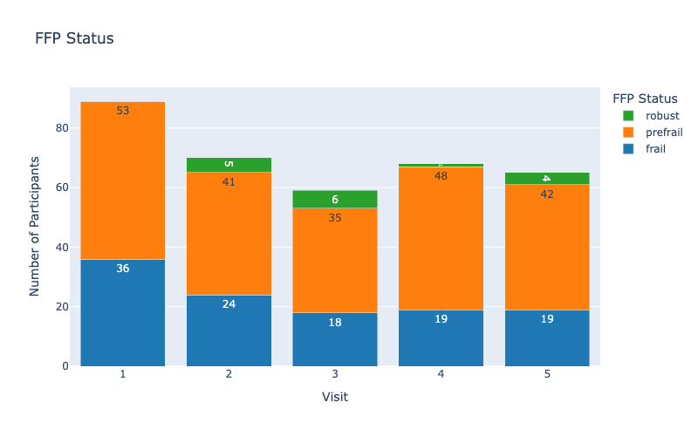
Visits (Frailty measurement (FFP score and FFP status))
FFP score = wt_loss + weak + slow + exhaust + phys_act
Notes:
I think we can combine Pre-frail and Robust into No-Frail so it becomes a binary classification task (No-Frail (0) and Frail (1) )

Slide 3
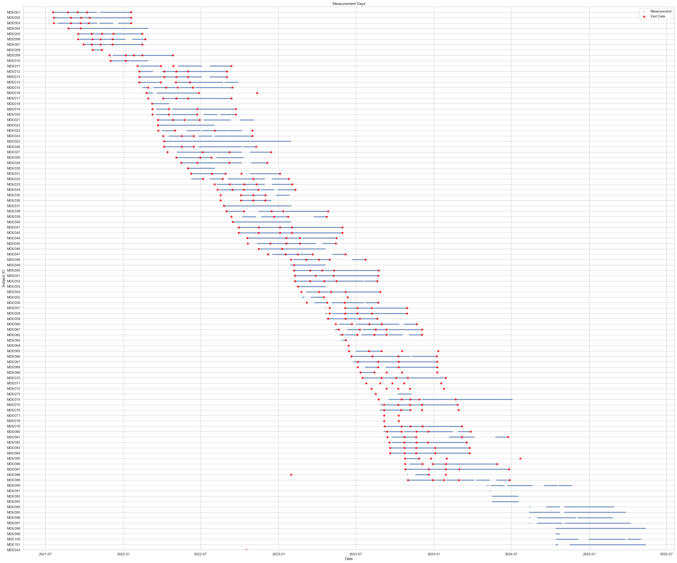
Notes:
The earliest visit date is 2021-07-19 from MDE01.

Slide 4
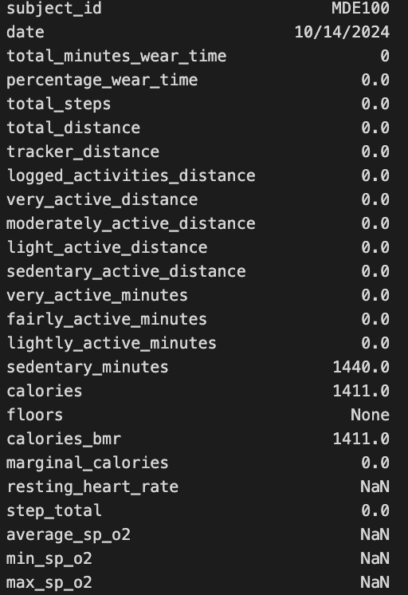
The device was on, but not worn?
This will be treated as no activity.
The calory should just be basal metabolic rate.

Slide 5
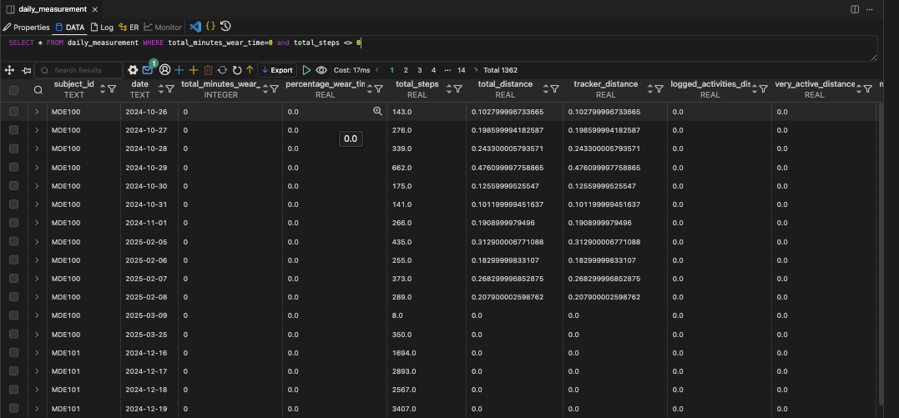
total_minutes_wear_time may not be a reliable marker for device usage

Slide 6
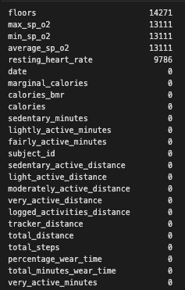
# of missing values
Notes:
Days not worn but steps recorded: 3581
Days with steps but no distance: 99

Slide 7
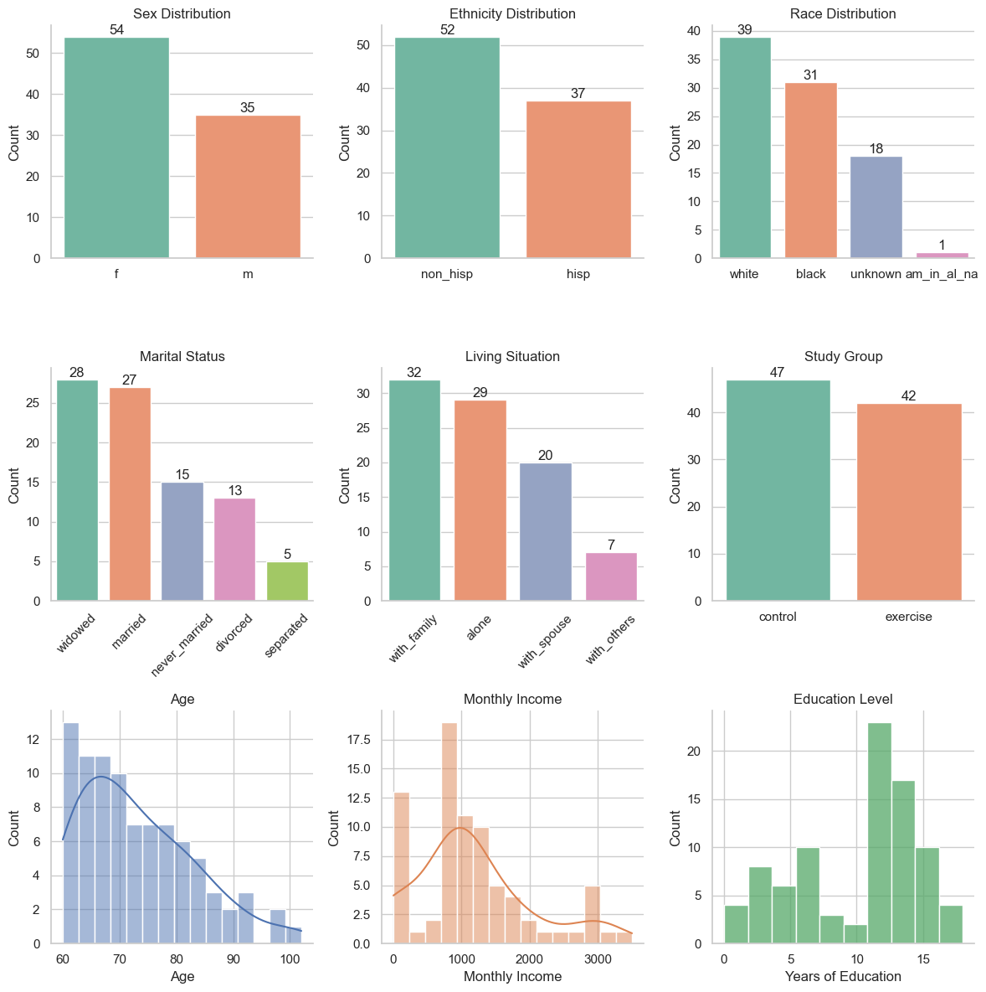
Subject demographics
Notes:
pulled from MDE clinical data.xlsx

Slide 8
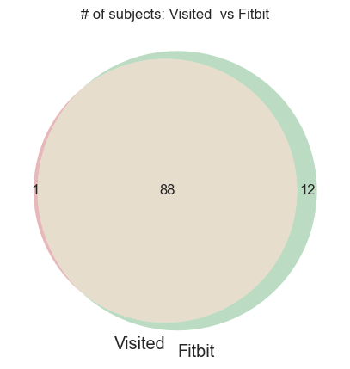
Patients that took the measurement, but not present in the visit (MDE clinical data.xlsx)
Notes:
88 has both visit and fitbit measurements.

Slide 9
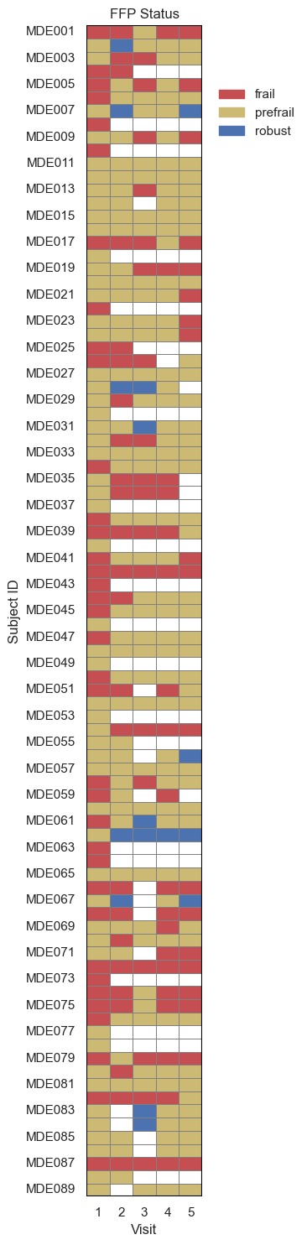
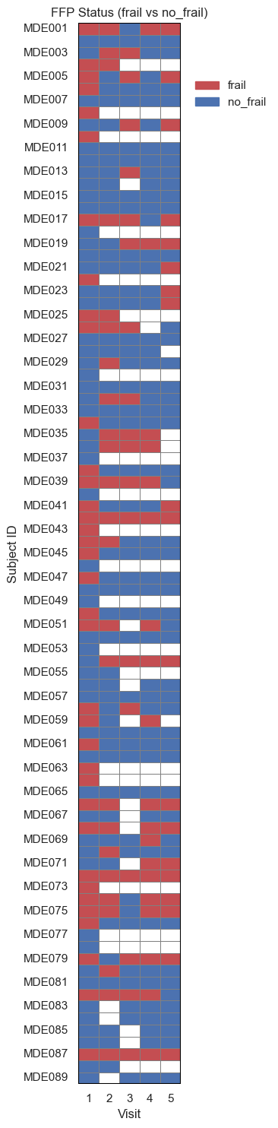
frail vs. no_frail (prefrail and robust has been combined into no_frail).
Notes:
Response variable binarized

Slide 10
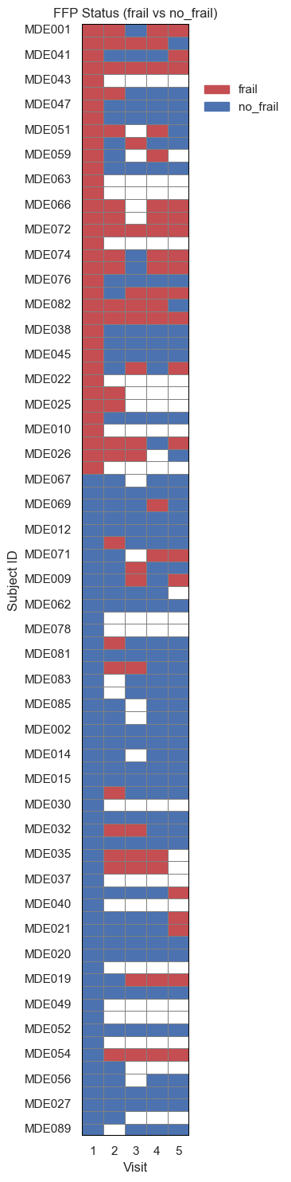
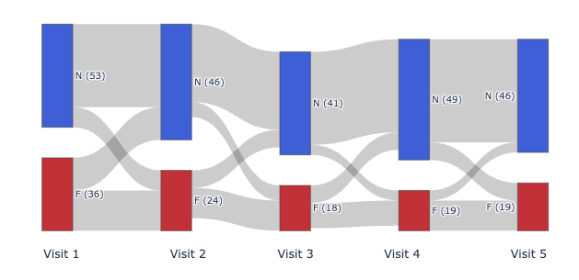
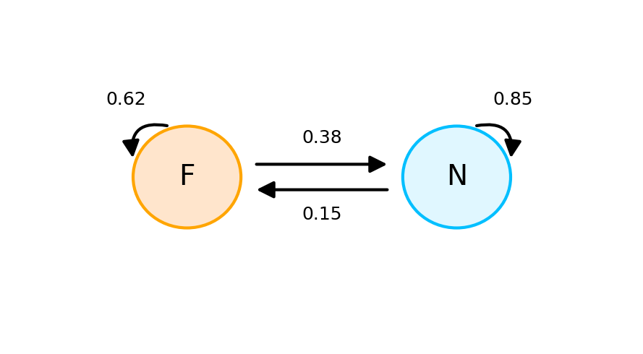
State transition
From → To | frail | no_frail
frail | 53 | 32
no_frail | 27 | 150
Notes:
Heatmap
Most subjects are “no_frail” (blue) at most visits.
Some subjects transition between frail and no_frail over time.
A few subjects remain persistently frail (red) or persistently no_frail (blue).
Sankey
The majority of subjects start as no_frail (N) and tend to remain no_frail across visits.
There is a visible flow from frail (F) to no_frail (N), indicating recovery.
Some subjects transition from no_frail to frail, but this is less common.
The number of frail subjects decreases over time, while no_frail remains high or increases.
Transition matrix
no_frail is a much more stable state than frail

Slide 11
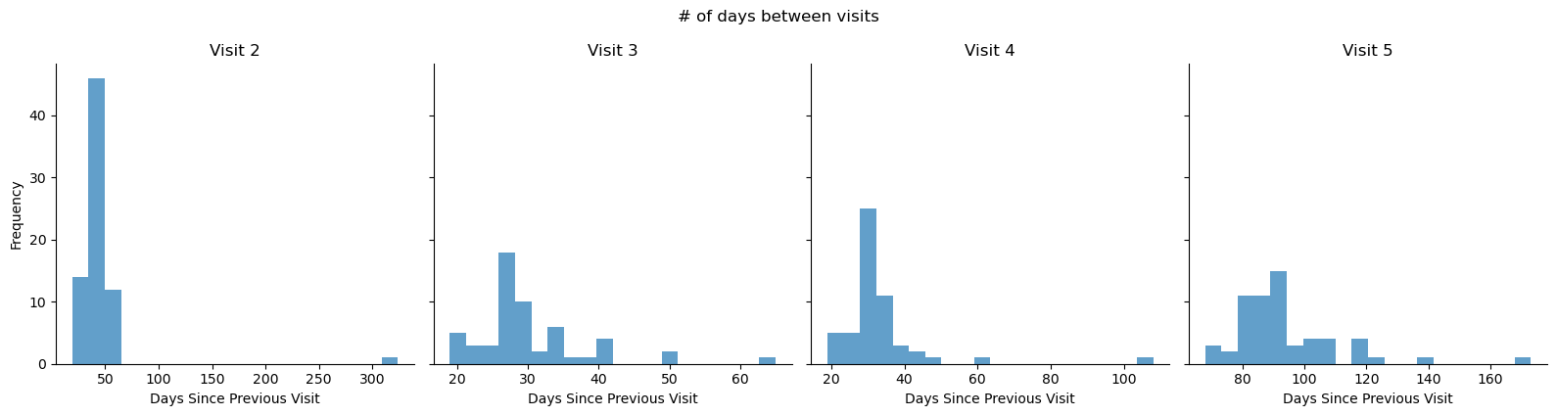
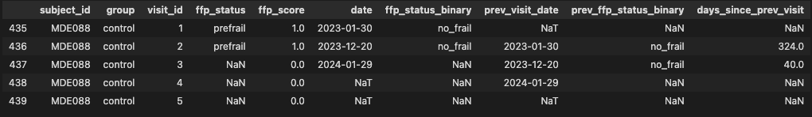
# days between visit intervals

Slide 12
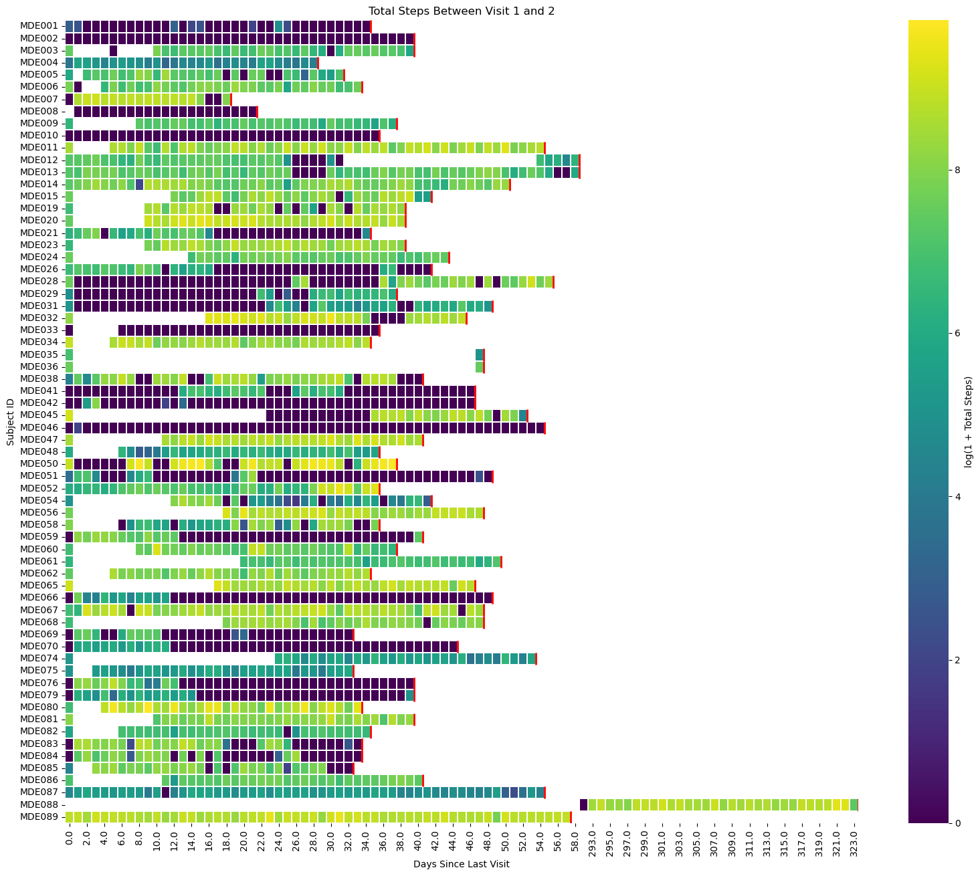
Total # of steps between visits (1 - 2)

Slide 13
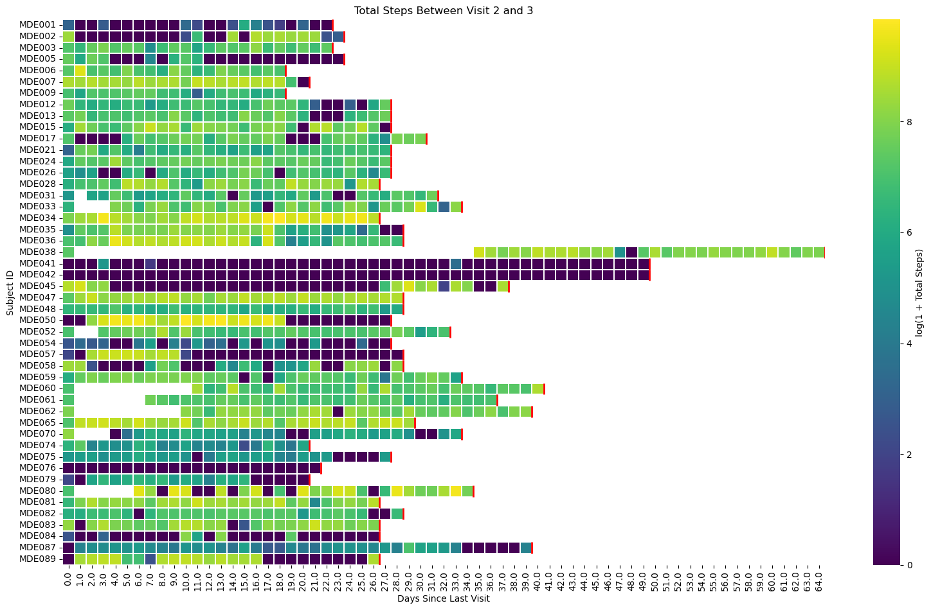
Total # of steps between visits (2 – 3)

Slide 14
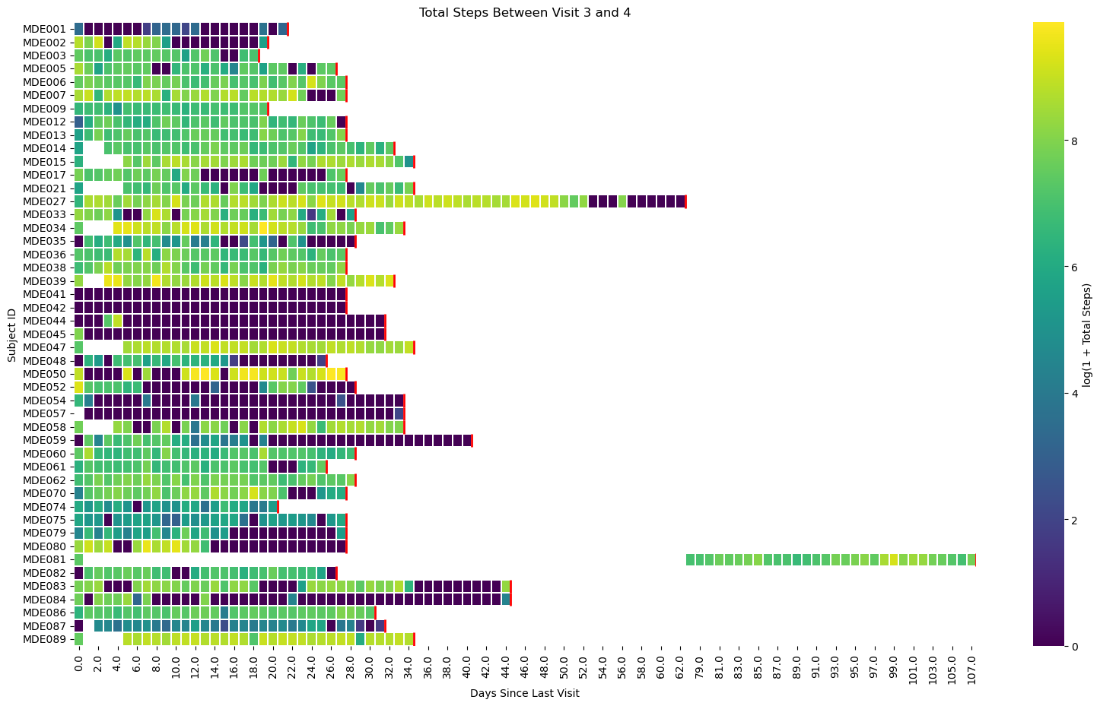
Total # of steps between visits (3 – 4)

Slide 15
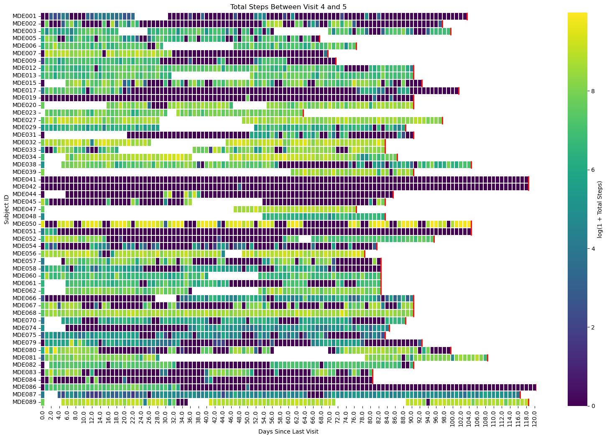
Total # of steps between visits ( 4 - 5)

Slide 16
Feature matrix
Target variable
subject_id | prev_ffp_status | total_steps_sum | total_steps_mean | total_steps_std | days_exercised | interval_length | longest_active_streak | prop_days_exercised | visit_interval | cumulative_steps | sex | age | ethnicity | race | monthly_income | education | marital_status | living_situation
MDE001 | frail | 358 | 9.944444444444445 | 31.889939698410437 | 9 | 36 | 2 | 0.25 | 1_to_2 | 358 | m | 83 | non_hisp | black | 3000 | 18 | never_married | with_others
MDE001 | frail | 639 | 26.625 | 87.48257590489962 | 11 | 24 | 5 | 0.4583333333333333 | 2_to_3 | 997 | m | 83 | non_hisp | black | 3000 | 18 | never_married | with_others
MDE001 | no_frail | 235 | 10.217391304347826 | 13.707849515511942 | 10 | 23 | 6 | 0.43478260869565216 | 3_to_4 | 1232 | m | 83 | non_hisp | black | 3000 | 18 | never_married | with_others
MDE001 | frail | 1291 | 13.309278350515465 | 29.515659976507333 | 29 | 97 | 12 | 0.29896907216494845 | 4_to_5 | 2523 | m | 83 | non_hisp | black | 3000 | 18 | never_married | with_others
MDE002 | no_frail | 0 | 0 | 0 | 0 | 41 | 0 | 0 | 1_to_2 | 0 | m | 61 | non_hisp | white | 1033 | 3 | never_married | alone
MDE002 | no_frail | 38928 | 1557.12 | 2279.0916560477917 | 12 | 25 | 9 | 0.48 | 2_to_3 | 38928 | m | 61 | non_hisp | white | 1033 | 3 | never_married | alone
MDE002 | no_frail | 44883 | 2137.285714285714 | 3039.364442492166 | 11 | 21 | 6 | 0.5238095238095238 | 3_to_4 | 83811 | m | 61 | non_hisp | white | 1033 | 3 | never_married | alone
MDE002 | no_frail | 79987 | 807.9494949494949 | 1807.017151888474 | 33 | 99 | 7 | 0.3333333333333333 | 4_to_5 | 163798 | m | 61 | non_hisp | white | 1033 | 3 | never_married | alone
target_ffp_status
frail
no_frail
frail
frail
no_frail
no_frail
no_frail
no_frail
Notes:
Imputation
# Fill missing total_steps_std with 0
df['total_steps_std'] = df['total_steps_std'].fillna(0)
# Fill missing monthly_income with median
median_income = df['monthly_income'].median()
df['monthly_income'] = df['monthly_income'].fillna(median_income)
# Fill missing education with mode
df['education'] = df['education'].fillna(df["education"].mode().iloc[0])
Feature imputation increased the performance on random forest classifier by ~2%

Slide 17
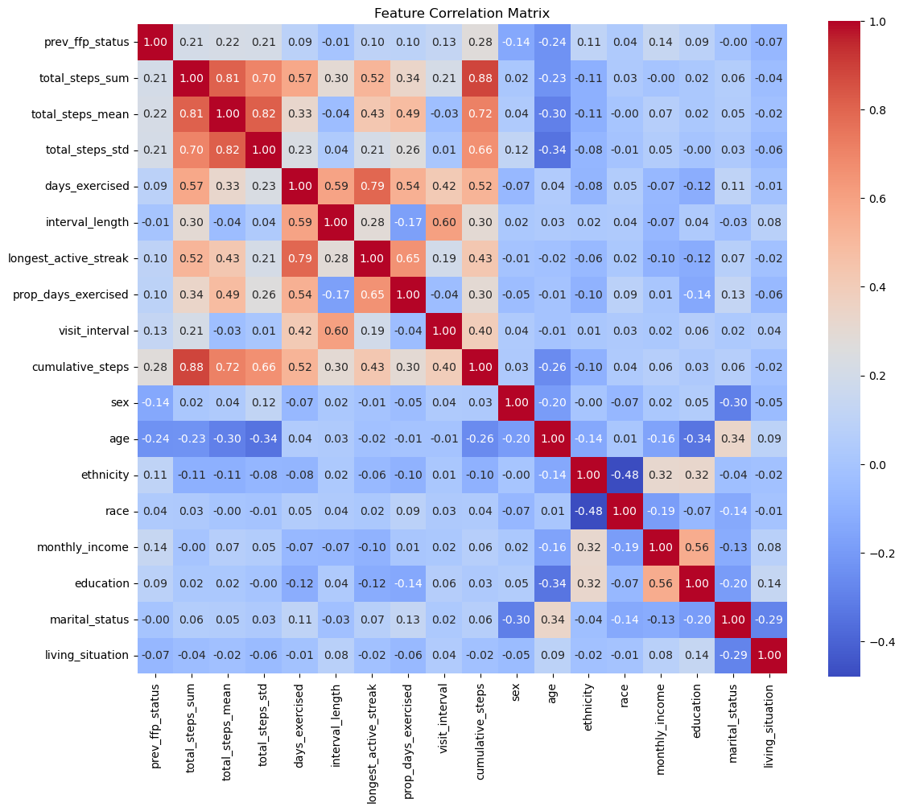
Notes:
- Activity features are highly correlated with each other so we might want to considering losing some redundant features.

Slide 18
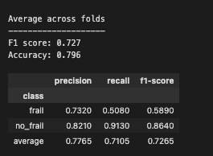
Model performance (Random forest classifier with 5-fold cross-validation)
Notes:
- Other models (xgboost) yields comparable performance. There’s room for improvement with hyper-parameter tuning.

Slide 19
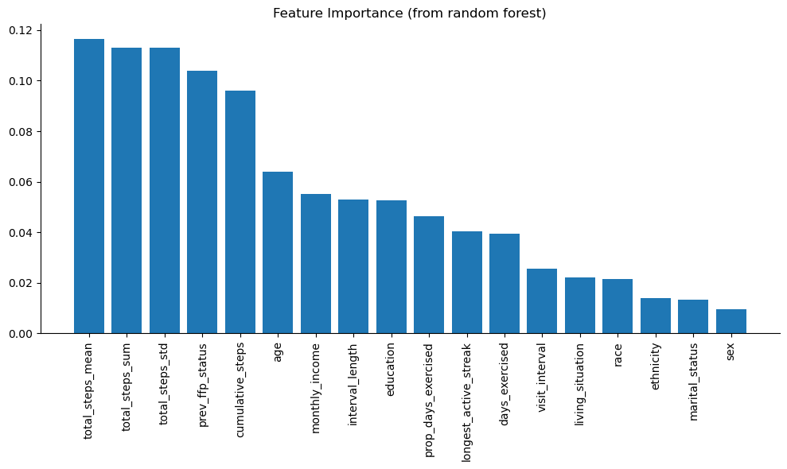

Slide 20
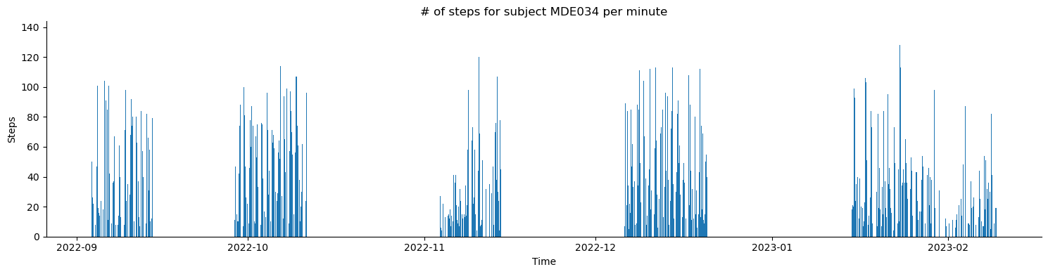
Minute level steps

Slide 21
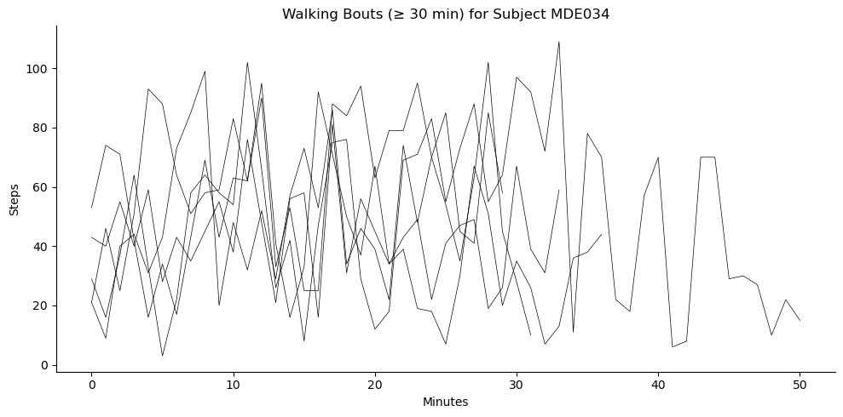
Walking bouts

