Slide 1
Leveraging social networks to detect of anomalous insider actions in collaborative environments
ISI 2011
You Chen, Steve Nyemba, Wen Zhang, Bradley Malin
Health Information Privacy Lab, Vanderbilt University

Slide 2
Outline
Motivation
Typical attacks
Methods
Experiments
Limitations and future works

Slide 3
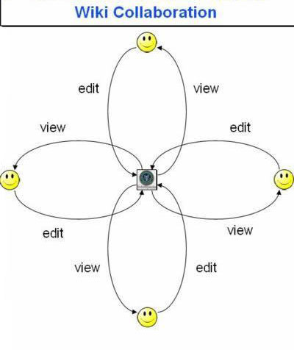

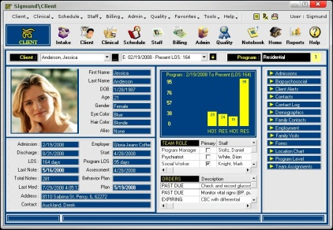


Motivation
Wiki Editing System: multiple users can view or edit common pages
Electrical Health Records Systems: multiple users access common patients’ records

Slide 4
Privacy requirements, especially for sensitive information
S_1
S
For different tasks, the roles and permissions are always evolving and changing, it is difficult to define these roles and permissions.
S_3
S_2
S_4
Hackers can steal different roles to illegally access subjects’ sensitive information without being detected
S_5
Roles and permissions
S_6
S_7
u_1
u_4
u_2
Behavior Modeling
u_6
Information requirements which leads to Information exposure
u_5
u_3
U

Slide 5
Outline
Motivation
Typical attacks
Methods
Experiments
Limitations and future works

Slide 6



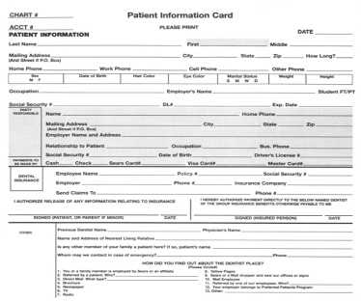



Typical Attacks
Two problems:
(1) Anomalous users detection-CODASPY11-CADS–user level
(2) Anomalous accesses detection-current works-SNAD –access level
Insider threats
c
b
a
a
External threats

Slide 7
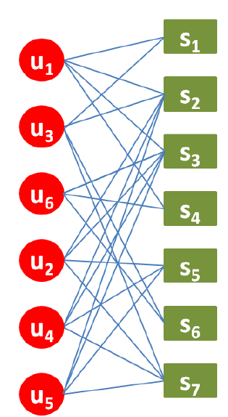
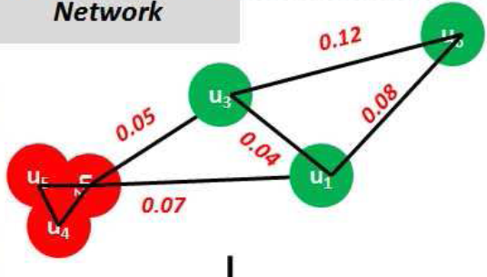
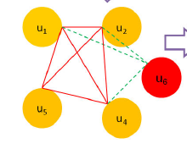
Detecting anomalous users from a global view is a cool way to protect privacy of subjects information, and CADS is a typical model by using global social network
For subject S₃, constructing local access network
Constructing a global nearest neighbor network
SNAD detects attacks from local view, and it detects more specific attacks such as anomalous accesses

Slide 8
Outline
Motivation
Typical attacks
Methods
Experiments
Limitations and Future works

Slide 9
Methods
The methods were both based on access patterns which can be retrieved from a bipartite graph of users and subjects
SNAD: A specialized network anomaly detection model
SNAD hypothesizes that if a user in the local network is anomalous, the similarity between this user to the network will be lower than the remaining users

Slide 10
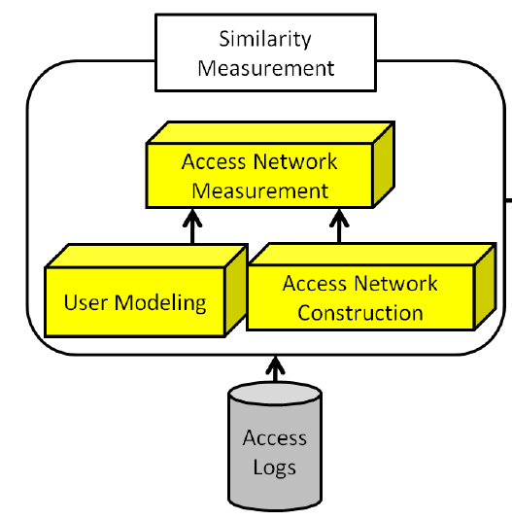
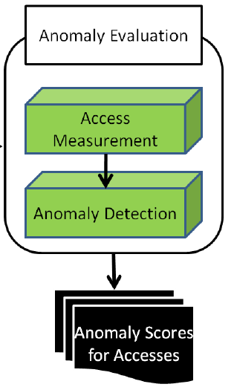
Framework of SNAD

Slide 11
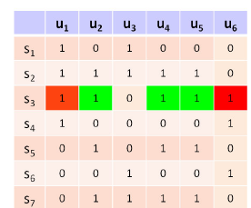
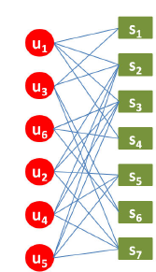
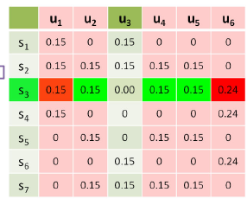

User Modeling

Slide 12
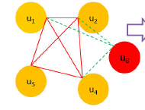
Access Network Construction

Slide 13
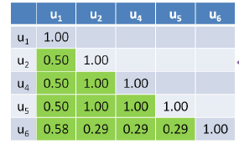
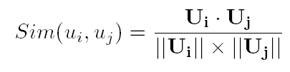
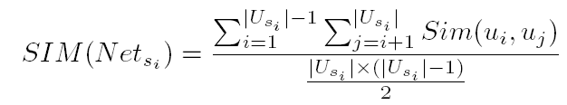
User Modeling

Slide 14
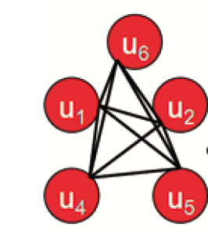
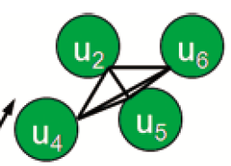

Anomaly Evaluation - Access Measurement

Slide 15
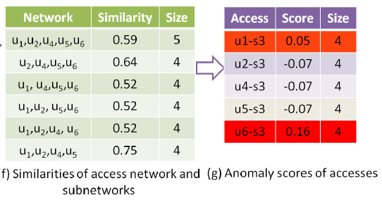
Anomaly Evaluation – Anomaly detection

Slide 16
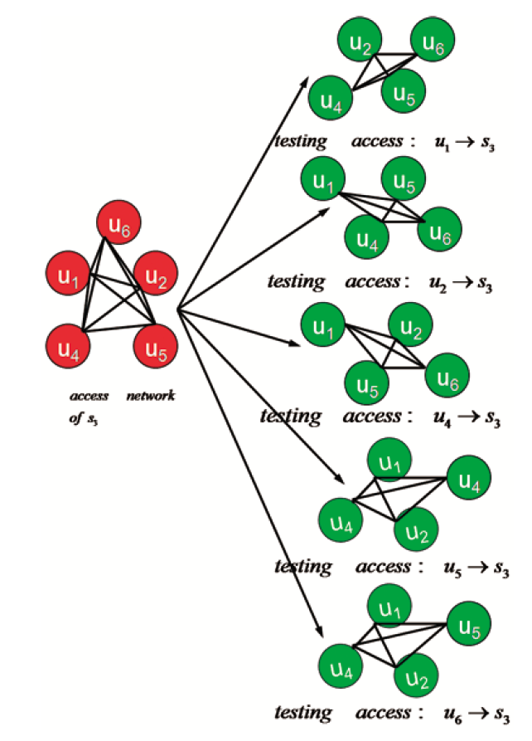

Anomaly Evaluation

Slide 17
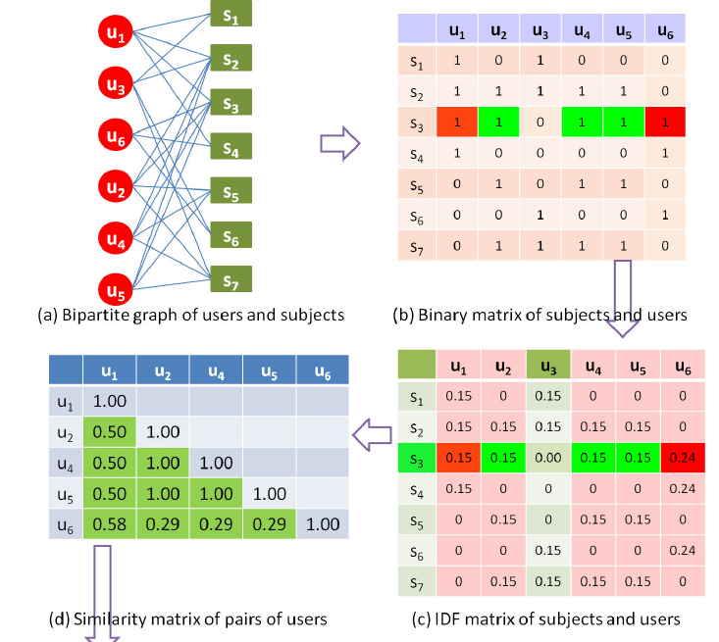
Compared Models: Spectral Anomaly Detection Model
Spectral decomposition binary matrix
Spectral analysis
Spectral decomposition on IDF matrix
Spectral decomposition is a popular and general method to measure communities of users, so we here compare our model with this method

Slide 18
Experiments
Motivation
Typical attacks
Methods
Experiments
Limitations and future works

Slide 19

Data Sets
Vanderbilt Medical Center. From a very large EHR system-patients’ records are considered as subjects
-Private dataset
Wiki editing system-pages are considered as subjects
-Public dataset and can be replicated SNAD on this dataset

Slide 20
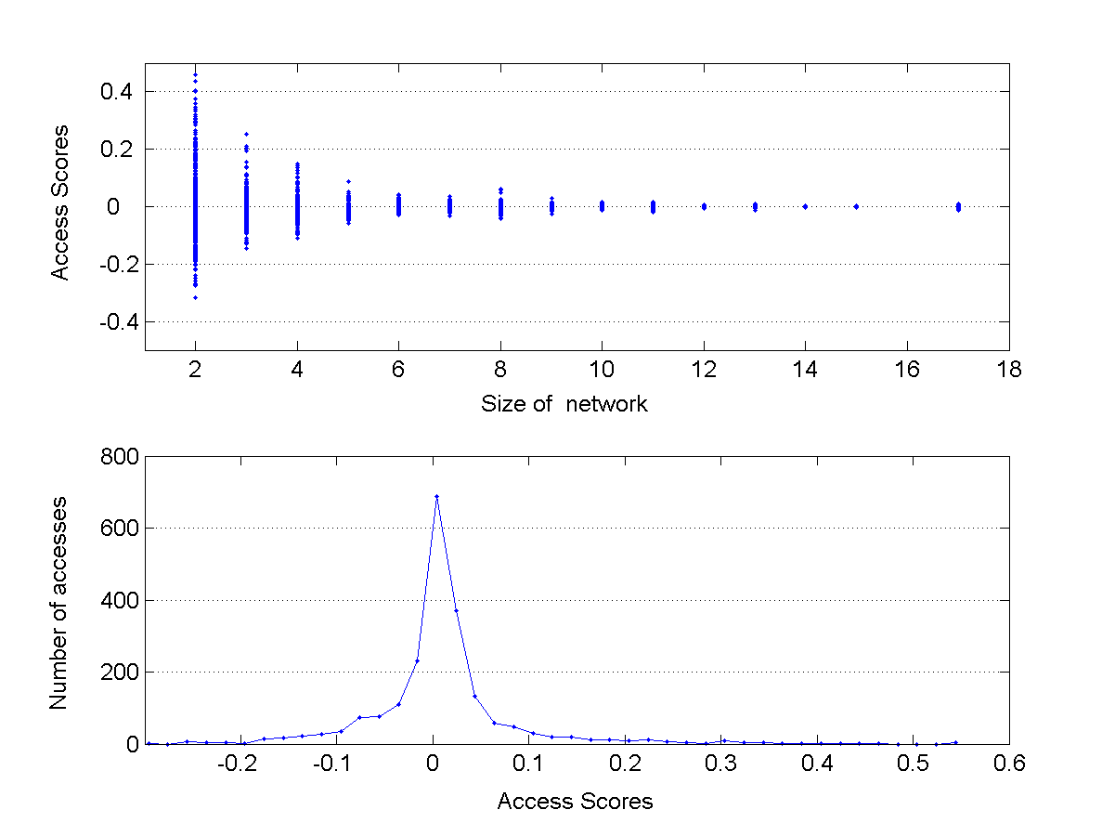
In EHR System-one week
Access Score
Size of network
Number of Accesses
Access Score

Slide 21
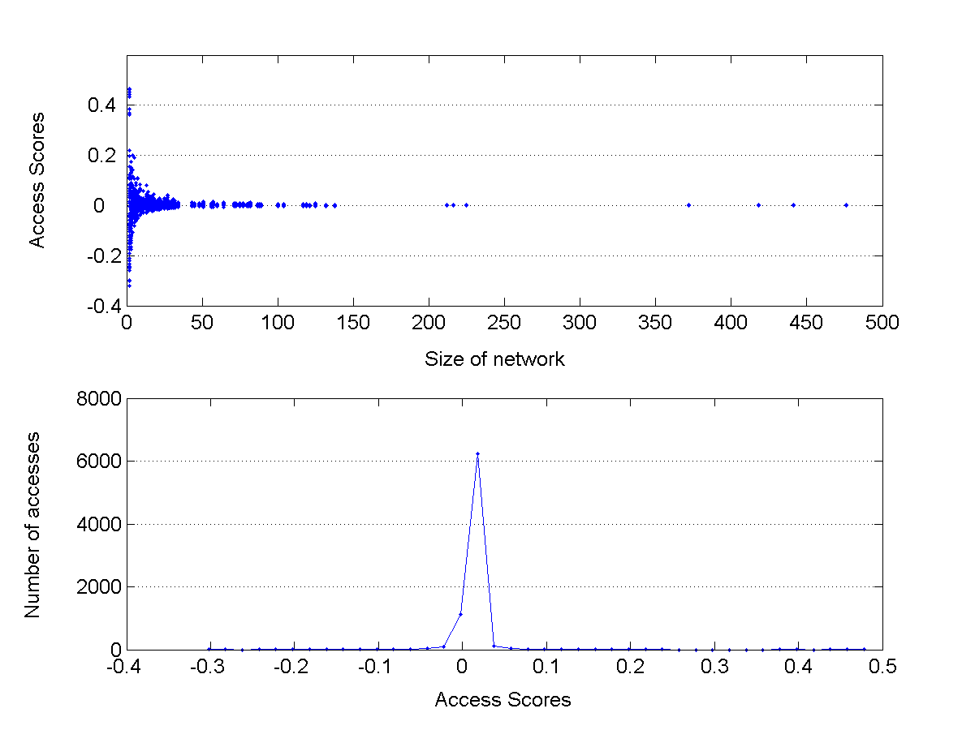
In Wiki-one week
Access Score
Size of network
Number of Accesses
Access Score

Slide 22
Evaluation
For a random user, verifying how number of simulated access injected into this user influence the performances of SNAD
For a fixed number of simulated accesses, verifying how number of intruded users influence the performances of SNAD
The number of simulated accesses and intruded users are both diverse

Slide 23
Model Evaluation-setting 1
For a random user, injecting simulated accesses
s₁ | s₂ | s₃ | … | s_{i} | … | s_{n}
0 | 1 | 0 | … | 0 | … | 0
0 | 1 | 1 | … | 0 | … | 0
1
1 | 1 | 1 | … | 0 | … | 0
2
.
.
.
1 | 1 | 1 | … | 1 | … | 1
100

Slide 24
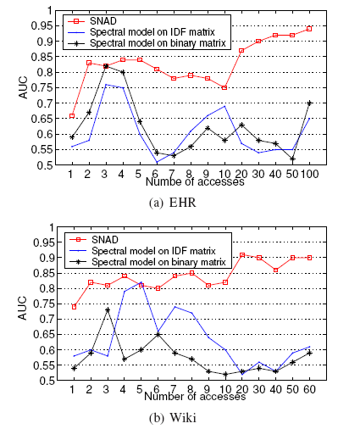

Slide 25
Model Evaluation-setting 2
Fixing number of simulated accesses, number of intruders is random
s₁ | s₂ | s₃ | … | s_{i} | … | s_{n}
1 | 1 | 1 | … | 0 | … | 1
Intruder_1
0 | 1 | 1 | … | 1 | … | 1
Intruder_2
.
.
.
1 | 1 | 1 | … | 1 | … | 0
Intruder_k
Notes:
The second setting investigates how the number of anomalous insiders influences the rate of detection. In this case, we vary the number of anomalous insiders from 2 to 20. An anomalous insider is that who has simulated accesses.

Slide 26
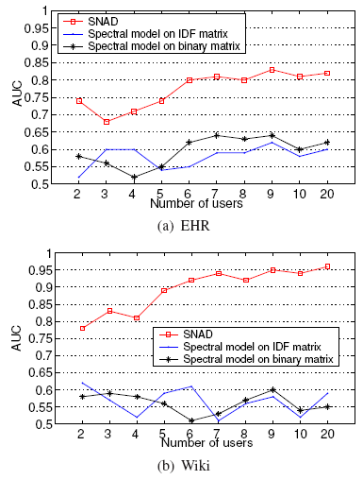

Slide 27
Model Evaluation-setting 3
Fixing number of simulated accesses, number of intruders is random
s₁ | s₂ | s₃ | … | s_{i} | … | s_{n}
1 | 1 | 0 | … | 0 | … | 0
Intruder_1
0 | 1 | 1 | … | 1 | … | 1
Intruder_2
.
.
.
0 | 1 | 1 | … | 1 | … | 0
Intruder_k

Slide 28
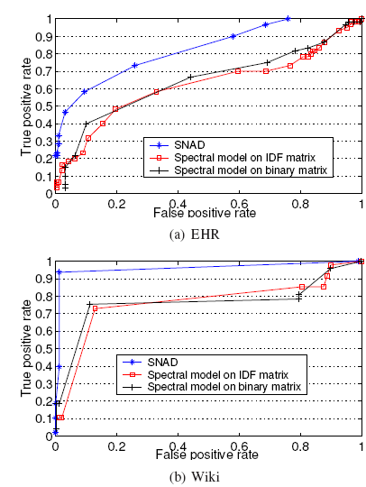


Slide 29
Experiments
Motivation
Typical attacks
Methods
Experiments
Limitations and future works

Slide 30
Limitations and Future Works
Only mining access patterns on users and subjects will lead to high false positive rates and low true positive rates
When mining normal patterns, we can include semantic information of users and subjects to decrease false positive rates and increase true positive rates
SNAD is not appropriate on large access network with low network similarity. In this case, the suppression of a user has little influence on the similarity of access network. In HER system and Wiki system, SNAD has high performance, since these systems are collaborative and access networks have high network similarity

Slide 31
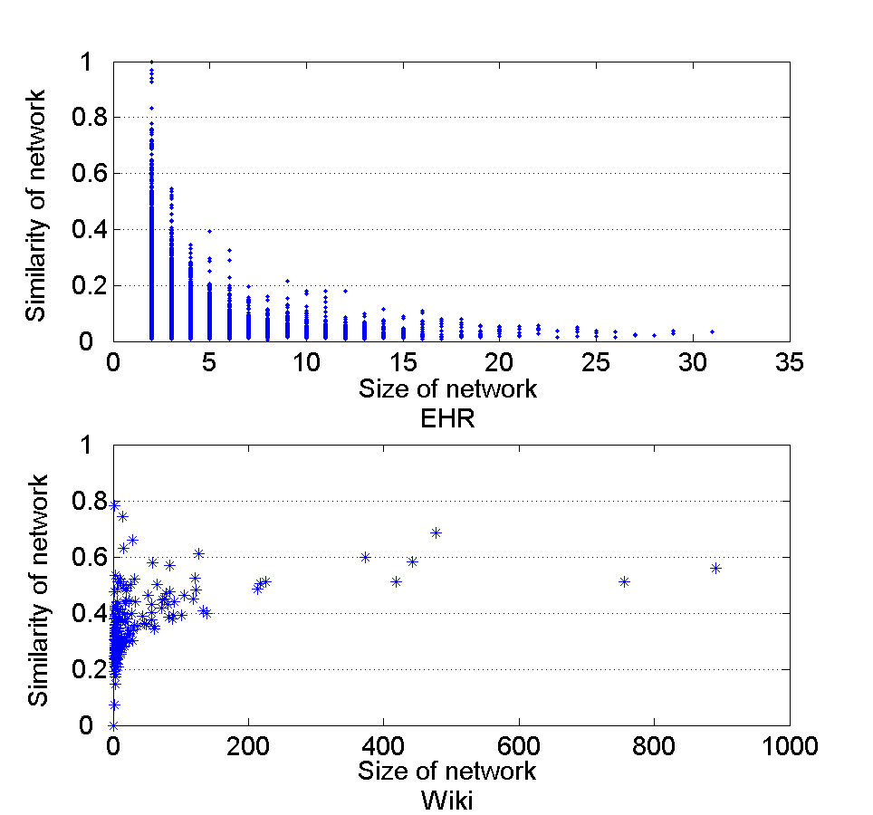

Slide 32
Questions?
You.chen@vanderbilt.edu

