Slide 1
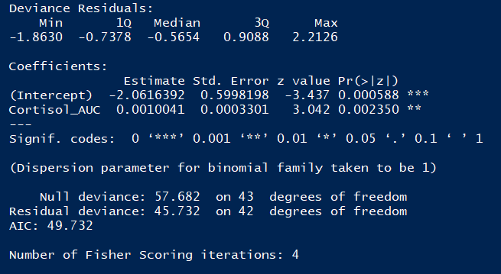
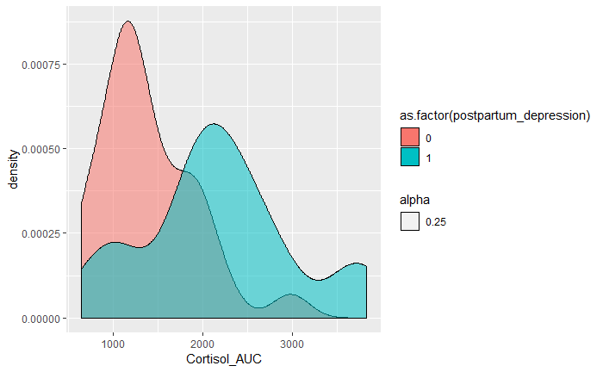
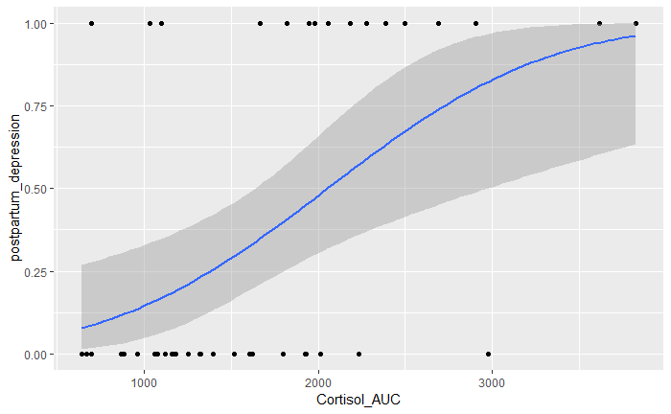
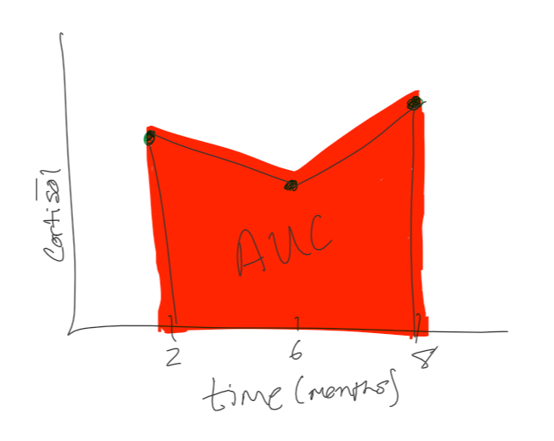
Extension
Using the longitudinal cortisol data, we performed linear interpolation to calculate the area under the curve (AUC) for each patient.
Using the cortisol AUC values, we plotted the density distribution, showing clear population divergences
Last, we fit a probit model to our postpartum depression with respect to cortisol AUC values
The ANOVA shows significance

