Slide 1
PRIDE Submission Guide
Phil Wilmarth
May 2020
Notes:
With more and more journals requiring mass spec data be placed in data repositories to submit manuscripts, you may find yourself struggling with an efficient workflow for ProteomeXchange data submissions. This guide is how I prepare the data and metadata for submissions.

Slide 2
ProteomeXchange is the portal
http://www.proteomexchange.org
http://www.proteomexchange.org/submission/index.html
https://www.ebi.ac.uk/pride/
There is a GUI submission tool
Java application
https://www.ebi.ac.uk/pride/markdownpage/submitdatapage#how_to_submit_data
https://www.ebi.ac.uk/pride/static/markdown/submitdatapage/files/Submission_Tutorial.pdf
Notes:
ProteomeXchange is not PRIDE. There are several other repository options that can meet journal requirements. ProteomeXchange is kind of a centralized switchyard for data archives. I have only used PRIDE. There is a Java GUI application that you use for submitting data to PRIDE via ProteomeXchange. This guide will show you how to use that tool to make your data submission. You should do some reading at the links above to get some overview of what is to come.

Slide 3
The Big Picture
You need to collect the data files
Despite large file sizes, it is best to have files copied to a single folder
You need to know which files you need
Need to know types of files and their relationships
You need to collect the required metadata
A copy of the manuscript helps
A Word or Text file with all metadata in one place helps
Notes:
I always create a new folder for PRIDE submissions and copy all files for the submission into one place. This folder can be large. If space is a concern, almost all files will be copies and the folder can probably be deleted after the submission has been accepted. At that point, you will have copies of all the files at PRIDE anyway.

Slide 4
What files do I have to try and find?
How long do you keep files and how good are your backup records?
It can take years to get mass spec data published
Scientists are just regular people in lab coats – don’t judge
You may have to do some detective work to associate the final results in a manuscript with the RAW files and other project files
You will need all RAW files the results were based on
You will need search engine results files
Notes:
Chain of custody for data is a can of worms. In our core, we archive the data for the clients. The clients typically get the major results summaries that are much small than the total project size. We often need to iterate on the data analysis choices with the clients once they start looking over the results (you used the wrong species, you did not use our favorite protein database, you did not have our expressed protein construct’s sequence correct, you did not look for “my favorite PTM”, etc.). If we were to start with a full data handoff (of several GB of files) then redo analyses, we end up with a version control mess. It is also likely that an experiment did not work and will be repeated. What data files constitute “the experiment” starts to get complicated.
Our solution of holding back the nitty gritty stuff like the RAW files hides a lot of unnecessary details from the client. That comes back to bite you in the ass at manuscript submission time when you have to find the old files (and find the correct old files for the actual set of results being published). We have no control over what clients do with results files in the months to years that elapse between acquiring the data and submitting the manuscript. It helps to keep some notes about what files were sent to clients. It helps to have nice, informative, summary files so that there is less perceived need to change the files so extensively that you have trouble matching them to the original files.
For the data used in this example, some of the runs were from 2013 for a manuscript being submitted in 2020. That is on the longer time frame, for sure. We do see 3-5 years pretty frequently. That means that having to submit data to archives was not a requirement when the data was collected. You and your clients started the project in a different context than we have now. This will cause some confusion when submitting a manuscript and running into the roadblock of having to have a data archive reference in the manuscript. Get used to this. It is going to keep happening. Be professional.

Slide 5
What files do I have to copy?
You will need all RAW files the results were based on
You might want to double check the instrument settings against the manuscript details
You will need search engine results files from those RAW files
That means the input (peak lists) and output files
Don’t forget the FASTA protein sequence file(s) you used
Check the search parameters against the manuscript details
You will need the results files generated from the search files
There are usually protein and peptide reports
There can be quantitative data reports
Notes:
Assuming that you have done thorough detective work and know what RAW files really go with the published data, you have to round up all of the intermediate files. RAW files are often processed to make peak list text files for input to search engines (like MGF files). Many newer search engines can read RAW files directly, so there may not be any peak list files. There will be search results. What do we mean by search results? That is another can of worms. Most search engines (Comet, SEQUEST, Mascot, Andromeda, etc.) produce a list of peptide spectrum matches (PSMs) with some collection of search engine quantities. No one wants to look at PSM lists. They are noisy and not what the biologist wants. Some sort of post processing is used to get rid of the noise. That can take many forms. The target/decoy method or some other form of FDR control are commonly used. That is usually from other parts of the black box for all-in-one programs or from another pipeline step like Percolator. Filtered PSMs are nicer than unfiltered PSMs. But still not what anyone wants. The next step is usually protein inference to turn a really long list of peptide sequences into a smaller list of proteins. Now we are getting into the biology realm. Quantitative studies have replaced flag planting discovery experiments (and pissing contests – my list is bigger than your list. We should call those list waving experiments or dickomics).
There will be many files to round up. You might forget some important ones – the FASTA file for the searches, the search program configuration file, etc. You might want to make a file key file, too.

Slide 6
Am I done yet?
If you have to ask…
Do the results files you found match the results files (usually in Supplemental files) in the manuscript?
Are there sample keys or other information that you should include?
What LC fractions go with each sample?
What samples were in each TMT channel?
Do you need to make file names consistent or shorter?
Many intermediate files in pipelines may be derived from the RAW names
Think carefully about changing RAW names, then don’t change them
Make a file or spreadsheet that has all the filenames and their descriptions associated with the PRIDE submission
Notes:
The slide title here is probably the funniest joke in the presentation. Think of the data archive like the stone tablets with the 10 Commandments; they are literally set in stone. The time before you submit the files is the time to double and triple check everything. This is also a major reason to make a separate folder for all of the files, so that the double checking is more efficient and the chance for mistakes is reduced. In quantitative experiments, the sample keys are essential. Think about someone else trying to figure out your experiment. What LC runs constitute the biological samples (did you have fractions?)? Do you have hidden sample dimensions (TMT channels, SILAC channels, etc.)? This is a little like comments in programming code. One of the more important people you write comments for is your future self.

Slide 7
I am not really done yet, am I?
Now that the data is collected, you can work on the metadata
What is metadata?
The PIs name and contact details
The organism that was studied
Species, cell type, disease
The proteomics experiment details
Type of experiment, instrument used, labeling details
The real metadata
The title
The actual experimental details
Notes:
Finding (and checking) all the data files is like the present that goes inside the box. The metadata is like the wrapping. The gift is not ready to go until the wrapping is done. You need to principle investigator details. You have to know something about the biology of the samples (species, tissue, cell type, disease, etc.). You have to define the pigeonhole to put the mass spec experiment into. There are some methods like details that are also required. You will want a copy of the manuscript draft at hand for the next steps.

Slide 8
The “real” metadata
Title (manuscript title is good)
Keywords (get those from the manuscript, too)
Project description (5000 characters with spaces)
Manuscript abstract usually works well
Sample processing (5000 characters with spaces)
Relevant parts of Methods (just the samples the mass spec was done on)
Should have the mass spec and LC instrument details here
Simple text – no Greek characters or special symbols
Data processing (5000 characters with spaces)
Search engine details, post-processing, FDR analysis, etc.
Round up the other info, too (PI details, species info, etc.)
Notes:
You will have to fill in a web-like form with these details. The forms have character limits and do not allow special characters (or at least not easily). I like to make a Word file with these details. You can make use of the spelling and grammar checking and the word and character counting tools. Copy/paste from the Word file when filling in the form is recommended. More and more manuscripts have experiments beyond the mass spec parts these days. You do not need to describe anything except the mass spec parts of the study. What specific biological samples were used in the mass spec experiment and how were they prepared. You may have details in your notebooks about how those samples were digested, cleaned up, run on the HPLC systems, and on the mass spec. You might want to compile this metadata at the time you send results to clients instead of years later.

Slide 9
Am I actually done?
Yes! (unless this is your first rodeo – you’ll forget something)
Launch the Java submission tool
You may need to install a JRE (Java Runtime Environment)
Usually just try double clicking the submission tool icon
Have the folder with the files open and handy
Have the metadata document open and handy
Have fresh coffee at hand (or a stiff drink)
Have you favorite four-letter words ready to go
Notes:
You are finally up to attempting to make the actual submission. Will you stick the landing? If you have downloaded the latest version of the submission tool, you have to get it to run. Java is strange. It is property of Oracle (a big database company that acquired Sun Micro Systems). It seems kind of open source. It can have some security issues, usually from out-of-date versions. It may be installed and up-to-date on your system or it may not. You can try to launch the submission tool by double clicking or you can also use the command line.

Slide 10
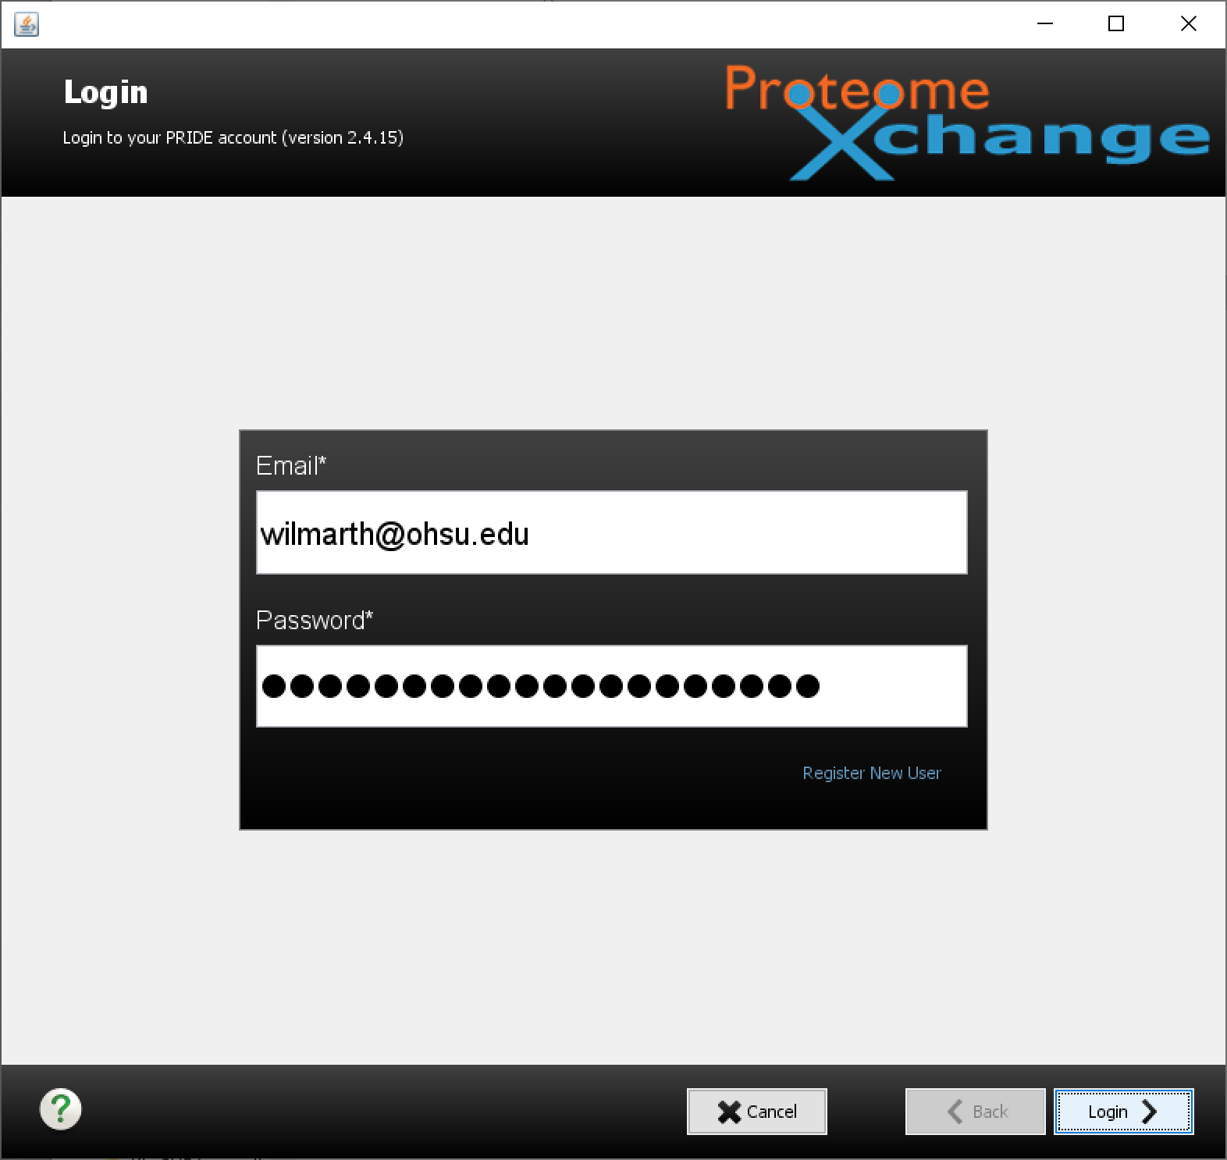
Notes:
When the tools starts up, the first thing is to login to PRIDE. Someone associated with with the submission needs to have a PRIDE account. You do not have to be a manuscript coauthor to submit data to PRIDE, but you will have to take some responsibility for the submission.

Slide 11
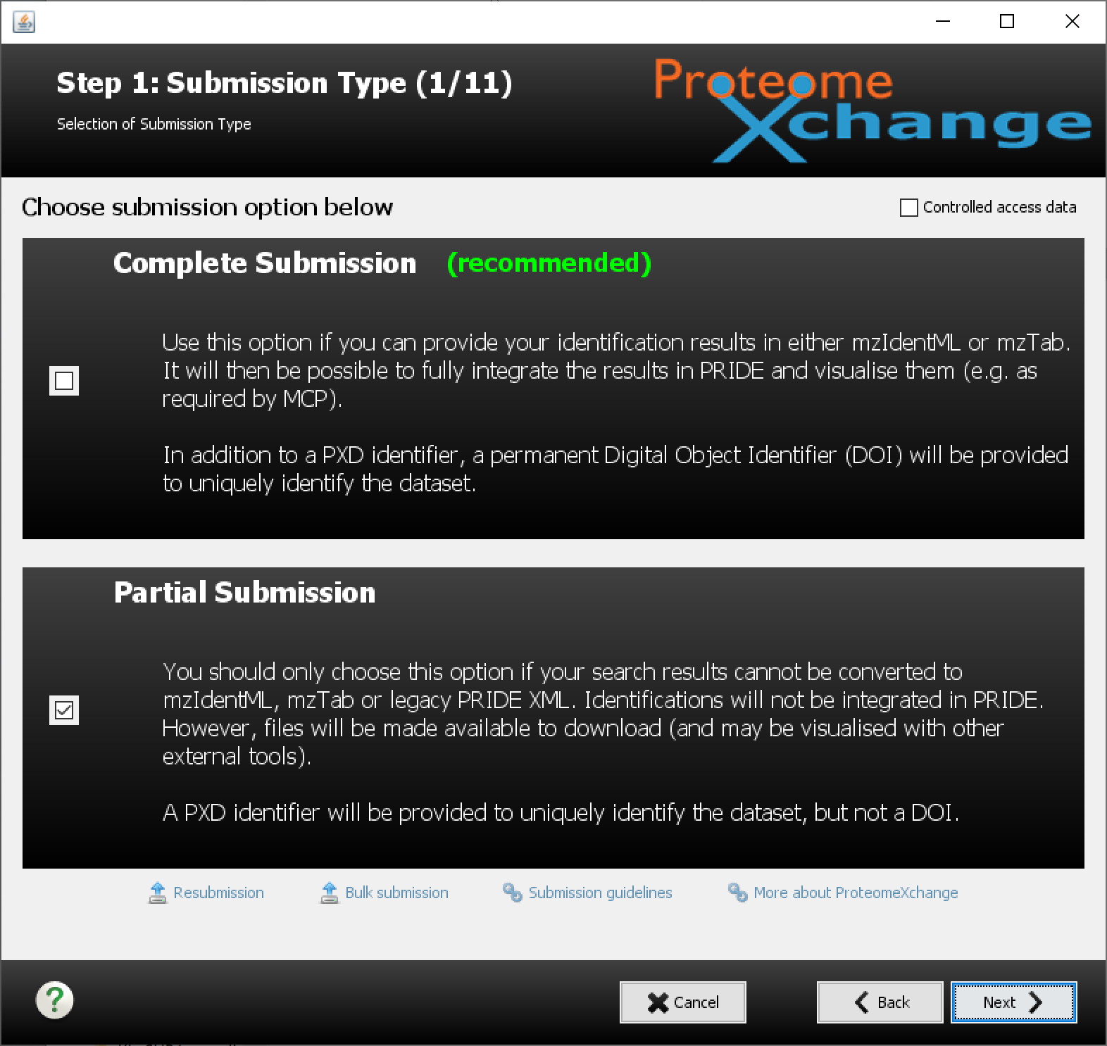
Notes:
The next step is what type of submission are you doing. The PAW pipeline does not make the kinds of standardized output files needed for complete submissions. Select the partial submission options. You will be scolded for being such a horrible person that would not do a complete submission. Keep a stiff upper lip, it will all be okay.

Slide 12
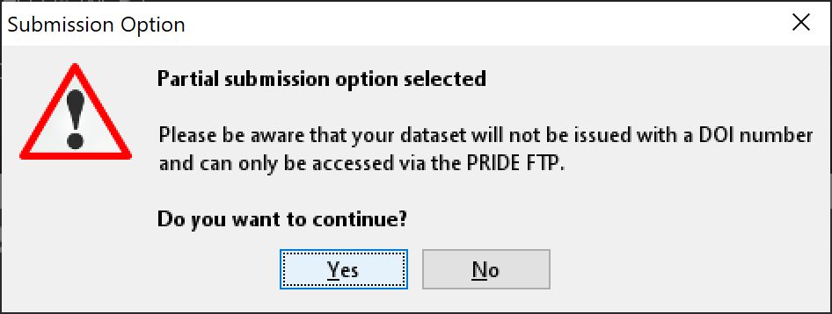
Notes:
Tears are hard on your keyboard. Click yes and save your hurts feelings for your therapist or cold beer.

Slide 13
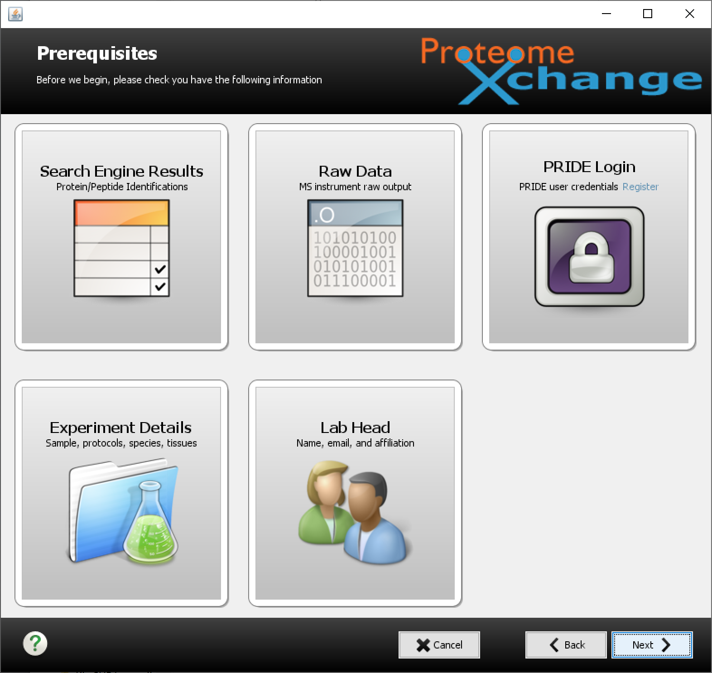
Notes:
This is the next screen. You just want to click on those cool, big buttons, don’t you? Well, they are not buttons. Sorry. Stay strong. Between the partial submission shaming and feeling like a fool for clicking on buttons that are not buttons, you may be ready to give. Don’t worry, it gets harder! Click next.

Slide 14
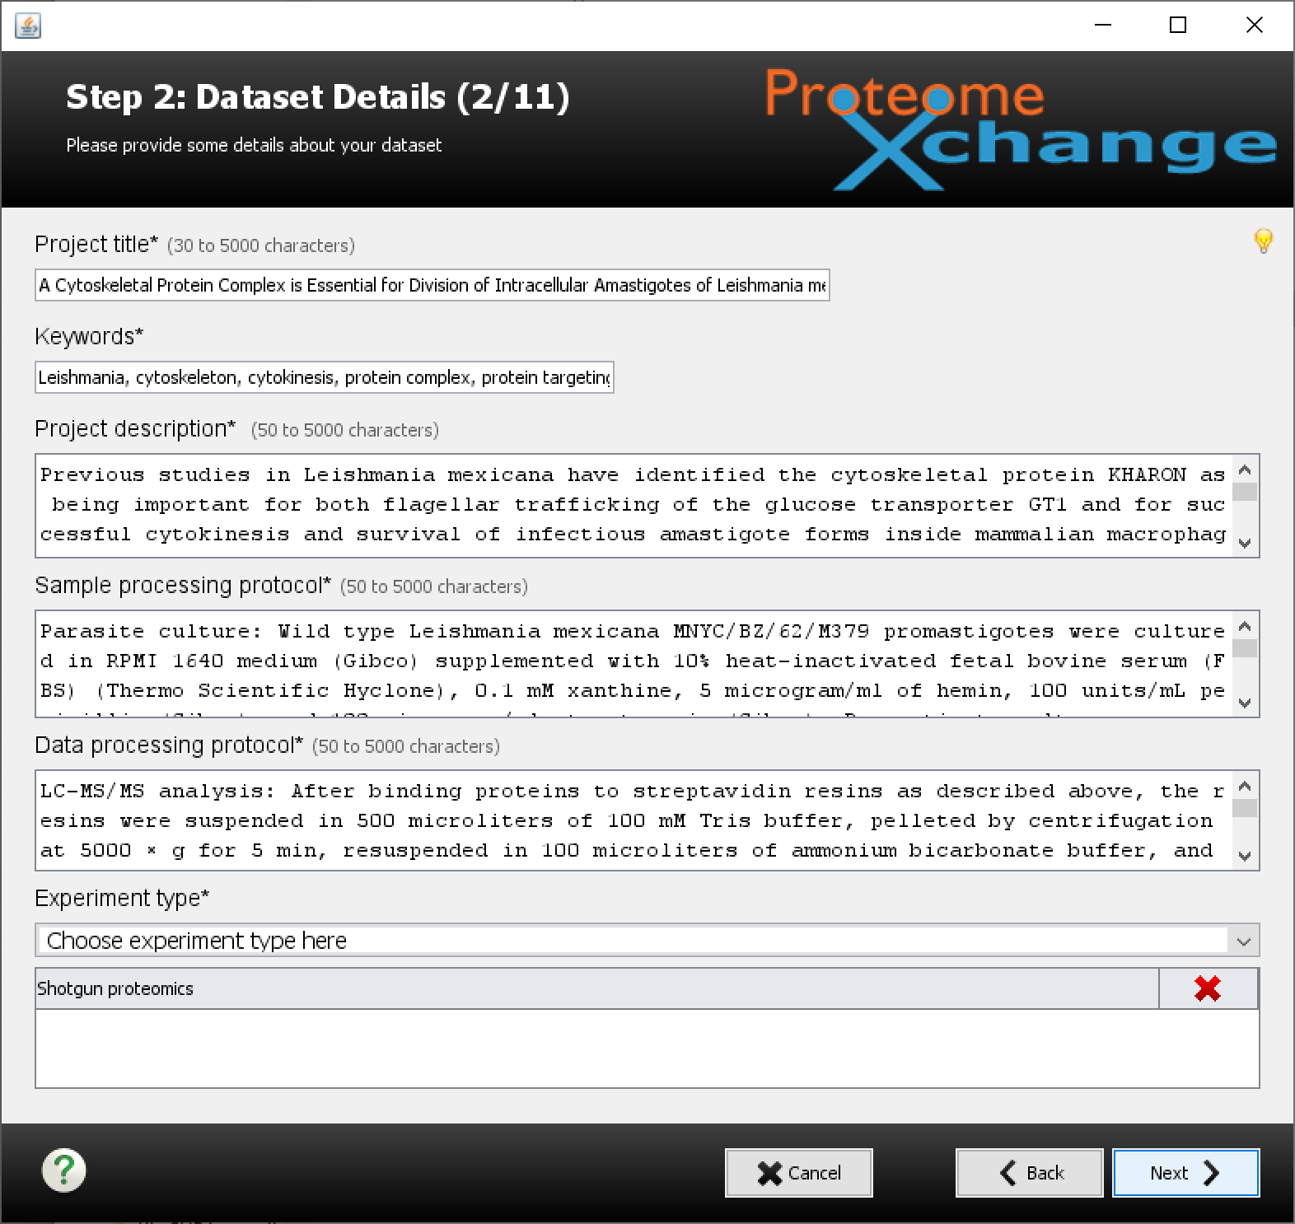
Notes:
Ah, here is why you created that Word file. If it is not already open, open it and get ready to copy/paste. Most of the page are entry forms. The bottom one is a pull-down menu that will let you select more than one thing. You may see ugly red highlighting if you have filled in an entry form with too few or too many characters. When everything is filled in and okay, click next.

Slide 15
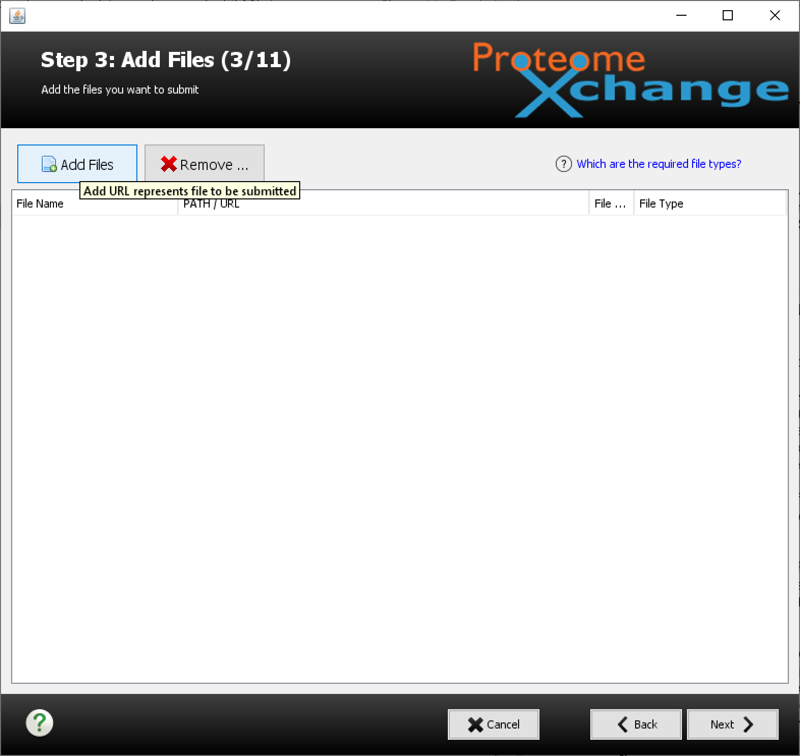
Notes:
Next, you upload all the files. Since you made a new folder with copies of the files you want to submit (right?), you just need to browser to that folder and select all the files.

Slide 16
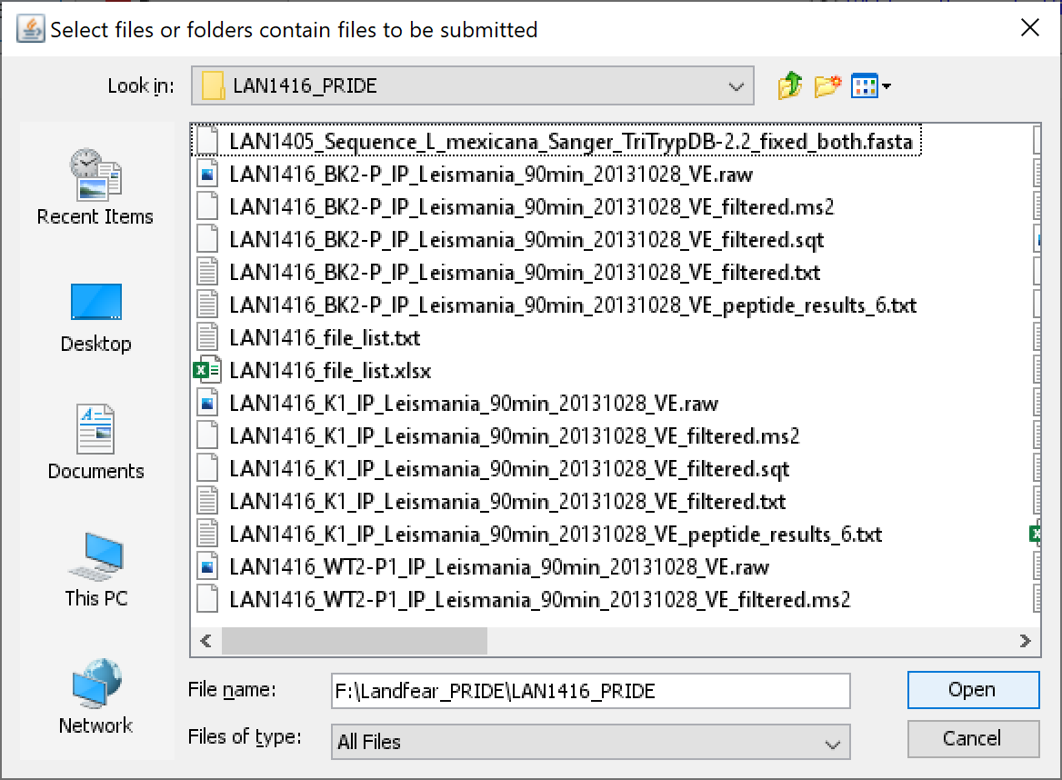
Notes:
This is the folder where I collected all the files for this submission. You might be able to select folders or open up the folder and select one or more files. You can keep selecting files in batches unto you get everything. Putting everything in one folder helps make sure you do not forget any files.
For the PAW pipeline, the peak list files are the MS2 files. The Comet results are the SQT files. The top-hit summary files are TXT files. We have flavors of those files that are before or after FDR filtering. Only the filtered files are used for protein inference and/or quantification. They are smaller and what we need to submit. Various summary files for PSMs, peptides, and proteins should also be part of the submission. FASTA files, parameter files, log files, roadmap files, sample keys, readme files, etc. should also be part of the submission.

Slide 17
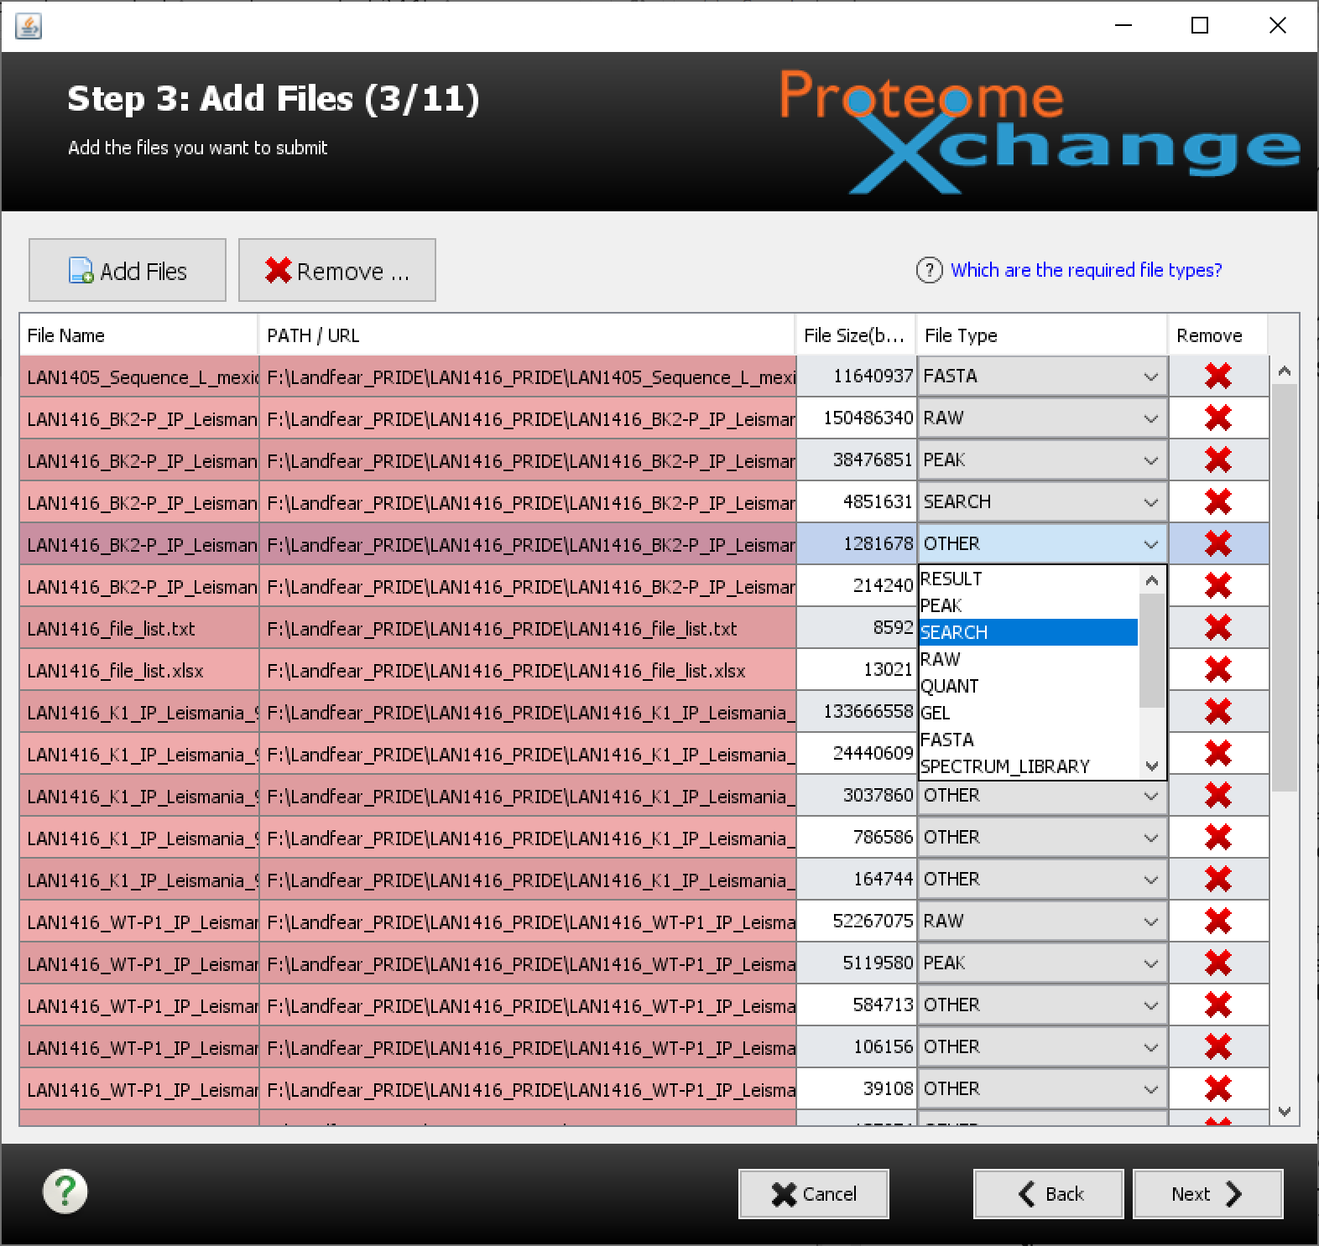
Notes:
After you select the files, the list will show up. If you have long file names, you may need to resize the window and adjust column widths. The tool recognizes some file extensions like .FASTA and .RAW and then automatically puts those files into categories. The default is OTHER for file type. Each RAW file might have an associated PEAK list file (these are the filtered MS2 files in the PAW pipeline), there will be SEARCH results. You may have to manually assign files to their categories using the pull-down menu. Results summaries and quantification table are best left as OTHER.

Slide 18
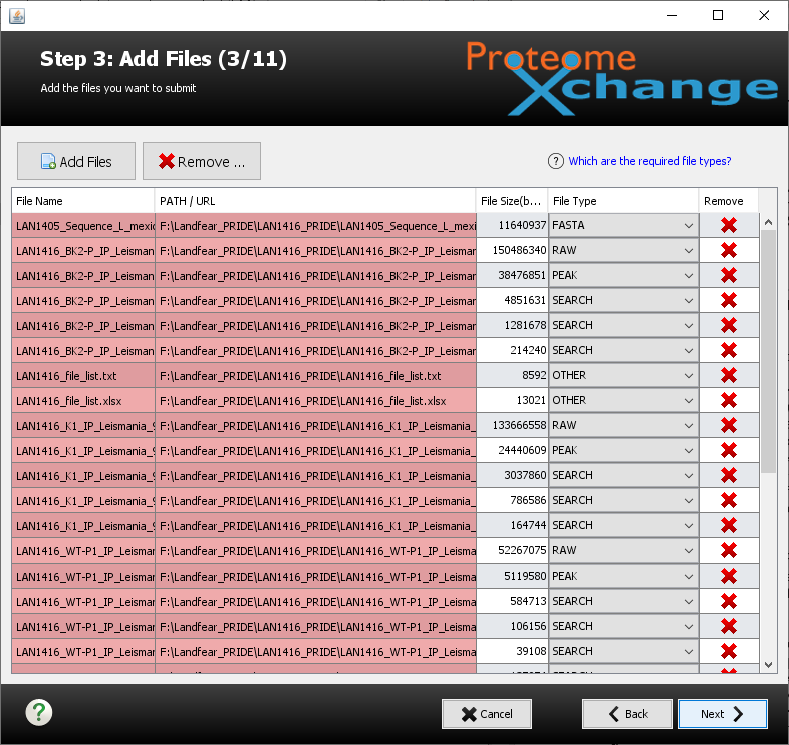
Notes:
When you have the files in the correct categories, click next. Do not worry about the red highlighting.

Slide 19
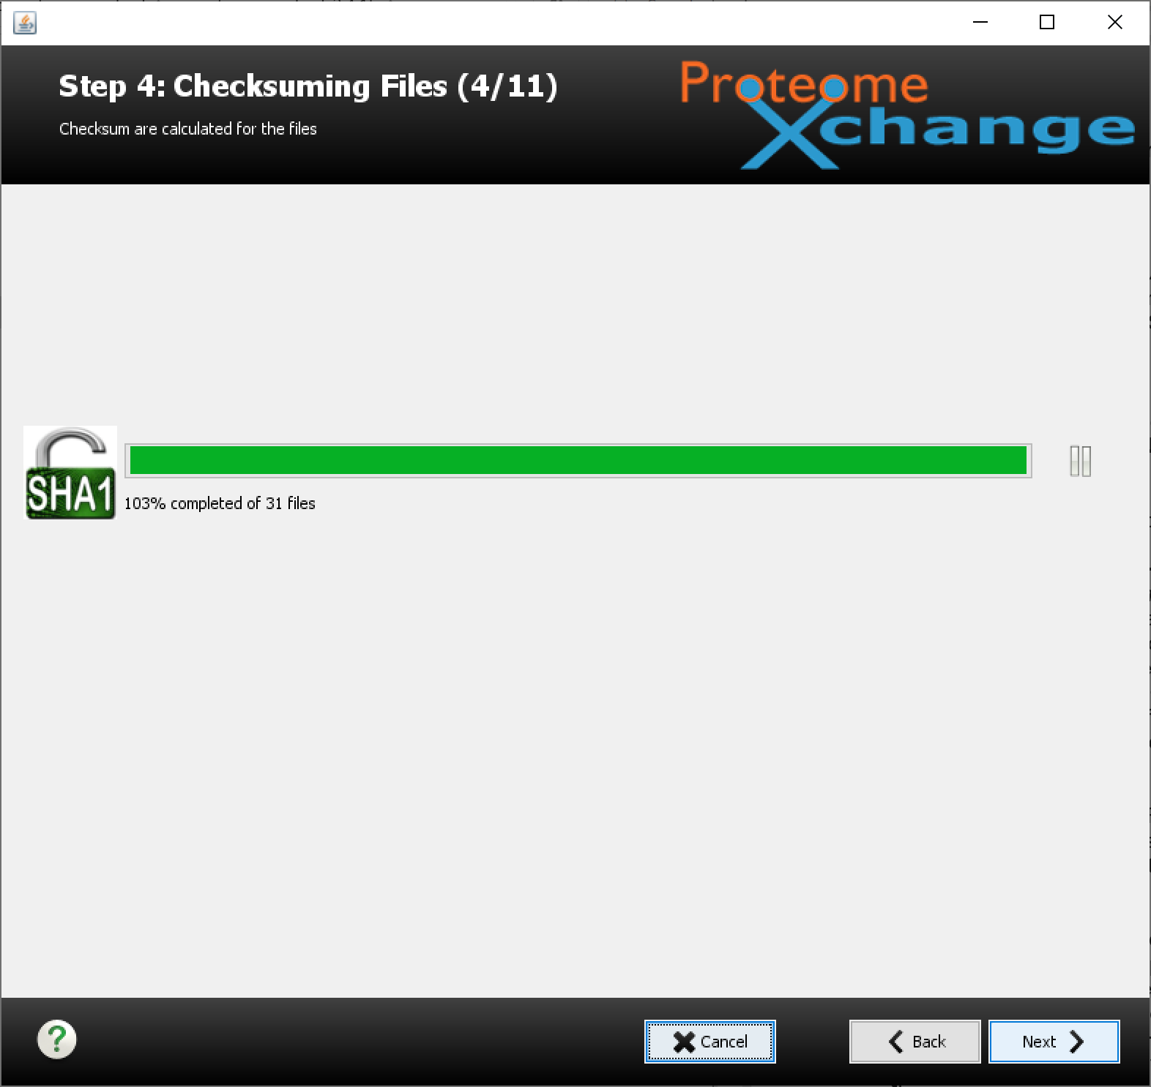
Notes:
A new (and very nice) feature is computing check sums to verify that the uploaded files made the trip in one piece. When it seems like it finished, wait a few minutes, then click next. It is quite aspirational. It did not quite give 110%, but the 103% is good enough for me.

Slide 20
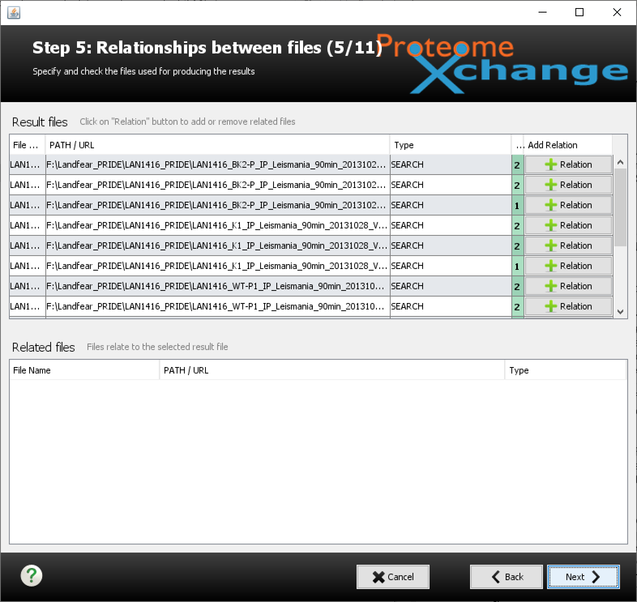
Notes:
Now we have one of the most confusing steps - defining the file relationships. This is really what PEAK and SEARCH files go with which RAW files. Based on base file names, the relationships may be already correctly guessed. If not, you have to select a file in the top window, and then add related files in the bottom window. Each RAW file has to have some relationship to at least one other file(s) in the submission (PEAK and SEARCH files). When you have defined things, click next.

Slide 21
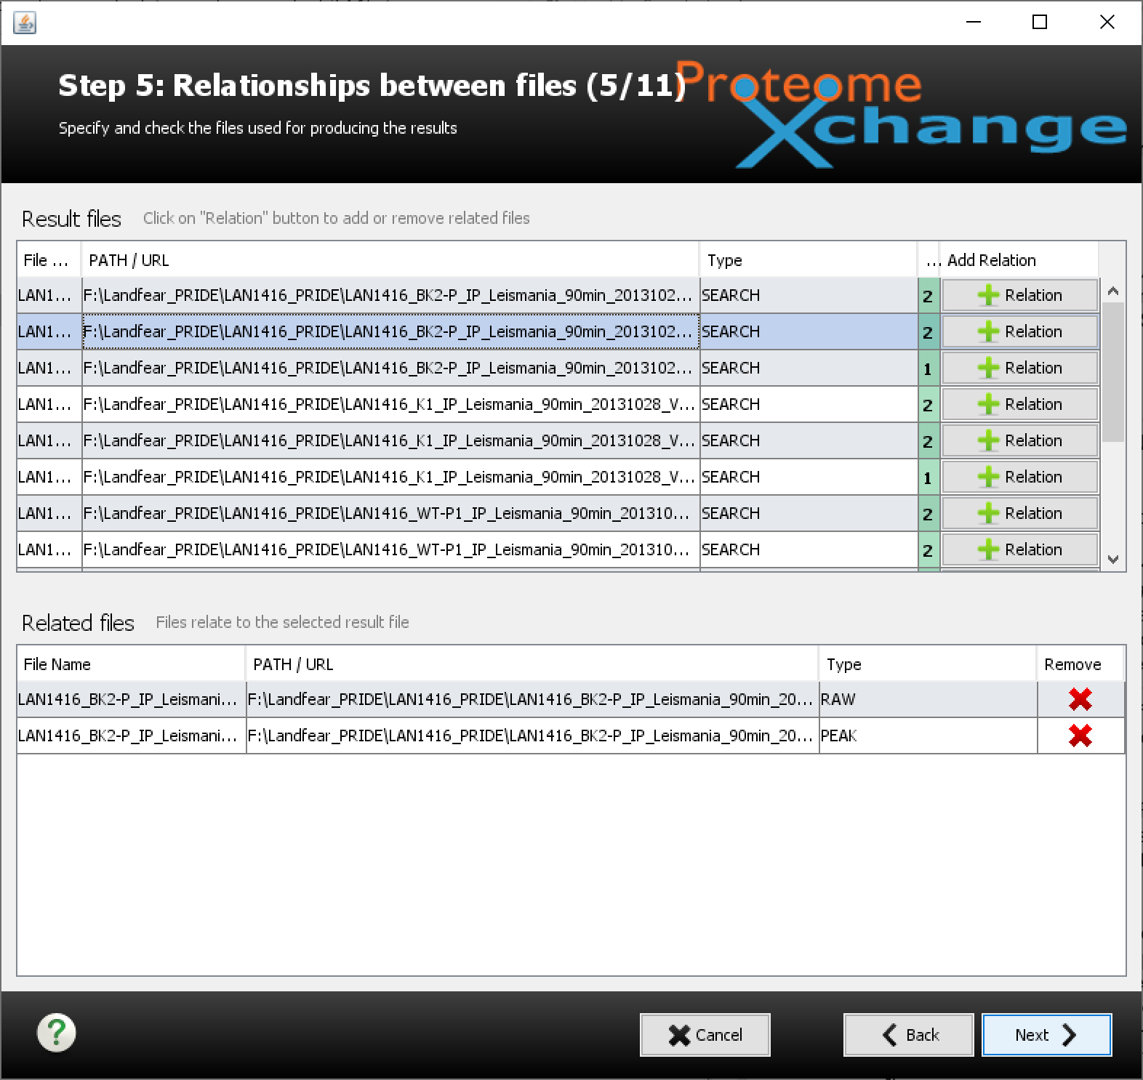
Notes:
If we select a file in the top window and click the add relation button to its right, we get a dialog box.

Slide 22
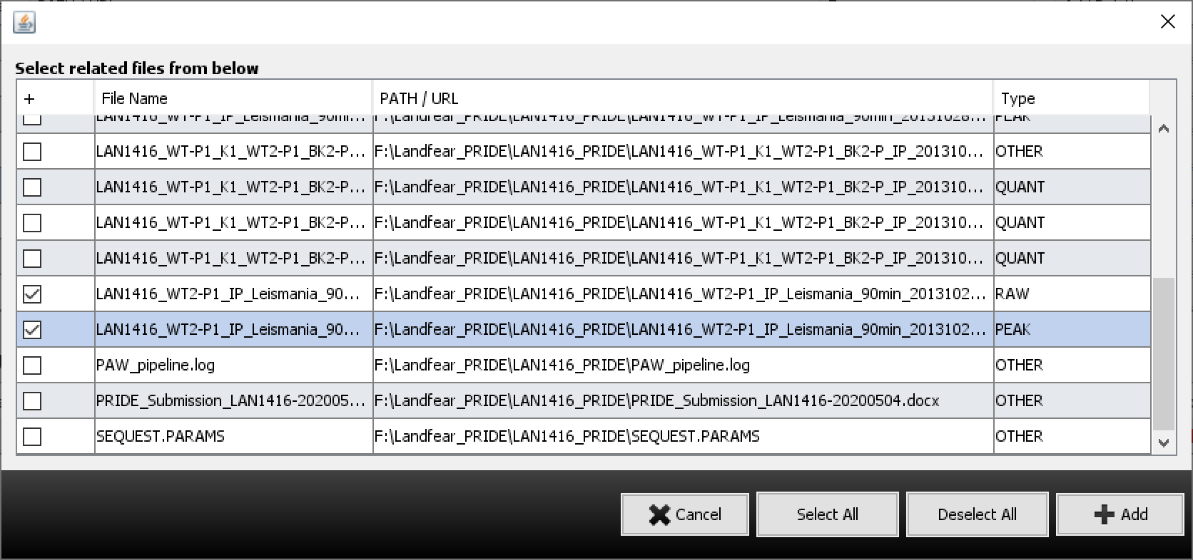
Notes:
The dialog box lets us check mark the related files, then click +Add.

Slide 23
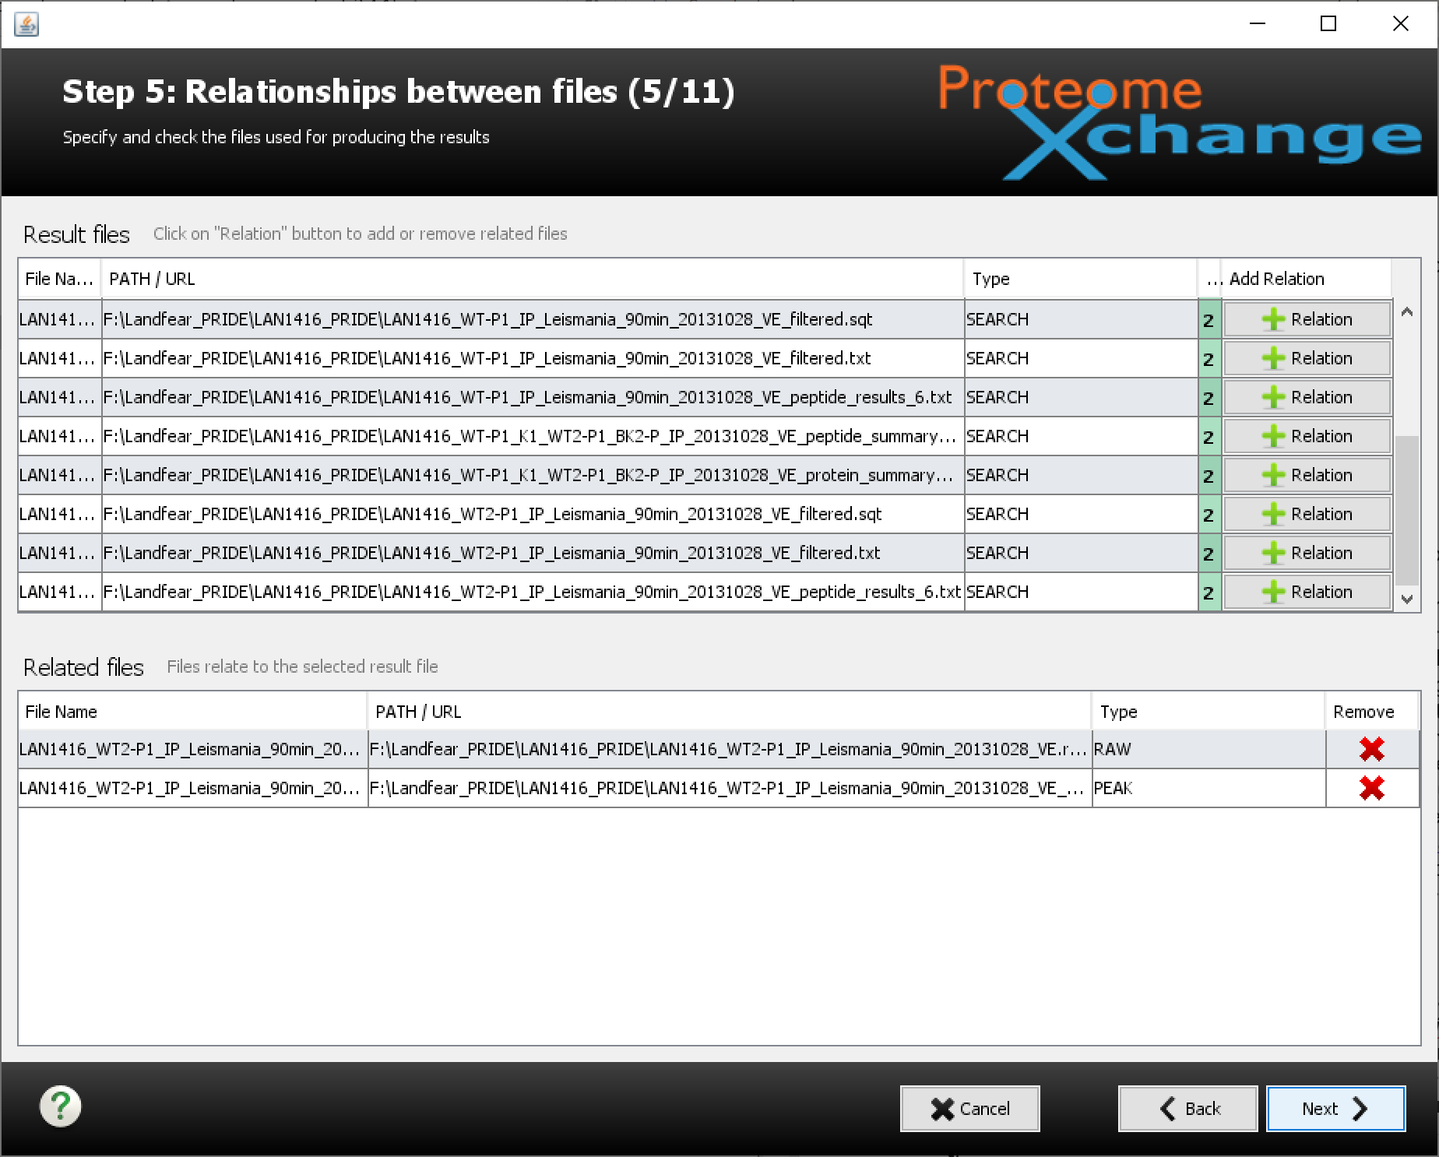
Notes:
Then we get those files in the bottom window. You can play around with the interface to see how it works. You can always cancel and start the whole submission over or go back some steps if you really screw things up.

Slide 24
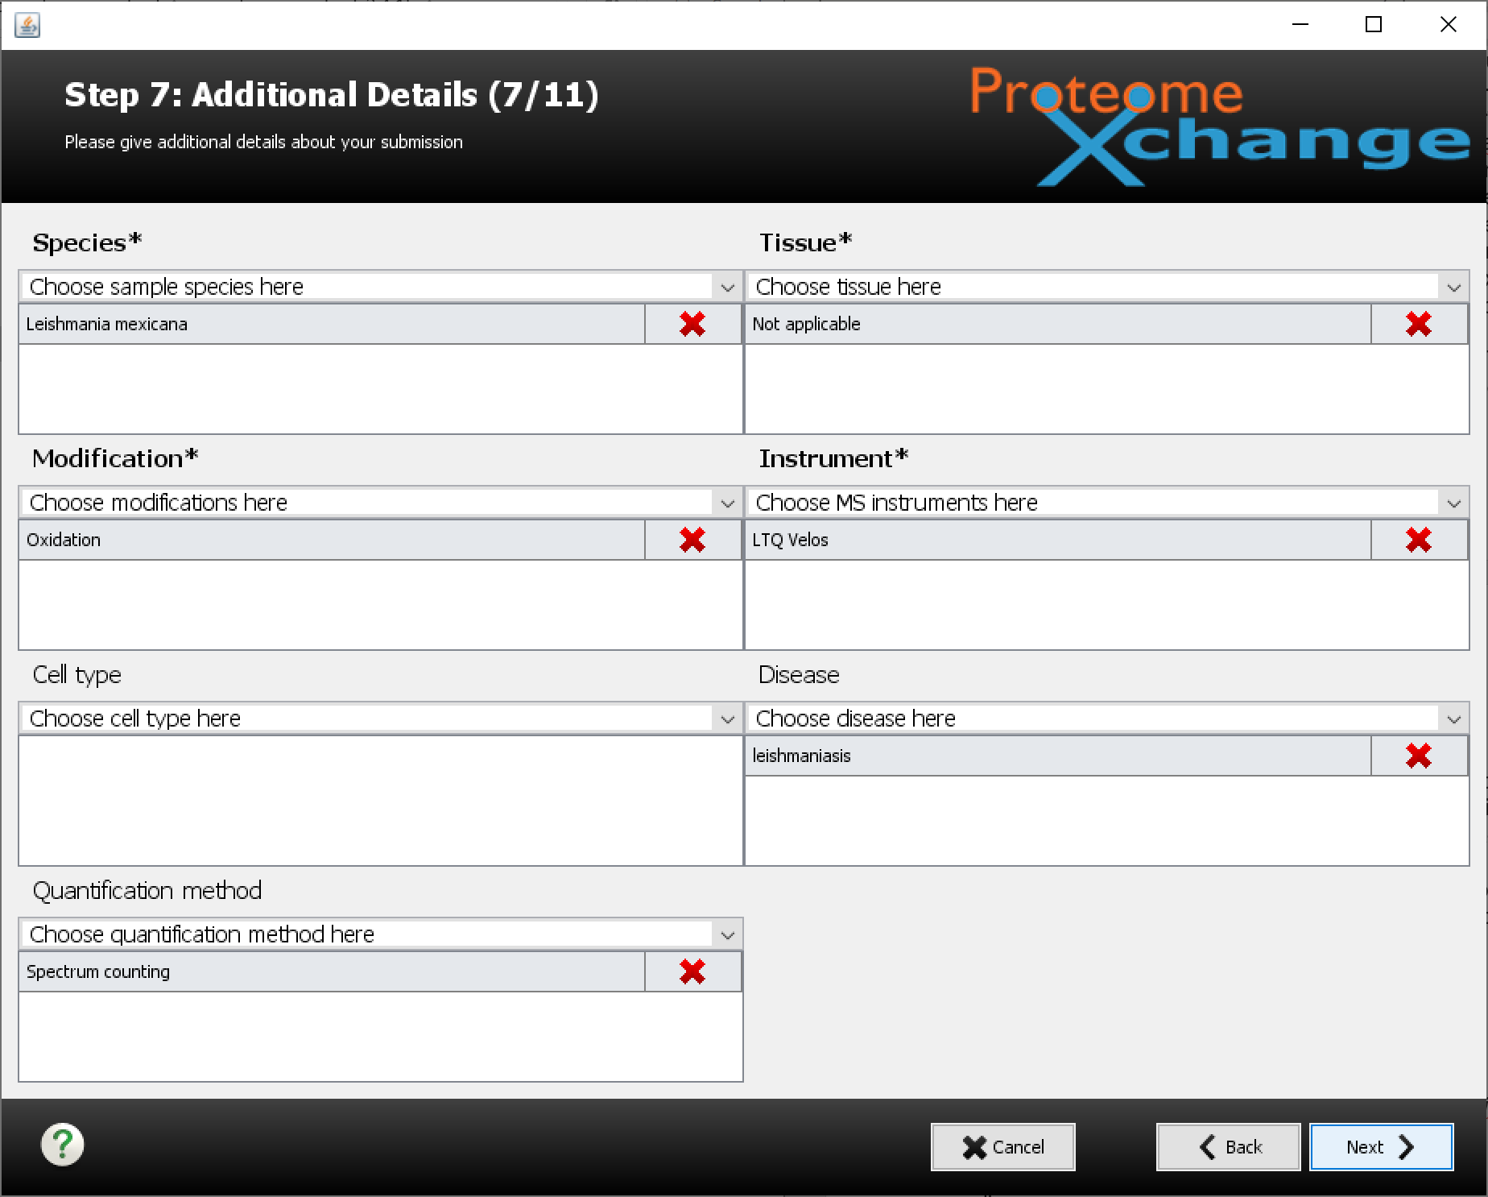
Notes:
This step lets you specify some controlled vocabulary terms in some categories. Not all categories are required. Some of the more common vocabulary terms are in the pull-down menus, other have to be searched for over the network. When you have everything that is relevant selected, click next.

Slide 25
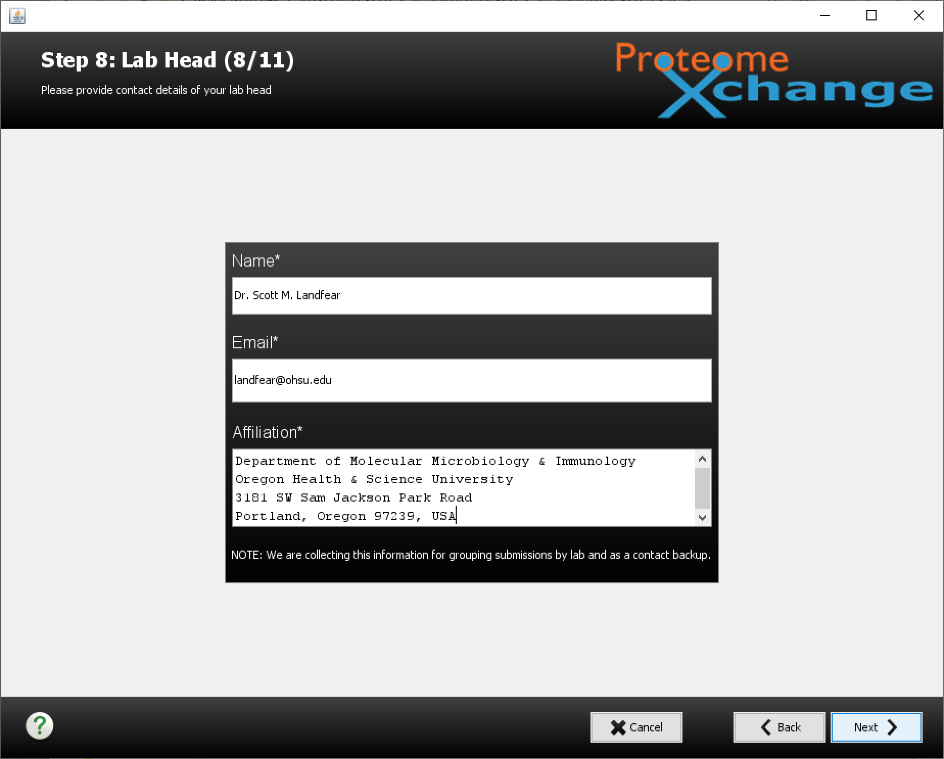
Notes:
Enter the information for the PI here and click next. The PI or Lab Head will be included in the emails about the progress of the submission. You may want to alert them that there will be a couple of emails header their way. You get one confusing email after the data uploads successfully that basically just says the submission has be opened. After the submission has been checked over, it is either accepted or rejected. If it is accepted (yeah!), an email with the PXD number and instruction on how to reference the submission in your manuscript are communicated to you and the Lab Head.

Slide 26
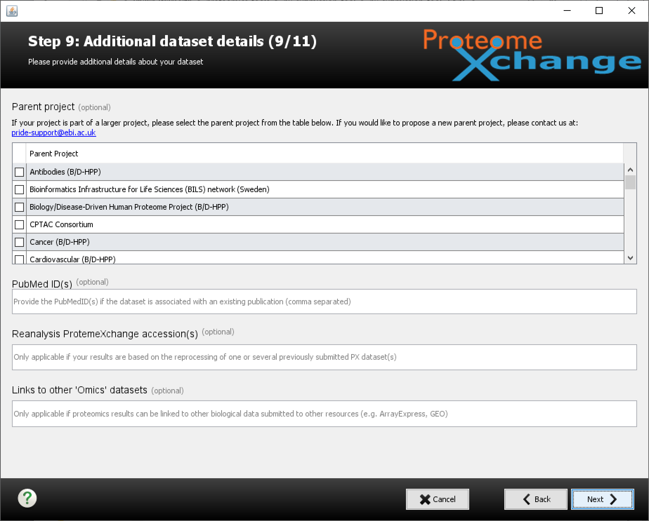
Notes:
This step is for special projects. Do not mess with anything and click next.

Slide 27
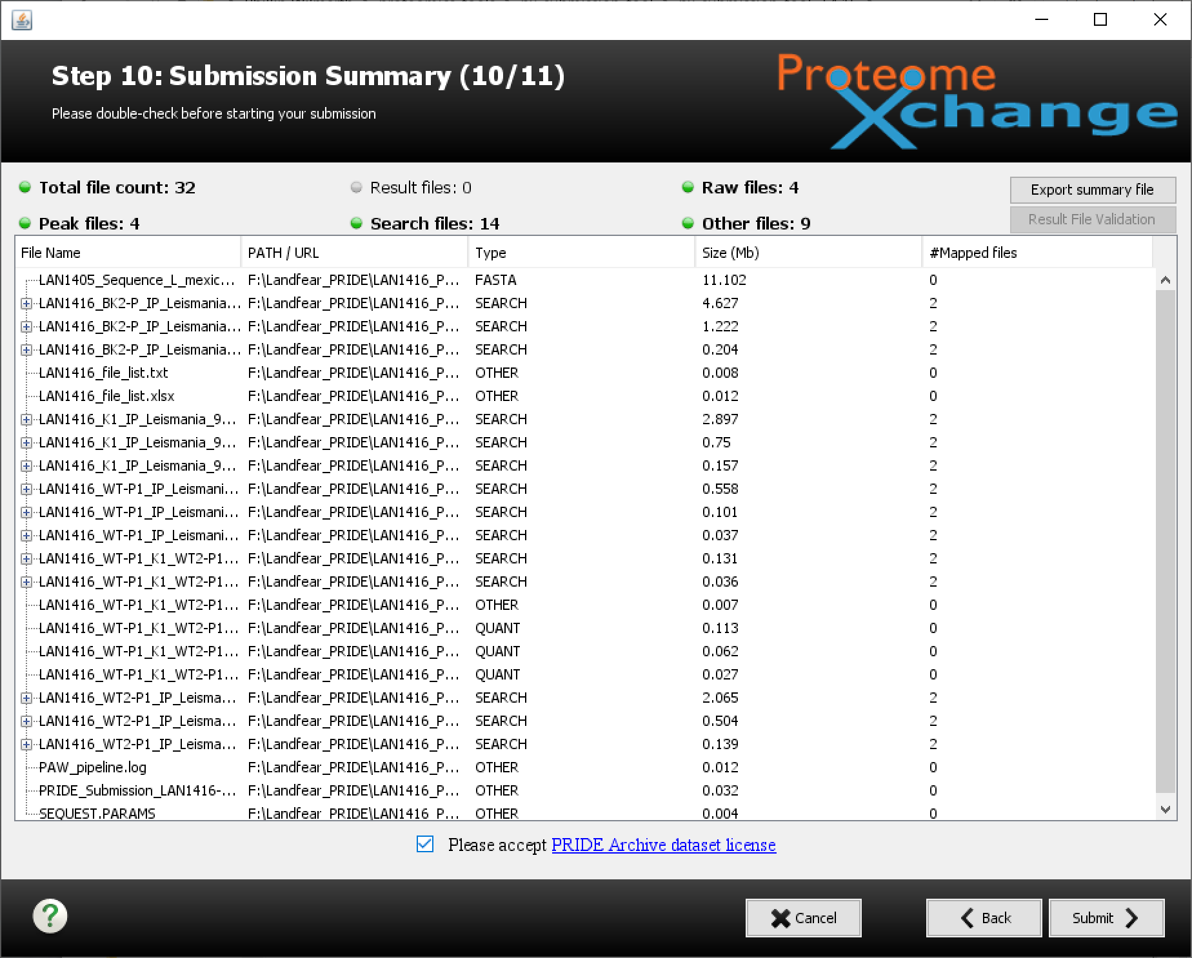
Notes:
This is like the final order confirmation screen you get when you are ordering something you don’t really need from some place you are too lazy to go to. What you see here should be what you had in your local submission folder. If you ignored that advice and have been adding files from all over your file system, you might want to check that you have everything selected that you need, and that file types and relations are all okay. You have to agree to the service terms (the little check box) so that PRIDE can sell all of your private data (ha-ha). Take a few deep breaths and then click submit.

Slide 28
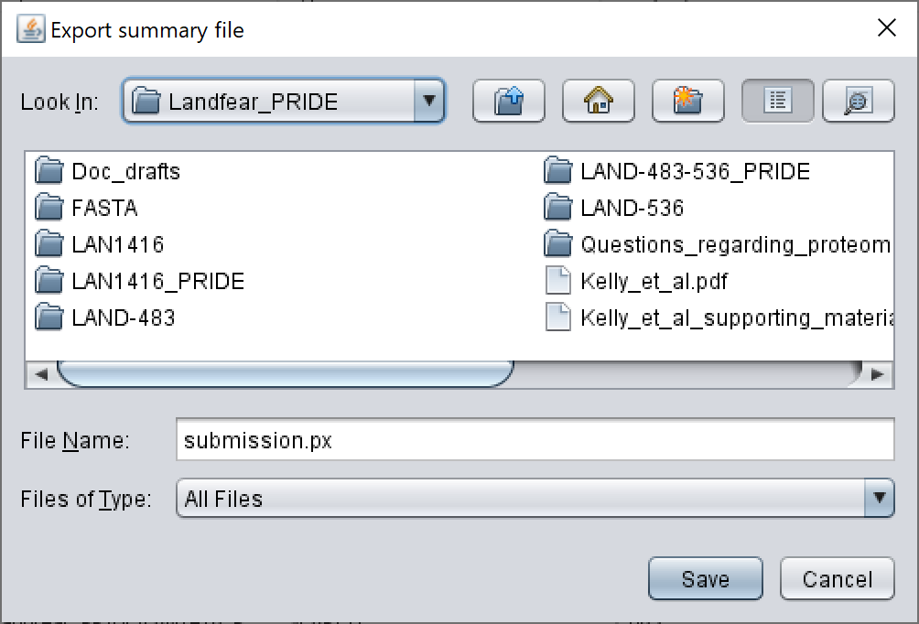
Notes:
The submission tool writes itself a record of what you did so that it can start over more gracefully if the actual file transfers fail. I usually just click the save button.

Slide 29
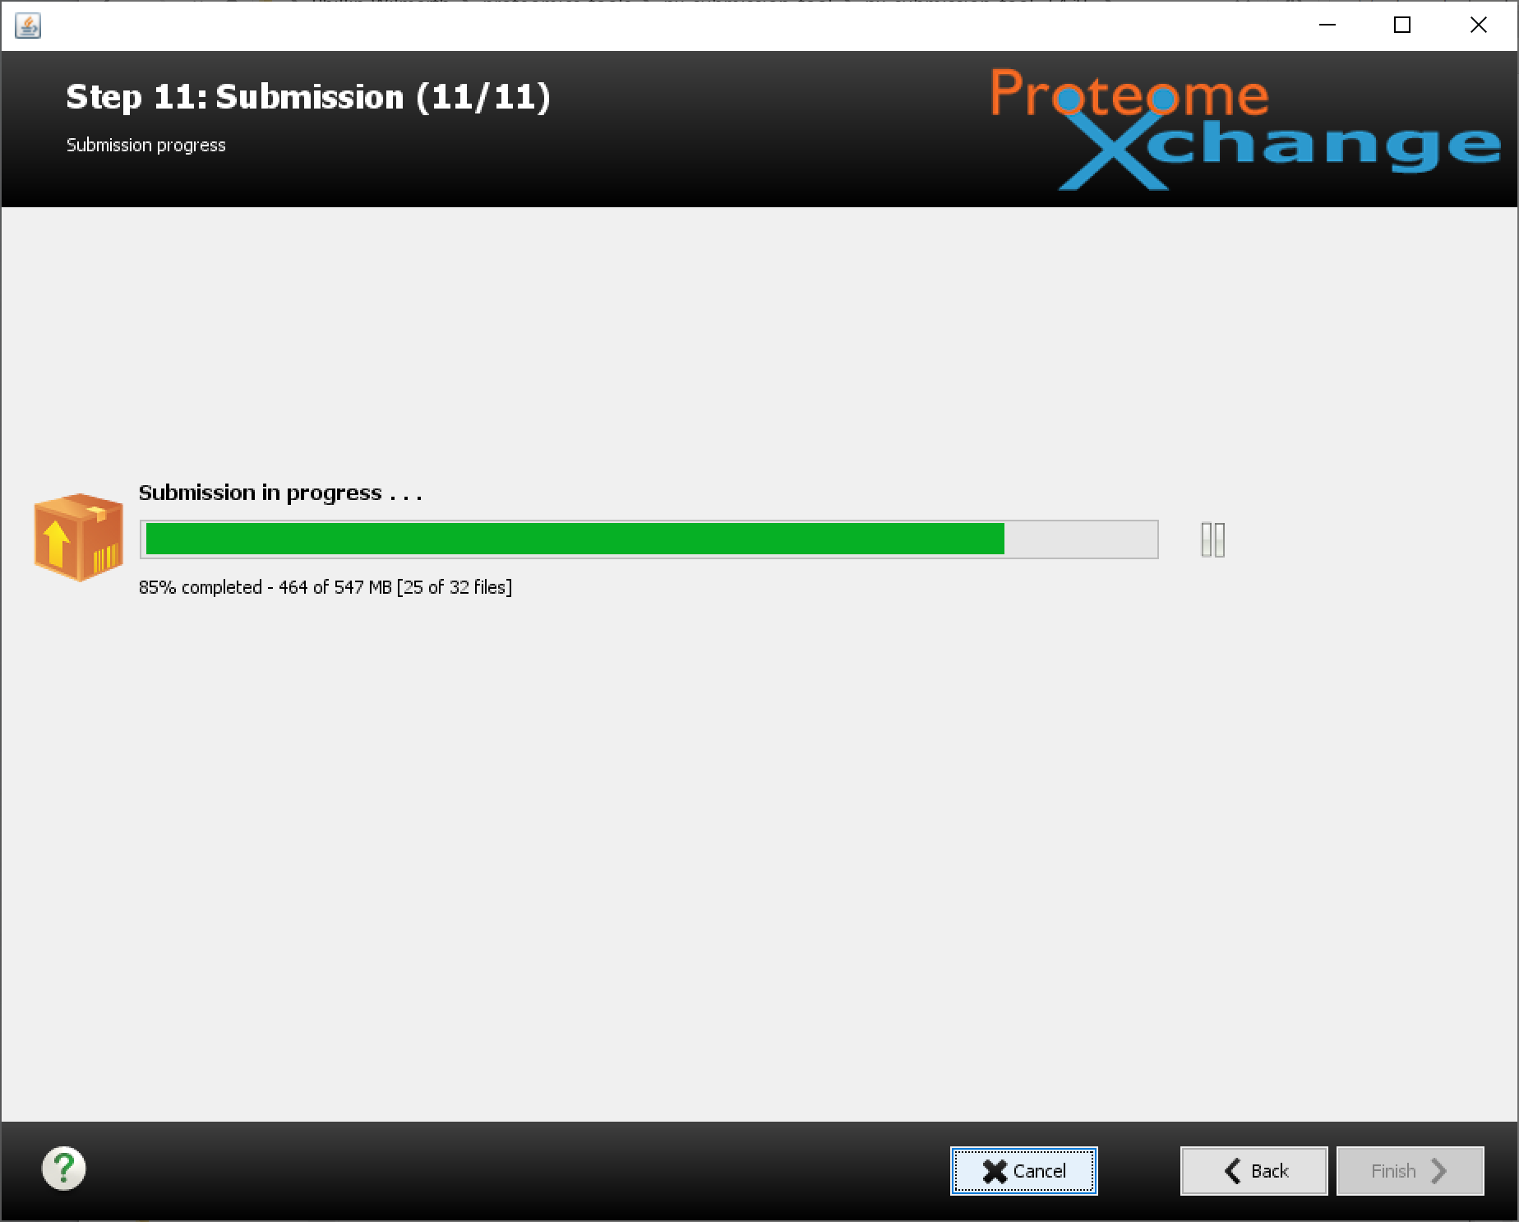
Notes:
You will get a progress bar for the actual file transfer step. This can take a long time to complete. The status indicator is a little flakey. There are two transfer protocols that the tool uses. Aspera is faster and that is used first. That does not always work. If it fails, FTP is used. You get a dialog box alert about that. However, the status information does not get reset, so you may thing noting is happening. It is better to just wait (like, several hours or overnight) and see if it finishes.

Slide 30
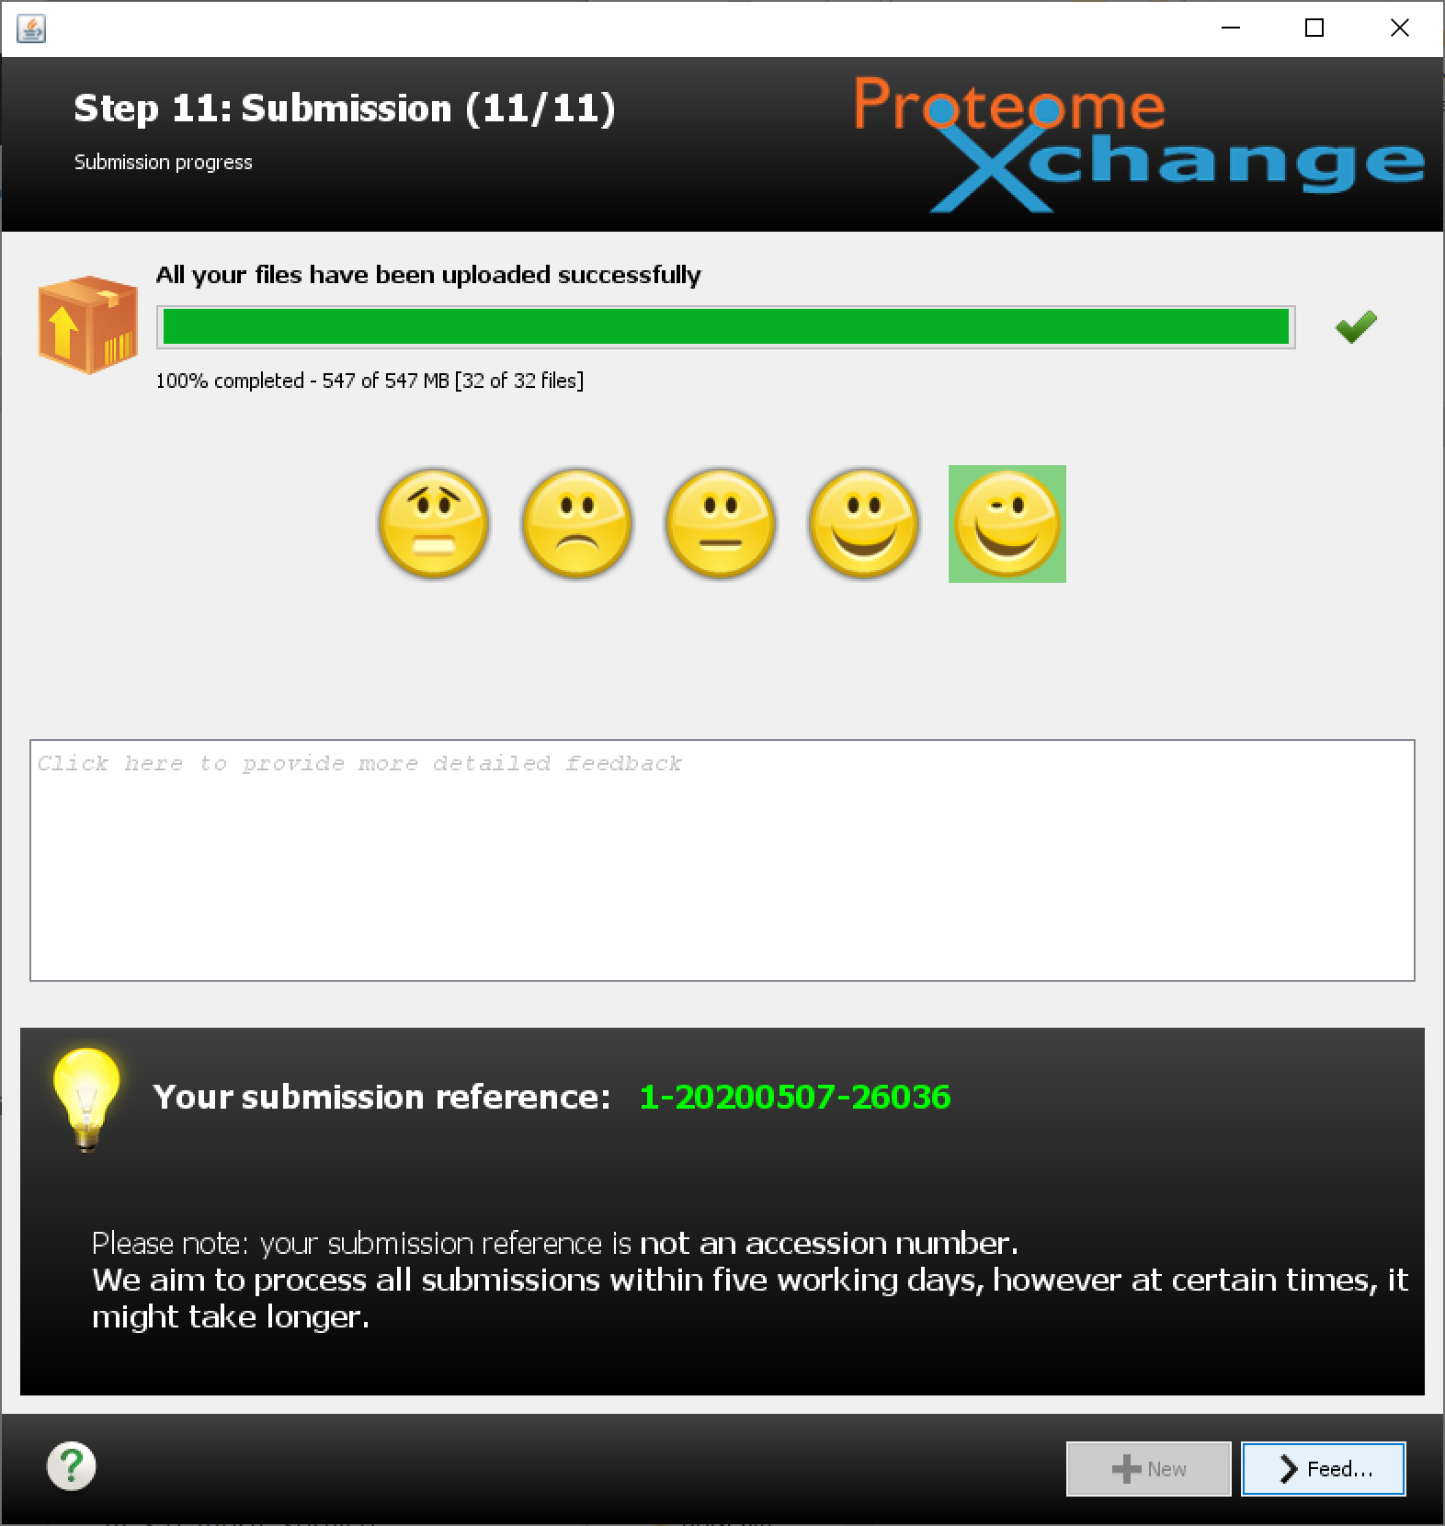
Notes:
If (or when) it finishes, you get the emoji screen. Be kind with your choice and click feedback. You did it!

Slide 31
What happens next?
You get an email right after the upload
You get another email in a day or two if accepted (or rejected)
Edit the manuscript and submit
The archive cannot be altered and is initially private
When publication is officially in PubMed, the archive will go public
Going public often just happens. If not, you can alert PRIDE
Notes:
You get a coupled of emails right after you submit the archive. The archive will be private during manuscript review. Then the timing and fate is up to the journal. If and/or when the paper sees the light of day (gets DOI number, PubMed number, actual Journal citation details), then the archive should be made public. That often happens automatically or can be triggered by letting PRIDE know that the paper is out.

