Slide 1
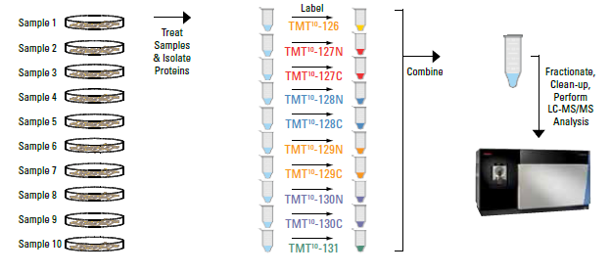
Multiplex quantitation 10-plex/16-plex TMT NH2 reactive reagents
TMT = Tandem Mass Tag, isobaric labeling reagents
Peptides are labeled with TMT reagents for comparison of peptide/protein abundance among samples
# refers to m/z in MS3
Reporter ions in MS3 differentiate
samples 1-10
www.thermofisher.com
Notes:
We perform our quantitative studies using TMT labels, which are isobaric labeling reagents from Thermo. We use the NH2 reactive reagents, which react with N-termini and lysines. The peptides from each sample are labeled with their own unique label; in the above example, all of the peptides in sample 1 are labeled with TMT-126, with the 126 number referring to the m/z of the reporter ion in the third stage of MS (or MS3). All of the labeled peptides, from all of the samples, are combined into one sample and that sample is injected into the LC-MS. Comparing peptides from sample 1-10 is done by the reporter ion readout in MS3.

Slide 2
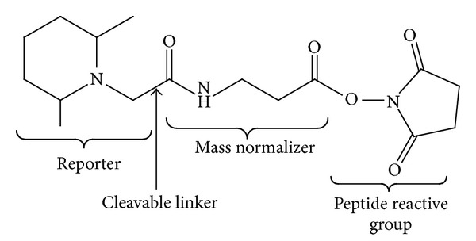
Multiplex quantitation 10/11-plex TMT Tag
Add 229 to each peptide
5 labeled ¹³C or ¹⁵N
*
*
*
*
*
*
*
*
*
*
*
*
*
*
*
*126C
*129N
*131N
Notes:
Here is a schematic of the 10/11-plex TMT tag. A N-terminus or lysine attaches to the mass normalizer group. The tags are isobaric, meaning they have the same nominal mass and structure, and therefore a peptide will elute at the same time with the same mass whether it is labeled with 126 or 131. The tags have five heavy atoms that are distributed differently throughout the mass normalizer and reporter groups – see above for the distribution for 126C, 129N and 131N. It is only when the tag undergoes HCD fragmentation before MS3 that the reporter ion breaks off and the peptides can be differentiated by the m/z in MS3.

Slide 3
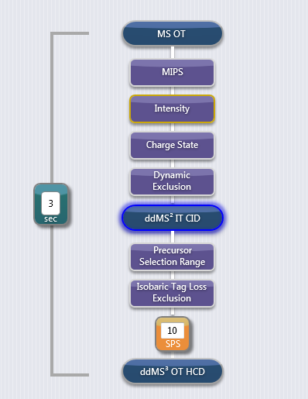
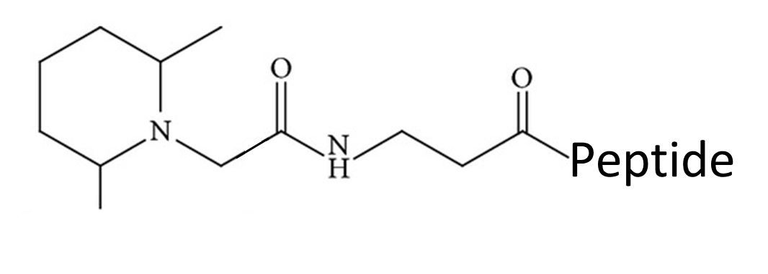

SPS-MS3 experiment for TMT analysis
Peptide A
precursor
TMT-ALINSMDQNMFK-TMT
y4
TMT-ALINSMDQ NMFK-TMT
Product ions
b8
y9
TMT-ALI NSMDQNMFK-TMT
b3
Reporter
ion
Top10
HCD
Synchronous Precursor Selection
Reporter ions
126-131
TMT tag fragments with HCD
Reporter ions are detected in MS3
Notes:
In the PSR core we use a SPS-MS3 method to analyze our TMT samples. In the first stage of MS, precursors are detected in the orbitrap. After meeting certain selection criteria, the precursor is fragmented by collision induced dissociation (CID) in the ion trap (IT, in MS2), producing product ions. The b ions are always TMT tagged, and the y-ions are only TMT tagged if the C-terminal residue is lysine. From there, the top 10 ions are sent to the ion routing multipole (IRM) where they undergo higher energy collisional dissociation (HCD), which fragments the TMT tag releasing the reporter ions into the orbitrap for eventual detection.

Slide 4
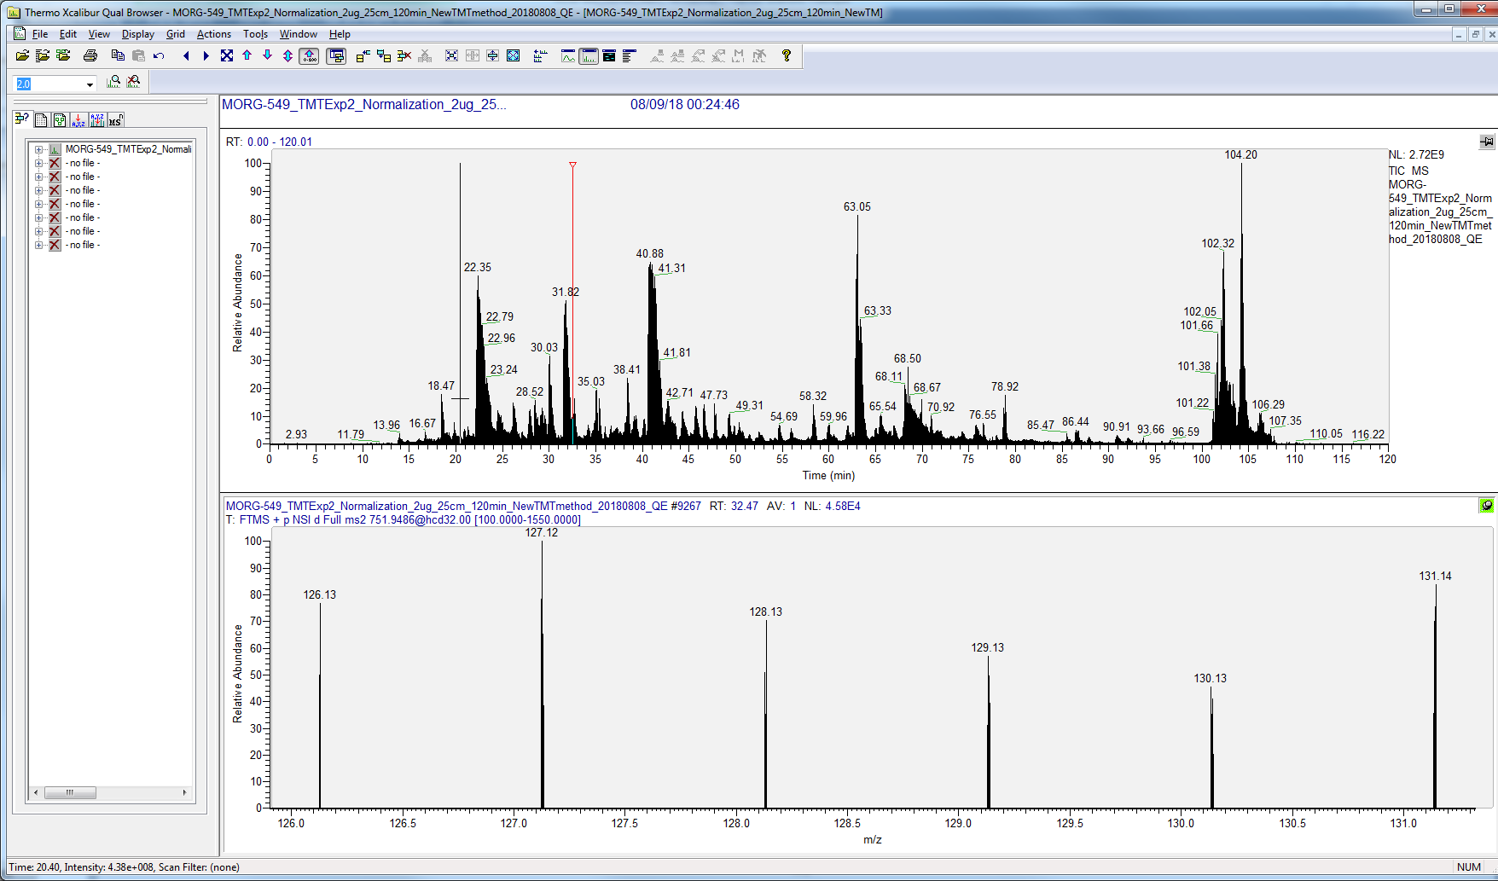
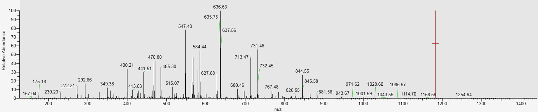
TIC and MS2 scan of TMT workflow
Peptide A
TIC
MS2 of Peptide A precursor
y and b ions are produced
Notes:
The top trace shows a total ion chromatogram (TIC), or all of the ions being detected over time. Let’s say Peptide A elutes at 32.5 min. The precursor is sent to the ion trap for MS2, producing product ions (y and b ions).

Slide 5
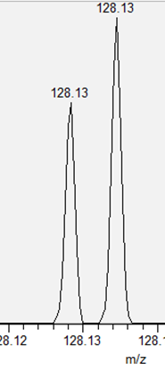
MS2 and MS3 scan of TMT workflow
MS2 of Peptide A precursor
128.1341
C
Reporter ions in MS3 from the
Top 10 fragments from MS2
128.1281
N
Δ = 6 mDa
Notes:
The top 10 y and b ions from MS2 are sent to the IRM, where they undergo HCD, and the reporter ions (from all 10 y/b ions) are sent to the orbitrap for MS3 detection. The mass resolution in the orbitrap is set to 60,000, enabling the mass resolution between the N and C TMT tags, which only differs by 6 mDa. In 128N labeled peptides from sample 4 and 128C labeled peptides from sample 5, peptide A is more abundant in sample 5 than in sample 4.

Slide 6
SPS-MS3: Quantitation at the peptide/protein level
Dataset has 3000 proteins (30,000 peptides) and Sample 1 is labeled with 126TMT
126TMT from b8
126TMT from b5
+
=
126TMT from b4
126TMT-Peptide A
126TMT from y7
126TMT from y4
Sum reporter ion intensities from fragments of Peptide A
126TMT-PeptideB
126TMT-PeptideF
+
=
126TMT-PeptideA
126TMT-PeptideE
126TMT-Protein X
126TMT-PeptideD
126TMT-PeptideC
Sum all peptide reporter ion intensities from Protein X
The abundance of the 3000 proteins and 30,000 peptides can be compared among the samples
Notes:
The SPS-MS3 method can be used to quantitate at the peptide or protein level. To quantitate at the peptide level, all of the reporter ion intensities from the peptide fragments are summed. To quantitate at the protein level, all of the peptide reporter ion intensities for that protein are summed. Comparisons can be made across the samples, or sample groups, at either the peptide or protein level.

Slide 7
Generates a list of peptides/proteins per label
Proteins
 | 126C | 127N | 127C | 128N | 128C | 129N | 129C | 130N | 130C | 131N | 131C
 | 3.79E+09 | 3.82E+09 | 3.81E+09 | 3.75E+09 | 3.73E+09 | 3.56E+09 | 3.71E+09 | 3.95E+09 | 3.85E+09 | 3.6E+09 | 3.6E+09
 | 0.96 | 0.97 | 0.96 | 0.95 | 0.94 | 0.90 | 0.94 | 1.00 | 0.97 | 0.91 | 0.91
 | Pre-Hib | Pre-Hib | Pre-Hib | Pre-Hib | Hib | Hib | Hib | Hib | Post-Hib | Post-Hib | Post-Hib
Accession | 223-Pre | 224-Pre | 225-Pre | 226-Pre | 228-Hib | 229-Hib | 230-Hib | 231-Hib | 233-Post | 234-Post | 235-Post
sp|O54761|ALMS_ICTTR | 1078081 | 2168857 | 1473666 | 3749832 | 8427054 | 6338368 | 2270730 | 5442509 | 4617526 | 4996850 | 1324696
sp|O54762|ALLT_ICTTR | 1224865 | 949389.7 | 171358.2 | 3372775 | 842642 | 579412.2 | 635760.2 | 2364568 | 3474822 | 971709.2 | 1045189
sp|P62335|PRS10_ICTTR | 1245288 | 1337613 | 1145176 | 1194272 | 1109269 | 1258214 | 945664.3 | 1361426 | 1069054 | 1029239 | 986823.1
sp|Q99P61|FABPH_ICTTR | 5441.796 | 4019.869 | 9425.308 | 4381.97 | 4411.512 | 6455.913 | 5611.805 | 4728.418 | 4899.279 | 4367.11 | 5074.854
sp|Q9R101|LIPS_ICTTR (+1) | 374838.4 | 401551.2 | 365565.1 | 379789.2 | 255463 | 355723 | 358249.4 | 279699.1 | 341538 | 298015.3 | 380453.5
tr|A0A0U2CKE1|A0A0U2CKE1_ICTTR | 233039.5 | 238564.5 | 207570.9 | 176895.3 | 181434 | 242395.6 | 229081.4 | 254668.4 | 250653.5 | 188740.2 | 193722.6
tr|A0A0U2CKU7|A0A0U2CKU7_ICTTR | 477570 | 466561.8 | 469820.7 | 397760.3 | 464024 | 487426.9 | 485717.5 | 508971.6 | 439954.3 | 400634.7 | 423184.7
tr|A0A287CRU0|A0A287CRU0_ICTTR | 18116.93 | 21606.71 | 20621.46 | 21939.54 | 19298.31 | 22290.67 | 18638.89 | 25524.8 | 20205.71 | 19739.41 | 20345.16
tr|A0A287CRX6|A0A287CRX6_ICTTR | 296874.8 | 341943 | 301249.8 | 295019.9 | 261050.7 | 296329.9 | 311544.3 | 353725.9 | 304488.8 | 271006.1 | 297276.6
tr|A0A287CRY0|A0A287CRY0_ICTTR | 7890.922 | 4748.218 | 5793.046 | 10530.28 | 11642.45 | 189491.2 | 11257.88 | 16250.11 | 11252.55 | 5919.164 | 6484.953
tr|A0A287CRZ8|A0A287CRZ8_ICTTR | 363171.7 | 389923.4 | 352822.8 | 435407.9 | 367365.6 | 287889.7 | 284354.6 | 364893.3 | 424774 | 330719.2 | 378623.7
tr|A0A287CS00|A0A287CS00_ICTTR | 193381.3 | 235069.2 | 219677.2 | 231155.8 | 239710 | 230637.1 | 238250.3 | 277114.8 | 250016.1 | 227151.8 | 238474.7
tr|A0A287CS17|A0A287CS17_ICTTR | 749511.8 | 886978.9 | 835860.1 | 764342.4 | 674931.5 | 793825.5 | 657719.1 | 749419.1 | 597055.4 | 630724.8 | 604268.2
tr|A0A287CS26|A0A287CS26_ICTTR | 1180511 | 1271816 | 1088656 | 1137241 | 1027159 | 971610.4 | 1011285 | 1137512 | 1054097 | 940394.6 | 983093.1
tr|A0A287CS27|A0A287CS27_ICTTR | 690837.5 | 801593.5 | 662493.3 | 751972.8 | 720781.1 | 582737.9 | 715251.9 | 730887.4 | 640575.5 | 520185.4 | 532807.8
tr|A0A287CS28|A0A287CS28_ICTTR | 1421725 | 1743982 | 1552043 | 1734988 | 1638235 | 1499845 | 1453111 | 1708069 | 1543255 | 1339186 | 1392417
tr|A0A287CS29|A0A287CS29_ICTTR | 249138.1 | 230967.2 | 248169.4 | 229052.1 | 228456.1 | 291195.9 | 233292.1 | 268798 | 220145.4 | 229716.8 | 221294.7
tr|A0A287CS30|A0A287CS30_ICTTR | 364161.2 | 385858.9 | 343229.5 | 400073.1 | 308690.4 | 247893.7 | 345962 | 345734.9 | 383025.3 | 401455.6 | 416370.3
tr|A0A287CS32|A0A287CS32_ICTTR | 21317.56 | 22543.02 | 23517.72 | 18401.96 | 19069.45 | 16793.87 | 22148.54 | 24791.19 | 30953.64 | 25007.36 | 30241.93
tr|A0A287CS35|A0A287CS35_ICTTR | 54127.19 | 59599.67 | 50088.14 | 67885.57 | 49888.95 | 51356.88 | 50865.36 | 59869.33 | 54363.21 | 45407.98 | 41074.87
tr|A0A287CS37|A0A287CS37_ICTTR | 4582429 | 5685445 | 4563295 | 5104213 | 4580723 | 4673210 | 4550853 | 5168406 | 5554055 | 4996821 | 4875702
tr|A0A287CS61|A0A287CS61_ICTTR | 29783.4 | 35563.63 | 29670.15 | 32973.12 | 35203.04 | 35826.96 | 37915.23 | 34427.13 | 33417.7 | 26156.91 | 32601.93
tr|A0A287CS80|A0A287CS80_ICTTR | 43667.47 | 54967.89 | 47407.46 | 45962.54 | 43763.24 | 58640.27 | 58419.14 | 52654.99 | 53869.1 | 50231.94 | 51888.14
tr|A0A287CS82|A0A287CS82_ICTTR | 9043.395 | 6461.133 | 11954.83 | 6467.582 | 7946.364 | 3957.566 | 4566.72 | 4089.969 | 6468.015 | 10226.51 | 8732.582
tr|A0A287CS97|A0A287CS97_ICTTR | 248213.4 | 221802.4 | 235673.7 | 216156.6 | 209216.3 | 162826.2 | 190589.3 | 234155.6 | 153950.5 | 173573.2 | 164392.1
tr|A0A287CS98|A0A287CS98_ICTTR | 133404.7 | 145989.6 | 128911.5 | 160691.8 | 142431 | 113987 | 144383.9 | 130951.2 | 123709.9 | 105413.5 | 116963.4
tr|A0A287CSA7|A0A287CSA7_ICTTR | 119126.9 | 127893.1 | 114091.6 | 122477.9 | 114329.9 | 126014.7 | 104277.1 | 120223.9 | 110025.6 | 104074.2 | 107139.1
tr|A0A287CSB4|A0A287CSB4_ICTTR | 9562.332 | 9682.725 | 14708.69 | 9029.234 | 9298.869 | 10637.27 | 9057.29 | 9760.597 | 11712.87 | 7392.504 | 12650.38
tr|A0A287CSD6|A0A287CSD6_ICTTR | 36948.6 | 45020.71 | 29730.37 | 37007.75 | 35133.83 | 47838.64 | 43941.76 | 44903.08 | 38853.77 | 33174 | 33566.07
tr|A0A287CSE0|A0A287CSE0_ICTTR | 720792.9 | 800959.4 | 940966.5 | 865349.7 | 747529.3 | 777369.8 | 938772.3 | 824150.5 | 756515 | 715940.9 | 738615.1
tr|A0A287CSE2|A0A287CSE2_ICTTR | 42949 | 43639.48 | 29135.29 | 48757.86 | 53396.14 | 46628.8 | 41302.82 | 41997.74 | 37140.06 | 30366.18 | 29475.68
tr|A0A287CSF3|A0A287CSF3_ICTTR | 50459.55 | 49799.82 | 50082.78 | 49243.96 | 51627.59 | 64302.65 | 53009.02 | 49538.9 | 48244.46 | 43681.84 | 43520.59
tr|A0A287CSF6|A0A287CSF6_ICTTR | 22269.93 | 32059.84 | 20460.13 | 36825.78 | 65634.46 | 49151.13 | 42388.91 | 66521.89 | 35796.12 | 34991.66 | 26920.64
Notes:
A list of peptides and proteins (example shown above) is generated, with the columns separated by sample. At the top under the TMT tag name is a value for TMT reporter ion intensities across all proteins in the sample. This value is used to normalize the samples. The reporter ion intensities are also reported on a protein level. If you look across the samples, you can compare the level of that particular protein.

Slide 8
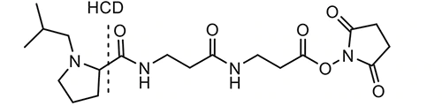
Multiplex quantitation TMTpro 16plex Label Reagents (126-134)
Add 304 to each peptide
9 labeled ¹³C or ¹⁵N
Cleavable Linker
Mass Normalizer
Reporter
Peptide Reactive
Group
Notes:
More recently, a 16plex TMT reagent kit has been introduced – named TMTpro. The concept is the same as the 10/11-plex just with different structures and chemistry. The reporter ions have m/z 126 – 134.

Slide 9
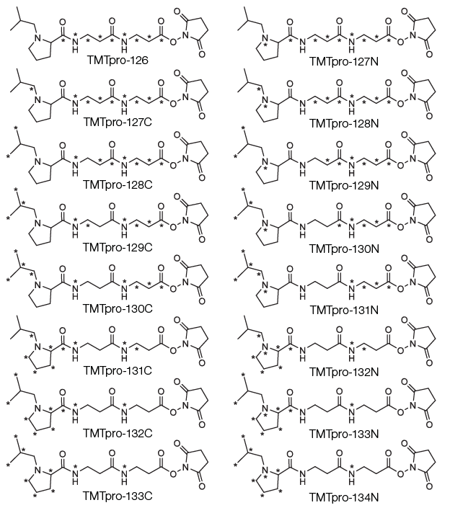
TMTpro
16plex
Notes:
Above is a schematic of the 16 TMTpro tags.

Slide 10
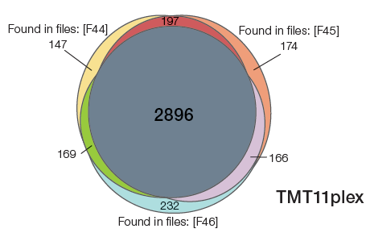
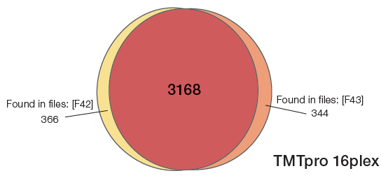
Advantages of TMTpro 16plex Reagents
Same labeling efficiency and peptide/protein ID rates as TMT11plex reagents
Same level of quantitation precision as TMT11plex reagents
Greater number of replicates analyzed in a single experiment leading to fewer missing values, and up to 20% more quantifiable proteins in 50% less time.
Venn diagrams of overlapping proteins quantified among 30 replicate HeLa cell digests labeled with three TMT11plex reagent sets or two TMTpro 16plex reagent sets.
Ref: Thermo tmtpro-label-reagents-higher-multiplex-quantitation-brochure
Notes:
A major advantage of the 16-plex over the 10/11-plex is the opportunity to compare more samples in the same experiment. This becomes especially advantageous when quantifying large numbers of samples across multiple experiments.

