Slide 1
Viewing your results from the PAW Pipeline
Proteomics Shared Resource
OHSU

Slide 2
Overview
This guide is designed to walk you through the basic results files from the PAW Pipeline.
It is easiest to view the results in Excel. We also provide tab-delimited text files that are useable with other spreadsheet programs. Let us know if you’re having problems opening your results.
The PAW Pipeline was written by Phil Wilmarth of OHSU, you can find the publication here: http://www.springerlink.com/content/9x5rk68628506216/fulltext.pdf
The PAW Pipeline uses the target/decoy method for reliable peptide and protein identification and has better sensitivity than most other software.
PAW was designed for the analysis of large datasets and can also effectively filter data for specific PTM analyses. It is frequently used by PSR Core due to superior sensitivity and support for TMT labeling.

Slide 3
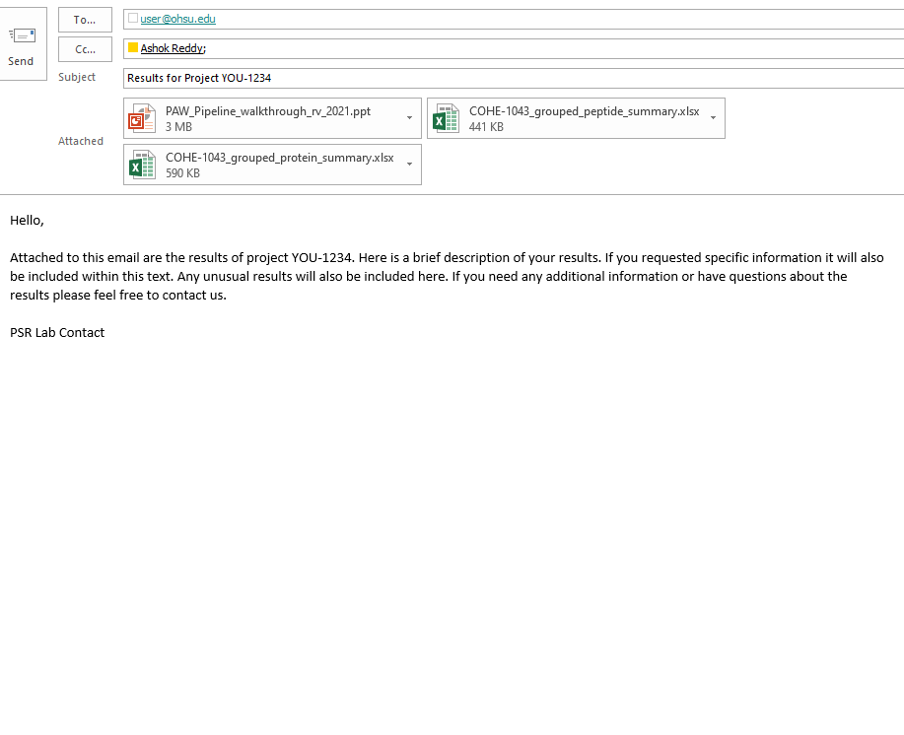
Your Results Files
Clients are typically emailed a protein results file (usually as an Excel spreadsheet) and a peptide results file.

Slide 4
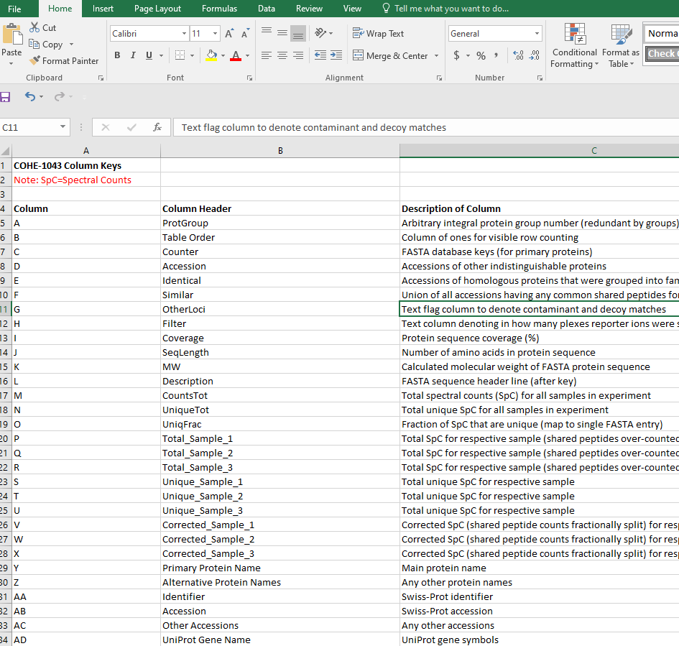
Protein Summary ReadMe Tab
The ReadMe tab includes descriptions of the
columns in the ‘grouped_protein_summary’ worksheet tab.

Slide 5
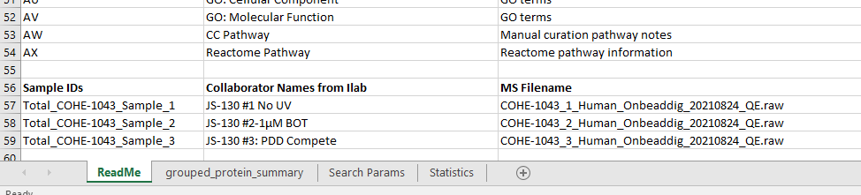
ReadMe Tab (cont.)
Below the descriptions are the sample IDs and the corresponding sample descriptions taken from the iLab submission. The file name of the mass spec data is also included.

Slide 6
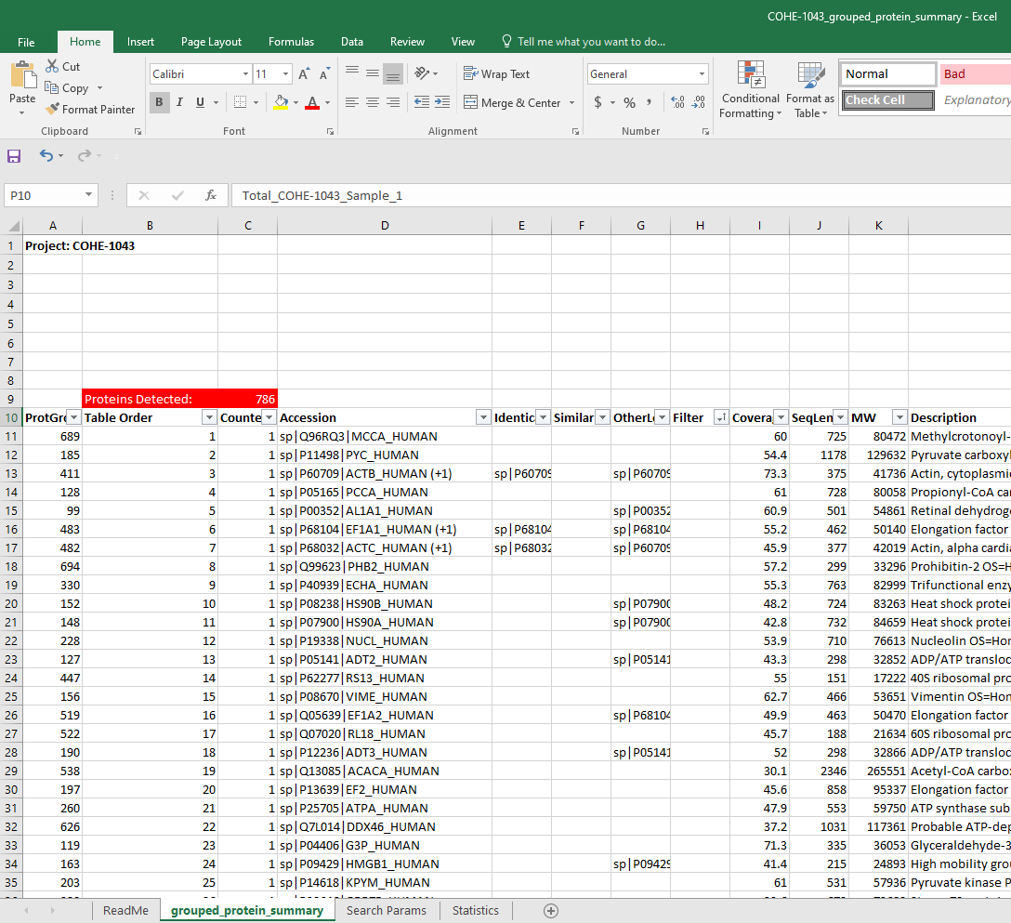
Excel file main tab
Your initial results file will look something like this screen shot.
This can be a little
overwhelming at
first, as there is a lot of information. Let’s break down what each of these columns are.
Note: your exact column letters may differ from those shown here.

Slide 7
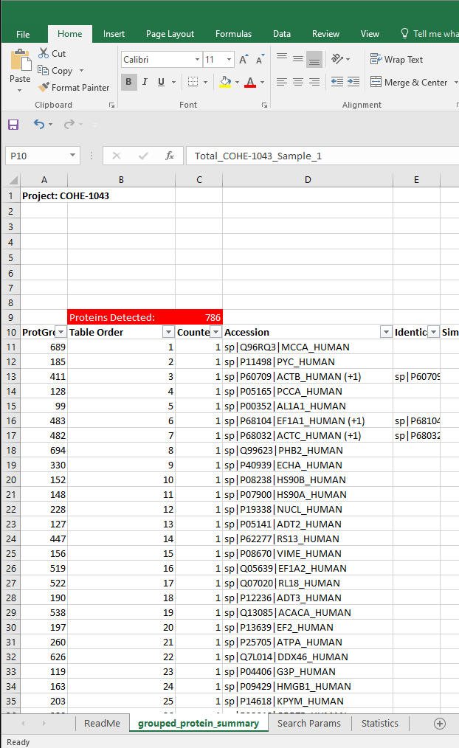
Columns A and B
Column A lists an arbitrary protein group number that correlates with other PAWs tables. Column B is the row order for the protein summary table (usually by decreasing protein abundance estimate).
Rows will group together proteins whose identified peptides were indistinguishable (group membership is indicated in the ‘Identical’ column E).

Slide 8
Column C
Column C contains a counter row.
The 1’s in each visible row are totaled in cell C9 at the top.
This allows you to sort and filter the data in different ways and have a count of the number of proteins (rows) passing the current set of column filters.
The total number of visible protein
entries is recorded here.

Slide 9
Columns D and E
Column D lists the accession string for the identified protein or protein group
Column E lists the accessions of any protein group members.
Accessions come from the UniProt, Ensembl, or NCBI FASTA files used for the database search.
Accessions containing ‘CONT_’ are common contaminates added to the FASTA file by PSR staff.
‘REV_’ are reversed protein entries used by the PAW pipeline to estimate false positive rates (FDRs).

Slide 10
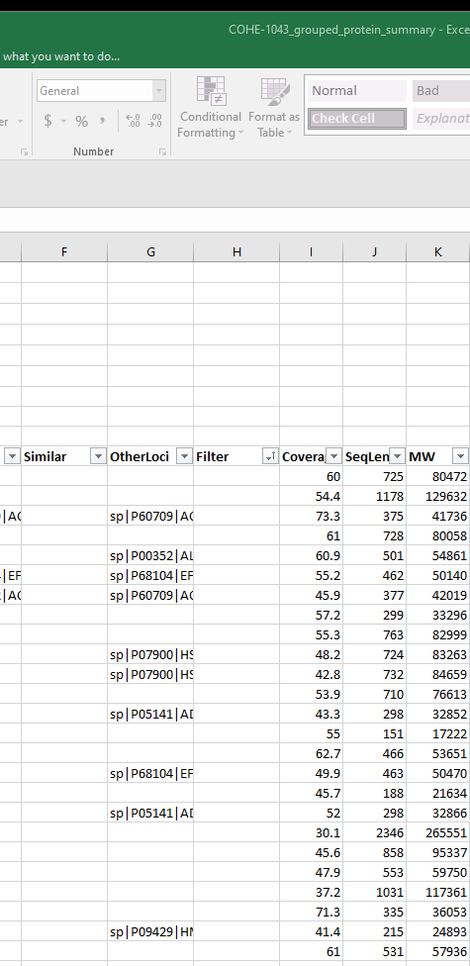
Columns G and H
Column G is the union of all accessions having any common shared peptides for respective protein
Column H is a text column used to denote common contaminants, decoys, or other matches to exclude
Column H is a filter used to hide rows we don’t want to appear in the results list, such as contaminant, redundant, and reversed protein rows
These small arrows let you filter data by choosing to include
or exclude different terms or values from the column.

Slide 11
Columns I-K
Column I lists the % of the FASTA protein sequence covered by the detected peptide sequences.
The number is combined across all the samples, so sample to sample difference in coverage isn’t visible here.
Column J lists the length of the protein sequence (amino acid count)
Column K gives the calculated average molecular weight of the protein sequence in Daltons.

Slide 12
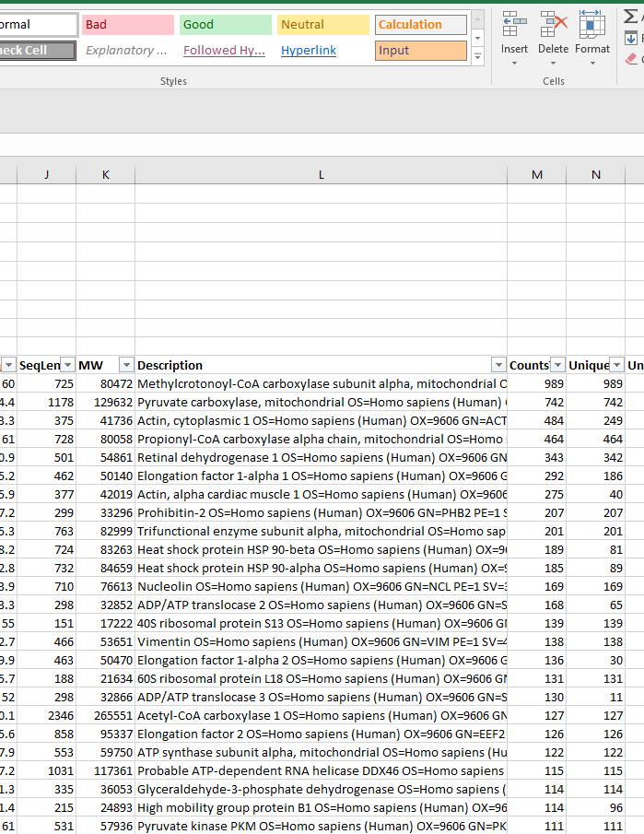
Column L
Column L contains a description of the protein.
This is the description contained in the FASTA file header line used in the Comet database search.

Slide 13
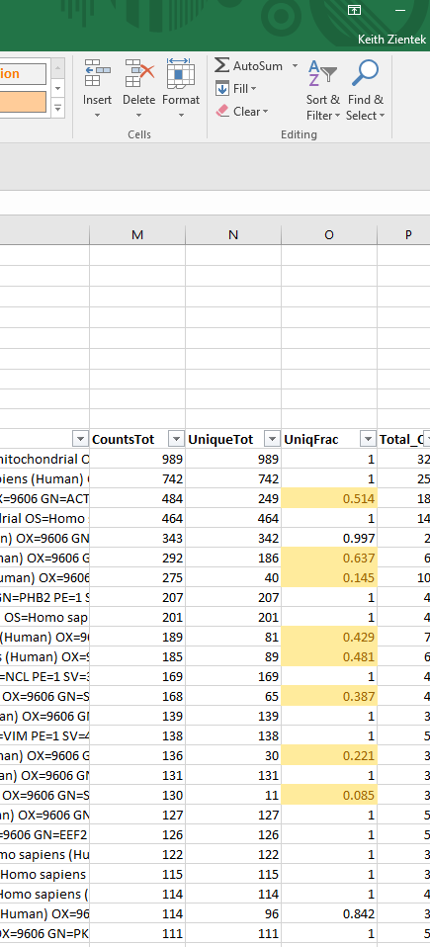
Columns M-O
Column M lists the total number of MS/MS spectra matching to the protein (summed over all samples).
Column N lists the total number of MS/MS spectra matching to ONLY that protein.
Column O displays the fraction of MS/MS spectra that are unique to the protein (column N/column M).
Column O is important when assessing relative quantitation and may be highlighted yellow when fewer than 75% of the MS/MS spectra match uniquely to the protein.
When Column O is much smaller than 1.0, protein abundance estimates can be less reliable because the protein shares many peptides with other proteins that may not share the same abundance differences.

Slide 14
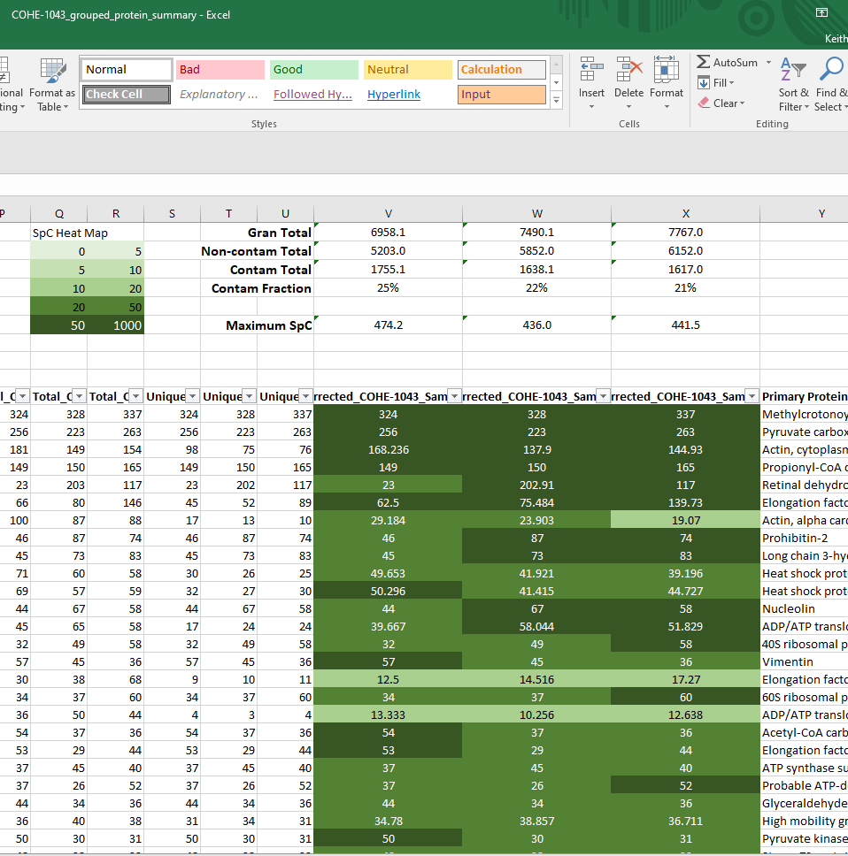
Sample Results Columns
The next several columns will list the total, unique, and corrected spectral counts for all the submitted samples.
The corrected counts columns fractionally split shared peptide counts to give better abundance estimates.
The corrected columns will be colored green for samples where the protein was found.
The shade of the green background changes with the number of spectra. A key is shown above the columns.

Slide 15
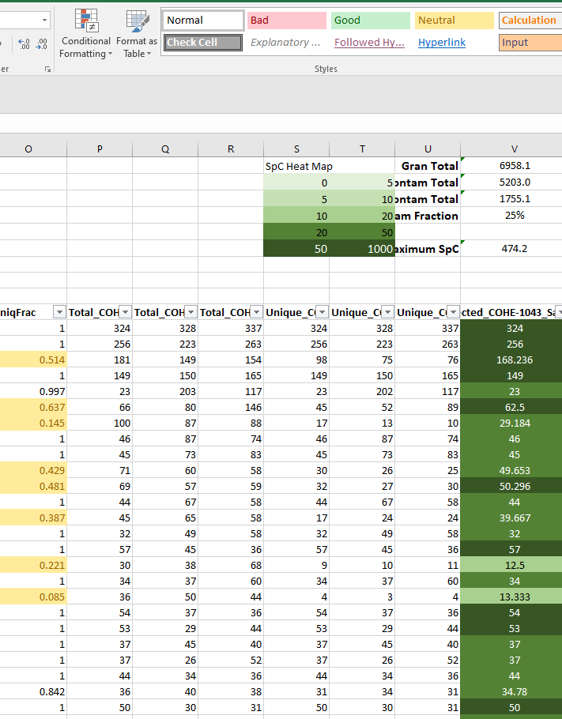
‘Total_’ Columns
The ‘Total_’ columns list the total number of MS/MS spectra matching the protein by biological sample.
These columns may have simplified names so that sample names are easier to read.

Slide 16
‘Unique_’ Columns
The ‘Unique_’ columns list the number of MS/MS spectra that match ONLY to the protein in that sample.
In cases where there are counts in the ‘Total_’ column but not in the ‘Unique_’ column, there is no direct evidence for the protein in that sample.
Samples with low numbers in the ‘Unique_’ column, compared to the ‘Total_’ column, may be difficult to compare between samples.

Slide 17
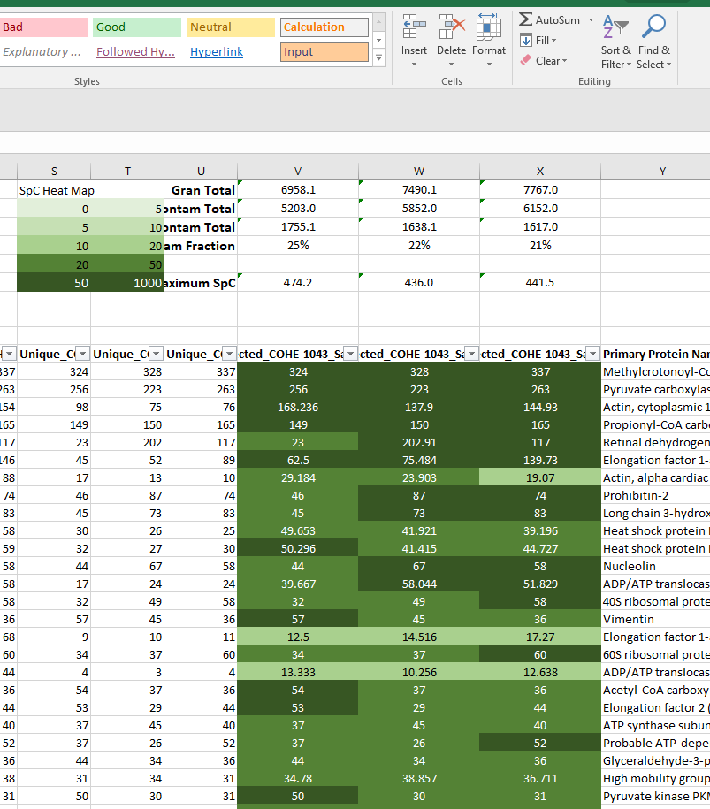
‘Corrected_’ Columns
The ‘Corrected_’ columns adjust the spectral count numbers from the ‘Total_’ columns after splitting counts from shared peptides.
The Corrected total is the Unique total plus a fraction of the “shared” peptides (determined by the relative unique counts of the respective proteins).
There may be additional count columns where values have been normalized and zero counts were replaced by small values.

Slide 18
More info about corrected numbers
There are some conditions that must be met for accurate corrected numbers:
There should be similar total amounts protein in each sample (within reason).
When the Column O value is small, the corrected number might be inaccurate. These proteins will have many shared peptides that can bias the corrected counts.
If data was normalized and normalization factors were greater than 1.5 or less than 0.67, the adjustments may become unreliable. Check housekeeping proteins for consistency.

Slide 19
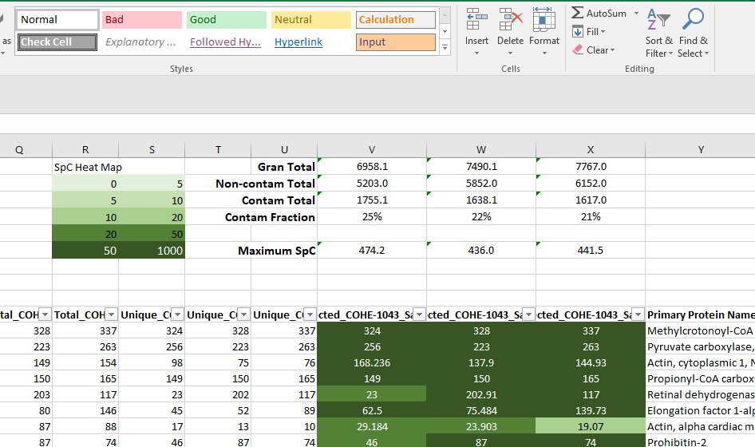
Contamination Summary Table
Some contamination is common in proteomics experiments. The PSR takes precautions to avoid keratin contamination (skin and hair), but contaminant proteins (keratin, bovine albumin, trypsin) will be identified. Proteases used for digestion are frequent contaminants.
Grand Total is the summed spectra counts (SpC) of all the proteins.
Non-contam Total is the summed spectral counts of all detected non-contaminant proteins.
Contam Total is the summed spectral counts of the contaminant proteins.
Contam Fraction is fraction of contaminant proteins detected.
Maximum SpC is the largest protein spectral count in that sample.

Slide 20
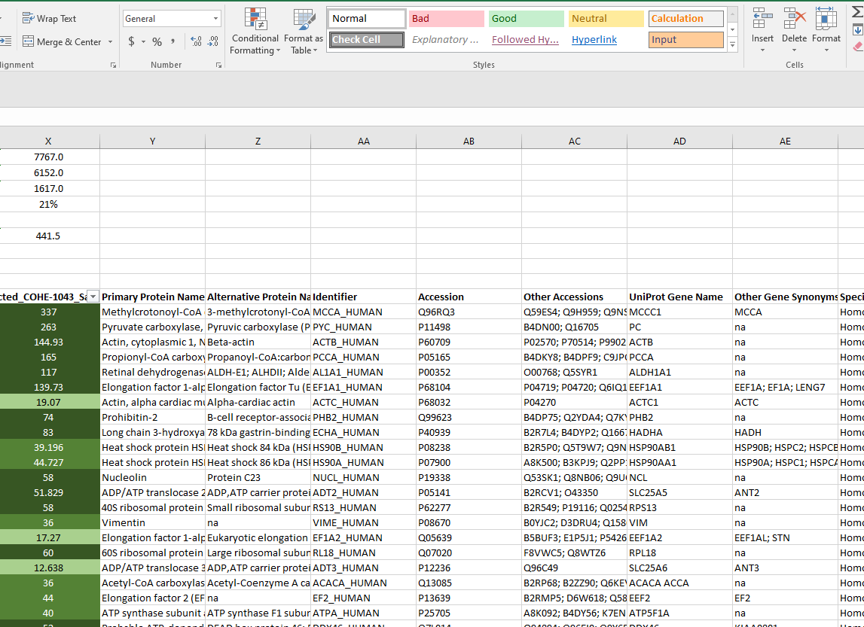
Additional Protein Information
Your data sheet may also have GO terms and additional protein information added after the corrected spectral counts.
Consult the ReadMe tab for descriptions of each column.

Slide 21
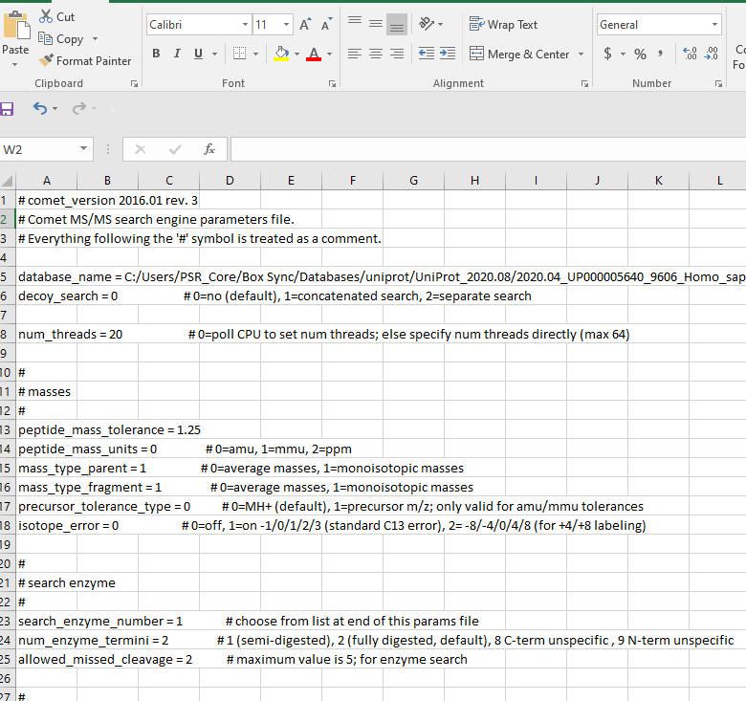
Search Params Tab
The ‘Search_Params’ tab contains a copy of the ‘comet.params’ file used for the database search step during PAW pipeline analysis.

Slide 22
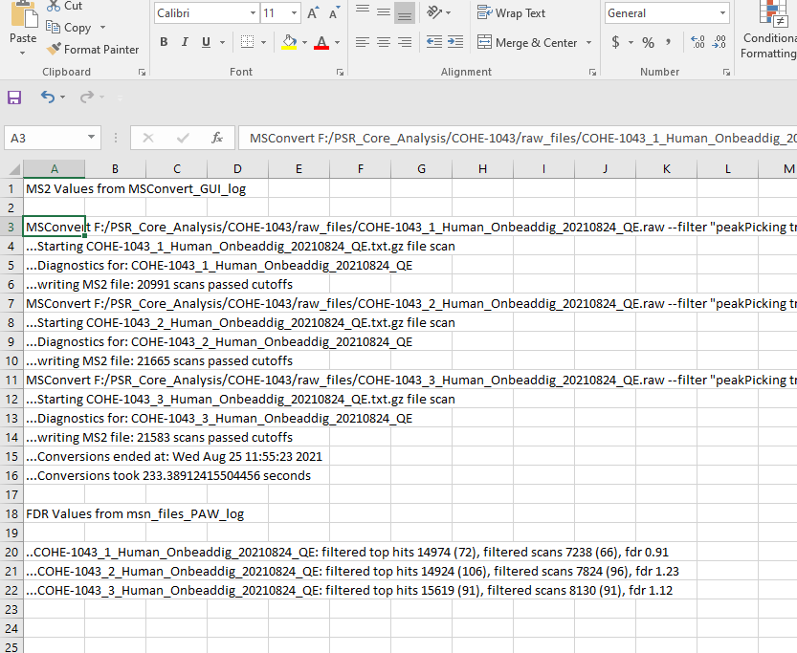
Statistics Tab
The Statistics Tab contains dataset info about the samples from the data processing.
The False Discovery Rates (FDR) for each sample is included here.

Slide 23
Contact Info
If you have questions about viewing your results, please contact us:
  Ashok Reddy: reddyas@ohsu.edu
  Phil Wilmarth: wilmarth@ohsu.edu
  Keith Zientek: zientek@ohsu.edu

