Slide 1
Introduction to Big Data
BDK02-01 | What is Big Data?
Shannon McWeeney, PhD| Department of Medical Informatics & Clinical Epidemiology
Oregon Health & Science University

Slide 2
How do we quantify data?

Slide 3

Bit + Byte
What is a bit?
What is a byte?
How large is 1 word?

Slide 4

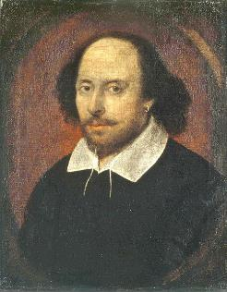
Kilo + Mega
What is a kilobyte?
What is a megabyte?

Slide 5


Giga + Tera
What is a gigabyte?
What is a terabyte?

Slide 6

Peta + Exa
What is a Petabyte?
What is a Exabyte?

Slide 7


Zetta + Yotta
What is a zettabyte?
What is a yottabyte?

Slide 8
What is Big Data?

Slide 9
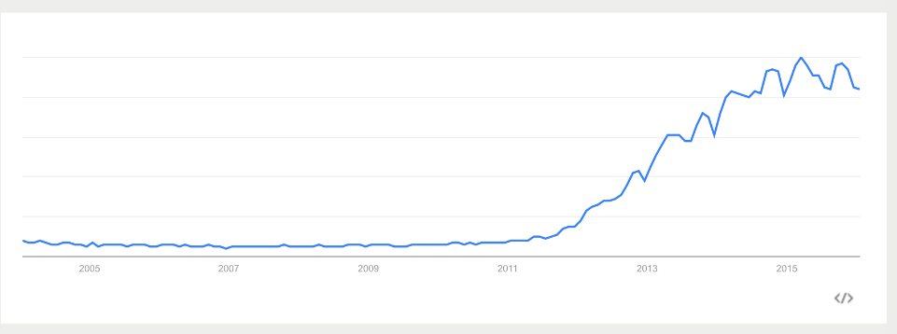
Google Trends: “Big Data”
Interest over time
Chart created 13th January 2016

Slide 10
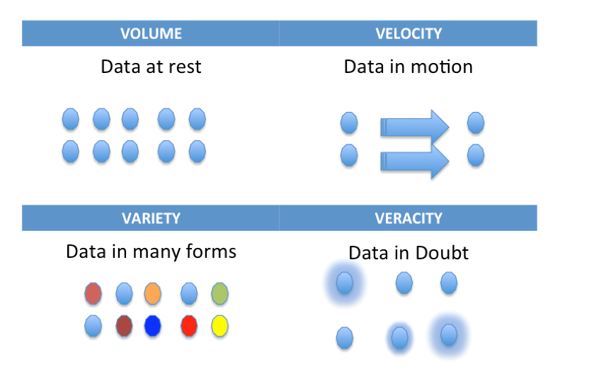
The Four V’s

Slide 11
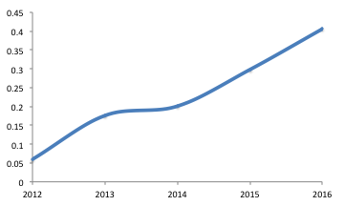
What does this mean to me?
% Jobs matching “Big Data”

Slide 12
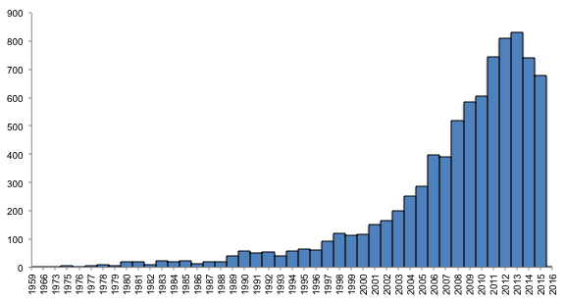
Scientific Considerations
Pubmed - ("retraction of publication"[Publication Type]) OR "retracted publication"[Publication Type]

Slide 13
How much data do you generate?
Quantifying Personal Self

Slide 14

Quantifying Personal Self
Dr. Bill Hersh
428 events recorded since April 2010
356 runs
https://connect.garmin.com/modern/activity/821430683

Slide 15
How much data do you generate (per lifetime)?
Clinical Data
Genomics Data
Exogenous Data (Behavioral, Socio-Economic, Environmental)
0.4 Terabytes
6 Terabytes
1100 Terabytes

Slide 16
Clinical data: Small but important !
Point | Example
Clinical data has potential to transform research across the translational continuum | Multiple opportunities to transform knowledge discovery and generate value
Clinical data is increasingly available but requires increased ethical protections | Increasing EHR adoption + interest -> concerns about privacy, confidentiality, use, and security
Clinical data is incomplete, inaccurate, and messy | Computing phenotypes is challenging
You can be part of the solution by sharing data, recording metadata, and being responsible | Up to you … just do it!

Slide 17
Data provided directly from the Patient
PatientsLikeME
PatientCrosroads
FreetheData

Slide 18
Where we need to focus: Human-Data Interaction
Negotiability
Legibility
Agency

Slide 19
Tracking Transience project
The way you protect your privacy Is to take control over it - if I give it you directly very different. Giving information makes info FBI has no value
- Hasan Elahi
http://trackingtransience.net/

Slide 20
Thank you
This course was made possible under a grant from the NIH (# 1R25GM114820-01)

