Slide 1
Standards and Interoperability
BDK04-1 | Clinical Data Standards Related to Big Data
William Hersh, MD | Department of Medical Informatics & Clinical Epidemiology
Oregon Health & Science University

Slide 2
Why are standards important in big data science?
Promote consistent naming of individuals, events, diagnoses, treatments, etc.
Allow better use of data for patient care as well as secondary uses, such as quality assurance, clinical research, public health, etc.
Enhance ability to transfer data among applications, allowing better system integration
Facilitate interoperability among information systems and users

Slide 3
Time is ripe for standards and interoperability
After massive investment in electronic health records (EHRs), the “blame game” should end.
Lack of interoperability compromises coordination of care.
(Adler-Milstein, 2017; Samal, 2016)

Slide 4
What is a standard?
There’s a standard for that!
From ISO, 2004 (underlined by Benson, 2012)
A standard document established by consensus and approved by a recognized body that provides for common and repeated use, rules, guidelines or characteristics for activities or their results, aimed at the optimum degree of order in a given context

Slide 5
Standards facilitate interoperability
IEEE original definition, widely cited (1990)
“The ability of two or more systems or components to exchange information and to use the information that has been exchanged.”
Extended for healthcare in 2005 by NAHIT (2005) and endorsed by 40 other healthcare organizations
“The ability of different information technology systems and software applications to communicate; to exchange data accurately, effectively, and consistently; and to use the information that has been exchanged.”
Current IEEE definition
“Ability of a system or a product to work with other systems or products without special effort on the part of the customer. Interoperability is made possible by the implementation of standards”

Slide 6
Levels of interoperability for healthcare
Level 1 – no interoperability
e.g., mail, fax, phone, etc.
Level 2 – machine-transportable (structural)
Information cannot be manipulated
e.g., scanned document, image, PDF
Level 3 – machine-organizable (syntactic)
Sender and receiver must understand vocabulary
e.g., email, files in proprietary format
Level 4 – machine-interpretable (semantic)
Structured messages with standardized and coded data
e.g., coded results from structured notes, lab, problem list, etc.
(Walker, 2005)

Slide 7
Value of standards throughout history
Roman chariots
Railroad tracks
Telephones
ASCII text in computers
Wi-Fi to connect computers, smartphones, tablets, etc. wirelessly to the Internet
Global financial transactions
Other examples?

Slide 8
Benefits and limitations of standards
Benefits
Interoperability
May allow innovation based on common foundation
Limitations
Dominance by one segment of industry
May stifle innovation
May be a mixed bag
Microsoft “standards,” e.g., Windows, Office, etc.
Ever hear of Esperanto? Why did English prevail? (Patterson, 1999)
“The nice thing about standards is that there are so many of them to choose from.” (Tanenbaum, 2010 – disputed)
(Patterson, 1999)

Slide 9
The standards development process – four approaches
Ad hoc – groups agree to informal specifications
De facto – single vendor controls industry
Government mandate – government agency creates standard and mandates its use
Consensus – interested parties work in open process
(Hammond, 2014)

Slide 10
Standards development
Overview of processes and organizations (Marshall, 2009)
Health IT Standards 101 – another overview (Boone)
http://motorcycleguy.blogspot.com/2012/04/healthit-standards-101.html
Stages of development (Hammond, 2014)
Identification
Conceptualization
Discussion
Specification
Early implementation
Conformance
Certification

Slide 11
Some US standards bodies (private, non-profit)
American National Standards Institute (ANSI) that accredits standards development organizations (SDOs), including in healthcare
Accredited Standards Committee (ASC) X12
Health Level 7 (HL7)
American Society for Testing and Materials (ASTM), which has a Committee E31 on Healthcare Informatics

Slide 12
International standards bodies
International Organization for Standardization (ISO)
Technical Committee 215 (TC 215) focuses on health informatics standards
European Committee for Standardization (CEN)
CEN/TC 251 is health informatics standards body for Europe
International Telecommunication Union (ITU) – UN agency focused on telecommunications standards (general, not medical)

Slide 13
US government health information standards leadership efforts
A number of approaches over last decade
Consolidated Health Informatics (CHI) initiative – effort to adopt ready standards by health-related US government agencies
Healthcare Information Technology Standards Panel (HITSP) of the Office of the National Coordinator for Health IT (ONC) – effort to identify ready standards and gaps needing to be filled
National Institute for Standards and Technology (NIST) – focused on efforts supporting ONC
National Library of Medicine (NLM) – efforts mostly around insuring terminology standards support messaging standards efforts (e.g., HL7)
All standards work now being led by ONC Health IT Standards Committee

Slide 14
Health IT Standards Committee
Charged with making recommendations to ONC on “standards, implementation specifications, and certification criteria for electronic exchange and use of health information”
Timeline of recent activities
JASON report calls for move to more “modern” API-based approaches to interoperability
ONC establishes JASON Task Force to respond to recommendations and develops evolving plans and documents
Interoperability Vision (2014) – vision and framework
Interoperability Roadmap (2015) – how to get there
(MITRE, 2014)

Slide 15
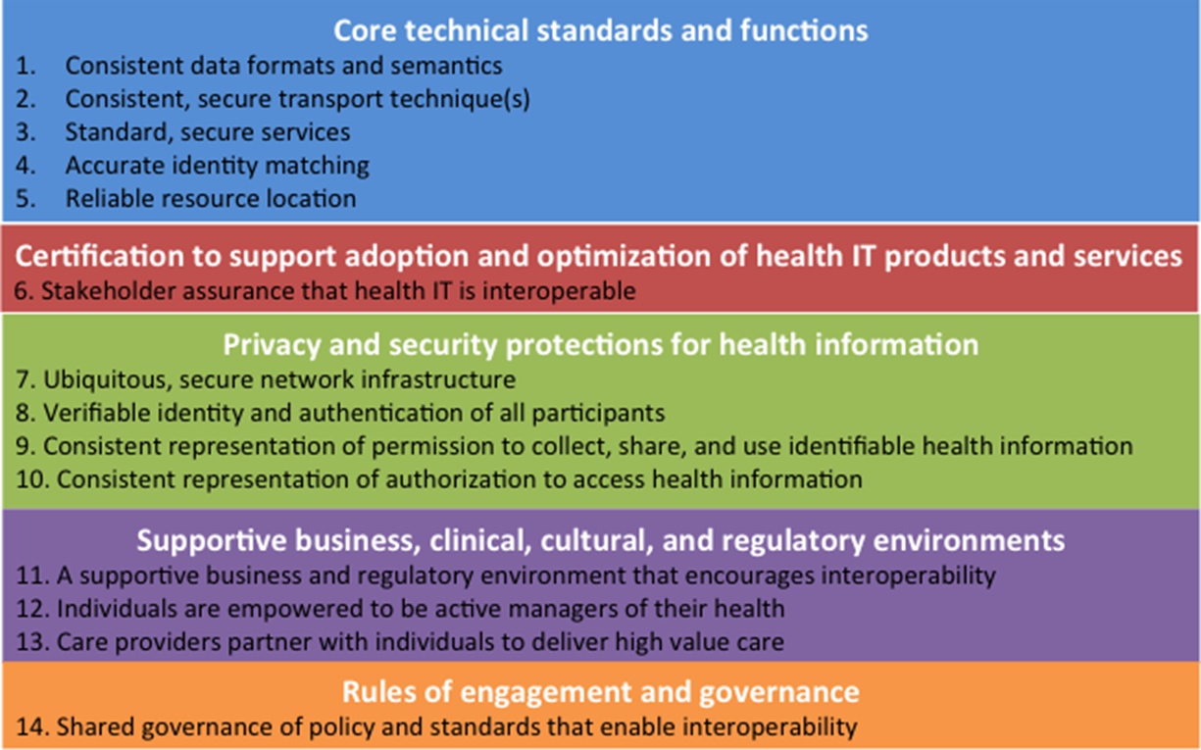
Overview of Interoperability Roadmap

Slide 16
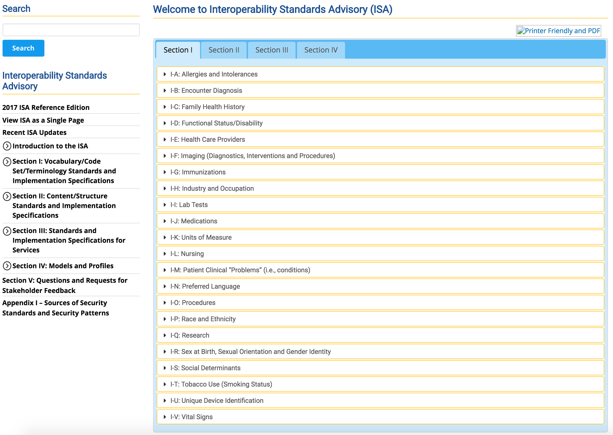
Current US HIT standards activities
Argonaut Project – charter (2014) and use cases (2015)
Implementation guide – http://argonautwiki.hl7.org/index.php?title=Implementation_Guide
Standards Advisory – annual release of list of standards ready for widespread adoption
Latest version at https://www.healthit.gov/isa/

Slide 17
Some perspectives on HIT standards efforts
What makes standards mature and adoptable (Baker, 2015)?
What are use cases to establish an EHR is open and interoperable (Sittig, 2015)?
Data blocking – report to ONC raising concern (2015), though some dispute existence (Halamka, 2015)
Interoperability Pledge – initiative of leading health systems and vendors to implement consumer access to data, lack of blocking, and adoption of recognized standards and security
https://www.healthit.gov/commitment

Slide 18
Integrating the Health Enterprise (IHE)
Non-federal effort that identifies and demonstrates solutions to real-world interoperability problems
Organizes interoperability showcases to demonstrate solutions
Organized across various clinical and operational domains
Each domain produces own set of Technical Framework documents in coordination with other domains
Committees in each domain review and republish these documents annually, often expanding with supplements that expand existing or define new profiles
Profiles eventually republished for trial implementation; if criteria for successful testing achieved, profile is published in final form
(Samarth, 2013)

Slide 19
Example IHE profiles from domain: Patient Care Coordination
[MS] Medical Summaries describes the content and format of Discharge Summaries and Referral Notes
[XPHR] Exchange of Personal Health Record describes the content and format of summary information extracted from a PHR system for import into an EHR system, and visa versa
[FSA] Functional Status Assessments describes the content and format of Functional Status Assessments that appear within summary documents
[QED] Query for Existing Data queries data repositories for clinical information on vital signs, problems, medications, immunizations, and diagnostic results
[IC] Immunization Content exchanges immunization data
[CM] Care Management exchanges information between HIT systems and applications used to manage care for specific conditions
[PPOC] Patient Plan of Care exchanges data related to creating and managing individualized patient care between and among HIT systems
[RCG] Request for Clinical Guidance obtains decision support when ordering medications, determining appropriate immunizations, diagnostic tests, etc.
[EDR] Emergency Department Referral communicates medical summary data from an EHR System to an EDIS System

Slide 20

Banking can do worldwide standards; why not healthcare?
Table from Bernstam, EV and Johnson, TR (2009). Why health information technology doesn't work. Frontiers of Engineering. 39(4): 30-35.

Slide 21
Biomedical and health data standards
Identifiers
Transactions
Message exchange
Terminology

Slide 22
Thank you
Please download the resource list with useful links from the “Resources” tab in the upper right of the player.
This course was made possible under a grant from the NIH (# 1R25GM114820-01)

