Slide 1
Message Exchange Standards 1/2
BDK04-3 | Clinical Data Standards Related to Big Data
William Hersh, MD | Department of Medical Informatics & Clinical Epidemiology
Oregon Health & Science University

Slide 2
Message exchange standards
Health Level 7 (HL7)
Fast Healthcare Interoperability Resources (FHIR)
Images: Digital Imaging and Communications (DICOM)
Devices: IEEE 1073 / ISO 11073 and others
ePrescribing: NCPDP and SCRIPT
Laboratory: ELINCS
Patient summaries: CCR, CCD, and ABBI
Platforms: Substitutable Medical Apps, reusable technologies (SMArt)

Slide 3
Health Level 7 International (HL7)
Major messaging standards for healthcare as well as the standards development organization that supports the standard
Name based on OSI seven-layer model of network communications
Two substantially different versions
Version 2 widely used and syntactic-oriented
Version 3 still being adopted and aims for semantic interoperability
FHIR may solve reconciliation of these
Documentation less than ideal but
Standards documents on Web site with voluminous detail
Overview book
(Benson, 2016)

Slide 4
HL7, version 2
Current versions (2.X) supported by most vendors for interchange of data
Implemented by bar-delimited ASCII files
Is mostly a syntax, where sender and receiver must understand meaning of messages, but subsequent versions adding more semantics (meaning)
Each message has segments consisting of three-character identifier and values, e.g.,
MSH – message header
EVN – event type
PID – patient identifier
OBR – results header
OBX – result details
(Henderson, 2003; Benson, 2016)

Slide 5
HL7 version 2.5 example
MSH|^~\&||^123457^Labs|||200808141530||ORU^R01|123456789|P|2.4
PID|||123456^^^SMH^PI||MOUSE^MICKEY||19620114|M|||14 Disney Rd^Disneyland^^^MM1 9DL
PV1|||5N|||||G123456^DR SMITH
OBR|||54321|666777^CULTURE^LN|||20080802||||||||SW^^^FOOT^RT|C987654
OBX||CE|0^ORG|01|STAU||||||F
OBX||CE|500152^AMP|01||||R|||F
OBX||CE|500155^SXT|01||||S|||F
OBX||CE|500162^CIP|01||||S|||F
Report from Lab123457, 15:30 14-Aug-2008, Ref 123456789
Patient: MICKEY MOUSE, DoB: 14-Jan-1962, M, Address: 14 Disney Rd, Disneyland, MM1 9DL
Provider: Dr. Smith (G123456), Ward: 5N
Specimen: Swab, FOOT, Right, Requested By: C987654
Organism: STAU (Staphylococcus aureus)
Susceptibility:
AMP R
SXT S
CIP S
(Benson, 2016)

Slide 6
Another HL7 version 2.5 example
MSH|^~&\|DHIS|OR|TMR|SICU|199212071425|password|ADT|16603529|P|2.1<cr>
EVN|A02|199212071425||<cr>
PID|||Z99999^5^M11||GUNCH^MODINE^SUE|RILEY|19430704 |F||C|RT. 1, BOX 97^ZIRCONIA^NC^27401 |HEND|(704)982-1234|(704)983-1822||S|C||245-33-9999<cr>
PV1|1|I|N22^2204|||OR^03|0940^DOCTOR^HOSPITAL^A|||SUR|||||A3<cr>
OBR|7|||93000^EKGREPORT|R|199401111000|199401111330|||RMT||||1994011111330|?|P030||||||199401120930||||||88-126666|A111|VIRANYI^ANDREW<cr>
OBX|1|ST|93000.1^VENTRICULAR RATE(EKG)||91|/MIN|60-100<cr>
OBX|2|ST|93000.2^ATRIAL RATE(EKG)||150|/MIN|60-100<cr>
...
OBX|8|ST|93000&IMP^EKG DIAGNOSIS|1|^ATRIAL FIBRILATION<cr>
(Hammond, 2014)

Slide 7
Releases of HL7 V2
V2.1 (1990): First implemented version - very basic, but still used
V2.2 (1994): Basic enhancements
V2.3 (1997): Scheduling and Finance messages added
V2.3.1 (1999): Pathology, Allergies, Referral as Scheduling
V2.4 (2000): Clinical Focus - Referrals and Discharge Summaries
V2.5 (2003): Data field lengths standardized
V2.5.1 (2007): Four data items added due to US regulatory requirements
V2.6 (2007): Data type changes
Coded Element (CE) → Coded With (No) Exceptions (CNE/CWE)
Time Stamp (TS) → Date/Time (DTM)
V2.7 (2011): Collaborative Care Message
V2.7.1 (2012): Lab Orders/Results features added for US “Meaningful Use”
V2.8 (2014): Authorization and Ordering information added

Slide 8
HL7 version 3
Attempts to introduce semantics (meaning, also termed computable semantic interoperability) beyond syntax of version 2
Differences demonstrated
Based on Reference Information Model (RIM), an object model of entities that pass messages
Implemented in eXtensible Mark-Up Language (XML)
Thought by many to be complicated, by some overly so
Some aspects have been called “incoherent”
(Hinchley, 2005), (Ringholm, 2007), (Mead, 2005), (Smith, 2006)

Slide 9
Overview of the RIM
RIM uses object-oriented approach to define healthcare interactions based on five abstract classes
Entity – things in world, e.g., people, organizations, other living subjects, drugs, devices
Role – capability or capacity, e.g., patient, practitioner
Participation – role in context of an act, e.g., performer, target
Act – clinical or administrative definitions, e.g., observation, diagnosis, procedure
Act relationship – links between acts, e.g., diagnosis act
All clinical, administrative, financial, etc. activities of healthcare can be expressed in “constraints” to model
(Mead, 2005; Benson, 2016)

Slide 10
HL7 version 3 instance of pulse measured at physician office visit
Entity
Role
Act
Act
Person
Patient
Patient-Encounter
Observation
Patient-Instance
Doctor-Visit
Pulse-Rate
Participation
Act-Relationship
Observations modeled as Entity-Attribute-Value (EAV)
and ideally are based on standard terminology, e.g., pulse (palpated at wrist) – rate 50 beats/minute

Slide 11
Backward and forward: Fast Health Interoperability Resources (FHIR)
Response to complexity of HL7 version 3, but maintaining compatibility with other HL7 standards, e.g., Clinical Document Architecture (CDA)
What is really needed is an API
Uses “modern” application programming interface (API) approach but less detailed semantics than HL7 version 3
Substantial backing, including via Argonaut Project
Key component is Resource, which defines and represents data elements, building them from data types that define common reusable patterns of elements
(Boone, 2012; Bender, 2013)

Slide 12
Overview of FHIR
Four types (patterns) of use
Documents – sharing notes, summaries, letters, etc.
Messages – sharing structured data, e.g., laboratory test results
API – exposing functionality and data across applications, e.g., decision support on a mobile device
Operations – extending API to expose logic, e.g., a decision support service accessed by a prescribing app
Resources provide the building blocks of profiles, which define their use in a specific clinical context
Semantics are standardized via common terminology
Based on standard code systems
Value sets for specific uses of codes in a given clinical context, with value defined (and constrained)
(Hay, 2016)

Slide 13
Overview: FHIR for Clinical Users
API like accessing a file cabinet
Search – search through folders for ones that meet set of search criteria
Read – get copy of one of specific folders in drawer
Create – add new folder to the appropriate drawer (with a new number)
Update – alter contents of specific folder
Delete – remove a folder from the cabinet
History – get history for one of the folders, or an entire drawer, or entire system
Transaction – give server a bunch of folders all at once to update

Slide 14
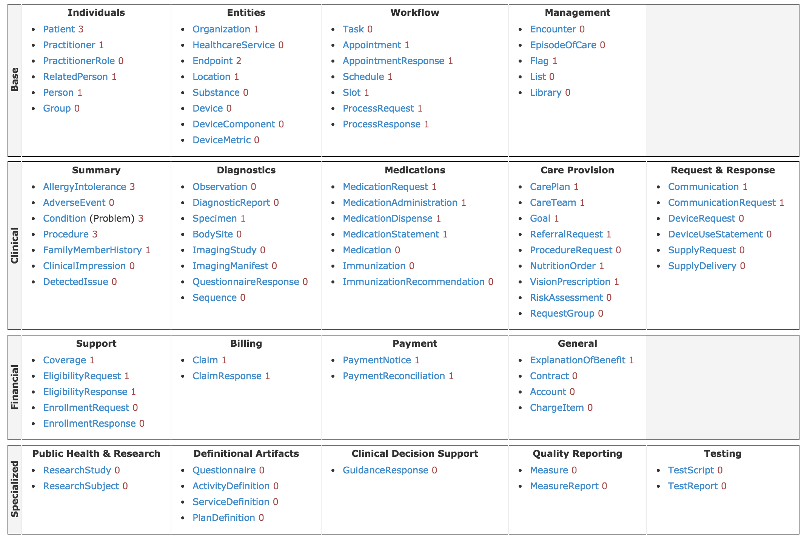

Growing development of Resources

Slide 15
Example resources: patient and medication
Image of http://wiki.hl7.org/index.php?title=File:Fhir-clinical-uml.png

Slide 16
Some additional activities of HL7
EHR System Functional Standard
Clinical Context Object Workgroup
Clinical Decision Support Workgroup
Clinical Document Architecture
(many more)

Slide 17
Clinical Document Architecture (CDA)
Much healthcare information is in “documents” required for human reading, but still want computable structure
CDA defines XML-based standard structure and metadata for clinical documents
Templates are reusable, computable components of CDA documents
“Unstructured” documents can be “wrapped” in CDA framework
Current release is version 2
Three “levels” of CDA
Level 1 – general document specification
Level 2 – adds document types with allowable structures
Level 3 – adds mark-up expressible in RIM
(Dolin, 2006; Boone, 2011)

Slide 18
Health Story – structuring CDA where cost-effective
Image from http://s3.amazonaws.com/rdcms-himss/files/production/public/HealthStoryProject/downloads/IHE%20NA%20Connectathon%20Conference%202014%20Presentation_Illustrations%20of%20Community%20HIEs%20and%20Interoperability.pdf

Slide 19
Toward Consolidated CDA
A series of “reusable templates” consisting of
Document templates – from Health Story Project, guides for specific types of common clinical notes, which are based on
Section templates – describe basic elements of notes, which are based on
Entry templates – contain the actual data

Slide 20
CCDA document and section templates
HL7 Implementation Guide for CDA® Release 2: IHE Health Story Consolidation, Release 1.1 - US Realm
Document Template | Section Template(s)
Continuity 0f Care Document (CCD) | Allergies Medications Problem List Procedures Results Advance Directives Encounters | Family History Functional Status Immunizations Medical Equipment Payers Plan of Care
Section templates in YELLOW demonstrate CDA’s interoperability and reusability.
Document Templates: 9
Continuity of Care Document (CCD)
Consultation Note
Diagnostic Imaging Report (DIR)
Discharge Summary
History and Physical (H&P)
Operative Note
Procedure Note
Progress Note
Unstructured Document
Section Templates: 60
Entry Templates: 82
History & Physical (H&P) | Allergies Medications Problem List Procedures Results Family History Immunizations Assessments | Assessment and Plan Plan of Care Social History Vital Signs History of Present Illness History of Present Illness | Chief Complaint Reason for Visit Review of Systems Physical Exam General Status
(ONC, 2012)

Slide 21
Thank you
Please download the resource list with useful links from the “Resources” tab in the upper right of the player.
This course was made possible under a grant from the NIH (# 1R25GM114820-01)

