Slide 1
Message Exchange Standards 2/2
BDK04-4 | Clinical Data Standards Related to Big Data
William Hersh, MD | Department of Medical Informatics & Clinical Epidemiology
Oregon Health & Science University

Slide 2
Message exchange standards
Health Level 7 (HL7)
Images: Digital Imaging and Communications (DICOM)
Devices: IEEE 1073 / ISO 11073 and others
ePrescribing: NCPDP and SCRIPT
Laboratory: ELINCS
Patient summaries: Continuity of Care Record (CCR), Continuity of Care Document (CCD), Consolidated CDA, Blue Button
Platforms: Substitutable Medical Apps, reusable technologies (SMArt)

Slide 3
Digital Imaging and Communications (DICOM)
Developed by American College of Radiology (ACR) and National Electrical Manufacturers Association (NEMA)
Defines how images and associated data are moved between electronic devices, including information systems
Used in most radiology picture and archiving systems (PACS)
Growing transfer of radiology images digitally leads to viewing problems when DICOM not used
(Rorden, 2007; Pianykh, 2010), (Kalia, 2011)

Slide 4

DICOM format files
Images from Rorden, C (2007). The DICOM Standard. Columbia, SC, University of South Carolina. http://www.cabiatl.com/mricro/dicom/index.html
Transfer Syntax UID reports structure and compression of image, e.g., JPEG and amount of compression
(Rorden, 2007)

Slide 5
Medical device standards
What is a medical device? From US Food, Drug, and Cosmetic Act, section 201(h)
An instrument, apparatus, implement, machine, contrivance, implant, in vitro reagent, or other similar or related article, including a component part, or accessory that is:
Intended for use in the diagnosis of disease or other conditions, or in the cure, mitigation, treatment, or prevention of disease, in man or other animals, or
Intended to affect the structure or any function of the body of man or other animals, and which does not achieve any of its primary intended purposes through chemical action within or on the body of man or other animals and which is not dependent upon being metabolized for the achievement of any of its primary intended purposes
(HIMSS Analytics, 2010; Day, 2011)

Slide 6
Medical information bus (MIB)
Aims to develop standards for control and linkage of information from medical devices
Most implementations just transfer data, but there is capability to issue commands, e.g., change settings of an intravenous fluid (IV) pump
Emerged as IEEE 1073 and now ISO 11073
(Kennelly, 1997; Kennelly, 1998)

Slide 7
Related medical device standards
Medical Device “Plug-and-Play” Interoperability Program – focus on interoperability of network-based devices, mainly in medical settings
Continua Health Alliance – consortium of companies and organizations devoted to interoperability of personal telehealth devices
(Whitehead, 2008), (Cnossen, 2010)

Slide 8
Continua “personal health eco-system”
Image from http://www.embeddedintel.com/special_features.php?article=287

Slide 9
NCPDP and SCRIPT
National Council for Prescription Drug Programs (NCPDP) has developed family of standards for pharmacy claims benefits
SCRIPT is NCPDP standard for electronic communications between prescriber and pharmacy
HITECH meaningful use criteria require NCPDP and SCRIPT standards for e-prescribing

Slide 10
EHR-Laboratory Interoperability and Connectivity Standard (ELINCS)
Goal to standardize laboratory ordering from and reporting to EHRs
Constrains ORU field of HL7 version 2 to defined set of allowable elements
Maintained by HL7
Figure from http://www.chcf.org/projects/2009/elincs
(Sujansky, 2009)

Slide 11
Continuity of Care Record and Document (CCR, CCD)
CCR was a “set of basic patient information consisting of the most relevant and timely facts about a patient’s condition”
Goal was for use when patient was referred, transferred, or discharged among healthcare providers and/or facilities, containing basic information for providing continuity of care
Original CCR was not compatible with existing standards, so HL7 and vendors created CCD, which was based on HL7 V3 and CDA
CCD has resulted in more standard use but errors and allowable variation from standard has limited semantic interoperability
(EHRVA, 2007), (D’Amore, 2012), (D’Amore, 2014)

Slide 12
CDA templates in CCD – Meaningful Use (MU) Stage 2 required data set
Header
Purpose
Problems
Procedures
Family history
Social history
Payers
Advance directives
Alerts
Medications
Immunizations
Medical equipment
Vital signs
Functional statistics
Results
Encounters
Plan of care

Slide 13

Blue Button Initiative
“Public-private partnership to empower consumers with easy and secure access to their health records from a variety of sources in a format they can use”
Started with Blue Button Initiative of VA that allowed patients to download an electronic summary of their medical data
Led to ONC launching Blue Button Toolkit to facilitate development

Slide 14
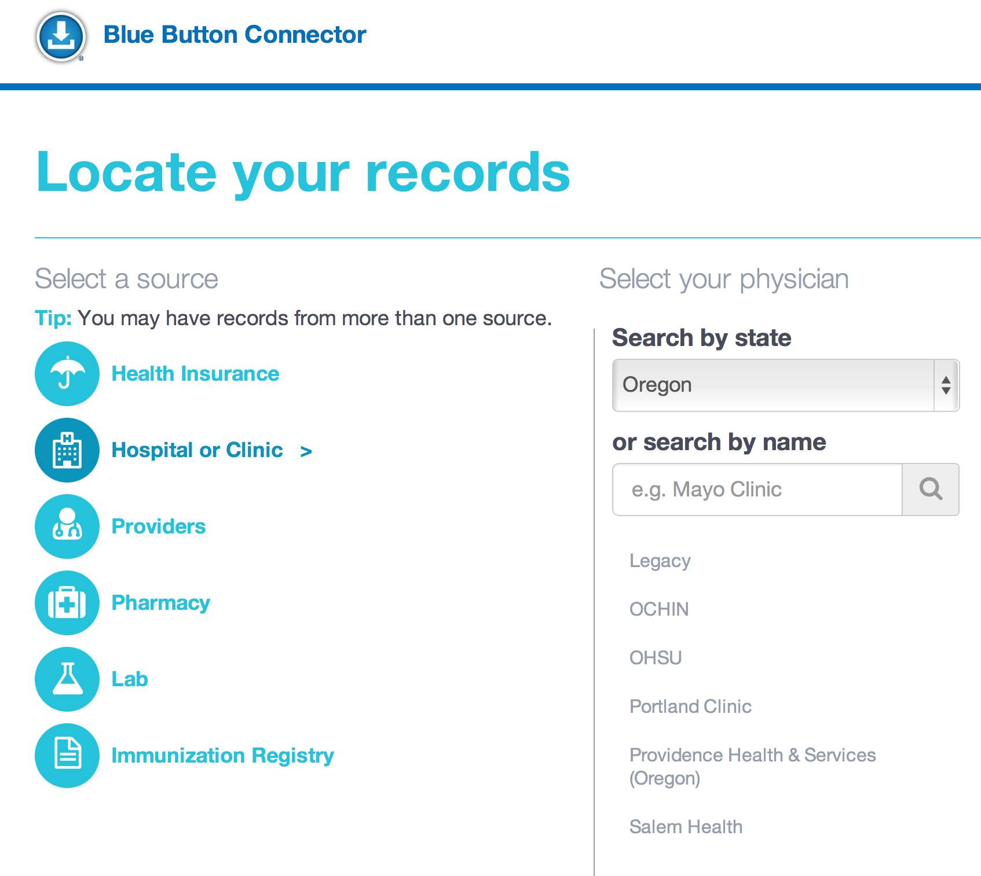
Blue Button Connector
Helps people find healthcare organizations that provide access to their data, e.g., institutions in Oregon that provide Blue Button services in their PHRs

Slide 15
Platforms
Much criticism that current EHRs are monolithic systems (“traps”) and not platforms
Substitutable Medical Apps, reusable technologies (SMART) – one of ONC SHARP projects
Based on platform for “app” development accessing store of information
Has adopted FHIR as API
Some vendors are pursuing platforms, sometimes in limited ways
Surescripts – expanding e-prescribing platform to more types of data with Kryptiq
Allscripts has launched an “open architecture platform”
Epic has developed API for accessing data and services and is developing an “app store”
(Mandl, 2012), (Newman, 2015)

Slide 16
Thank you
Please download the resource list with useful links from the “Resources” tab in the upper right of the player.
This course was made possible under a grant from the NIH (# 1R25GM114820-01)

