Slide 1
Basic Research Data Standards
BDK05
Nicole Vasilevsky | OHSU Library - Ontology Development Group
Oregon Health & Science University

Slide 2
Learning objectives
1 | What constitutes a data standard?
2 | Why use a data standard?
3 | Which data standards should be used?
4 | What are the criteria by which one should choose a standard?

Slide 3
What constitutes a standard?

Slide 4
Different groups and individuals have different definitions for ‘data standards’
"Standards are documented agreements containing technical specifications or other precise criteria to be used consistently as rules, guidelines, or definitions of characteristics to ensure that materials, products, processes, and services are fit for their purpose."
International Organization for Standardization (ISO)

Slide 5
Different groups and individuals have different definitions for ‘data standards’
Data standards are the rules by which data are described and recorded. In order to share, exchange, and understand data, we must standardize the format as well as the meaning.
http://www.usgs.gov/datamanagement/plan/datastandards.php

Slide 6
The stakeholder ecosystem
Benefits many, including adopters
Official Standards Broadly Adopted
(eg. Internet Protocol)
Benefits primarily others besides adopters
Official Standards Poorly Adopted
Benefits primarily adopters, and niche communities, but not others
Unofficial conventions with
varying adoption
No broadly compelling need
for a standard
Wild west: No convention at all

Slide 7
Features of standards
Some standards
convey benefits for implementers
even when it is not implemented perfectly
or by everyone
Some standards
convey few benefits unless / until
everyone conforms, and conforms
perfectly
Benefit from implementing standard
Cost of implementing standard

Slide 8
Types of Standards: Glossary
Data content standards
Data content standards are a standardized, pre-defined terminology that is used consistently throughout a dataset.
Example:
When describing a variable, use the same terminology throughout, such as male/female for gender (as opposed to M/F, men/women, etc.)

Slide 9
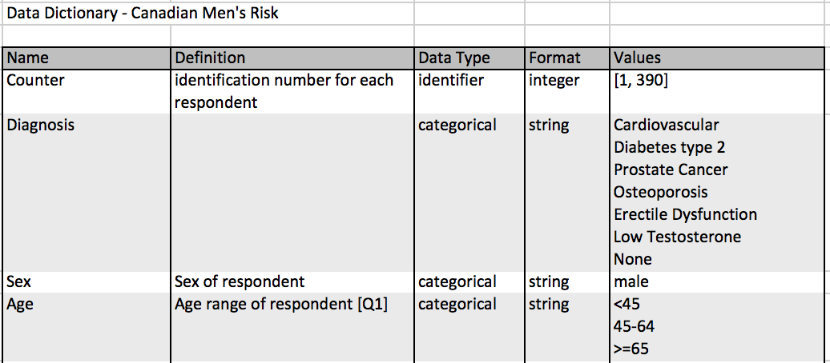
Types of Standards: Glossary
Data dictionary
The purpose of a data dictionary is to ensure consistent terminology throughout a dataset. It contains a list of descriptive data types that are being collected.
Example:

Slide 10
Types of Standards: Glossary
Data modeling
Data modeling is the a process that is typically performed before data collection. It involves identifying the user needs from the data set and and determining the relationships among the data, and how the data should be best captured.
Example:
Data modeling for the eagle-i Network.

Slide 11
Types of Standards: Glossary
Metadata
Metadata is often referred to as “data about data”. Metadata is intended to describe other data, in order to clarify the meaning of a dataset. Metadata consists of both indexing terms (ie terms that can be used for search and retrieval of the data) and descriptive attributes.
Example:

Slide 12
Types of Standards: Glossary
Ontology
A controlled vocabulary that defines the terms in a given domain or knowledgebase, and the relationships between those terms.
Example:
Gene Ontology
Mammalian Phenotype Ontology

Slide 13
Why use a data standard?

Slide 14

2 | Why use a biomedical data standard?
Increased demand for data sharing
Funding agency mandates
Journals
Big data is too complex for analysis by single researcher/group
Maximize your research dollars by sharing and re-using data
General organization

Slide 15

Funding agency mandates
NIH
Data sharing plan for new proposals
Specific institutes and Centers have specific data sharing requirements

Slide 16
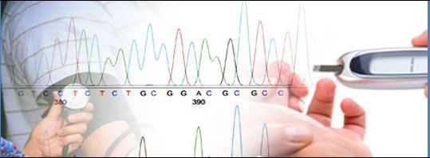



Funding agency mandates
NIH/Genomic data

Slide 17

Funding agency mandates
NSF
Requires a maximum 2 page data plan for data management and sharing of the products of research for all proposals

Slide 18
Journal reporting requirements
Reporting requirements vary
Methods section is meant to contain enough information so someone could independently replicate your experiment
Some journals are starting to increase their standards

Slide 19
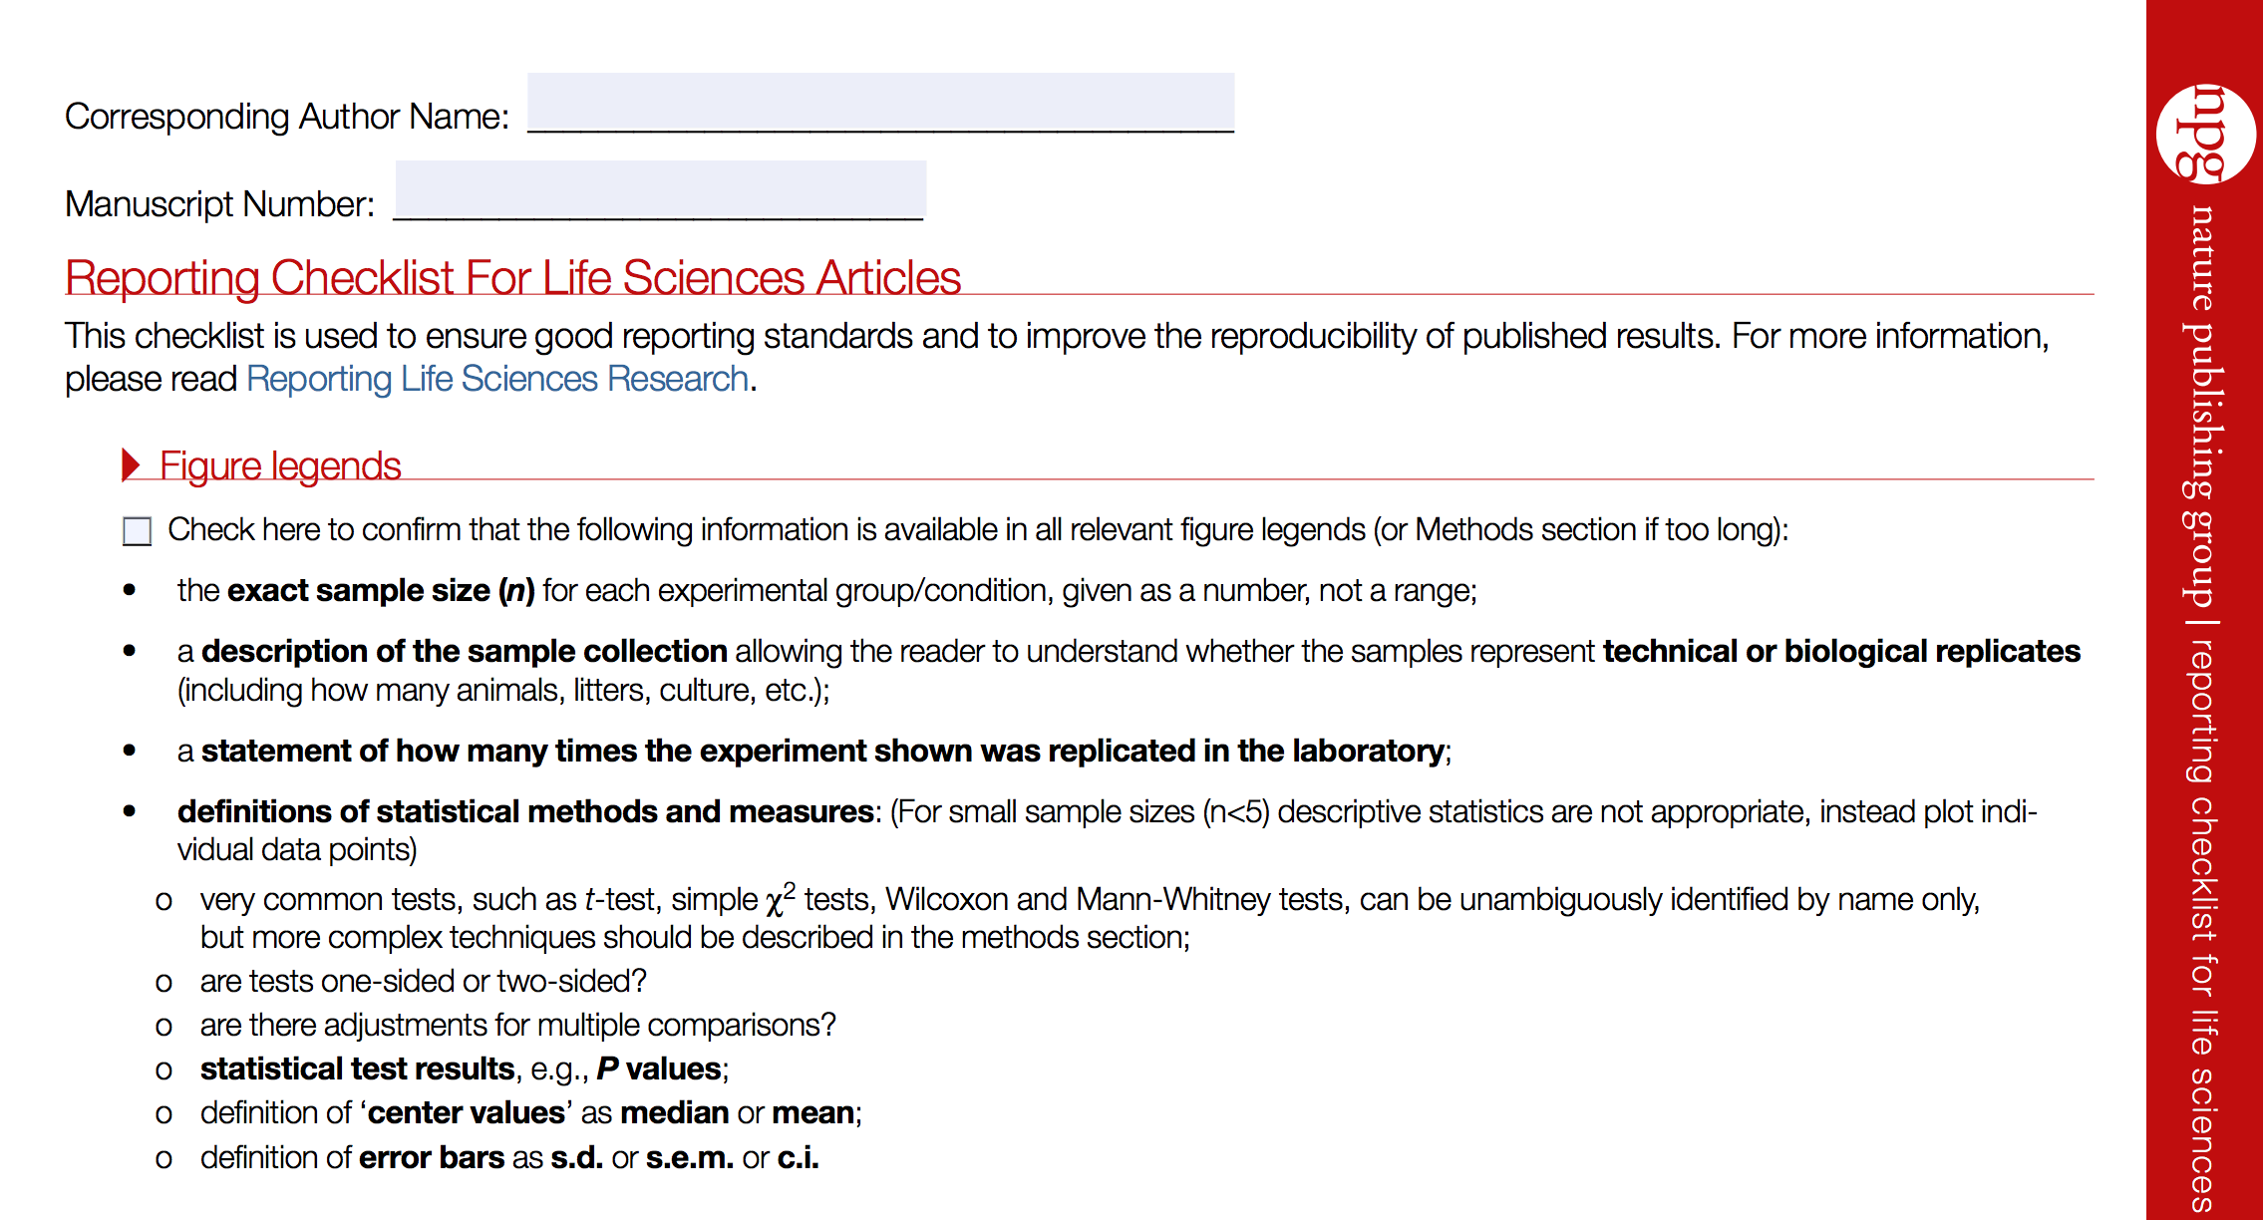
Nature checklist

Slide 20



Slide 21
Common Data Element (CDE)
Common Data Elements (CDEs) were developed by NIH
For use in clinical research, patient registries, human subject research
Improve data quality
Make data more interoperable

Slide 22

Where can I find a data standard for bioscience research?

Slide 23
Which data standard should be used?

Slide 24
3 | Which data standards should be used?
No “right” standard
Select based on individual needs

Slide 25
Use cases
Protocol for an assay
Preparing datasets for public sharing
Contribution of data to a structured data repository

Slide 26
Protocol for an assay
Minimal Information for Protein Functional Evaluation Data standard includes
General features
1.1 Date stamp
1.2 Responsible person
1.3 Kind of experiment
Sample
2.1 Sample name
2.2 Protein accession number
2.3 Sequence
2.3.1 Full length protein
2.3.2 Domain (precise the boundary)
2.3.3 Mutations
Etc…
Purification strategy
3.1 Pre-chromatographic steps
3.1.1 Pellet washing
3.1.2 Ammonium sulfate precipitation
3.1.3 Filtration
3.2 Lysis conditions
3.2.1 Denaturing conditions
3.2.1.1 Protocol
3.2.1.2 Buffer
Etc…
Validation assays
4.1 General tests
4.1.1 Fluorimetric aggregation index
4.1.2 Oxidation status
Etc…
http://mibbi.sourceforge.net/projects/MIPFE.shtml

Slide 27

Preparing datasets for sharing
Example:
LINCS Data standard
Figure from http://www.lincsproject.org/wp-content/uploads/2015/08/cell_line.pdf

Slide 28
Contribution of data to a structured data repository
New DNA and amino acid sequences must have a GenBank Accession number prior to publication
Specific file formats may be required
A minimum amount of information may be required for submission

Slide 29
Criteria for evaluating data standards for adoption

Slide 30
The standard itself
Specification documentation
Ease of implementation (eg, level of documentation, requirement for programmer support)
Human and machine readability
Formal structure
Expressivity—the breadth of information that can be represented
Ease of use, for example, minimal required fields, text- based interface familiarity to biologists.

Slide 31
Adoption and user community
Broad adoption and implementation, outside the initial group
Support supplied by the user community
Use by community databases
Software development that supports the standard (eg, for curating, submitting to databases)
Responsiveness to community requests
Availability of examples of use
Requirements of relevant authoritative bodies, for example, funders (NIH, National Science Foundation, Centers for Medicare & Medicaid Services), publishers, etc.

Slide 32
Additional factors
Integration/compatibility with other standards
Extensibility and flexibility to cover new domains
Conversion and mapping, when applicable cost (eg, open vs licensing fee).

Slide 33
Summary
1 | What constitutes a data standard?
2 | Why use a data standard?
3 | Which data standards should be used?
4 | What are the criteria by which one should choose a standard?

Slide 34
Thank you
This course was made possible under a grant from the NIH (# 1R25GM114820-01)

