Slide 1
Sources and Types of Clinical Data
BDK08-2 | Secondary Use (Re-Use) of Clinical Information
William Hersh, MD | Department of Medical Informatics & Clinical Epidemiology
Oregon Health & Science University

Slide 2
What are clinical data?
A datum is a single observation
Clinical data are the collection of observations about a patient
Example in “reading assignment” from John Halamka of Geek Doctor blog fame (2007), part of Personal Genomes Project
Each datum about a patient has a minimum of four elements:
the patient (Bill Hersh)
the attribute (heart rate)
the value of the attribute (52 beats per minute)
the time of the observation (1:00 pm on 4/1/14 – many ways to record dates!)

Slide 3
Where do clinical data come from?
Dis-ease – pain, altered body function, etc.
Maintenance – follow-up of ongoing problems
Preventive measures (primary, secondary) – screening
Pre-work/school examination

Slide 4
Types of clinical data
Narrative – recording by clinician
Numerical measurements – blood pressure, temperature, lab values
Coded data – selection from a controlled terminology system
Textual data – other results reported as text
Recorded signals – EKG, EEG
Pictures – radiographs, photographs, and other images

Slide 5
Uses of clinical data
Form basis of historical record
Support communication among providers
Anticipate future health problems
Record standard preventive measures
Coding and billing
Provide a legal record
Support clinical research

Slide 6
Types of clinical data documents
History and physical – initial assessment by a clinician
Progress notes – update of progress by primary, consulting, and ancillary providers
Reports – by specialists, ancillary providers
Typical paper chart maintains all patient notes in chronological order, sometimes separated into different components

Slide 7
Assessment of a stable patient
Chief complaint
History of the present illness
Past medical history
Social history
Family history
Review of systems
Physical examination
Testing – lab, x-ray, other
Assessment and plan

Slide 8
Some complications of data
Circumstances of observation – e.g., how was heart rate taken? pulse? EKG?
Uncertainty – how accurate is patient reporting, measurement, device?
Time – what level of specificity do we need?
Imprecision vs. inaccuracy

Slide 9
Coding of clinical data
Historically performed by a Clinical Coding Specialist (CCS)
Major purpose has historically been for reimbursement (Scott, 2008)
A core issue in biomedical informatics has been how to generate and use coded data for other purposes
Trade-offs
Standardization of language vs. freedom of expression
Time to narrate vs. code
Other difficulties
Creating and maintaining coding systems
Structuring coding systems to capture meaning

Slide 10
We need better access to clinical data
Missing clinical information during primary care visits
Information reported missing in 13.6% of clinical visits
Available but outside system in 52% of instances
Estimated to adversely effect patients 44% of time
Unsuccessful searching for it took >5 minutes 35% of time
Physicians have two unmet information needs for every three patients, do not have time or motivation to pursue 70% of time
Secondary use or re-use of clinical data
(Smith, 2005), (Gorman, 1995; Ely, 1999; Del Fiol, 2014), (Safran, 2007; Denny, 2012)

Slide 11
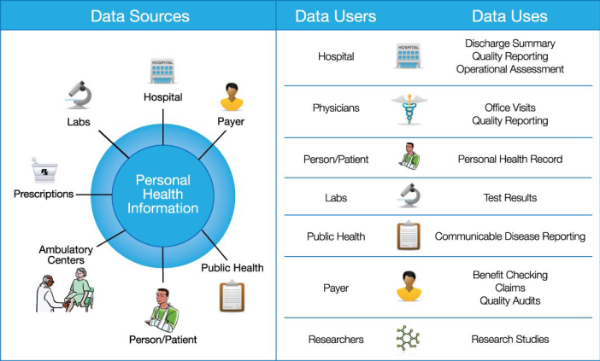
We also need better “stewardship” of data
Ensuring the “knowledgeable and appropriate” use of data from individuals’ personal health information
(NCVHS, 2009)

Slide 12
A big challenge for paper or electronic records: data entry
General categories of data entry
Free-form entry by historical methods
Writing
Dictation – opportunity to engage patient
Typing
Structured (menu-driven) data entry by mouse, typing, or (in past) pen
Speech recognition for either of above
“Scribes” – people who enter data for physicians
(Teichman, 2001; de Silva, 2010), (Szabo, 2009; Baugh, 2012)

Slide 13
Structured or menu-driven data entry
Many attempts from old to new (Oceania)
Can be done via mouse or pen, with typing
Benefits
Data codified for easier retrieval and analysis
Reduces ambiguity if language used consistently
Drawbacks
In general, more time-consuming
Requires exhaustive vocabulary
Requires dedication to use by clinicians
Alternative: Processing spoken text with natural language processing and tagging output in XML?
(Greenes, 1970; Cimino, 1987; Bell, 1994), (OpenSDE – Los, 2005), (Johnson, 2008; Klann, 2009)

Slide 14
Speech recognition for data entry
Most common use is for narration
e.g., computer dictation of clinical notes
Improved technology and algorithms have greatly advanced systems over the years
Many established systems on the market that operate on front end (used by clinician) or back end (process dictations)
An advantage to front-end systems is instant availability of dictated content
(Huang, 2014), (Brown, 2008)

Slide 15
Benefits and limitations of speech recognition
Modern speech recognition systems are improved but still have challenges
Systems have output lag behind user input, which can be distracting
Require area with minimum of background noise and where patient privacy can be protected
Most common types of errors systems make include
Enunciation errors from mispronunciation
Dictionary errors from missing terms
Suffix errors from misrecognition of appropriate tenses of a word
Added or deleted words
Homonym errors from substitution of phonetically identical words
Recent systematic review of research studies found
Productivity – report turnaround time faster
Quality – human transcription slightly more accurate, varies by setting and system
System design – macros and templates improve turnaround time, accuracy, and completeness
(Zafar, 2004), (Johnson, 2014)

Slide 16
Principles for clinical data capture and documentation
A number of recent reports call for principled use
Cusack/AMIA, 2012 – be clinically pertinent, patient-centric, high-quality, efficient, and allow downstream use
Sinsky, 2014 – focus on patient-centered design, improving work of healthcare professional, efficiency, and balancing regulatory and payment needs
Kuhn/ACP, 2015 – primary focus on supporting patient care and communication, with structured data only captured where useful in care delivery or analysis

Slide 17
Thank you
Please download the resource list with useful links from the “Resources” tab in the upper right of the player.
This course was made possible under a grant from the NIH (# 1R25GM114820-01)

