Slide 1
Metadata Overview
BDK15-1 | Metadata perspectives from the web and databases systems
Matthew Brush, PhD | Ontology Development Group

Slide 2
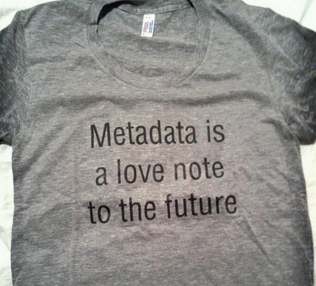
What is Metadata?
“Data about Data”
“Data” broadly covers any
information entity
digital or physical
text-based or multimedia
data elements, sets, or collections
“Metadata is structured information that describes, explains, locates, or otherwise makes it easier to retrieve, use, or manage an information resource” (NISO. ‘Understanding Metadata’, 2004) ‘
Metadata is information that enables one to put context and meaning to things
https://www.flickr.com/photos/sarahseverson/6245395188

Slide 3
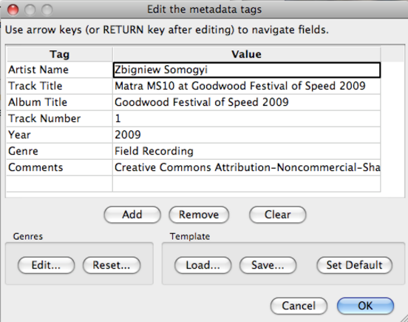
Audio File Metadata
https://commons.wikimedia.org/wiki/File:Audio_Tutorial_-_08_Metadata.png

Slide 4
Metadata is practiced in many communities and systems. . .
Libraries: describes library holdings
The Web: describes ‘resources’ for consumption and use
Scientific Research: describes data, resources, workflows
Database Systems: describe schema elements and values
. . . and supports critical functions
for different users
Resource consumers: discovery, evaluation, use
Resource managers: curation, storage, preservation
Database Admins: automation, data quality, interoperability
Organizations: operational efficiencies, data governance

Slide 5
Two Perspectives on Metadata
1
RESOURCE METADATA
Describes a resource as a whole (e,g. a book, image, or dataset)
Supports resource discovery, management and use
DATABASE METADATA
Contextualizes and describes values in a database and how they relate to each other
Supports deeper technical understanding of the data for managing and operating on it
2

Slide 6

‘Resource’ Metadata
Describes a ‘resource’ as a whole
Information resources: books, images, websites, datasets, journal articles
Physical resources: merchandise, research reagents, people
Ensures implicit knowledge persists with the resource
Helps us to find resources, understand what they are and how to use them

Slide 7
Classification of Metadata
1 Descriptive metadata: Supports discovery and identification
examples: title, creator, identifiers, subjects, keywords
2 Structural metadata: Describes how a resource is organized
examples: manifest of files in a dataset, table of contents for a book, schema of database tables
3 Administrative metadata: Helps manage the resource
Technical - describes technical aspects of a resource
examples: file type, version information, how/when created
Rights management - explains intellectual property rights
examples: licensing, use restrictions, privacy concerns
Preservation - supports maintenance and archiving of a resource
examples: provenance/ownership, history of use, authenticity

Slide 8
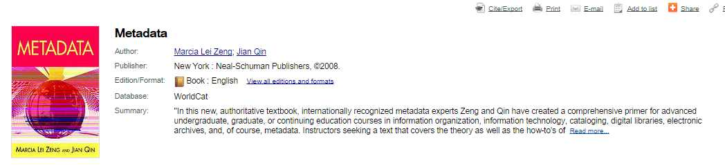
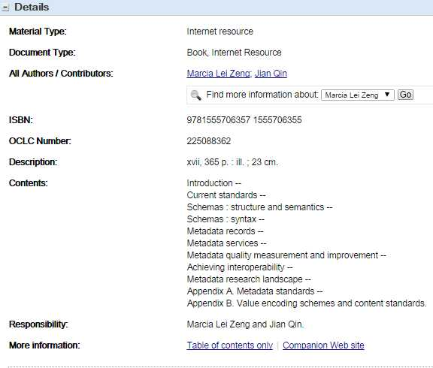
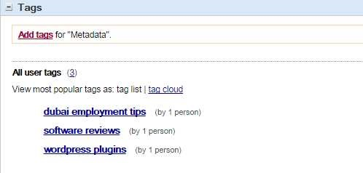
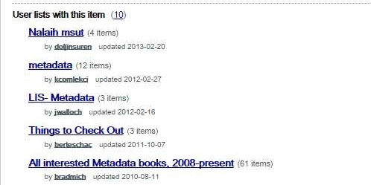
Library Book Catalog Record
Descriptive
Structural
Administrative

Slide 9
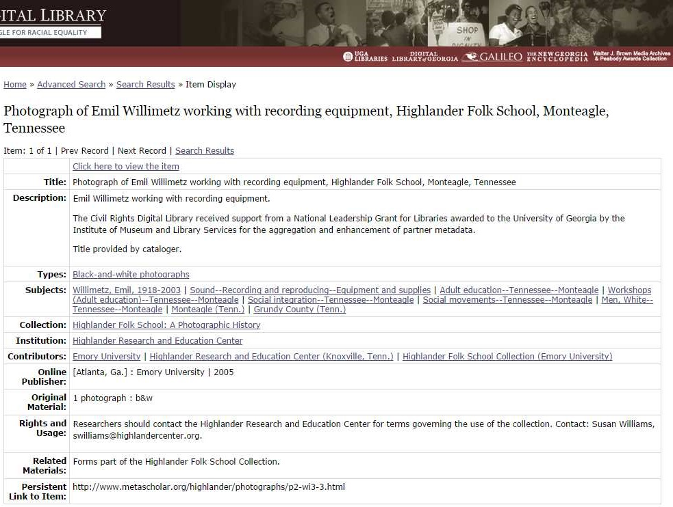

Digital Photograph Library
Descriptive
Structural
Administrative

Slide 10


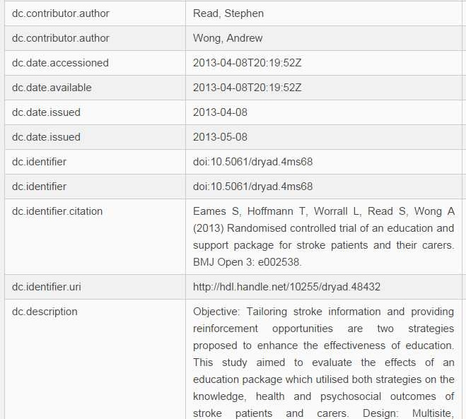
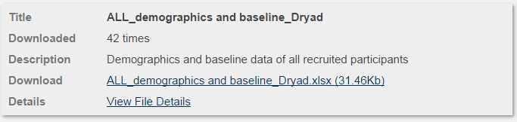
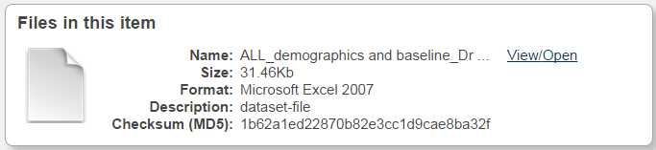
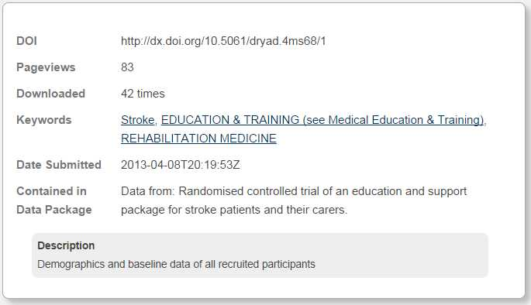
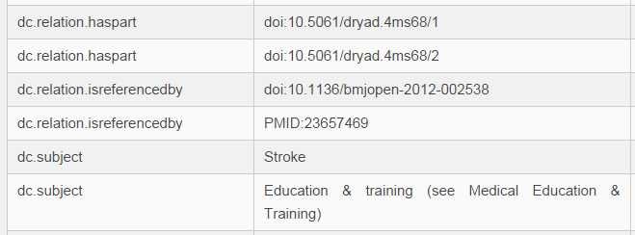
Research Datasets/Files
Dataset Description
Data File Description
Descriptive
Administrative
Structural

Slide 11
Creation of Metadata
Manual
High-quality, but high cost
Crowdsourcing vs professional curators
Automated
Extraction tools identify and record metadata (intrinsic file information, natural language processing (NLP)-generated indexes)
Semi-Automated
Pipelines wherein tools assist manual creation

Slide 12
Storing and Accessing Resource Metadata
Can be stored within a resource . . .
Metadata captured in filenames, image metadata embedded in file itself, . . .
Ensures maintenance and currency of metadata
Not possible for some resource types
More typically lives separately from the resource
In databases and/or structured text files (XML, JSON, RDF)
Easier to manage, retrieve, and analyze metadata
Facilitates exchange, rendering on the web, and programmatic access

Slide 13
Storing and Accessing Resource Metadata
Resource providers can make metadata available for both human and computational agents
Parsed to HTML for human consumption on the web
Exposed for indexing by web crawlers, e.g. harvesting by Google and resource aggregators
Provisioned by web services and APIs that provide programmatic access to data

Slide 14
Best practices for creating metadata
Think from perspective of user of the resource
Requirements -driven development
Keep metadata simple as possible to meet needs
Adopt/extend existing standards as practical and possible
Expose metadata using established approaches to make it broadly discoverable and usable

Slide 15
Best practices using metadata
Understand the schema or standard
Understand the provenance
How is metadata exposed/accessible?
What are the terms of use?

Slide 16
Thank you
This course was made possible under a grant from the NIH (# 1R25GM114820-01)

