Slide 1
Metadata Standards
BDK15-2 | Metadata perspectives from the web and databases systems
Matthew Brush, PhD | Ontology Development Group

Slide 2
Metadata Standards
Metadata models: formal specifications describing how to collect, structure, encode metadata in a given domain
Minimally define a set of elements used to capture specific information about a resource
Metadata standards: open, re-usable, normative, and community-supported metadata models
Accompanied by documentation to facilitate discovery, and support correct and consistent use

Slide 3
Some Common Metadata Standards
Dublin Core
General web resources
Friend of a Friend (FOAF)
General info about persons, their activities, and relationships on the web
W3C HCLS Dataset Description Standard
Attributes of research datasets
Learning Object Metadata (LOM) Standard
Discovery and use of educational and training resources
Metadata Object Description Schema (MODS)
Bibliographic metadata for libraries
Darwin Core (DwC)
Rich description biodiversity studies

Slide 4

Benefits of Metadata Standards
Can leverage existing resources, save time and effort
Efficiency
Standards are created and vetted by community of experts
Quality
Metadata from different systems can be exchanged with minimal loss of content and functionality, and aggregated for centralized discovery and analysis
Interoperability

Slide 5
A Framework for Understanding Metadata Standards
Four types of artifacts can comprise a metadata standard
Schema: elements structuring data
Value Standards: constrain value entry
Reporting Guidelines: inform how and when to create metadata
Encoding Specifications: formats for encoding data
1
2
3
4

Slide 6
Metadata Standards
1 Schema

Slide 7
Schemas
Comprised of a set of data elements used to capture specific information about a resource
Schema documentation describes attributes of each element
Identifier: a name and/or stable ID
Semantics: a definition of the element’s meaning and use
Elements can be structured in different ways
as flat lists, hierarchies, or structured domain models

Slide 8
Dublin Core Metadata Initiative Schema (DCMI)
One of the first efforts (1995) at standardizing metadata to improve resource discovery on the web
Core schema consists of 15 general data elements
Metadata Elements: title, identifier, type, description, creator, contributor, date, subject, format, language, source, publisher, relation, coverage, rights

Slide 9
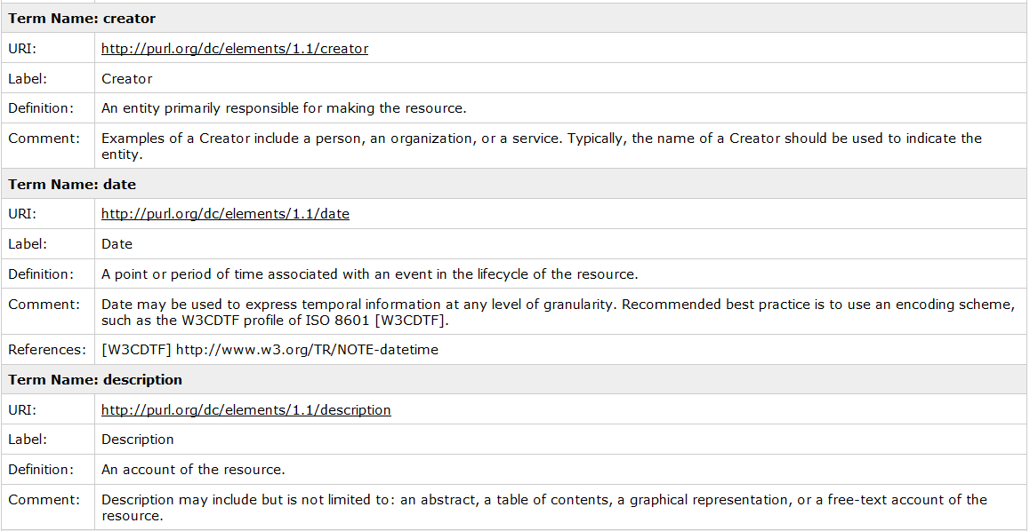
Dublin Core Metadata Initiative Schema (DCMI)

Slide 10

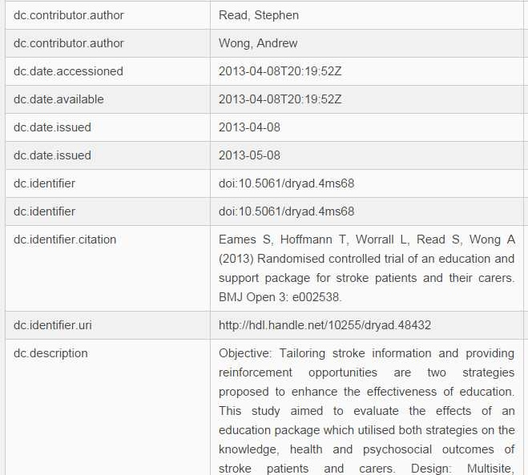
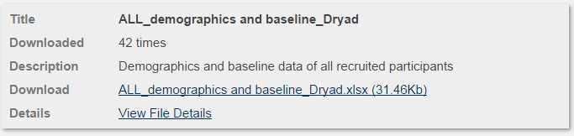
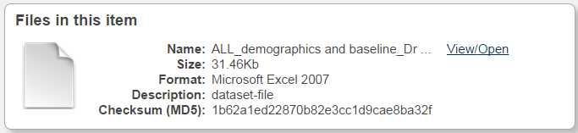
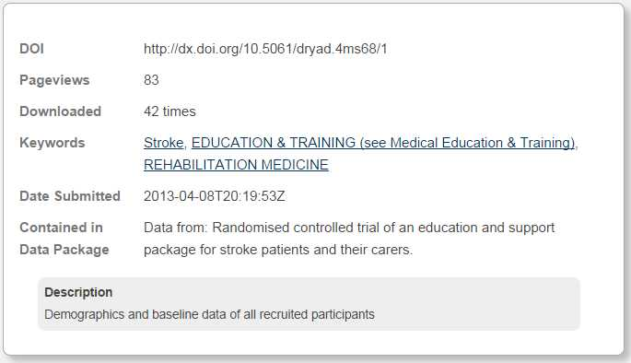
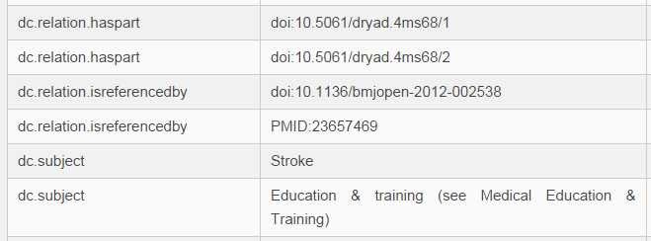
Use of DCMI in Dryad Data Repository
Data Set Description
Data File Description

Slide 11
W3C HCLS Dataset Description Standard
Provides ~ 60 metadata elements needed to comprehensively describe research datasets
A composite schema that is comprised entirely of elements from 15 existing community standards, e.g.
DCMI (Dublin Core Metadata Initiative)
DCAT (Data Catalog Vocabulary)
PAV (Provenance, Authoring, and Versioning Ontology)
CITO (Citation Ontology)
FOAF (friend of a Friend)
Schema elements capture core info covered by DCMI, but also data related to provenance and change, availability and distribution, and dataset statistics

Slide 12
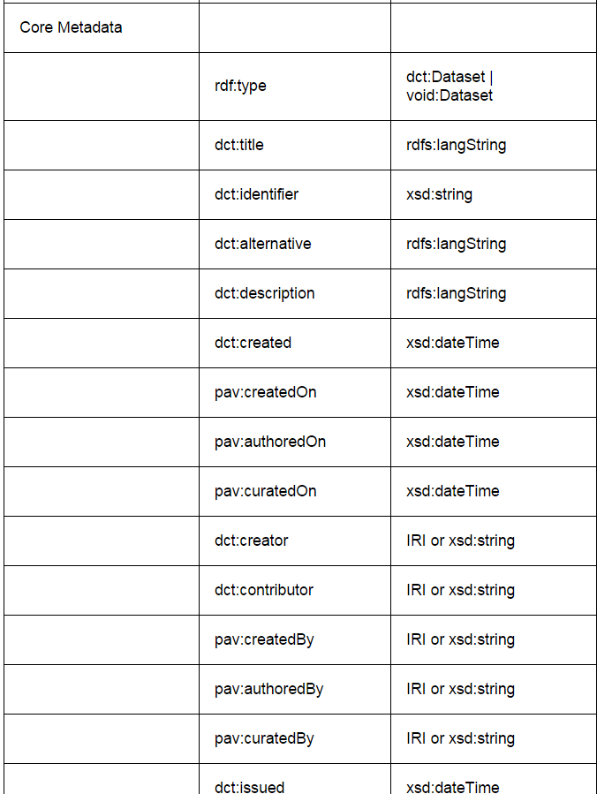
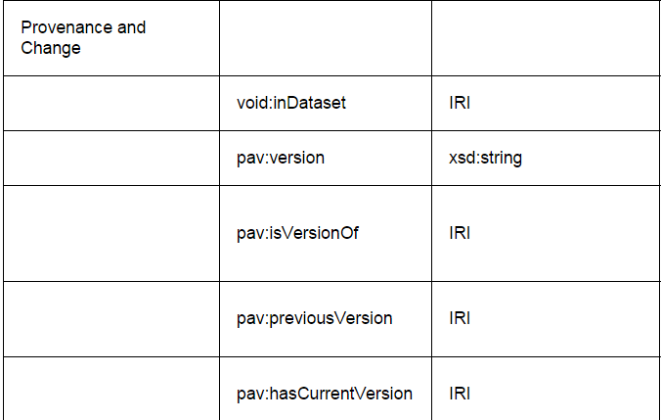
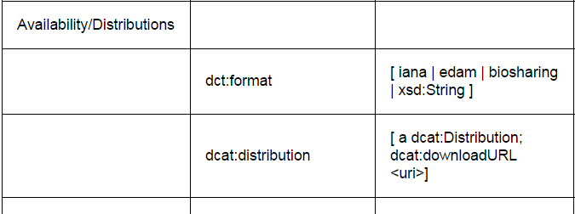
W3C HCLS Dataset Description Standard
Core Metadata
Property
Value
Provenance
Property
Value
Availability

Slide 13
Darwin Core Metadata Standard
Used in biodiversity community to collect metadata about specimen observations and the geographic occurrence of species
Provides schema at two levels of complexity:
A simple schema
flat, denormalized, minimal
2. A complex schema
15 classes representing domain concepts, each with its own set of elements (~180 total)

Slide 14
Darwin Core Metadata Standard
Occurrence
Organism
occurrenceID
catalogNumber
recordedBy
individualCount
organismQuanitty
sex
lifeStage
behavior
associatedTaxa
organismID
organismName
organismScope
associatedOccurrences
previousIdentifications
organismRemaks
Record
dc:type
dc:modified
dclicense
dc:accessRights
dataseID
institutionID
collection ID
basisOfRecord
Taxon
taxonID
scientificName
kingdom
phylum
class
order
family
genus
specificEpithet
Location
locationID
continent
country
hihgerGeography
decimalLatitude
verbatimElevation

Slide 15
Metadata Standards
2 Value Standards

Slide 16
Value standards
Constrain entry of values for metadata elements to ensure more consistent, computable metadata
Data types and technical standards
Constrain value form/syntax
Authority lists
Terminologies that constrain proper nouns (instances)
Controlled Vocabularies
Terminologies that constrain concepts (types)

Slide 17
A Data Types and Technical Standards
Data Types
Define allowable character types for a value
Dictates the way values are stored and the operations that can be performed
examples: xsd:string, xsd:decimal, xsd:boolean
Technical Standards/Formats
Define a syntax to standardize entry
ISO 8601 technical standard for dates and times
2015-06-26T22:57:09Z

Slide 18
Authority lists
Define controlled values for proper nouns
persons (ORCID)
organizations (FundRef)
places (Gazeteer)
Open Researcher and Contributor IDentifier (ORCID)
an unambiguous, persistent, resolvable identifier for researchers
e.g. http://orcid.org/0000-0002-1048-5019

Slide 19
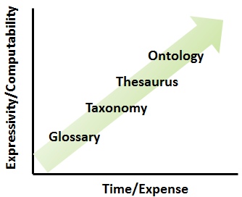
Controlled Vocabularies
Controlled vocabularies define types in a domain, and come in a spectrum of rigor and complexity.
Glossaries: flat list of terms and definitions
Taxonomies/Thesauri: terms organized into a hierarchy with identifiers and synonyms
Ontologies: terms inter-related to form a knowledge graph, and logically defined to allow computational reasoning
Structure and semantics can add value to metadata

Slide 20
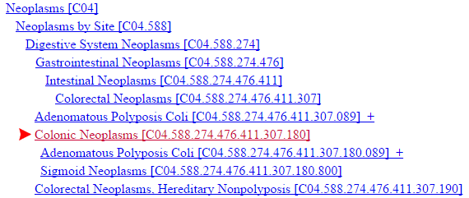
MeSH: A Taxonomy of Medical Concepts
A hierarchical taxonomy of terms describing subjects of biomedical literature
Co-opted by other systems to capture subject/keyword metadata

Slide 21
Knowledge in Structured Vocabularies Can Support ‘Query Expansion’
Query: "colonic neoplasms" ---mapped to---> MeSH:D003110
Query Expansion
{ "colonic cancer" [synonym] OR "colonic tumors" [synonym]
OR MeSH:D011125 ('Adenomatous Polyposis Coli(APC)’) [subtype] OR MeSH:D012811 ('Sigmoid Neoplasms') [subtype] }

Slide 22
Metadata Standards
3 Reporting Guidelines

Slide 23
Reporting Guidelines
Provide guidance for what metadata to apply and how
Provide best practice recommendations for what attributes should be described for a given resource type
Conceptual domain models define and distinguish the types of entities in a domain
Often part of larger metadata standards, where they support its consistent application and understanding

Slide 24
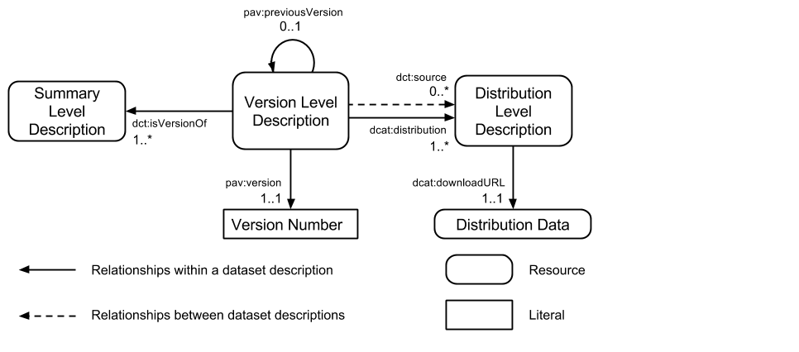
Reporting Guidelines Example
The HCLS Standard Domain Model
Defines three ‘levels’ at which datasets can be described
The summary level describes the dataset in general
The version level describes a specific version of the dataset
The distribution level describes a format/representation of a version

Slide 25


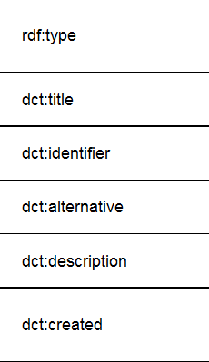
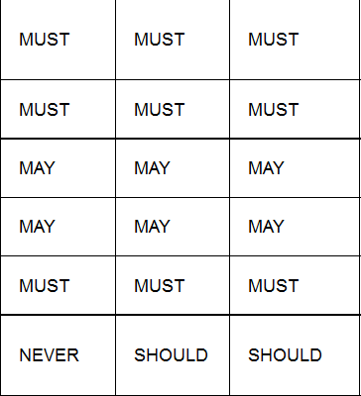


Reporting Guidelines Example
HCLS Standard Content Guidelines
Recommend when a given element MUST, SHOULD, MAY, or must NEVER be used for each dataset level
Facilitates comprehensive and consistent metadata collection
Element

Slide 26
Metadata Standards
4 Encoding Specifications

Slide 27
Encoding Specifications
Rules for expressing metadata in defined formats and syntax
Support machine readability, communication, and data exchange
XML (eXtensible Markup Language)
hierarchical format
highly flexible and extensible
many standards are implemented as XML-based markup languages ( e.g. NeuroML, OME-XML)

Slide 28
Metadata Standards Summary
METADATA SCHEMA
Defines, structures elements
that capture metadata
VALUE STANDARDS
(datatypes, technical specifications,
controlled vocabularies, authority lists)
Constrain and standardize values
METADATA
STANDARD
ENCODING SPECIFICATION
Bind metadata to defined syntactic format (e.g. xml, rdf) for machine readability, exchange
REPORTING GUIDELINES
Provide specific guidance for what metadata to apply and how
Metadata standards come in many forms, and a given standard specification may contain one or all of them

Slide 29
Thank you
This course was made possible under a grant from the NIH (# 1R25GM114820-01)

