Slide 1
Metadata in Database Systems
BDK15-3 | Metadata perspectives from the web and databases systems
Matthew Brush, PhD | OHSU Library - Ontology Development Group
Notes:
The final lecture in this module about metadata will cover metadata in database systems.

Slide 2
Two Perspectives on Metadata
1
RESOURCE METADATA
Describes a resource as a whole (e,g. a book, image, or dataset)
Supports resource discovery, management and use
DATABASE METADATA
Contextualizes and describes values in a database and how they relate to each other
Supports deeper technical understanding of the data for managing and operating on it
2
Notes:
We have previously introduced the distinction between resource metadata, which was the subject of the first lecture, and database metadata which will be discussed here.
Again, the key difference is the context and granularity at which metadata is applied in describing data in database systems, versus resources on the web.
In our discussion of database metadata, we will draw from standards and practices used in managing medical information systems such as clinical and research databases.

Slide 3
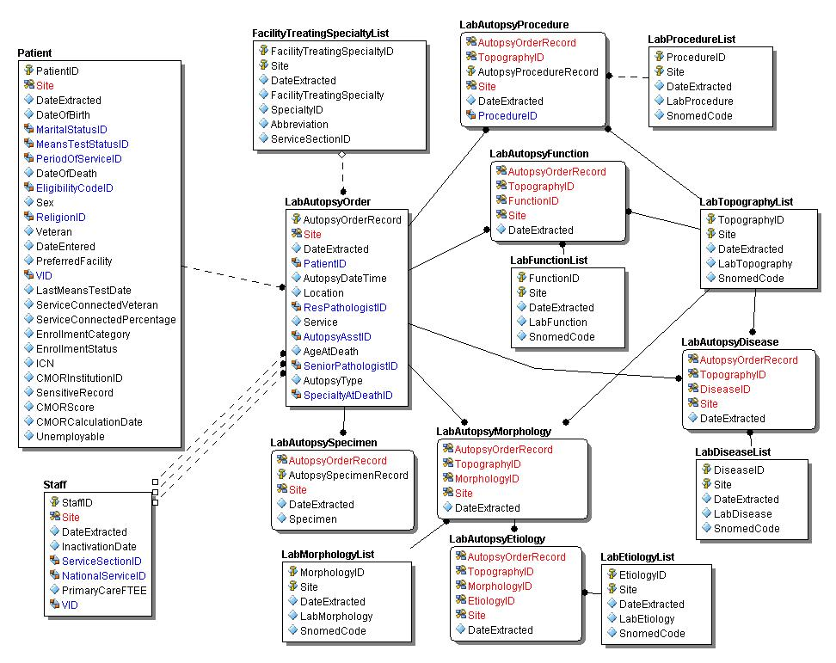
Metadata in (Medical) Database Systems
Structural Metadata
Describes the structure of database objects and the relationships between them
ER-diagrams depict high level schema including tables, data elements, and relationships among them
Notes:
http://www.visn20.med.va.gov/VISN20/V20/DataWarehouse/Images/LabAutopsy.jpg
We can consider two categories of metadata for database systems.
Structural metadata describes the structure of database objects and how they are linked together in a schema. It is commonly encoded in ER-diagrams that give a 30000 foot view of a database schema, depicting the tables it contains, the data elements in these tables, and the relationships between them.
The example here is an ER diagram from a VA hospital relational database, that describes autopsy report data. Each box is a table in the schema representing an entity about which data is collected, using the elements listed for each table. So this schema would support various types of data being collected about things like lab orders, procedures, specimens, and patients.

Slide 4
Metadata in Database Systems
Element Metadata
Specifies attributes of data elements, and rules for recoding their values
Describes meaning of data at a very fine granularity
Notes:
The second is category of metadata is about the individual elements in a database schema. This metadata define the meaning of the data in a database at a very fine granularity, specifying the definitions of each data element, and rules for recoding their values.
The need for such metadata should be clear to anyone who has seen database records such as the example here, which cannot be fully interpreted without additional information.
For example, what are the PATIENT RACES are associated with the codes in the data, what is the meaning of the LOC_ID element, and from what vocabulary do the TEST CODES derive?

Slide 5
Data Dictionary
Notes:
Addressing these questions is the job of a Data Dictionary – which provides very granular metadata about the individual elements and their values.
Here is the dictionary for the table shown on the last slide, where each row in this dictionary describes on element represented as a column in the previous data table.
Data dictionaries will typically provide a Definition for each element, giving the precise meaning of data in each field. For example, that LOC_ID is a location identifier where the test was performed, and that NORM RESULT is a lab value normalized to a percentile score.
A value domain constrains allowable values for an element for consistent entry and validation of data. For the PATIENT RACE element, it lists all allowable codes and their meaning. And for the TEST CODE element, it identifies the LOINC standard of laboratory test codes as the source of all values.
In the data format and type column we are told how values are stored in the system to understand how they can be operated on.
So given this metadata about the elements in the schema, we can now go back to the original data table and make much better sense of what it all means. And if we adding new data to the system, we will have a much better sense of how to do this completely and consistently.

Slide 6
Goals of a Data Dictionary
Provide shared and unambiguous understanding of the data
Support consistent data collection, representation, and manipulation
Facilitate maintenance of the data model
Support data integration, exchange, and re-use
Notes:
So Data dictionaries are critical for providing a shared and unambiguous understanding of the data for all users. They support consistent data collection, representation, and manipulation. They facilitate maintenance of the data model. And supporting data integration, exchange, and re-use.

Slide 7
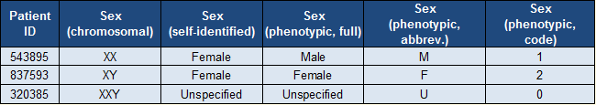
Metadata Interoperability
Systems across/within organizations use different schema and elements
Sharing and aggregation of data across sources is increasingly important
The same data can be represented in many ways
Notes:
This is all fine and good if all the world used one schema and system to hold its data– but obviously this is not the case. Systems across and even within organizations use different schema and elements to describe their data. This can pose a barrier to sharing and aggregation of data, which is increasingly important for purposes of integrated care, research and evaluation.
Consistent representation of even simple information can be challenging, given the diversity of ways that the same data can be structured. For example, integration of data about something as simple as the sex of a patient can be difficult given the fact that an individual’s sex can be defined by genetics, phenotype, or self-identifcation, and the fact that values for sex can be recorded in many ways - as a complete word, an abbreviations, a local code, or a term from community vocabularies.
So clearly there may be difficulties in integrating data from systems that capture patient sex different ways.

Slide 8
Common Data Elements (CDEs)
Common Data Elements (CDEs) are shared data elements for re-use across medical databases
CDEs Registries
CDEs are available from metadata registries that hold data elements for a defined domain (see the NIH CDE portal at http://www.nlm.nih.gov/cde)
Provide extensive element descriptions to support understanding and proper application
Many registries provide additional services to facilitate implementation
Notes:
The solution to such challenges of course is the use of data standards. As we saw in the previous lecture, these afford a measure of consistency and interoperability that support aggregation and exchange of data with minimal loss of content and functionality.
In the realm of medical database systems, Common Data Element (CDE) Initiatives are the primary standards used for these purposes.
Common Data Elements (CDEs) are shared data elements that are re-used across medical systems and databases.
CDEs are available from a number of metadata registries that hold data elements for a defined domain, accessible through search portals.
These registries provide extensive element descriptions to support understanding and proper application of CDEs.
And many registries provide additional services and tools to facilitate CDE implementation in data collection tools, such as forms where fields have embedded CDEs integration.

Slide 9
NINDS CDE Registry
National Institute for Neurological Disease and Stroke registry houses >20,000 CDEs
‘Core’ element set covers general concepts common across diseases
‘Supplementary’ sets covering concepts specific to a given neurological disease
Support for generating case report forms (CRFs) with embedded CDE mappings
Notes:
One example is the National Institute for Neurological Disease and Stroke registry, which houses over 20,000 CDEs.
Its core element set covers general concepts in medical domain related to things like demographics, examinations, interventions, and outcomes.
Supplementary CDE sets cover specific diseases and research concepts such as spinal injury, Parkinson’s disease, ALS.
The NINDS registry also provides services for generating case report forms with CDE mappings embedded in data collection fields.

Slide 10
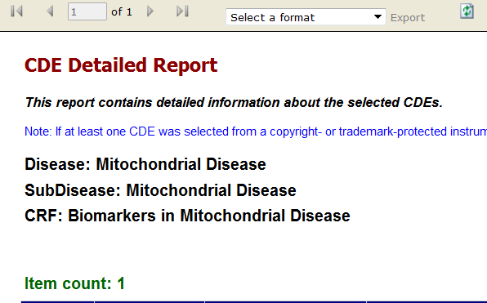
NINDS CDE Example
Blood specimen lactate measurement status
C19552
Notes:
Here is the record for a single CDE from the NINDS registry that describes Blood specimen lactate measurement status.
It has a unique identifier, and is described by a rich set of metadata that is similar but more extensive than the data dictionary we looked at earlier. This element metadata is critical to ensure consistent and proper use across systems that adopt a given CDE.

Slide 11
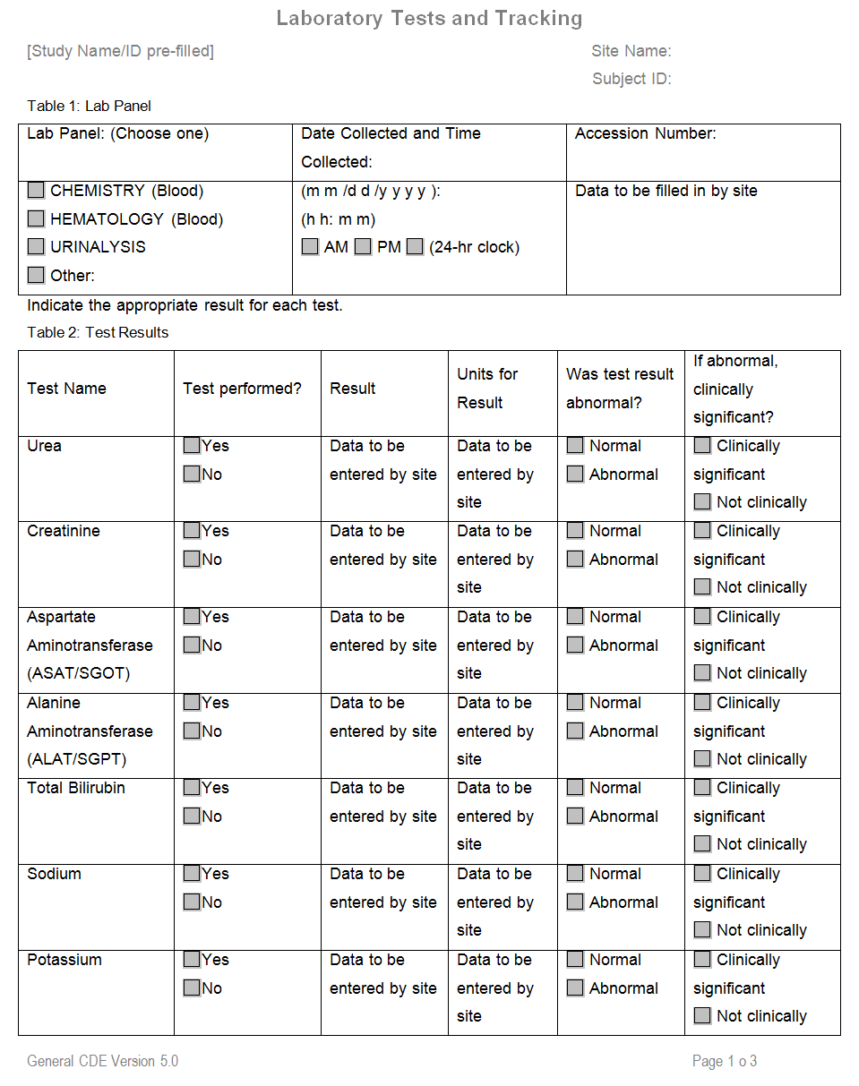
NINDS Case Report Forms
Laboratory Tests and Tracking
Notes:
And here is an example of a form provided by the NINDS that where each field is mapped to a specific CDE from their registry.

Slide 12
NCI caDSR CDE Registry
The National Cancer Institute Cancer Data Standards Registry (caDSR) is the largest and most widely used CDE registry
50,000 CDEs
400+ forms
Aggregates CDEs from several initiatives under a unified model and technical infrastructure
Follows the ISO11179 standard for metadata registries
Notes:
The NINDS is an extensive but relatively simple example of a CDE registry.
The National Cancer Institute’s Data Standards Registry, called the caDSR, is much larger and conceptually much more complex. It houses over 50000 CDEs, and provides over 400 forms with embedded CDE support.
It aggregates CDEs from several initiatives under a unified model and technical infrastructure, and follows a complex technical standard for metadata registries called ISO11179.

Slide 13
ISO11179 in the caDSR
ISO11179 in the caDSR
Data Element
Concept
Value Domain
Class
Property
Value
Represen-tation
Valid
Values
Notes:
The ISO11179 standard provides a conceptual model wherein each element is decomposed into several more fundamental concepts as depicted here. Over the next few slides we will step through this model, and highlight the value it brings to the caDSR registry.
At the top level, each element is comprised of a concept and value domain.

Slide 14
Concept Element Mapping
Data Element
PT_GENDER_CODE
Concept = idea specified by the data element, independent of a particular representation
Class = a set of real world objects with shared characteristics
Property = a characteristic common to all members of an class
Concept
‘patient gender’
Class
‘person’
Property
‘gender’
Notes:
The concept is the idea specified by the data element, independent of a particular representation. For the patient gender code element in the example here, this is the concept of a patient gender.
In the ISO model this concept is further broken down into a Class and a Property.
The class represents what the concept is about – here, a person.
The property is represents a characteristic common to members of the class – a gender in our example.

Slide 15
Concept Element Mapping
Data Element
PT_GENDER_CODE
Concept
‘patient gender’
Class and property concepts are mapped to NCI taxonomy terms to formally encode their semantics
Class Mapping
person = C25190
Property Mapping
gender = C17357
Class
‘person’
C25190
Property
‘gender’
C17357
Notes:
Class and property concepts are mapped to terms from an ontology called the NCI thesaurus, in order to more formally capture their meaning. This mapping is the crux of the model and we’ll see in a minute the value this adds.

Slide 16
Value Domain Mapping
Data Element
PT_GENDER_CODE
Value domain = describes the type and set of attribute values for the element
Value Representation = ‘type(s)’ of data the value represents
Valid Values = the actual allowed values for a given value domain
Value Domain
Value Rep.
‘person’, ‘gender’, ‘code’
Valid Values
‘0’,’1’,’2’,’9’
Notes:
On the other side of the data element, the value domain describes the type and set of attribute values for the element.
It is broken down into a value representation and a set of valid values.
The value representation indicates the type(s) of data the value can be seen to represent. In our example this is ‘person’ data, ‘gender’ data, and ‘coded’ data.
The valid values are the actual allowed values specified by the value domain – here the gender codes 0,1,2, and 9.

Slide 17
Value Domain Mapping
Data Element
PT_GENDER_CODE
Value Representation Mappings
‘person’ = C25190
‘gender’ = C17357
‘code’ = C25162
Valid Value Mappings
0 = unknown C17998
1 = female gender C46110
2 = male gender C46109
9 = unspecified n/a
Value Domain
Value Rep.
‘person’, ‘gender’, ‘code’
Valid Values
‘0’,’1’,’2’,’9’
Notes:
And again, each of these is mapped to an NCI thesaurus term, in red, to formally capture its semantics.
So as you can imagine, this approach leads to a quite rich set of metadata about the common data elements in the caDSR – and indeed their dictionary describes over 100 attributes for each CDE (as opposed to 30 in the NINDS registry)

Slide 18
Semantic Interoperability
Unambiguous understanding for humans and machines
NCI mappings leverage the structure of the thesaurus to formally define relationships between common data elements
Aids in discovery and application of CDEs
Important given the number, granularity, and overlap of concepts in the registry
Supports data integration and analysis that leverage semantics in the NCI thesaurus
Notes:
So why bother with this complexity? The payoff of is the clarity, interoperability, and semantic enhancement it affords.
Mappings provide unambiguous understanding of element semantics - for both humans and machines because the NCI thesaurus is a logically defined ontology.
The structure and relationships between the terms in the NCI thesaurus are inherited by the CDEs they are mapped to, and these relationships can be leveraged to improve CDE discovery in search portals, and facilitate integration, presentation, and analysis of data collected under caDSR CDEs.
The details of how this works are beyond the scope of this lecture, but suffice it to say that these semantic mappings provides powerful and necessary value added, given the volume, granularity, and overlap of concepts in the registry.

Slide 19
Common Data Element Summary
CDEs standardize data elements for use across medical information systems
Benefits
Promote standardized and systematic data collection
Improve data quality and consistency
Facilitate data sharing, integration, meta-analysis
Potential to reduce the cost and time needed to develop data collection tools
Challenges
Sheer abundance/granularity of elements available
Complex technical and conceptual models
Tools supporting practical application exist but are immature
Notes:
So to close our discussion here we will review some of the benefits and challenges of using CDEs for data collection and storage.
The primary benefit is standardized and systematic data collection across medical information systems.
CDEs can improve data quality and consistency, facilitate data sharing, integration, meta-analysis, and have the potential to reduce the cost and time needed to develop data collection tools.
Challenges to their use include the sheer abundance and granularity of elements available, the complex technical and conceptual models some registries subscribe to, and the fact that the tools supporting practical application of CDEs exist, but are still immature.

Slide 20
Thank you
This course was made possible under a grant from the NIH (# 1R25GM114820-01)

