Slide 1
Privacy, Confidentiality, and Security 2/2
BDK20-2 | Regulatory Issues in Big Data for Genomics and Health
William Hersh, MD | Department of Medical Informatics & Clinical Epidemiology
Oregon Health & Science University

Slide 2
Concerns about security
Comprehensive overviews
Growing calls for cybersecurity focused on healthcare
Many points of leakage
A problem for paper too
Consequences of poor security
Medical identity theft
Tools to protect security
(Herzig, 2010; Stallings, 2011; ONC, 2015), (Perakslis, 2014)

Slide 3
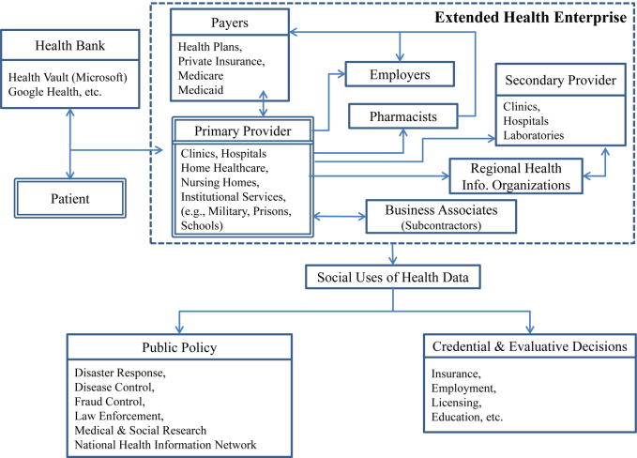
Flow of information in healthcare – many points to “leak”
(Appari, 2010)

Slide 4

Another view of where data may go –
Figure from http://thedatamap.org

Slide 5
We can’t forget that paper records have insecurity as well
Difficult to audit trail of paper chart
Fax machines are still used and easily accessible to people in offices
Records frequently copied for many reasons
New providers, insurance purposes
Records abstracted for variety of purposes
Research
Quality assurance
Insurance fraud → Medical Information Bureau
(Rothfeder, 1992)

Slide 6
Potential consequences of poor security
Rindfleish (1997)
Patients avoid healthcare
Patients lie
Providers avoid entering sensitive data
Providers devise work-arounds
CHCF (2005) – 13% of consumers admit to engaging in “privacy-protective” behaviors that might put health at risk, such as
Asking doctor to lie about diagnosis
Paying for a test because they did not want to submit a claim
Avoid seeing their regular doctor
Agaku (2013) – two-thirds of US adults have concern about breach when health data transmitted electronically; 12.3% have withheld information due to security concerns

Slide 7
Medical identity theft
A growing concern, emanating from general identity theft, defined as use of IIHI for obtaining access to property or services
Victims are not only individuals but also healthcare providers and plans as well as society at large
Value of medical identity information much higher than just Social Security number
Physicians at risk as well
Can also be costly in money and reputation
Over 2M known victims, 500K in 2014 alone
Average cost to rectify is $13,500
Much more lucrative than credit card fraud
(AHIMA, 2008), (Agrawal, 2011), (Ponemon, 2015)

Slide 8
Tools for protecting health information
IOM report: For the Record (1997)
Report commissioned by NLM; informed HIPAA legislation
Looked at current practices at six institutions
Recommended immediate and future best practices
Most content dated, but framework not

Slide 9
Threats to security
Insider
Accidental disclosure
Curiosity
Subornation
Secondary use settings
Outside institution
A lot of press, few examples

Slide 10
Technologies to secure information
Deterrents
Alerts
Audit trails
System management precautions
Software management
Analysis of vulnerability
Obstacles
Authentication
Authorization
Integrity management
Digital signatures
Encryption
Firewalls
Rights management

Slide 11
Encryption
Necessary but not sufficient to ensure security
Should, however, be used for all communications over public networks, e.g., the Internet
Information is scrambled and unscrambled using a key
Types: symmetric vs. asymmetric
Asymmetric, aka public key encryption, can be used for digital certificates, electronic signatures, etc.

Slide 12
Standards for encryption and related functions
Advanced Encryption Standard (AES) – NIST-designated standard for encryption/decryption (Daemen, 2002)
Transport Layer Security (TLS) and predecessor, Secure Sockets Layer (SSL) – cryptographic protocols that provide security for communications over all points on networks (Rescorla, 2001)
Internet Protocol Security (IPsec) – protocol for securing Internet Protocol (IP) communications by authenticating and encrypting each IP packet of a data stream
Part of IPv6 but also added as standalone on top of IPv4
At lower levels of TCP/IP than TLS or SSL
Secure Hash Algorithm (SHA) protocols insure integrity of transmitted information and documents (NIST, 2002)
Security flaws were identified in SHA-1 so SHA-2 family of protocols was developed
For more: http://csrc.nist.gov/groups/ST/toolkit/

Slide 13
Standards for information security
ISO 27000 series specify standards for best practices with information security
NIST 800 series reports outline issues and best practices for information security
Emerging standard for Internet is OAuth2
Used by Google, Facebook, etc. to authenticate individuals
Increasing advocacy for use in healthcare
(Ping, 2014), (Mandel, 2015)

Slide 14
Authentication and passwords
Authentication is process of gaining access to secure computer
Most commonly done with user passwords
Growing use of two-factor authentication, i.e., in addition to passwords (“what you know”), may add physical entities (“what you have”), e.g.,
Biometric devices – physical characteristic, such as thumbprint (e.g., iPhone 5S), retina (NCIS)
Physical devices – smart card or some other physical “key”
Typical user interacts with many professional and personal sites for which he/she must use password
Many clamor for “single sign-on,” especially in healthcare, where users authenticate just once
(Pabrai, 2008)

Slide 15
Some challenges with passwords
Many practices based on outdated principles
Best password is one that user can remember but no one else can guess
But systems and sites use different standards for length and make-up of passwords
Users require so many that they re-use them, such that discovery of one can lead to access to many systems
Key-logging software (sometimes running without user knowing) can identify passwords
Poor password policies take user time and reduce usability of systems
One common approach to security is password “aging” (i.e., expiration), which is less effective than other measures
Session-locking – one or small number of simultaneous logons
Login failure lockout – after 3-5 attempts
But passwords persist; time to “kill” them?
(Cheswick, 2012), (Florencio, 2007), (Herley, 2009), (Herley, 2009), (Norman, 2009), (Wagner, 2005; Allan, 2005), (Honan, 2012)

Slide 16
Security challenges often come from users
“Good users do bad things”
Especially when rewarded by immediate gratification
Patients and everyone else in healthcare system need good “data hygiene”
(Blythe, 2013), (Acquisti, 2004), (Blumenthal, 2015)

Slide 17
Health information security is probably a trade-off
No security
- Web pages
Total security
- CIA, NSA
Where is the happy
medium for healthcare?

Slide 18
Many issues to ponder …
Who owns information?
How is informed consent implemented?
When does public good exceed personal privacy?
e.g., public health, research, law enforcement
What conflicts are there with business interests?
How do we let individuals “opt out” of systems?
What are the costs and harms? When do we override?

Slide 19
Thank you
Please download the resource list with useful links from the “Resources” tab in the upper right of the player.
This course was made possible under a grant from the NIH (# 1R25GM114820-01)

