Slide 1
Open-Access Publishing and NIH Publication Policy
BDK22-1 | Guidelines for Reporting, Publications, and Data Sharing
William Hersh, MD | Department of Medical Informatics & Clinical Epidemiology
Oregon Health & Science University

Slide 2
Open-access (OA) publishing
Rationale
Definition
Chronology
Counter-arguments
Examples
Current status

Slide 3
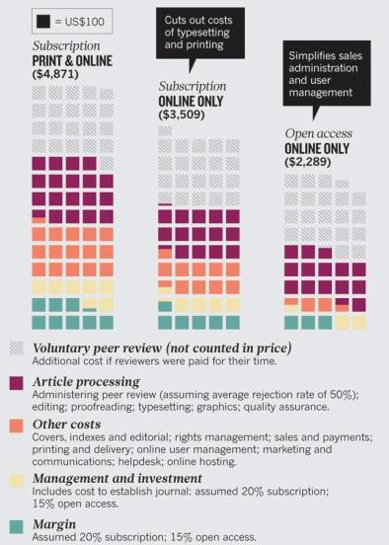
OA – rationale
Scientists perform research, usually publicly (taxpayer) funded and then turn over copyright of report to publishers, limiting access
Growing questions over what traditional publishing process adds to science publication, especially in era of Web
Online-only costs remove cost of typesetting and printing
Open access publishing removes other costs
(Frank, 2013; Wolpert, 2013), (Van Noorden, 2013)

Slide 4
OA – definition
Publishing model where content is freely available and costs covered by some other means
Rationale is that Web provides means to do so
Two models for OA publishing
Gold – “author pays” model, i.e., research funding cover costs
Charges estimated to be a fraction of typical research grant, e.g., 0.3% of research costs
Green – author required to deposit manuscript in public repository, e.g., PubMed Central
(Björk, 2012; Frank, 2013), (Zerhouni, 2004)

Slide 5
OA – chronology
Idea gaining momentum for several years
Many worldwide groups endorsed idea as did reports to UK House of Commons (2004) and European Commission (2006, 2007)
Calls for better public access to research in the US as well
There has also been development of journals with business models built on OA, e.g., Biomed Central (BMC), Public Library of Science (PLoS)
(Laasko, 2011; Björk, 2012), (Grivell, 2004)

Slide 6
Counter-arguments to OA publishing
DeAngelis, editor of JAMA (2004)
Business model not sustainable, especially for journals like JAMA with low acceptance rate and high-stakes research
May provide incentive to publish more and lower standards
May limit publishing by resource-poor scientists (although BMC and PLoS have hardship exceptions)
Alternative plan proposed by non-profit publishers
Washington DC Principles for Free Access to Science
Content freely available as soon as business plan allows (typically 6-12 months), with selected important articles free immediately and all content free to scientists in developing countries
Growth of “predatory” new OA journals that offer inexpensive publishing and appointment to editorial boards, which exist mostly to make money
(Haug, 2013)

Slide 7
Biomed Central – BMC
Provides “barrier-free” access to scientific literature
Authors maintain copyright but provide exclusive royalty-free license
Peer-reviewed, indexed in MEDLINE, and archived in PubMed Central
Business model centers around “article-processing” charge to authors
Amount has gone up as costs become more definitive, now around $1500-$2000
Institutional memberships available that eliminate charge
Other revenues include advertising and value-added services
In 2008, sold to Springer – no changes so far
(Gawrylewski, 2008)

Slide 8
Public Library of Science – PLoS
Began as letter signed by scientists who agree to only subscribe to and publish in journals that agree to make articles available to PubMed Central or similar efforts
Have now developed several journals that use model similar to BMC
Started with PLoS Biology and then PLoS Medicine and now a number of others, including PLoS ONE
Authors pay fee after paper accepted

Slide 9
PubMed Central – PMC
Archive of scientific research reports made publicly available
First proposed by Varmus (1999), modified along way
Current status
Journals keep copyright and, if they desire, content on their own sites
Can have lag time of up to 6-12 months
NIH has standard tags for document elements
Uptake modest, but has been increased by NIH Public Access Policy

Slide 10
NIH publishing policy
NIH Public Access Policy ensures that the public has access to the published results of NIH-funded research
Scientists required to submit final peer-reviewed journal manuscripts that arise from NIH funds to PubMed Central upon acceptance for publication
Compliance with policy requires
Address copyright – ensure publishing agreement allows paper to be posted to PubMed Central in accordance with policy (last submitted draft as a minimum)
Submit paper (published version or last submitted draft) to PubMed Central
Include PMCID at the end of the full citation

Slide 11
Thank you
Please download the resource list with useful links from the “Resources” tab in the upper right of the player.
This course was made possible under a grant from the NIH (# 1R25GM114820-01)

