Slide 1
Fuel Cycle Benchmark Result (Rekindling Jin Hwan Bae’s Work)
Reactor Technology Integration Group (ReTI)
April 16th 2026
Taesuk Oh
Nuclear Engineering & Engineering Physics (NEEP)
University of Wisconsin-Madison

Slide 2
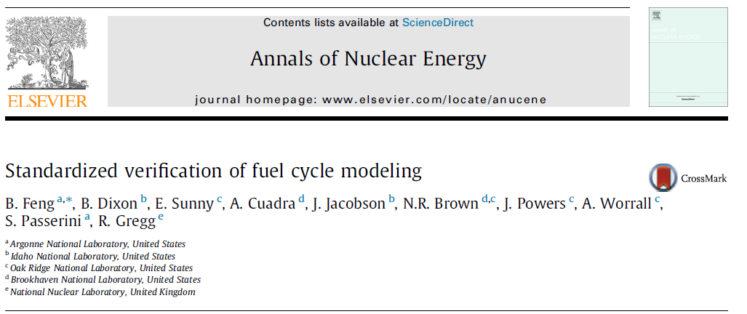
Motivation & Objectives
Discussed about ‘large scale modelling’ of fuel cycles using Cyclus
Found a representative benchmark: devised for comparison between various fuel cycle codes
There is a previous work which used Cyclus to model the above benchmark
Since Cyclus employs a discrete time-step simulation, adjustments had been made
Aim to re-kindle the published work & organize the results to serve as a ‘tutorial’
Original work can be found from Jin Hwan Bae’s Master’s Thesis

Slide 3
Problem Description
The benchmark considers a 100-year transition scenario (2015–2115) beginning with an initial
fleet of 100 light-water reactors (LWRs), each rated at 1 Gwe
Total electricity demand is held constant at 90 GWe, and the system transitions progressively toward a sodium fast reactor (SFR) fleet
Each retiring LWR is replaced by three 333.3 MWe SFRs, preserving the overall generating capacity during the transition
LWR UNF reprocessing begins in 2025 with a fixed throughput of 2000 tIHM/year, while SFR
UNF is reprocessed as needed after cooling
Mandatory cooling times are 4 years for LWR UNF and 1 year for SFR UNF
All recovered TRU is recycled into SFR fresh fuel, with recovered uranium reused as fertile makeup material
To isolate the transition dynamics, all fuel cycle process losses are neglected
The benchmark retirement profile is defined such that the SFR deployment rate is maximized while minimizing unused TRU inventory throughout the transition.

Slide 4
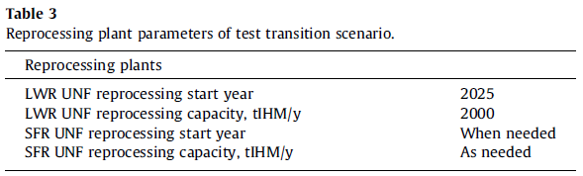
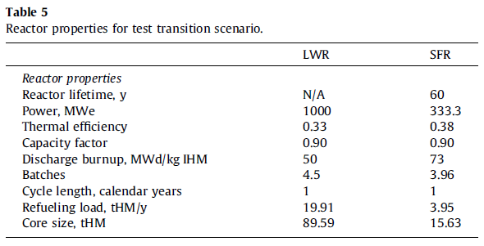
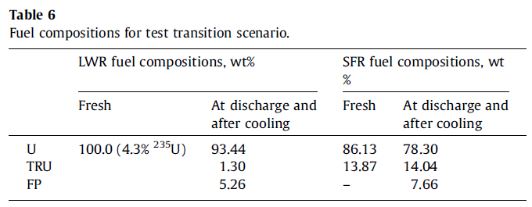
Problem Description
Cyclus cannot model
non-integer batch vals

Slide 5
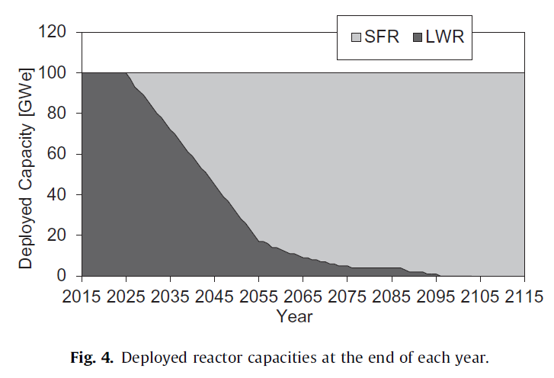
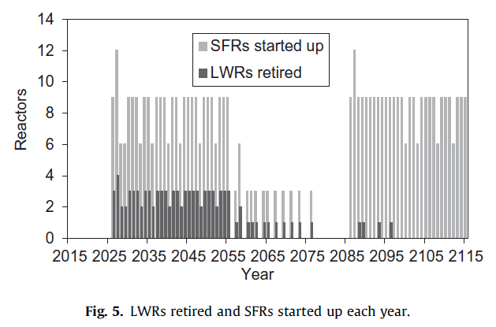
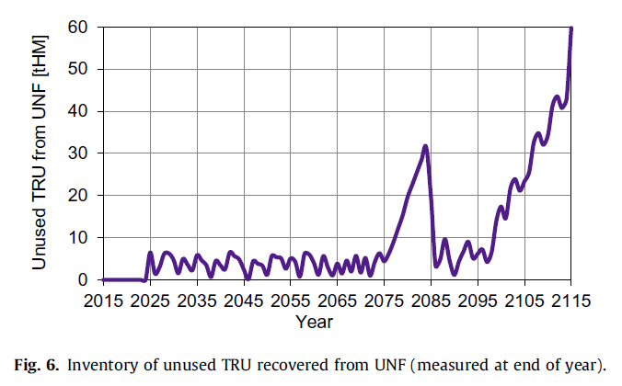
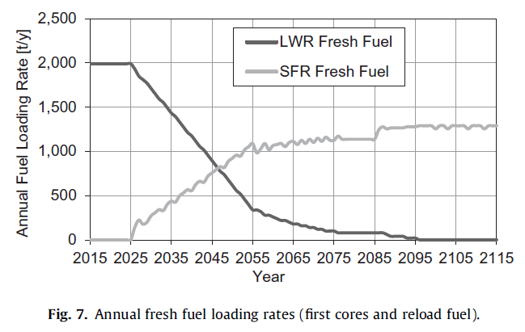
Benchmark Results
Problem specifies retirement &
deployment of LWRs and SFRs
1 LWR is replaced by 3 SFRs
UNF accumulated to deploy 2nd wave of SFR fleets

Slide 6
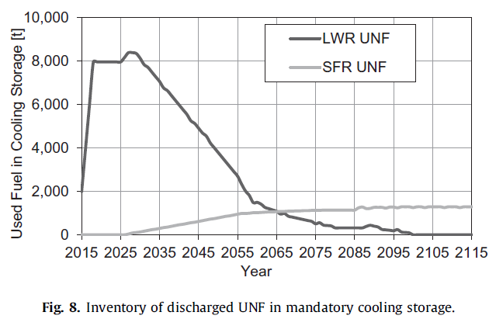
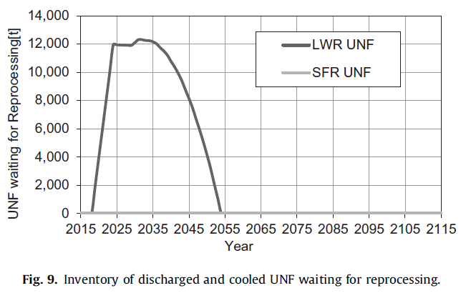
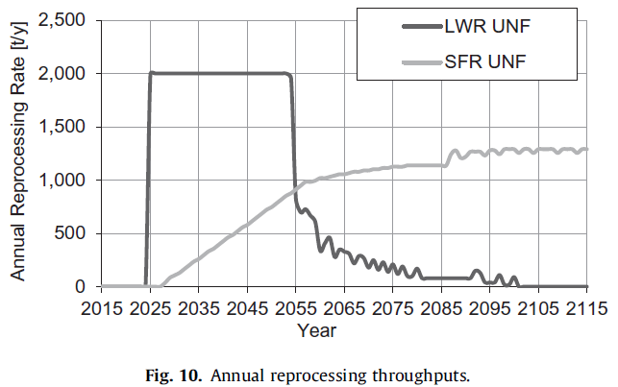
Benchmark Results
Limited to 2000t/yr

Slide 7
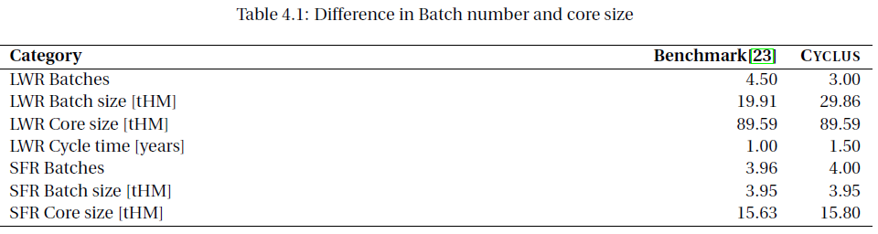
Cyclus Modelling Assmuption
According to Bae’s Thesis:
The CYCAMORE recipe reactor depletes half of its core when decommissioned mid-cycle, whereas the codes in the benchmark deplete all their reactors’ fuel when decommissioned.
For this study, I changed the CYCAMORE Reactor source code to deplete all its assemblies to the depleted recipe. Also, the CYCAMORE recipe reactor treats each batch (and assembly) as a discrete material, while some codes have continuous fuel discharge.
We can to gauge how the difference in core size manifests in the result

Slide 8
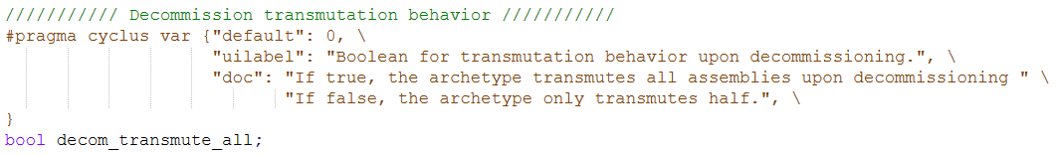
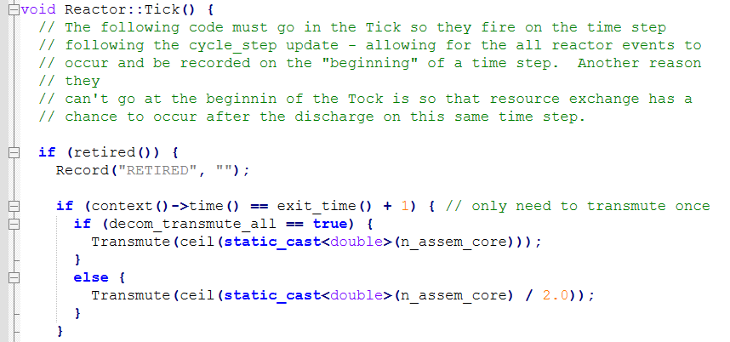
CYCAMORE: Reactor
The ‘Reactor’ Archetype supports two different options for depletion (retirement)
The default option is to transmute half of the core / Keyword ‘decom_transmute_all’
[reactor.h]
[reactor.cc]

Slide 9
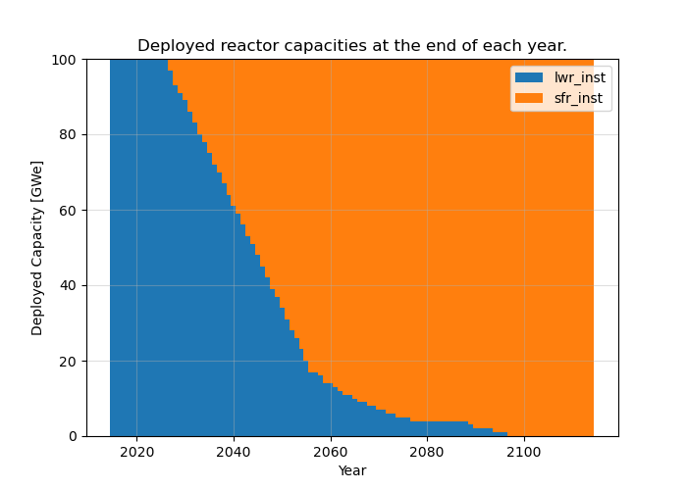
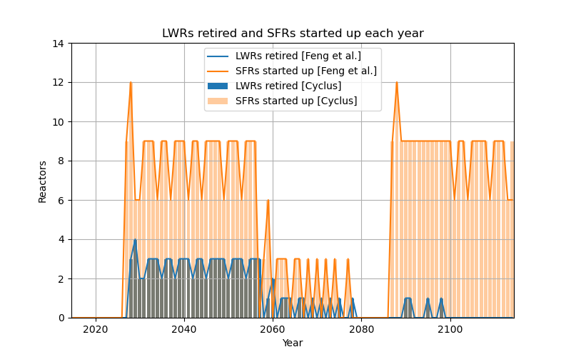
Cyclus Results
All the presented results were calculated on my computer
The original script for visualizing the data was adopted to generate cartoons
User (the benchmark) specifies when LWRs are retired, so the presented result above does not change regardless of how we treat the transmutation at the onset of decommission
No conspicuous difference w.r.t ‘decom_transmute_all’ option, except for the cartoon which shows unused TRU from UNF in time

Slide 10
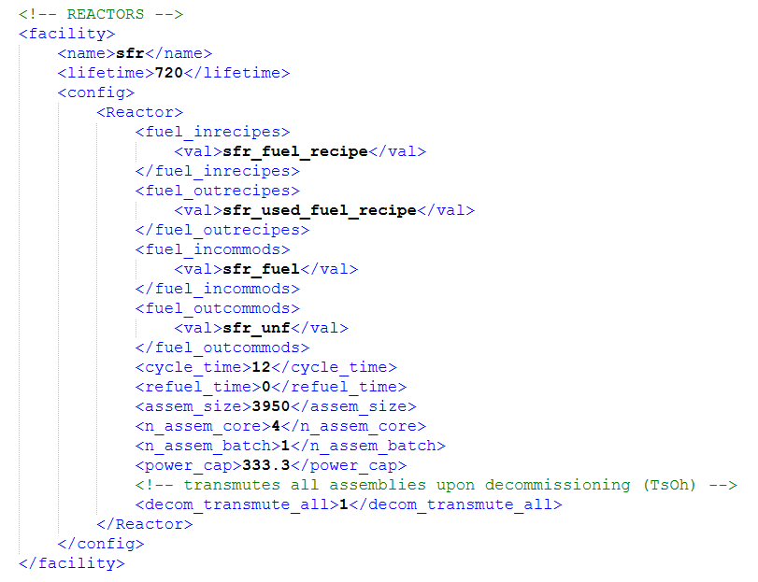
Cyclus Results

Slide 11
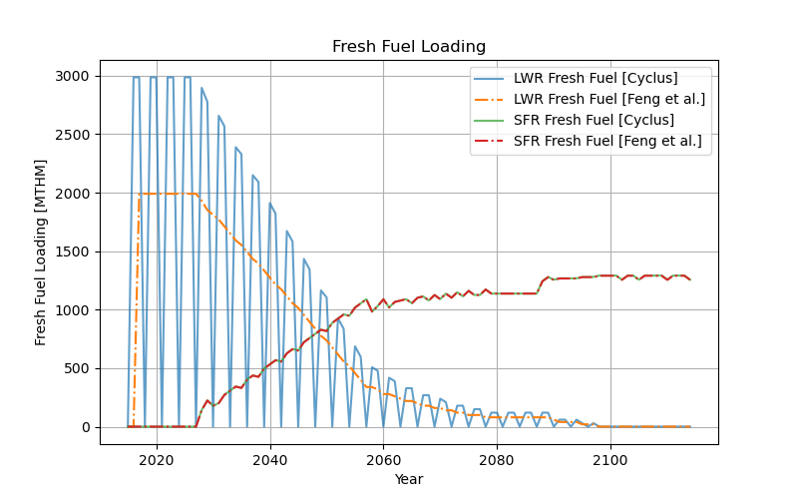
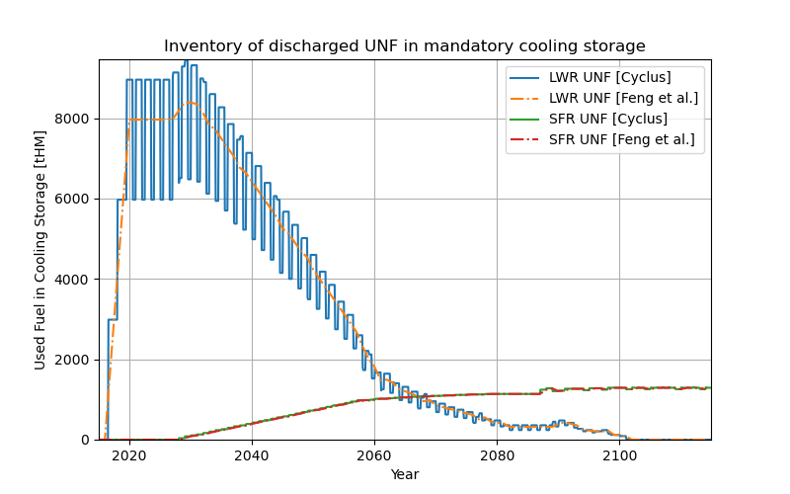
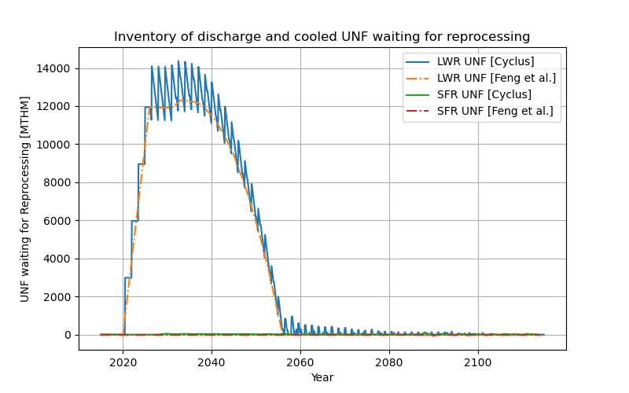
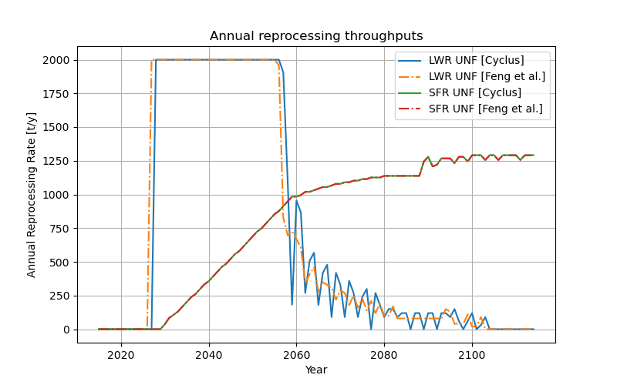
Cyclus Results
Limited to 2000t/yr

Slide 12
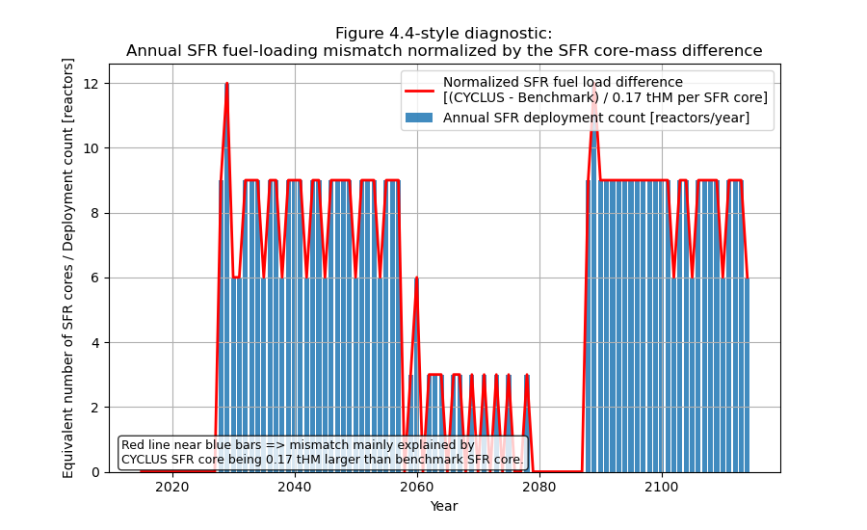
Cyclus Results

Slide 13
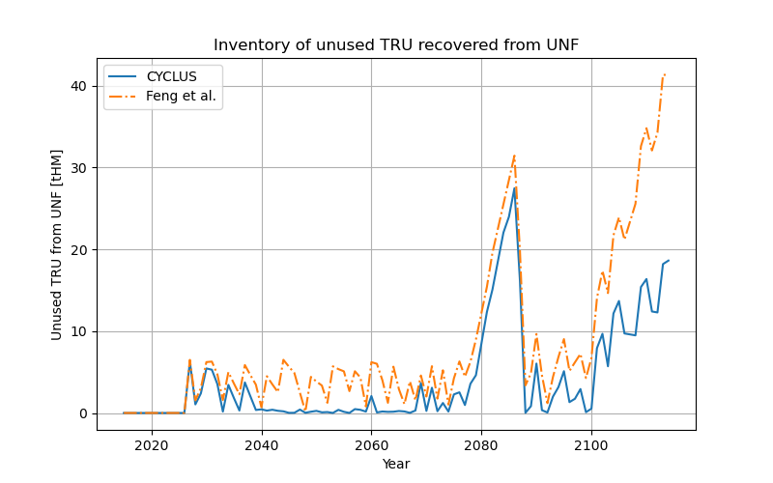
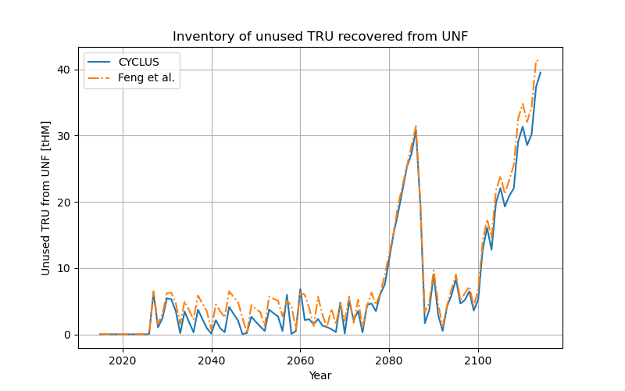
Cyclus Results
decom_transmute_all = F
decom_transmute_all = T

Slide 14


Thank You
Any Questions?

