Slide 1
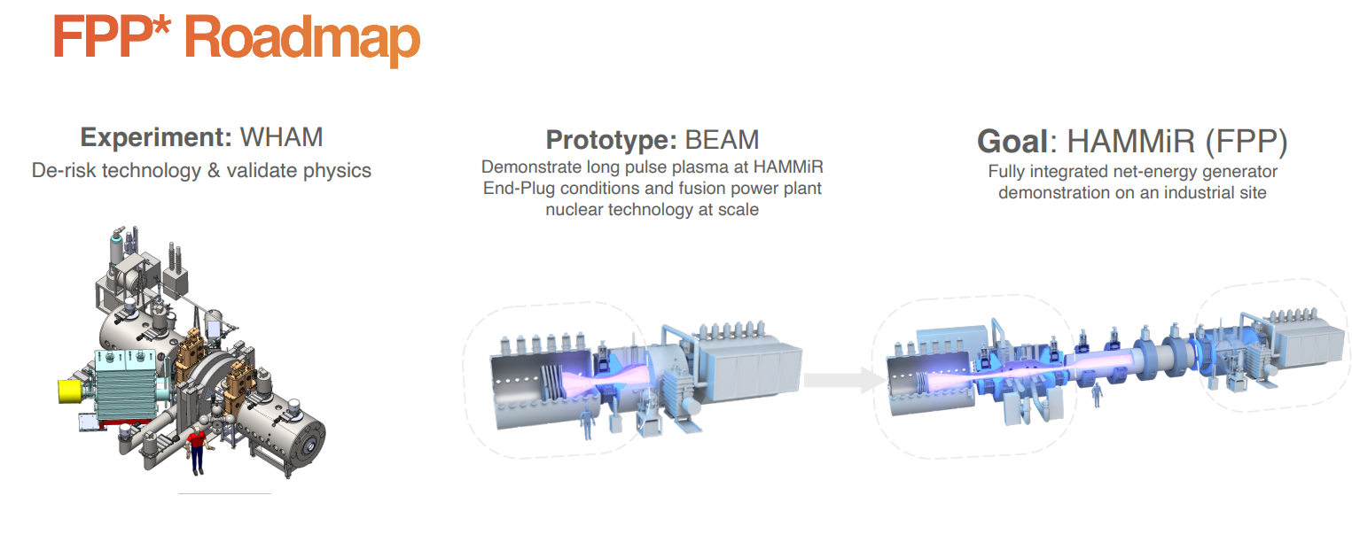
Design Overview – Hammir
High-field Axisymmetric Magnetic Mirror Machine
Very long ‘Fusion Plasma’ region length / Requires lots of LF coil in the centre region
Based on the presented material(s), make a best guess regarding the configuration of the Hammir FPP
Length of the central axis (vacuum vessel surrounding plasma)
Number (position) of magnets in both central & end plug regions

Slide 2
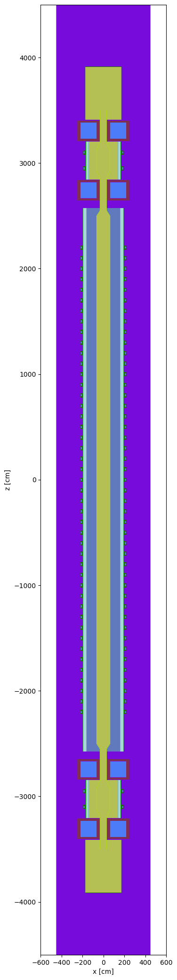
Design Overview – Hammir
Modelling used PARATAN code: https://github.com/hitarthrs/paratan
Python based code for generating OpenMC input for modelling magnetic mirrors/tandem
The information for Hammir configuration was extrapolated from:
Samuel Frank et al., ‘Confinement performance predictions for a high field axisymmetric tandem mirror’ J. Plasma Phys. (2025), vol. 91, E110
Hitarth Shah et al., ‘ParaTAN: Parametric Neutronics Modelling for Mirror Devices’ SOFE 2025 Poster Presentation
The central plasma length is ~ 50 m, with central coils placed with 1 m distancing
Fusion power of 350 MWth (= Net electricity power of 165 Mwe)

Slide 3
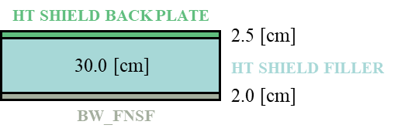
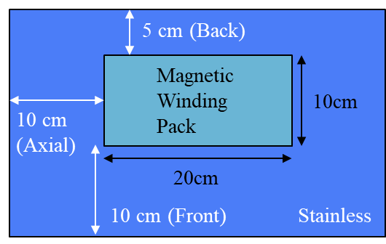
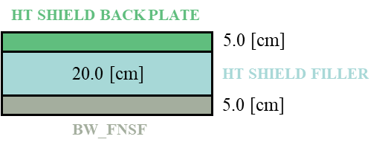
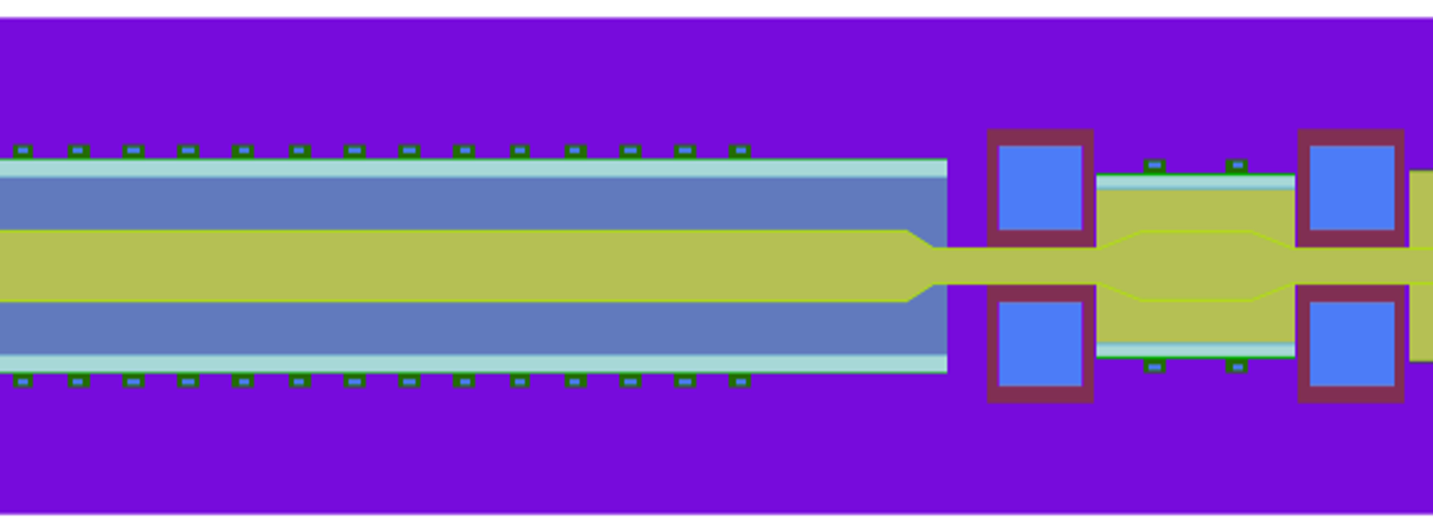
Design Overview – Hammir
Plasma
First Wall: Tungsten + Eurofer97 (Rafm Steel)
PbLi (Blanket)
Magnetic
Winding
Pack
Vacuum
HF coils:
*Magnetic Winding Pack: copper, silver, Rebco, LaMnO3, MgO, Y2O3, Alumina, Hastelloy
HF coils: Magnetic Winding Pack surrounded by thin SS316n / Thick Tungsten Boride

Slide 4
Design Overview – Hammir
component_name | mass [ton]
PbLi | 3352.09
tungsten carbide | 2280.55
tungsten boride WB | 781.18
Hastelloy C-276 | 649.75
stainless 304 | 438.60
Eurofer97 (Includes First Wall Eurofer97 as well) | 180.33
Copper | 109.14
Silver | 51.11
Tungsten | 23.57
SS316LN | 17.25
REBCO tape [MADE A MISTAKE!] | 15.35
Magnesium oxide MgO | 0.44
LaMnO3 | 0.32
Alumina: Al2O3 | 0.19
Yttrium Oxide: Y2O3 | 0.06
Eurofer97 (from First Wall) | 23.536
Pb (84.3 at%), Li (15.7 at%)
Natural Pb (lead), and Li-6 enrichment 30 at%
Both PbLi & tungsten boride WB are likely to incur bottleneck issue / Others can be readily procured

Slide 5
Design Overview – Hammir
Corresponding approximate PbLi mass fractions:
Li_enr = 0.00598618 / Pb = 0.99401382
For one full HAMMIR build:
PbLi = 3,352,100 kg
Enriched Li requirement is: 3,352,100 * 0.00598618 ≈ 20,066 kg ≈ 20.1 t
The mass of Li-6 is then around 6 tons (for deploying Hammir)
The annual Li-6 consumption is around 38.5 kg/year (50 years: ~ 2 tons)
May require replenishing Lithium-6 during operation
(NEWLY ADDED) The OpenMC model only considers Blanket Region
Need to accommodate heat exchanger volume as well / Uses Brayton cycle
Lack of information or detail --- Postulate (x2) of the blanket volume for whole PbLi volume
PbLi = 3,352,100 kg (x2) = 6,704,200 kg
Enriched Li requirement is approximately 40.2 tons (Mass of Li-6 would be around 12 tons)
Made a mistake interpreting required REBCO for Hammir
See the following slides for corrected interpretation

Slide 6
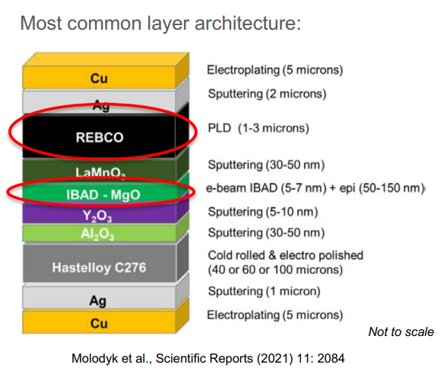
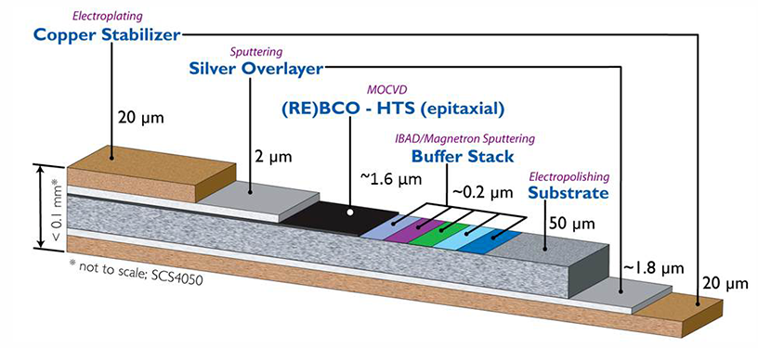
Magnetic Winding Pack – REBCO Tapes
Despite recent progress on High Temperature Superconductor (HTS) cables
(1) quench protection and (2) winding pack stress management remain to be outstanding issues for large scale applications for fusion.
Quenching?
Transition from superconducting state → normal resistive state
Causes sudden heat generation (J²R heating)
Can lead to thermal runaway and magnet damage if not controlled
REBCO (Rare Earth Barium Copper Oxide) Tape:
Thickness ~ 0.1 mm / Width ~ 10 mm

Slide 7
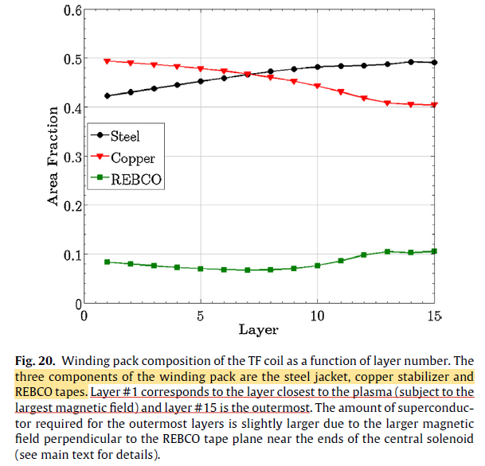
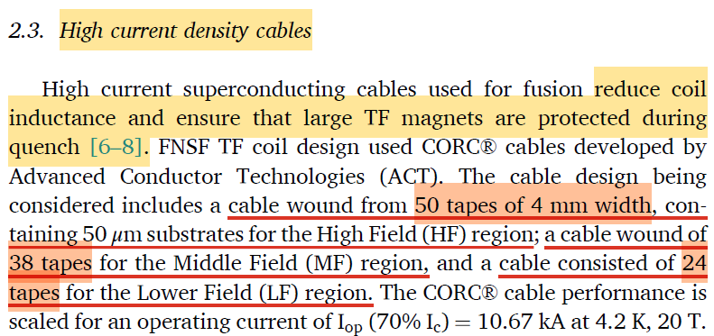
Magnetic Winding Pack – REBCO Tapes
The magnetic winding pact does not solely comprise of REBCO tape
While REBCO tape includes an intrinsic stabilizer, additional coil-level stabilization is required due to quench propagation in HTS magnets.
The average composition of the winding pack (by area) is:
45.9% copper,
46.1% steel, and
8.0% REBCO tapes (corresponding to a stack of 106 REBCO tapes of 12 mm width).
(from ARC paper)
[2021] Conceptual design of HTS magnets for fusion nuclear science facility

Slide 8
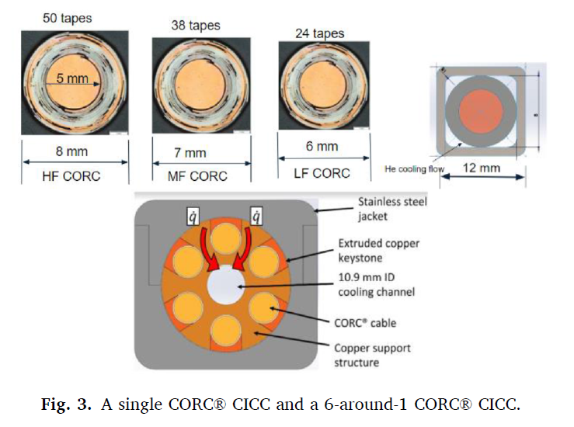
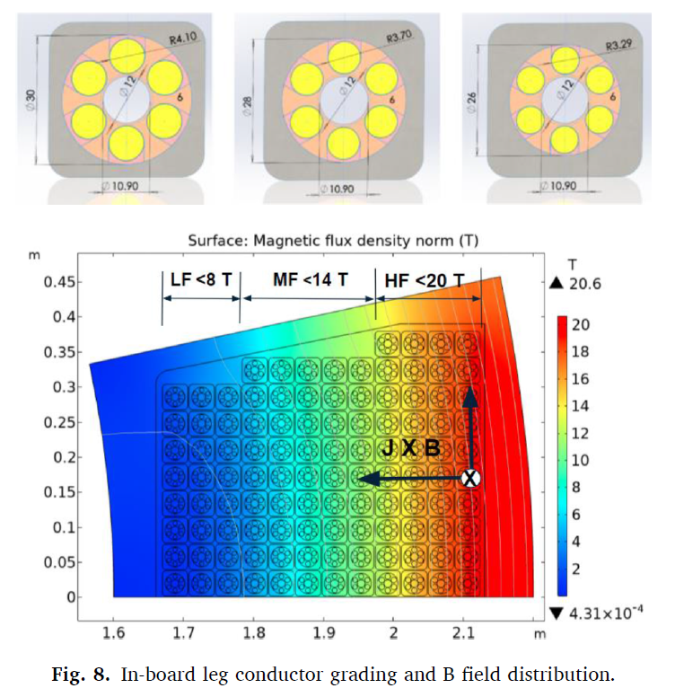
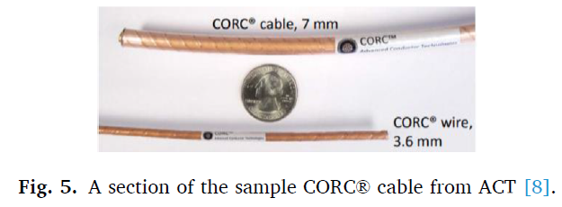
Magnetic Winding Pack – REBCO Tapes
Magnetic Winding Pack is not solely comprised of REBCO tape

Slide 9
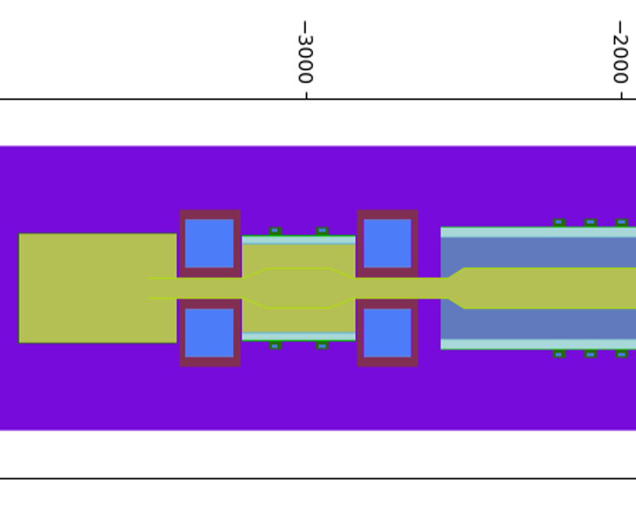
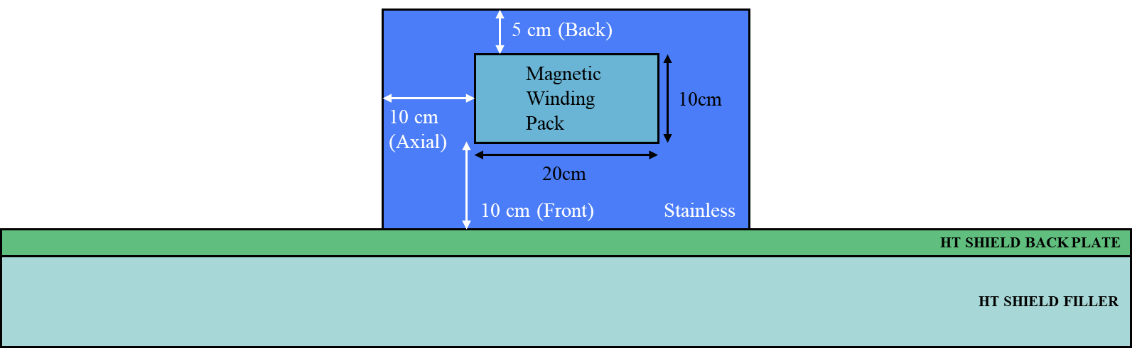
REBCO in Hammir?
The following procedure was taken to estimate the REBCO quantity (in mass) for Hammir:
Modelled Hammir (magnetic tandem) using Paratan
The size for LF coils was assumed as: radial thickness 10 [cm], height 20 [cm]
Bore radius would differ for lf coils placed at core region (plasma) & end-plug regions
The size for HF coils was assumed as: radial thickness 150 [cm], height 150 [cm]
The above values are taken from pre-existing Hammir input
Filled with material named ‘Magnetic Winding Pack’
LF coil as well filled with ‘Magnetic Winding Pack’

Slide 10
REBCO in Hammir?
From the OpenMC modelling of Hammir, deduce the volume occupied with material named
‘Magnetic Winding Pack 2.0’
Such material is comprised of the following items:
Resembles the REBCO tape configuration, but not the other structural materials
Recall that REBCO tape by itself does not solely comprise the Winding Pack in reality
The net volume of ‘Magnetic Winding Pack 2.0’ for the previous design is 9.28E+07 [cc]
The volume occupied by rebco according to the above table is then 2.44E+06 [cc]
With density value of 6.3 g/cc, yields 15.38 [ton] (!) --- This approach is invalid!
Material Name | Fraction (at %) [-]
copper | 1.31E-01
silver | 5.25E-02
rebco | 2.63E-02
lamno3 | 5.25E-04
MgO | 1.31E-03
yttrium_oxide | 1.31E-04
alumina | 5.25E-04
hastelloy | 7.88E-01
SUM | 1.00E+00

Slide 11
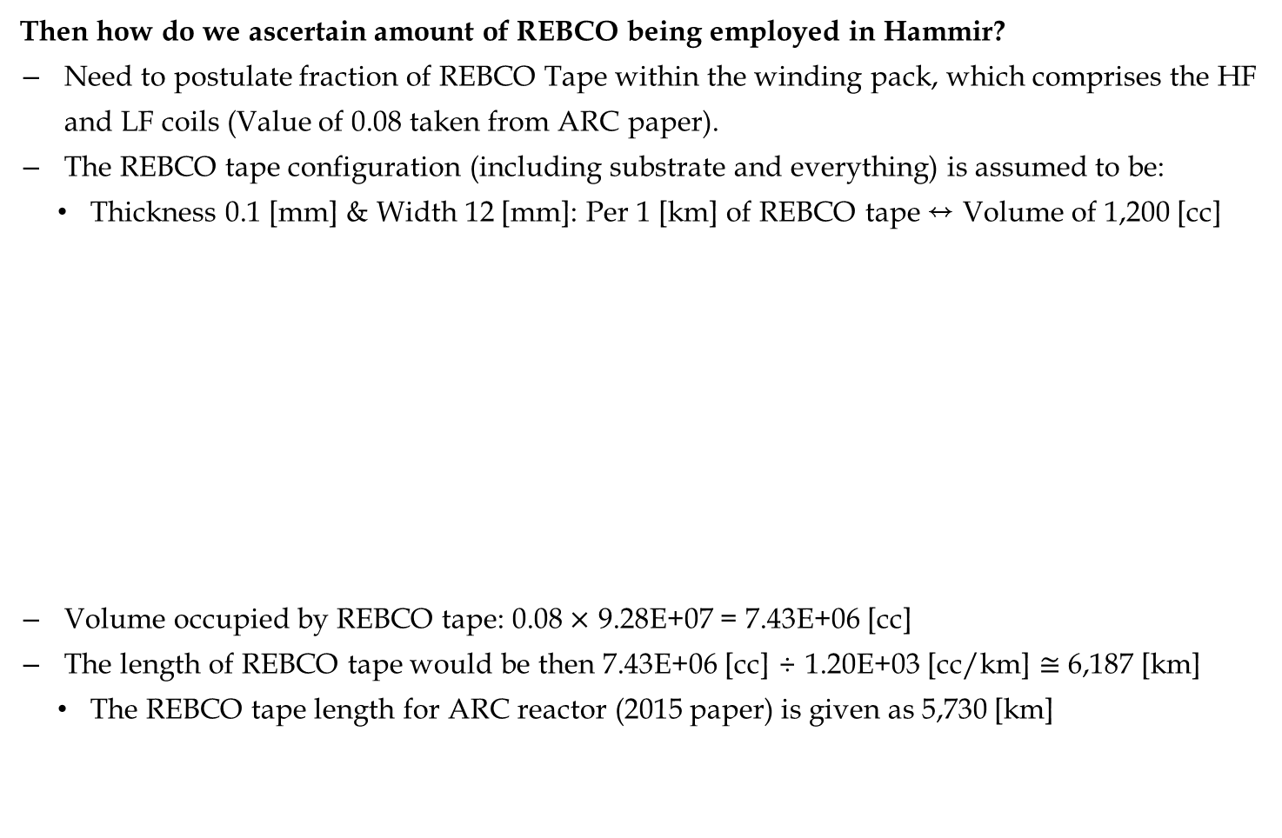
REBCO in Hammir?
Then how do we ascertain amount of REBCO being employed in Hammir?
Need to postulate fraction of REBCO Tape within the winding pack, which comprises the HF and LF coils (Value of 0.08 taken from ARC paper).
The REBCO tape configuration (including substrate and everything) is assumed to be:
Thickness 0.1 [mm] & Width 12 [mm]: Per 1 [km] of REBCO tape ↔ Volume of 1,200 [cc]
Volume occupied by REBCO tape: 0.08 $×$ 9.28E+07 = 7.43E+06 [cc]
The length of REBCO tape would be then 7.43E+06 [cc] ÷ 1.20E+03 [cc/km] $≅$ 6,187 [km]
The REBCO tape length for ARC reactor (2015 paper) is given as 5,730 [km]

Slide 12
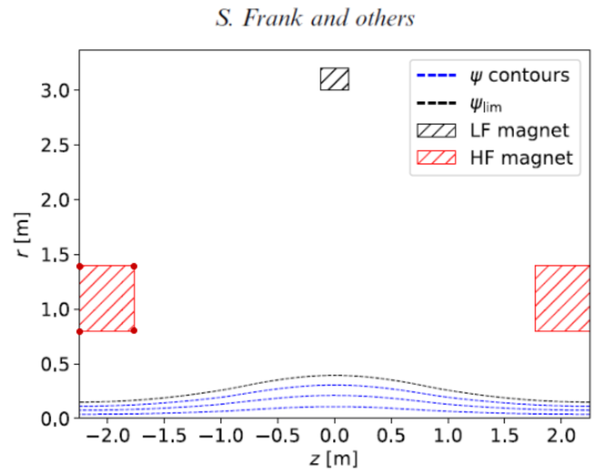

REBCO in Hammir?
The following HF coil configuration was employed for comparison:
Retrieved from Samuel Frank, et al., ‘Confinement performance predictions for a high field axisymmetric tandem mirror’ J. Plasma Phys. (2025), vol. 91, E110
Assuming same LF coil configuration, yields total ‘Magnetic Winding Pack 2.0’ volume of 2.11E+07 [cc], which corresponds to REBCO tape length of $≅$ 1,406 [km]
Bore radius: 0.6 [m]
Radial thickness: 0.8 [m]
Height: 0.5 [m]

Slide 13
References
B.N. Sorbom, et al., ‘ARC: A compact, high-field, fusion nuclear science facility and demo-nstration power plant with demountable magnets’ Fusion Engineering and Design 100 (2015) 378–405
Yuhu Zhai, et al., ‘Conceptual design of HTS magnets for fusion nuclear science facility ’ Fusion Engineering and Design 168 (2021) 112611
Samuel Frank, et al., ‘Confinement performance predictions for a high field axisymmetric tandem mirror’ J. Plasma Phys. (2025), vol. 91, E110

