Slide 1
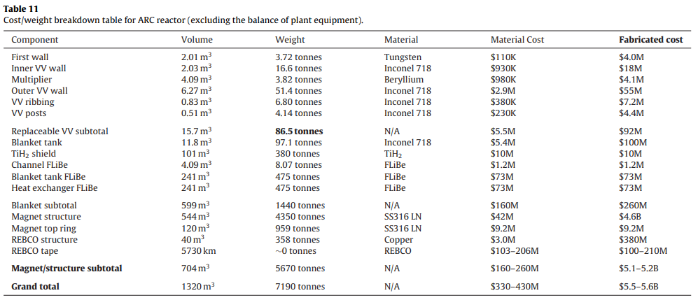
Material Requirement – ARC
Based on the following paper:
B.N. Sorbom et al., ‘ARC: A compact, high-field, fusion nuclear science facility and demonstration power plant with demountable magnets’ Fusion Engineering and Design 100 (2015) 378–405
One modification: We do not use Inconel718 for structural material / Substituted with Vanadium
Periodically replaced

Slide 2
Material Requirement – ARC
Vanadium is employed for (i) periodically replaced and (ii) initial deployment materials
Assume the same volume from the table, in which Inconel718 is occupying.
Accommodate the density (g/cc) difference for Vanadium and Inconel → calculate the mass
For periodically replaced Vanadium: 58.33 tons
For initial deployment Vanadium: 71.39 tons
Through literature survey, found out that FLiBe being the most prominent material that will
cause the bottleneck issue for deployment of ARC reactor
For further information, refer to the WARF project meeting PPT files.

Slide 3
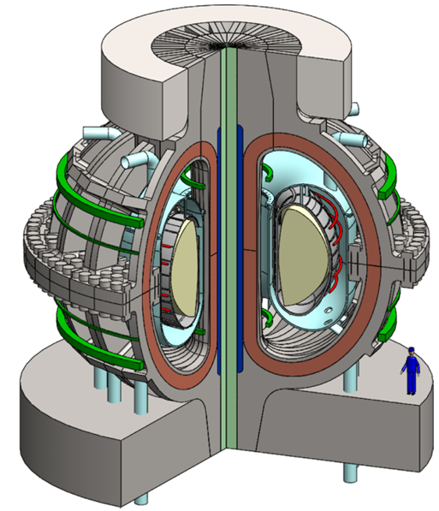
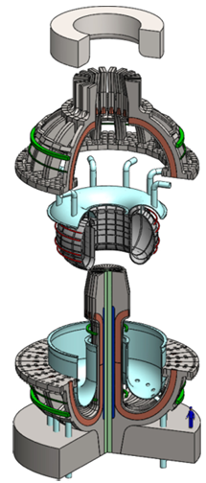
Design Overview – ARC
Information taken from:
B.N. Sorbom et al., ‘ARC: A compact, high-field, fusion nuclear science facility and demonstration power plant with demountable magnets’ Fusion Engineering and Design 100 (2015) 378–405
Modularized!
Fusion Power of 525 MWth
Net electricity power of 190 MWe
Fig. 1. The ARC reactor, shown with the plasma in yellow and the TF superconducting tape in brown.
Fig. 3. The upper half of ARC’s superconducting coils can be removed, allowing the
vacuum vessel to be re-moved from the
blanket tank as a single piece.
Utilizes a fully liquid blanket (FLiBe)

Slide 4
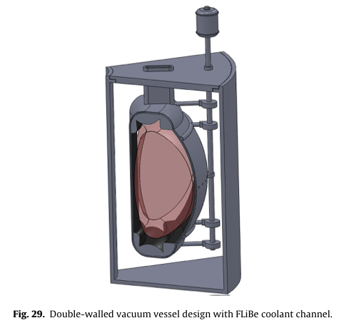
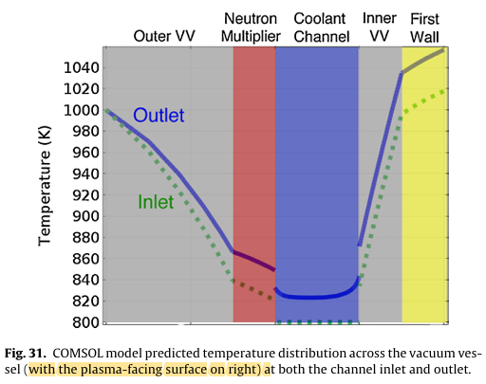
Design Overview – ARC
Bombarded by neutrons
(Replaced!)
Be
Cycle | Components | Typical Mass | Frequency | Notes
Short (0.5–1 yr) | VV + W modules | ≈ 86.5 t | 6–12 mo | Main radioactive waste driver
Long (5–9 yr) | Be multiplier / TiH₂ shield | 3.8 t / 380 t | 5–9 yr | Occasional structural swap
Continuous | FLiBe impurities / filters | < 1 t yr⁻¹ | Steady | Corrosion by-products

Slide 5
Design Overview – ARC
In the original paper, Inconel 718 was considered → Changed to Vanadium in our Analysis
The tungsten employed in the first wall (replaced most often) weights 3.72 tons
The vanadium employed in the first wall weights ~ 80 tons
Very unlikely for ‘short-term replaced materials’ to cause bottleneck issue
Materials to be replenished with longer time-scale & for initial deployment
For Periodic long-term (~9years) replaced materials:
For initial deployment:
Material | Weight [tons] | Weight Fraction [-]
Be | 3.82 | 0.0086
TiH₂ | 380.18 | 0.8595
V | 58.33 | 0.1319
Material | Weight [tons] | Weight Fraction [-]
FLiBe | 958 | 0.1433
SS316 | 5,300 | 0.7925
Cu | 358 | 0.0535
V | 71.39 | 0.0107
Although, the quality (impurity level) of material would matter, but will be neglected in this analysis

Slide 6
Design Overview – ARC
Lithium-6 enrichment of 90 a/o considered for ARC
Out of 958 tons of FLiBe, weight fraction of Be is about 9.26% and Lithium is about 13.84%
Required mass of Be is about 88.7 tons
Required mass of Lithium (including both Li-6 and Li-7) is about 132.6 tons (Li-6: 119.34 t)
The REBCO tape is required about 5,730 km
No explicit mentioning for refueling of Lithium in FLiBe salt
Each D–T fusion reaction releases 17.6 MeV
Corresponds to 2.82E-12 J/reaction
One neutron is produced per fusion reaction
Ideally, one neutron breeds one tritium atom
one Li-6 atom is consumed per fusion reaction (neglect contribution from Li-7)
For a thermal power of 1 GWth: requires 3.55E+20 reactions/s
The same amount of Li-6 is consumed
Corresponds to about 110 kg/year of Li-6 consumption
For ARC, approximately 57.8 kg/year of Li-6 consumption / 50 years operation ~ 2.9 tons

