Slide 1
Lithium-6 Consumption Issue
Some papers explicitly discuss about replenishing Lithium-6, whereas others don’t
Each D–T fusion reaction releases 17.6 MeV
Corresponds to 2.82E-12 J/reaction
One neutron is produced per fusion reaction
Ideally, one neutron breeds one tritium atom
one Li-6 atom is consumed per fusion reaction (neglect contribution from Li-7)
For a thermal power of 1 GWth: requires 3.55E+20 reactions/s
The same amount of Li-6 is consumed
Corresponds to about 110 kg/year of Li-6 consumption
We note that establishing nuclear-grade supply chains is non-trivial for a range of materials
including structural components such as vanadium, due to quality control requirements and the need to scale production processes.
In this context, the supply chain related to the hardest material (e.g., FLiBe) to procure can be viewed as a representative limiting case, as it tends to combine multiple challenges

Slide 2
Candidate #01: ARC
Material | Weight [tons] | Replacement Period
Tungsten | 3.72 | 6-12 month
Vanadium* | 58.3 | 6-12 month
Beryllium | 3.82 | 5-9 years
TiH₂ | 380.18 | 5-9 years
FLiBe | 958 | Steady
SS316 | 5,300 | Steady
Copper | 358 | Steady
Vanadium** | 71.4 | Steady
V* is related to vacuum vessels. V** is related to blanket tanks.
Vanadium is employed for (i) periodically replaced and (ii) initial deployment materials
Assume the same volume from the table, in which Inconel718 is occupying.
Lithium-6 enrichment of 90 a/o considered for ARC
Out of 958 tons of FLiBe, weight fraction of Be is about 9.26% and Lithium is about 13.84%
Required mass of Be is about 88.7 tons
Required mass of Lithium (including both Li-6 and Li-7) is about 132.6 tons (Li-6: 119.34 t)
The required REBCO tape is about 5,730 km
Fusion Power of 525 MWth (Net electricity power of 190 MWe)
Approximately 57.8 kg/year of Li-6 consumption (50 years operation ~ 2.9 tons)

Slide 3
Candidate #02: Hammir
component_name | mass [ton]
PbLi | 6704.20
tungsten carbide | 2280.55
tungsten boride WB | 781.18
Hastelloy C-276 | 649.75
stainless 304 | 438.60
Eurofer97 (Includes First Wall Eurofer97 as well) | 180.33
Copper | 109.14
Silver | 51.11
Tungsten | 23.57
SS316LN | 17.25
Magnesium oxide MgO | 0.44
LaMnO3 | 0.32
Alumina: Al2O3 | 0.19
Yttrium Oxide: Y2O3 | 0.06
Pb (84.3 at%), Li (15.7 at%): For a single Hammir PbLi = 6,704,200 kg & Enriched Li ≈ 40.2 t
Natural Pb (lead), and Li-6 enrichment 30 at% (Mass Ratio: Li_enr = 0.00598618 / Pb = 0.99401382)
Both PbLi & tungsten boride WB are likely to incur bottleneck issue / Others can be readily procured
The mass of Li-6 is then around 12 tons (for deploying Hammir)
The annual Li-6 consumption is around 38.5 kg/year (50 years: ~ 2 tons)
The required REBCO tape is about 1,406 km
Fusion power of 350 MWth (= Net electricity power of 165 Mwe)

Slide 4
Candidate #03: EU-DEMO Derived
Two different blanket concepts:
WCLL (Water Cooled Lithium Lead) .vs. HCPB (Helium Cooled Pebble Beds)
The WCLL concept exploits an eutectic alloy made of liquid Lithium and Lead (Li16-Pb84)
It flows into the breeding zone and acting both as breeding material and neutron multiplier
WCLL structures are actively cooled by water, while Helium is used to extract tritium from the LiPb alloy
Postulates 90% Li-6 / ~ 13.6 times the amount of natural Lithium (kg) per WCLL grade Lithium (kg)
The HCPB concept uses pebbles out of BeTi as neutron multiplier and the so-called KALOS-ACB pebbles
[65 %Mol-Li4SiO4 35 %Mol-Li2TiO3] as breeding material.
Helium is exploited both as cooling fluid for structures and for purging of tritium.
Total Lithium in KALOS-ACB is about 18.5 wt% / ~30 tons of enriched Li (Li-6 60 %)
Approximately 9 times the amount of natural Lithium (kg) per WCLL grade Lithium (kg)
VERY LIMITED INFORMATION FOR BeTi Production
For both the HCPB and WCLL concepts, fusion specific reduced activation ferritic martensitic (RAFM) steel, EUROFER, is currently considered the preferred structural material

Slide 5
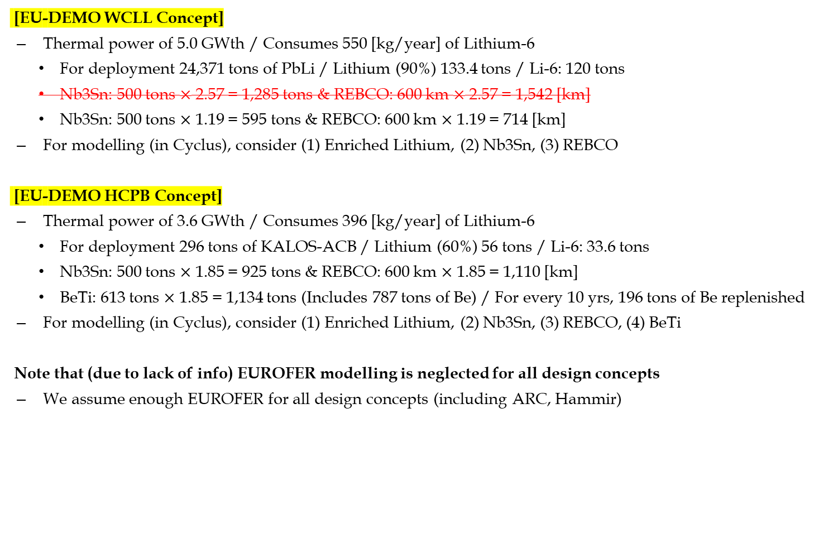
Candidate #03: EU-DEMO Derived
[EU-DEMO WCLL Concept]
Thermal power of 5.0 GWth / Consumes 550 [kg/year] of Lithium-6
For deployment 24,371 tons of PbLi / Lithium (90%) 133.4 tons / Li-6: 120 tons
Nb3Sn: 500 tons $×$ 2.57 = 1,285 tons & REBCO: 600 km $×$ 2.57 = 1,542 [km]
Nb3Sn: 500 tons $×$ 1.19 = 595 tons & REBCO: 600 km $×$ 1.19 = 714 [km]
For modelling (in Cyclus), consider (1) Enriched Lithium, (2) Nb3Sn, (3) REBCO
[EU-DEMO HCPB Concept]
Thermal power of 3.6 GWth / Consumes 396 [kg/year] of Lithium-6
For deployment 296 tons of KALOS-ACB / Lithium (60%) 56 tons / Li-6: 33.6 tons
Nb3Sn: 500 tons $×$ 1.85 = 925 tons & REBCO: 600 km $×$ 1.85 = 1,110 [km]
BeTi: 613 tons $×$ 1.85 = 1,134 tons (Includes 787 tons of Be) / For every 10 yrs, 196 tons of Be replenished
For modelling (in Cyclus), consider (1) Enriched Lithium, (2) Nb3Sn, (3) REBCO, (4) BeTi
Note that (due to lack of info) EUROFER modelling is neglected for all design concepts
We assume enough EUROFER for all design concepts (including ARC, Hammir)

Slide 6
Candidate #03: EU-DEMO Derived
EU-DEMO WCLL Concept
Thermal power of 5.0 GWth [1.55 GWe] / Consumes 550 [kg/year] of Lithium-6
REBCO tape: 714 [km] / Lithium (90%) 133.4 tons (Li-6: 120 tons)
EU-DEMO HCPB Concept
Thermal power of 3.6 GWth / Consumes 396 [kg/year] of Lithium-6
REBCO tape: 1,110 [km] / Lithium (60%) 56 tons (Li-6: 33.6 tons)
BeTi: 1,134 tons (Includes 787 tons of Be) / For every 10 yrs, 196 tons of Be replenished
TOO MANY BERYLLIUM! / WILL EXCLUDE DOING CYCLUS MODELLING
component_name | mass [ton]
PbLi | 24,371
Nb3Sn | 595
component_name | mass [ton]
KALOS-ACB | 296
Nb3Sn | 925
BeTi | 1,134

Slide 7
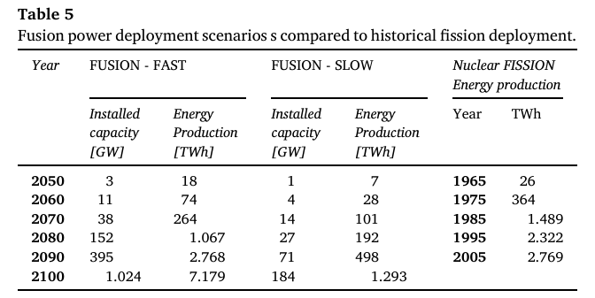
Efficiency of Using REBCO / Electricity Generation
Variables | ARC | Hammir | EU DEMO (WCLL)
Fusion Power [MW] | 525 | 350 | 5,000
Electric Power [MW] | 190 | 165 | 1,550
REBCO [km] | 5,730 | 1,406 | 1,542
Conversion efficiency [-] | 0.36 | 0.47 | 0.31
Fusion Power per unit REBCO length [kW/km] | 91.6 | 248.9 | 7002.8
Electric Power per unit REBCO length [kW/km] | 33.2 | 117.4 | 2170.9

Slide 8

Overall Table
Parameter | ARC | Hammir | EU DEMO-like
Fusion power [MW] | 525 | 350 | 5,000
Net electric power [MWe] | 190 | 165 | 1,550
Startup enriched Li inventory [t/plant]* | 132.6 Li-90 | 40.2 Li-30 | 133.4 Li-90
Li-6 burnup [kg/yr/plant] | 57.8 | 38.5 | 550
Annual enriched Li demand [kg/yr-plant]* | 64.2 | 128.3 | 611.1
REBCO [km/plant] | 5,730 | 1,406 | 714
PbLi [t/plant] | — | 6,704.2 | 24,371
WB [t/plant] | — | 781.18 | —
Nb3Sn [t/plant] | — | — | 595
Startup enriched Li intensity [t/GWe]* | 697.9 | 243.6 | 86.1
REBCO intensity [km/GWe] | 30,158 | 8,521 | 461
Annual enriched Li intensity [t/GWe-yr]* | 0.338 | 0.778 | 0.394
* Startup and annual enriched Li demand denote the required mass of enriched lithium, obtained by dividing the required Li-6 mass by the corresponding Li-6 enrichment fraction:
$$M_{enriched}=\frac{M_{Li−6}}{x_{Li−6}}$$

