Slide 1
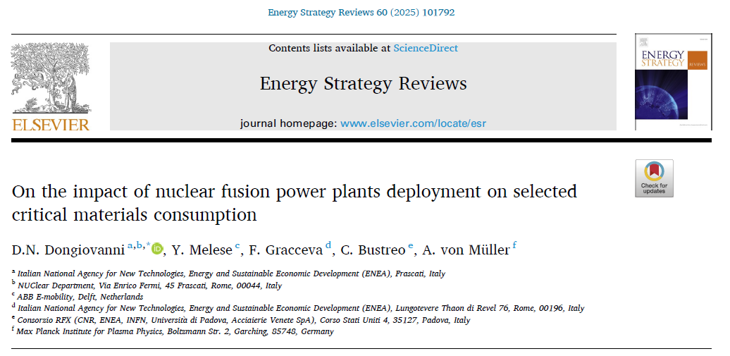
EU-DEMO Overview
Based on the following paper:
Harness the material requirement to deploy one single EU-DEMO reactor
Actually, two different designs that extrapolates from the origianl EU-DEMO

Slide 2
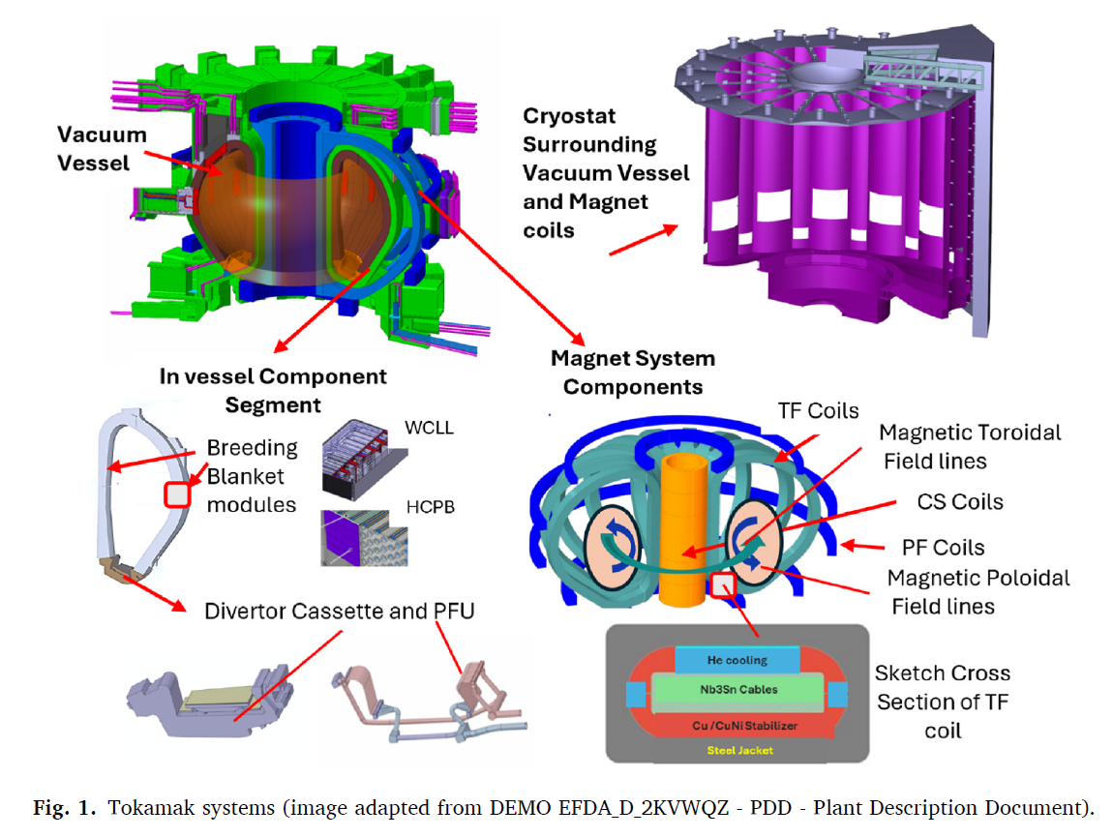
EU-DEMO Overview
Two different blanket concepts:
WCLL (Water Cooled Lithium Lead) .vs. HCPB (Helium Cooled Pebble Beds)

Slide 3
EU-DEMO Overview
The WCLL concept exploits an eutectic alloy made of liquid Lithium and Lead (Li16Pb84)
It flows into the breeding zone and acting both as breeding material and neutron multiplier
WCLL structures are actively cooled by water, while Helium is used to extract tritium from the LiPb alloy
Postulates 90% Lithium-6 enrichment / ~ 13.6 times the amount of natural Lithium (kg) per WCLL grade Lithium (kg)
The HCPB concept uses pebbles out of BeTi as neutron multiplier and the so-called KALOS-
ACB pebbles [65 %Mol-Li4SiO4 35 %Mol-Li2TiO3] as breeding material.
Helium is exploited both as cooling fluid for structures and for purging of tritium.
Total Lithium in KALOS-ACB is about 18.5 wt% / ~30 tons of enriched Li (Li-6 60 %)
Approximately 9 times the amount of natural Lithium (kg) per WCLL grade Lithium (kg)
VERY LIMITED INFORMATION FOR BeTi Production
For both the HCPB and WCLL concepts, fusion specific reduced activation ferritic martensitic
(RAFM) steel, EUROFER, is currently considered the preferred structural material

Slide 4
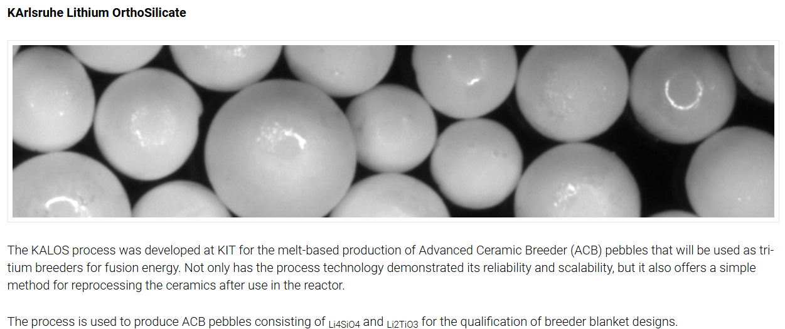
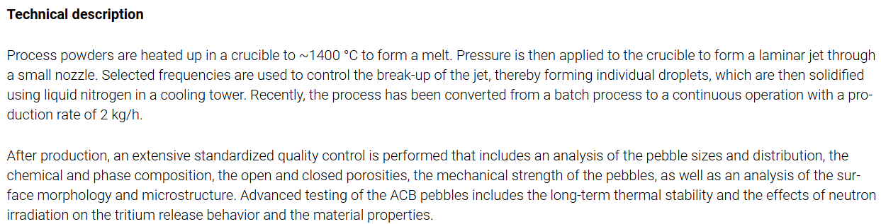
KALOS-ACB Pebbles
Very Limited Production Capability at the moment!
2 kg/h is equivalent to 17.52 tons per year
https://www.fusion.kit.edu/english/284.php

Slide 5
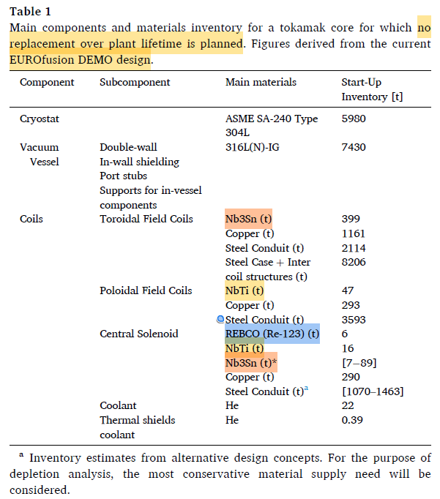
EU-DEMO (No Replacement Inventory)
Used for ITER's toroidal field and central solenoid
magnet systems:
ㅁ 500 metric tons of strand (> 100,000 km) were
produced by nine suppliers in a procurement effort
that lasted from 2008 to 2015.
This large-scale industrial effort demanded a ramp-up of global production capacity from 15 metric tons/year to 100 metric tons/year, as well as the introduction of three new strand suppliers.
The question would be, is it easy to ramp up the
production rate of Nb3Sn when there is enough
demand!
In 2024, approximately 1,000 metric tons of NbTi
was produced. Expected CAGR is about 11%.
Assume Nb3Sn ~ 500 tons for EU-DEMO
REBCO Tape in [km]?
Since TF and PF coils do not use REBCO, expect
the length to be (quite) shorter than ARC-type
6000 (kg) / 10.2 (kg/km) = 588 km
Approximately 600 km (smaller than ARC)

Slide 6
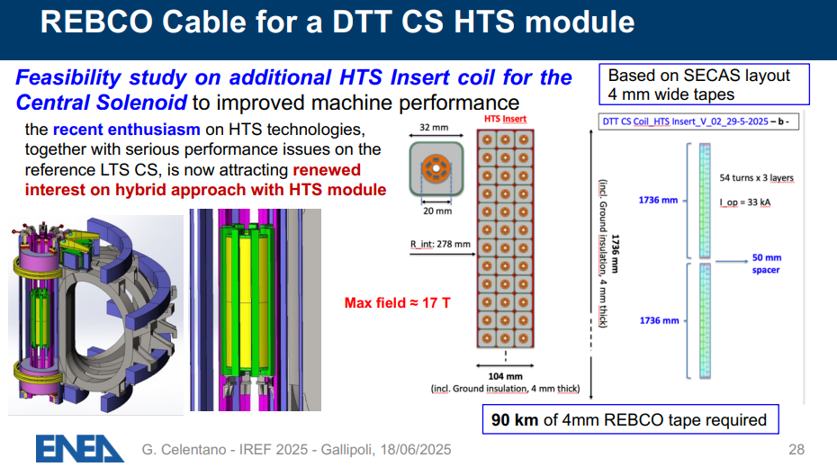
REBCO for EU-DEMO?
Have found that for DTT (Divertor Tokamak Test), approximately 90 km of REBCO
Usage of SECAS: Stacked Enhanced Conductor for Advanced Solenoid
We postulate similar REBCO tape length for EU-DEMO as well, as it only employs REBCO for central solenoid / Assume ~100 km length (good enough?)
DEPRECATED!

Slide 7
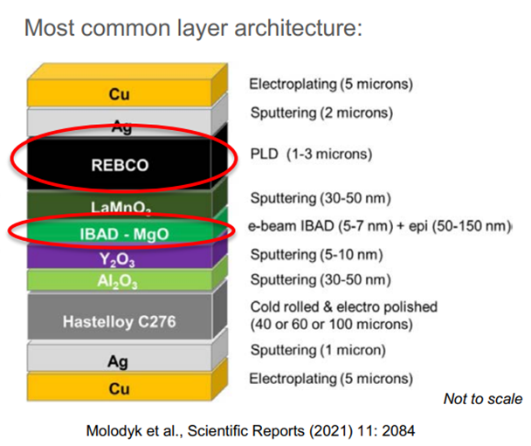
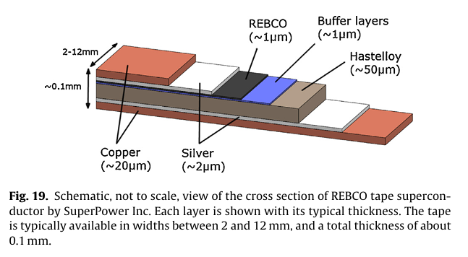

REBCO for EU-DEMO?
Need to do our best to convert ‘6 ton’ information for REBCO (Re-123) into [km]
Assume thickness 0.1 mm & width 12 mm REBCO tape (retrieved from ARC)
The EU-DEMO paper states:
Postulate ~8.5 g/cc density for the REBCO tape (per km, 10.2 kg) $⟺$ yields ~600 [km]
1 km of REBCO tape volume: 12 mm $×$ 0.1 mm $×$ 1.0 km = 1.2 $×$ 10⁻³ m³
(from Hitarth’s work)
For the realization of the HTS superconductor, Rare Earth elements are used as well as other elements such as Barium, Copper and Oxygen.
For the manufacturing of the tape, additional materials are used, such as Silver, Hastelloy and SnPb.
Each Re-123 tape is made of Re-123 (~1 %), Hastelloy (~41 %), silver (~1 %) and SnPb solder (~57 %).
For the material inventory assessment regarding the magnetic field coils, the densities used are the following:
ρ_{Cu} = 8960 kg/m3, ρ_{Nb3Sn} = 8950 kg/m3, ρ_{NbTi} = 6000 kg/m3, ρ_{Re-123} = 5000 kg/m3, ρ_{Steel} = 7860 kg/m3.

Slide 8
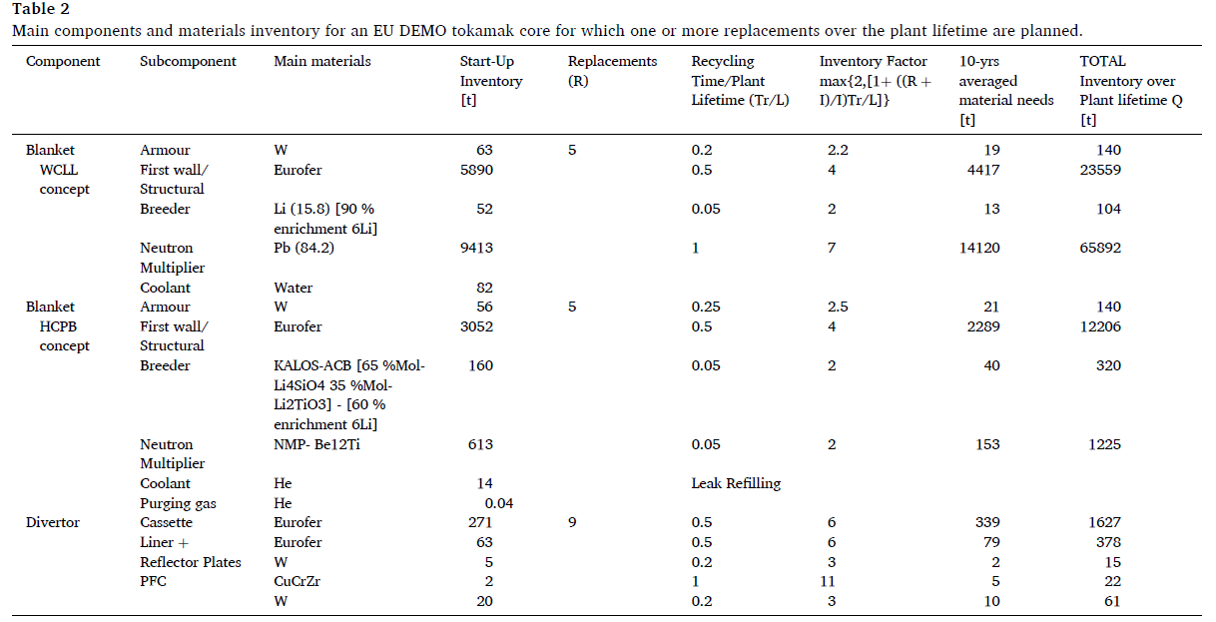
EU-DEMO Materials Inventory
Postulates refurbishment of materials / Since Lithium-6 is consumed & Irradiation damage

Slide 9
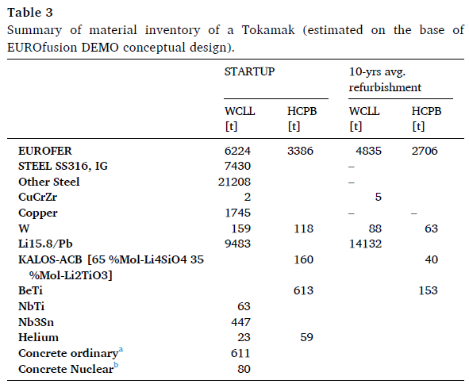
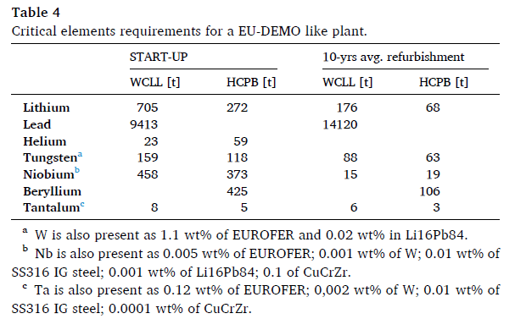
EU-DEMO Materials Inventory
Production capability of KALOS-ACB pebble & BeTi unknown
Enough raw material (apart from processing)
Enough NbTi production
Need to inquire Nb3Sn production
Need to inquire REBCO requirement (though 100 km seems to be a good guess)
Multiplication estimated factors have been
applied to the Lithium inventory resulting
from breeding material estimated in Table 3
ㅁ account for 90 % and 60 % enrichment for WCLL and HCPB concepts.
Need to divide by 13.6 and 9 to get mass of
enriched lithium for each design concepts

Slide 10
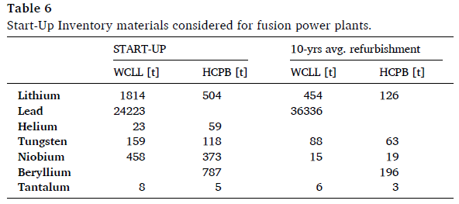
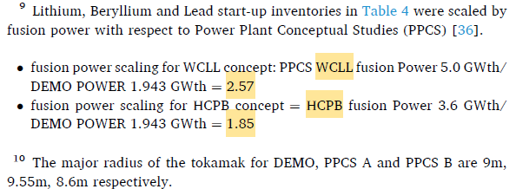
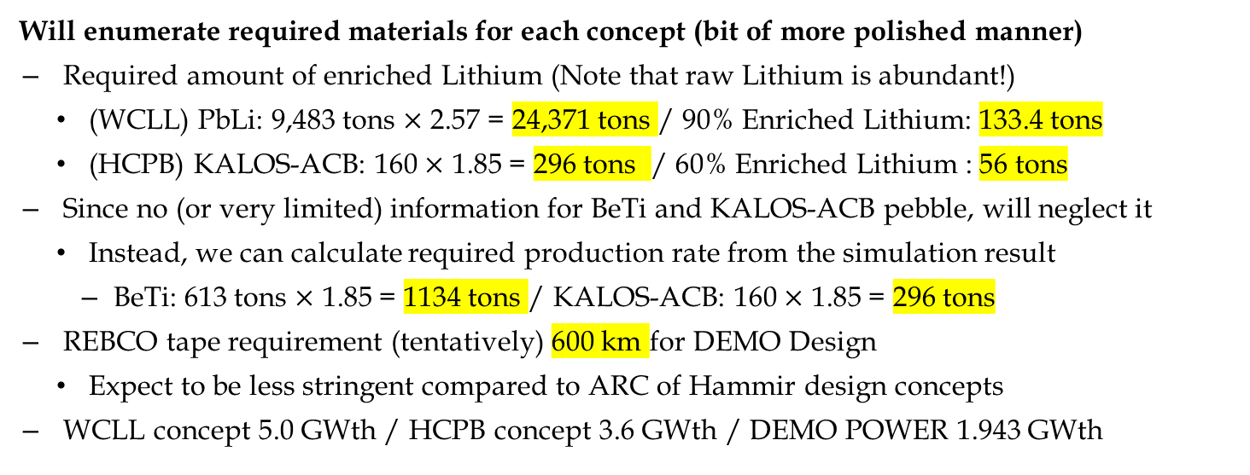
EU-DEMO Materials Inventory
HAD BEEN SCALED FROM EU-DEMO DESIGN!
Table4 Be multiplied by 1.85
(Multiplied by 2.57 and 1.85 w.r.t Table 4)
Need to divide by 13.6 and 9 to get mass of
enriched lithium for each design concepts
Amount of Nb does not change (no scaling w.r.t original design)
Will enumerate required materials for each concept (bit of more polished manner)
Required amount of enriched Lithium (Note that raw Lithium is abundant!)
(WCLL) PbLi: 9,483 tons $×$ 2.57 = 24,371 tons / 90% Enriched Lithium: 133.4 tons
(HCPB) KALOS-ACB: 160 $×$ 1.85 = 296 tons / 60% Enriched Lithium : 56 tons
Since no (or very limited) information for BeTi and KALOS-ACB pebble, will neglect it
Instead, we can calculate required production rate from the simulation result
BeTi: 613 tons $×$ 1.85 = 1134 tons / KALOS-ACB: 160 $×$ 1.85 = 296 tons
REBCO tape requirement (tentatively) 600 km for DEMO Design
Expect to be less stringent compared to ARC of Hammir design concepts
WCLL concept 5.0 GWth / HCPB concept 3.6 GWth / DEMO POWER 1.943 GWth

Slide 11
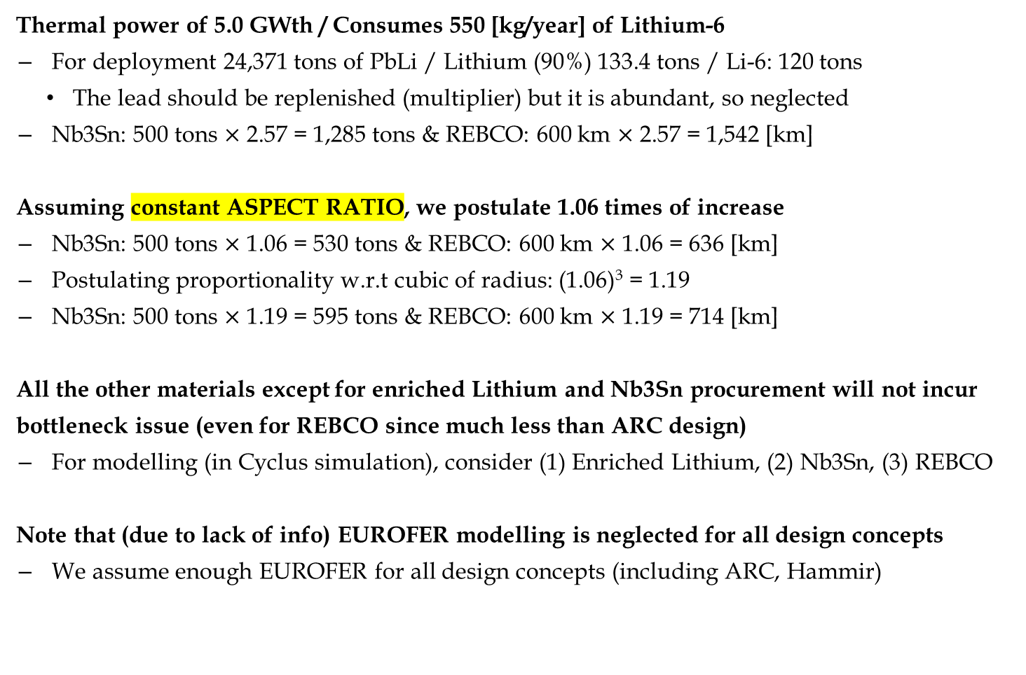
EU-DEMO WCLL Concept
Thermal power of 5.0 GWth / Consumes 550 [kg/year] of Lithium-6
For deployment 24,371 tons of PbLi / Lithium (90%) 133.4 tons / Li-6: 120 tons
The lead should be replenished (multiplier) but it is abundant, so neglected
Nb3Sn: 500 tons $×$ 2.57 = 1,285 tons & REBCO: 600 km $×$ 2.57 = 1,542 [km]
Assuming constant ASPECT RATIO, we postulate 1.06 times of increase
Nb3Sn: 500 tons $×$ 1.06 = 530 tons & REBCO: 600 km $×$ 1.06 = 636 [km]
Postulating proportionality w.r.t cubic of radius: (1.06)³ = 1.19
Nb3Sn: 500 tons $×$ 1.19 = 595 tons & REBCO: 600 km $×$ 1.19 = 714 [km]
All the other materials except for enriched Lithium and Nb3Sn procurement will not incur
bottleneck issue (even for REBCO since much less than ARC design)
For modelling (in Cyclus simulation), consider (1) Enriched Lithium, (2) Nb3Sn, (3) REBCO
Note that (due to lack of info) EUROFER modelling is neglected for all design concepts
We assume enough EUROFER for all design concepts (including ARC, Hammir)

Slide 12
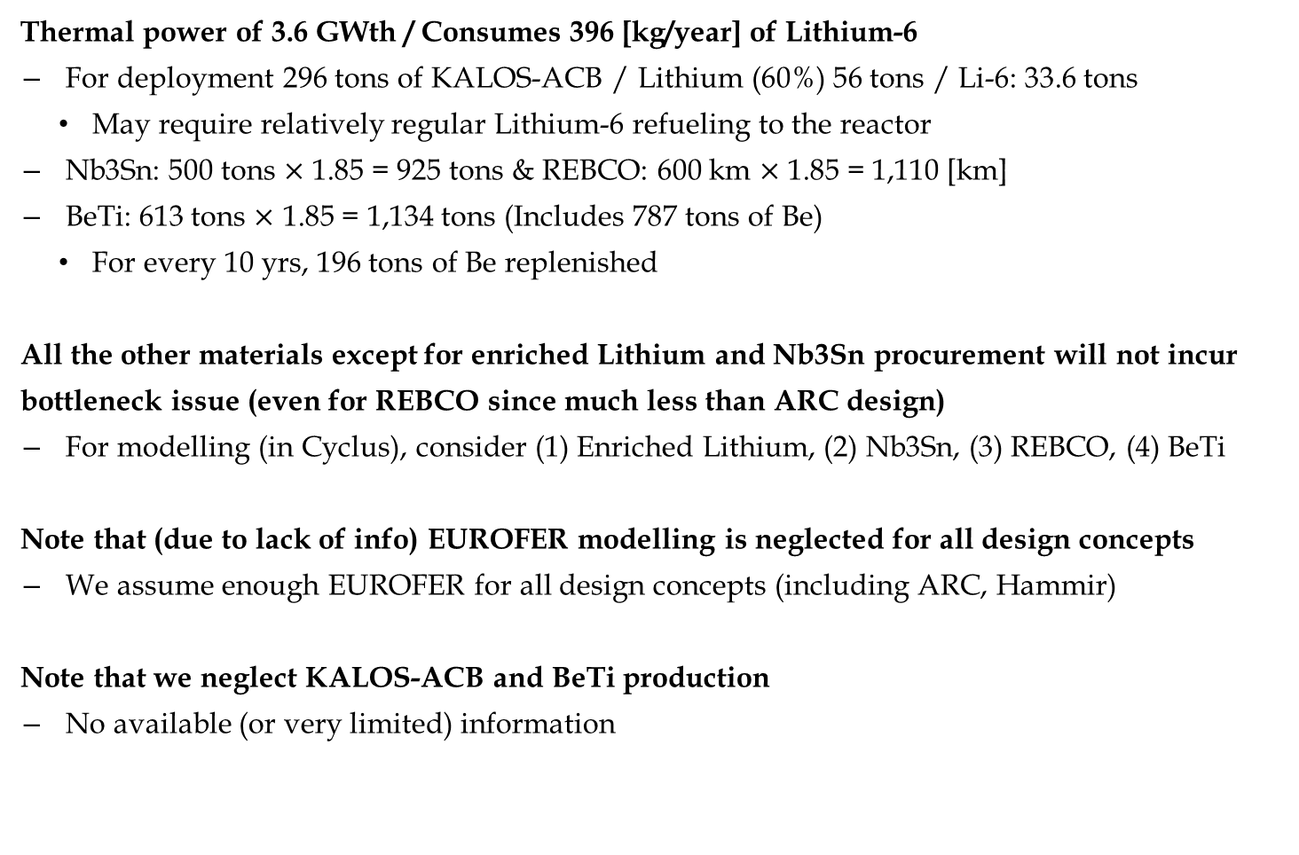
EU-DEMO HCPB Concept
Thermal power of 3.6 GWth / Consumes 396 [kg/year] of Lithium-6
For deployment 296 tons of KALOS-ACB / Lithium (60%) 56 tons / Li-6: 33.6 tons
May require relatively regular Lithium-6 refueling to the reactor
Nb3Sn: 500 tons $×$ 1.85 = 925 tons & REBCO: 600 km $×$ 1.85 = 1,110 [km]
BeTi: 613 tons $×$ 1.85 = 1,134 tons (Includes 787 tons of Be)
For every 10 yrs, 196 tons of Be replenished
All the other materials except for enriched Lithium and Nb3Sn procurement will not incur
bottleneck issue (even for REBCO since much less than ARC design)
For modelling (in Cyclus), consider (1) Enriched Lithium, (2) Nb3Sn, (3) REBCO, (4) BeTi
Note that (due to lack of info) EUROFER modelling is neglected for all design concepts
We assume enough EUROFER for all design concepts (including ARC, Hammir)
Note that we neglect KALOS-ACB and BeTi production
No available (or very limited) information

Slide 13
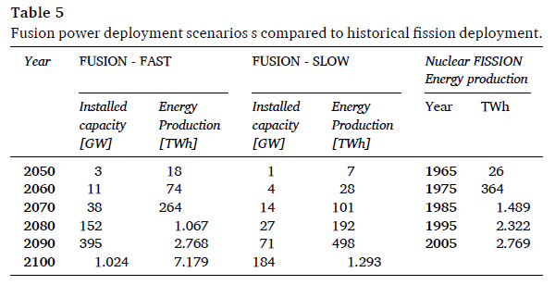
Power Demand Scenario?
Could try the following scenario included in the paper:

Slide 14
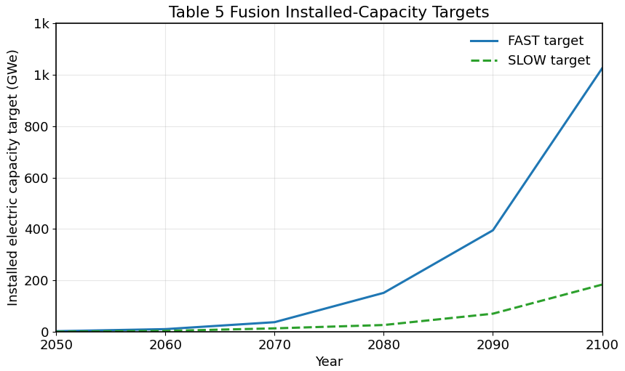
Power Demand Scenario?
1.2 k

