Slide 1
OpenMC v0.15.3 Depletion – Comparison with Serpent2.2.1
Reactor Technology Integration Group (ReTI)
Taesuk Oh
Nuclear Engineering & Engineering Physics (NEEP)
University of Wisconsin-Madison

Slide 2
Motivation & Objectives
Employ OpenMC as the main transport code for ARPA-E NEWTON project
Should model removal of fission products during depletion
Relatively new feature included in OpenMC → Want to verify the module w.r.t Serpent2.2.1
Perform apple-to-apple comparison for depletion analysis:
Consistent XS-library, requires consistent normalization whilst tallying reaction rate
Also, consistent decay library (pathway for FPs) for solving Bateman Equation
Important to do ‘our best’ for the ARPA-E NEWTON project
Whether the obtained numbers are reasonable / Are they out best guess?
Depending on the normalization method, the absolute reaction rate differs!
OpenMC: ‘fission-q’ where Q-value for fission is enumerated in chain files
Serpent: Default Q-value for U235 fission / Scale other fissile element’s Q-value accordingly
(1) Demonstrate the conventional depletion (no gas removal) matches well
(2) Demonstrate that both codes provide consistent keff value when FP removal modelled
(3) Demonstrate that modification in the OpenMC chain file (for Li-6,7 tritium) is reliable

Slide 3
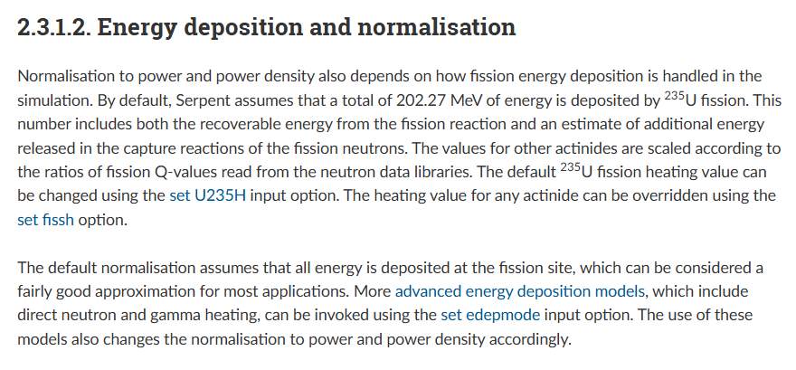
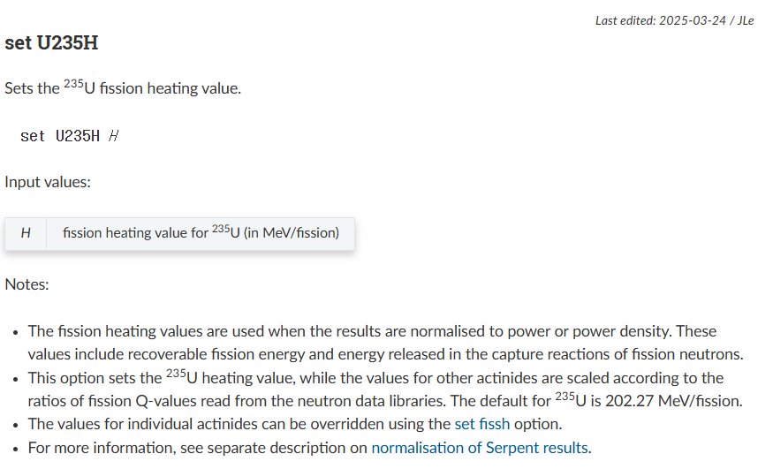
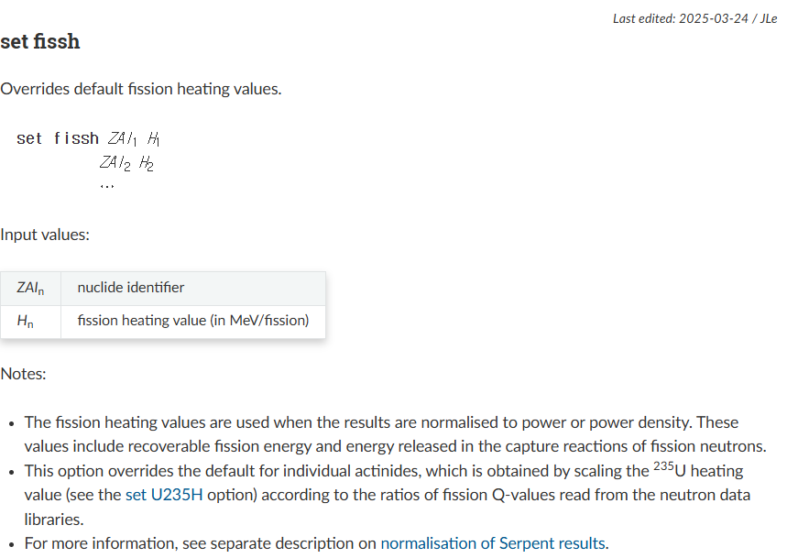
Serpent2.2.1 Normalization during Depletion

Slide 4
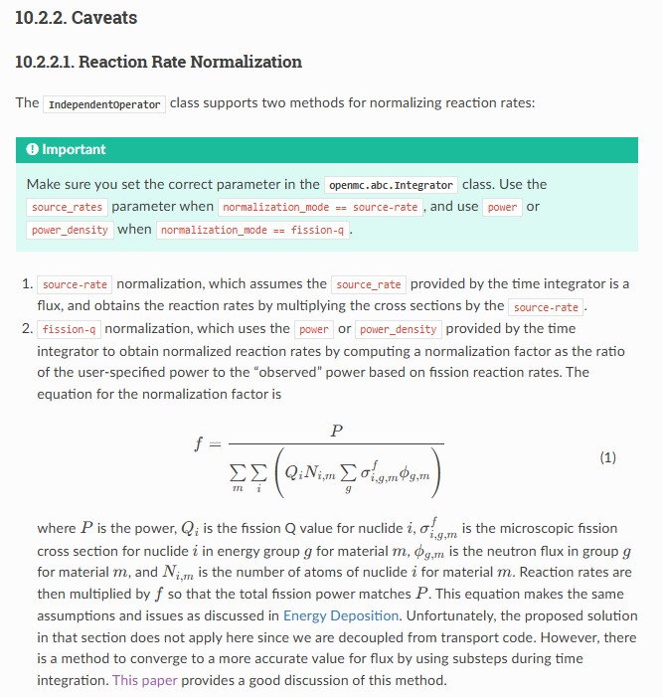
OpenMC Normalization during Depletion

Slide 5
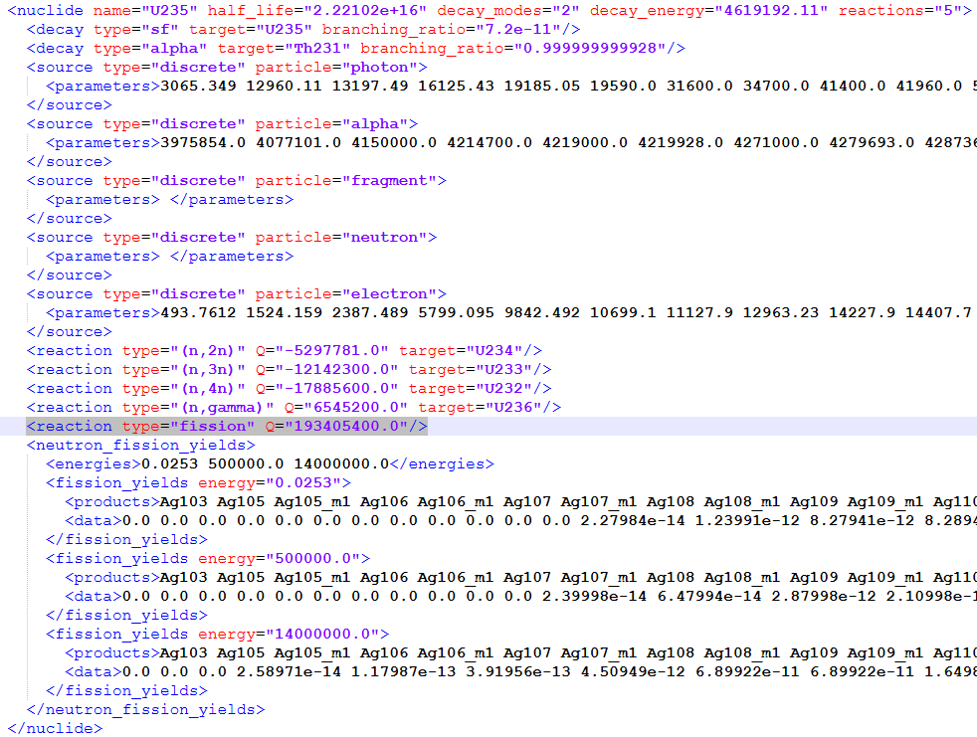
OpenMC Normalization during Depletion
Adjust Q-value for SERPENT2.2.1 to correspond with OpenMC value

Slide 6
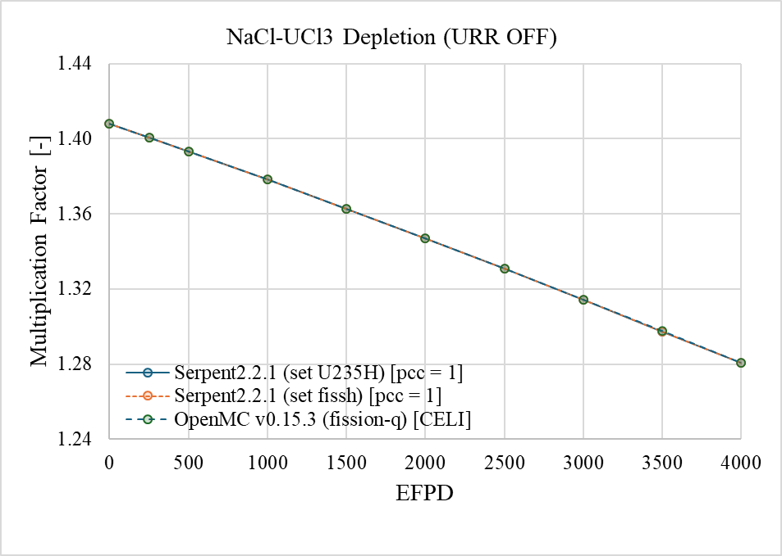
NaCl-UCl3 Depletion (No Gas Removal)
Always URR option was ‘off’ for all cases in this work
pcc = 1: Predictor Corrector (CE/LI)

Slide 7
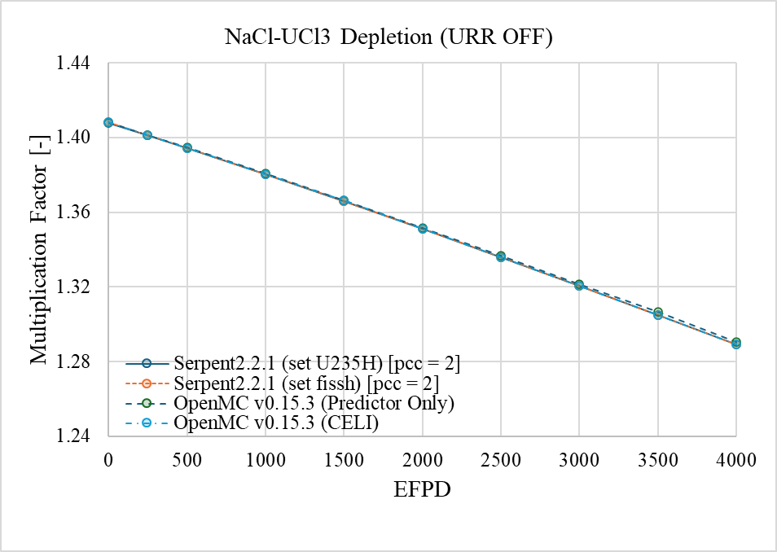
NaCl-UCl3 Depletion (Gas Removal)
pcc = 2: Predictor Only / Serpent2.2.1 does not provide CE/LI option when FP is removed
But, intriguingly, Serpent Value well match with OpenMC result with CE/LI option!

Slide 8
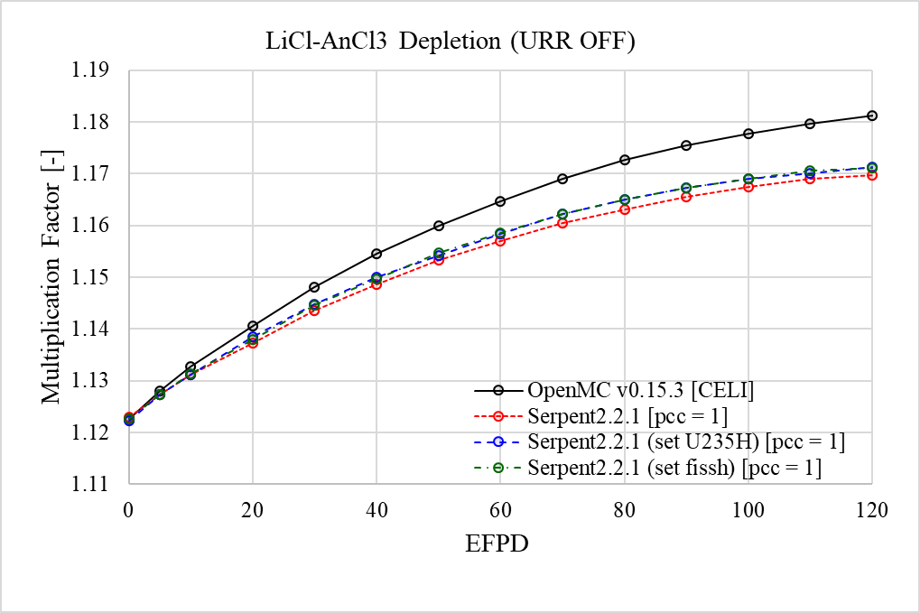
LiCl-AnCl3
Tritium breeding from Li-6 & 7 should be considered
The ‘Minor Actinide (An)’ comprises of Np237, Am241, Am243, Cm244
Does the difference stems from (i) Lithium chain file, (or/and) (ii) Minor Actinides?

Slide 9
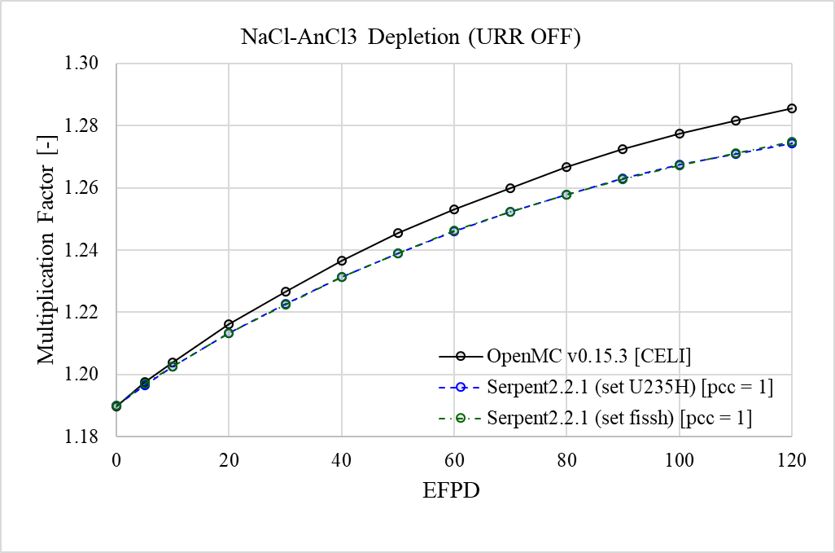
NaCl-AnCl3
Since NaCl-UCl3 agreed well between OpenMC & Serpent, the presented difference stems
from ‘Minor Actinides’ in the salt

Slide 10
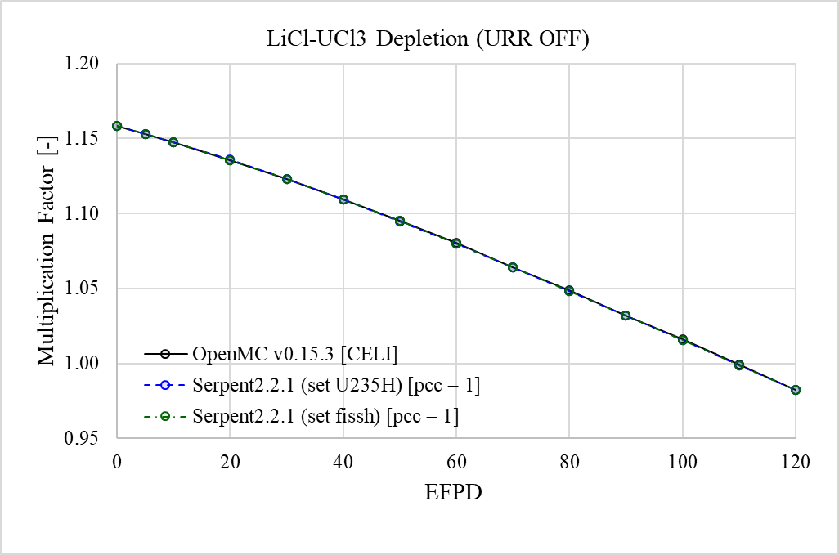
LiCl-UCl3
Could see that correction in the chain file for Lithium 6 & 7 is valid
Well Matches!

Slide 11
LiCl-AnCl3
Performed depletion calculation for each MA isotopes:
(1) Np237 : Means LiCl-Np237Cl3 was considered
(2) Am241
(3) Am243
(4) Np237 & Cm244 / Serpent cannot calculate when Cm244 is solely used
Found out that ‘Am241’ is the culprit for the difference!
All the other cases, both OpenMC & Serpent results well resemble each other
Only the case of Am241, conspicuous difference is observed
The next step will be to scrutinize why specifically for Am241, difference occurs
Also, investigate for other minor actinides if necessary
Confirmed that when XS-data is consistent, both OpenMC & Serpent2 yields same depletion
result even if for the case where FP removal is considered
Correction in the Lithium 6 and 7 decay chain file (for tritium production) is reliable

Slide 12


Thank You
Any Questions?

Slide 13
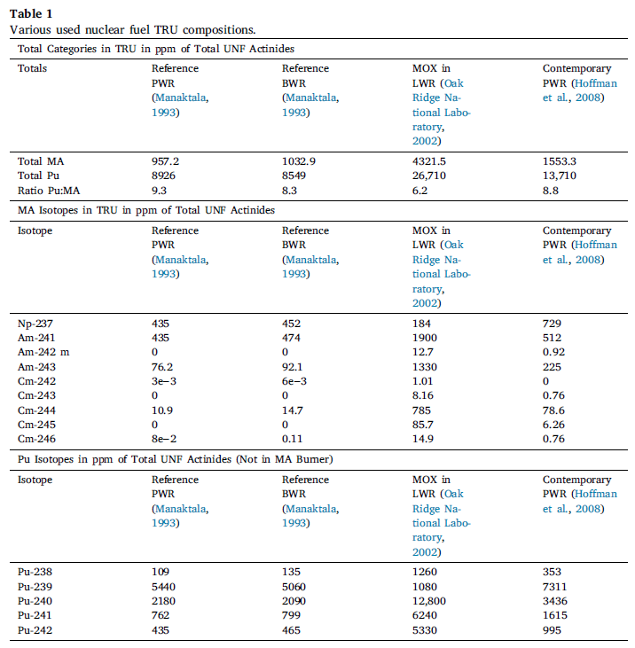
Minor Actinide Composition
Retrieved from Matt’s Work
Element | RAW |  | NORMALIZE
 | UOX | MOX | UOX | MOX
Np237 | 435 | 184 | 4.545E-01 | 4.258E-02
Am241 | 435 | 1900 | 4.545E-01 | 4.397E-01
Am242m | 0 | 12.7 | 0.000E+00 | 2.939E-03
Am243 | 76.2 | 1330 | 7.961E-02 | 3.078E-01
Cm242 | 0.003 | 1.01 | 3.134E-06 | 2.337E-04
Cm243 | 0 | 8.16 | 0.000E+00 | 1.888E-03
Cm244 | 10.9 | 785 | 1.139E-02 | 1.817E-01
Cm245 | 0 | 85.7 | 0.000E+00 | 1.983E-02
Cm246 | 0.08 | 14.9 | 8.358E-05 | 3.448E-03
Sum | 957.183 | 4321.47 | 1 | 1
The density of LiCl-AnCl3 was
calculated from ideal liquid
model, assuming UCl3 density to be simiar to that of the AnCl3

Slide 14
Lithium – 6 & 7 Chain File Correction
The Fast Spectrum Chain File (ENDF 7.1) Lithium 6 and 7
Does not specify tritium production through (n,t) reaction
For realistic (improved) result, need to adjust the chain file
<nuclide name="Li6" reactions="2"> <reaction type="(n,gamma)" Q="7250600.0" target="Li7"/> <reaction type="(n,p)" Q="-2727300.0" target="He6"/> </nuclide> <nuclide name="Li7" reactions="2"> <reaction type="(n,2n)" Q="-7250500.0" target="Li6"/> <reaction type="(n,gamma)" Q="2032800.0" target="Li8"/> </nuclide>
<nuclide name="Li6" reactions="2"> <reaction type="(n,gamma)" Q="7250600.0" target="Li7"/> <reaction type="(n,p)" Q="-2727300.0" target="He6"/> <reaction type="(n,t)" Q="4783800.0" target="He4"/> </nuclide> <nuclide name="Li7" reactions=“3"> <reaction type="(n,2n)" Q="-7250500.0" target="Li6"/> <reaction type="(n,gamma)" Q="2032800.0" target="Li8"/> <reaction type="(n,nt)" Q="-2470000.0" target="He4"/> </nuclide>

