Slide 1
OpenMC v0.15.3 Depletion – Restart Issue (CE/LI .vs. CE/CM)
Reactor Technology Integration Group (ReTI)
Taesuk Oh
Nuclear Engineering & Engineering Physics (NEEP)
University of Wisconsin-Madison

Slide 2
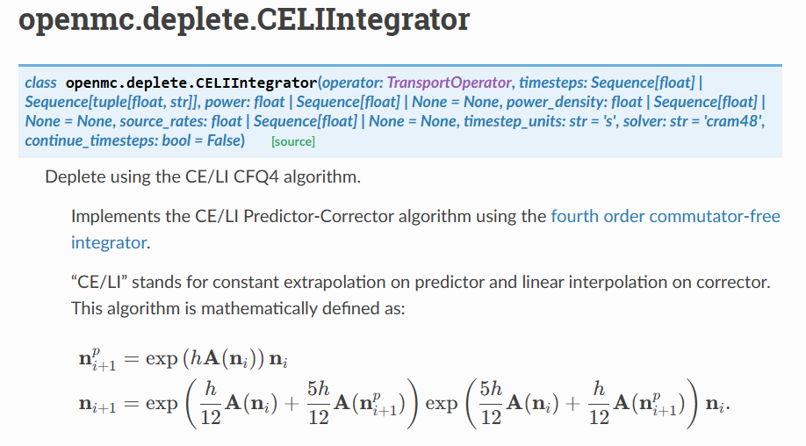
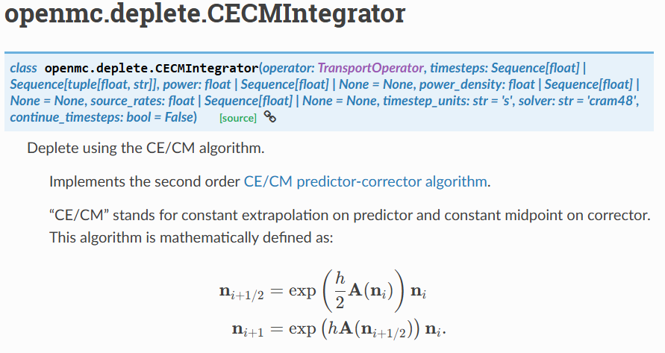
Motivation & Objectives
Often, the depletion simulation using OpenMC is halted (mostly due to wall clock issue)
Since depletion calculation is very expensive (especially for OpenMC), we want to restart it
It is quite the standard to employ Predictor-Corrector scheme in depletion
Two different (most popular) approaches have been considered: CE/LI .vs. CE/CM
Regardless of the depletion scheme, the result (keff depletion curve) should be similar
Also, need to support appropriate depletion restart feature

Slide 3
Restart Feature in OpenMC
We need ‘depletion_results.h5’ file
Load the previous depletion result (the name could differ; user specified)
Use the keyword ‘prev_results’ in the openmc.deplete. CoupledOperator(...)
Use the keyword ‘continue_timesteps’ in the openmc.deplete.CECMIntegrator(…)
The following is part of the script for running restart depletion:
# -------------------------------
# 2) Load previous depletion results
# -------------------------------
prev_results = openmc.deplete.Results("depletion_results.h5")
.
.
.
# -------------------------------
# 6) Operator
# -------------------------------
CHAIN_FILE = "/home/toh8/OpenMC/nuclear-data/chains/chain_endfb71_sfr_Lithium6_v2.xml“
operator = openmc.deplete.CoupledOperator(model, chain_file=CHAIN_FILE,
normalization_mode="fission-q", prev_results=prev_results)
# -------------------------------
# 7) Integrator (CECM)
# -------------------------------
integrator = openmc.deplete.CECMIntegrator(operator, time_steps, power=TOTAL_POWER,
timestep_units="d", solver="cram48", continue_timesteps=True)

Slide 4
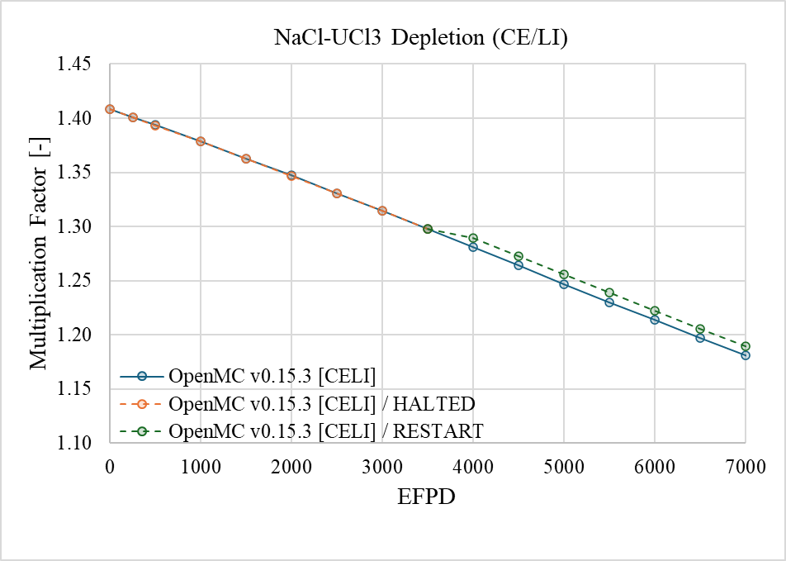
Numerical Results
NaCl-UCl₃ Salt considered (Always URR Off)
Infinite pool geometry, Inactive cycles: 50 / Active cycles: 200 / Histories per cycle: 100k
Point of HALT/RESTART
Inconsistent

Slide 5
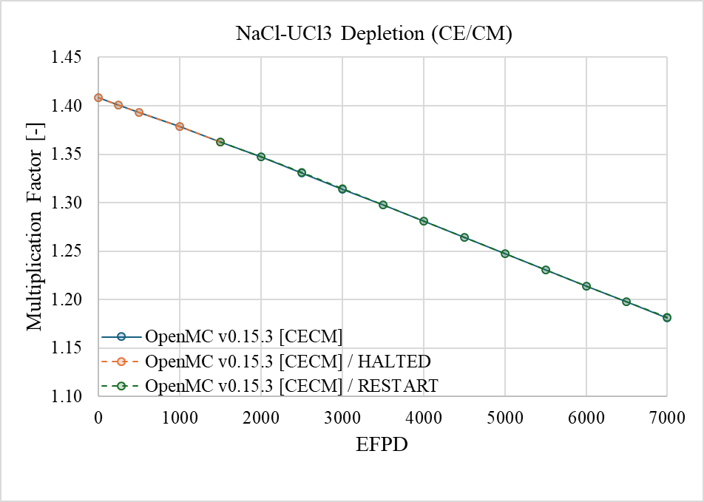
Numerical Results
Point of HALT/RESTART
Consistent
Could see that CE/LI does not show consistent depletion result when ‘Restart’ option used
On the other hand, CE/CM option shows consistent depletion result for ‘Restart’ case
Maybe, there might be a bug for running CE/LI depletion in ‘Restart’ mode

Slide 6


Thank You
Any Questions?

