Slide 1

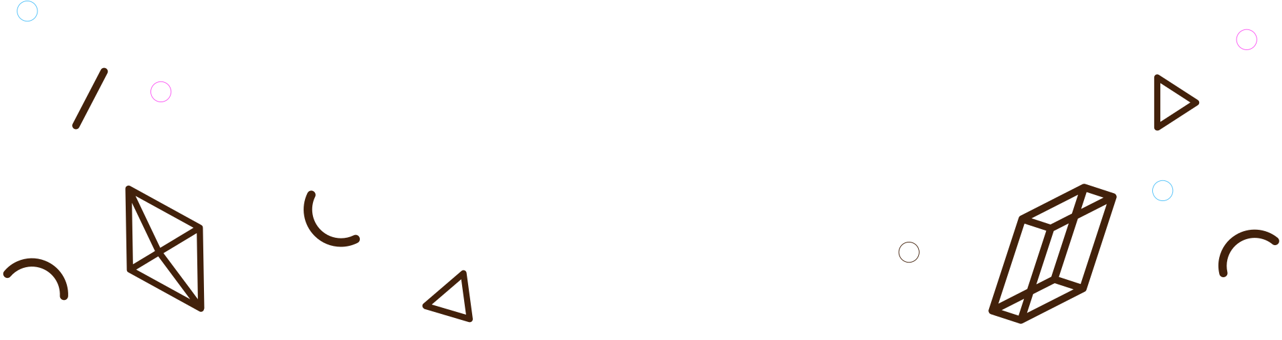
NHẬP MÔN CÔNG NGHỆ PHẦN MỀM 21-22
Bilinguo
English learning platform
Group 03
21120110 - Nguyễn Tấn Phát
21120115 - Nguyễn Trọng Phúc
21120322 - Nguyễn Dương Trường Sinh
21120405 - Trần Minh Triết
21120417 - Nguyễn Thị Ngọc Châm

Slide 2


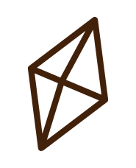

TABLE OF CONTENTS
Problem and Solution
01
Project management
02
Software requirements
Problem statement
product position statement, users
Team structure and responsibilities of team members.
03
Use-case model, non-functional requirements
Analysis and design
04
Architecture and technologies used.
Software testing
05
Test environments, test plan, and test results.
Demo
06
Flashcards, Dictionary, Mocktests,..

Slide 3

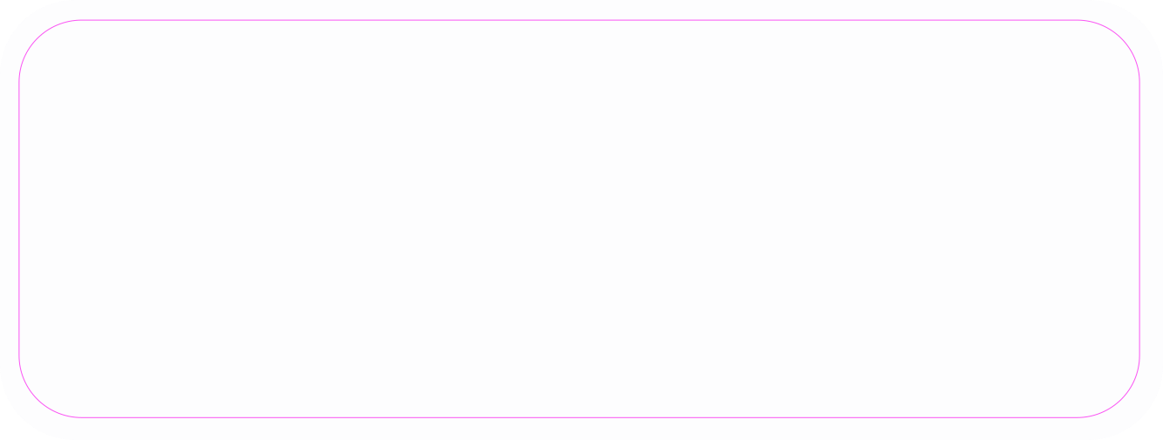




01
PROBLEM AND SOLUTION
What are the problems that it solve?

Slide 4

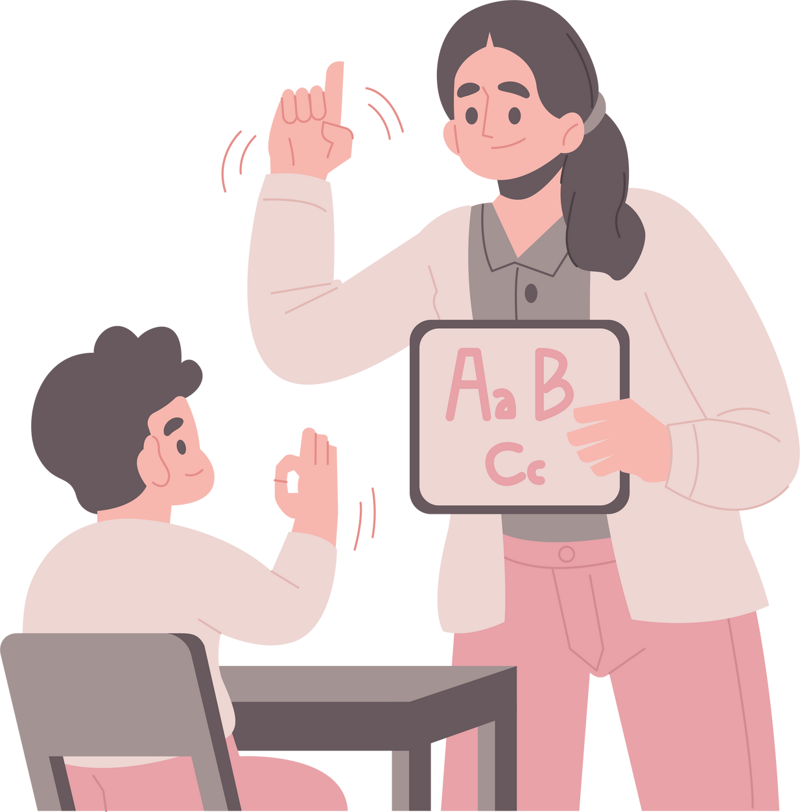

Traditional methods of learning English can be boring and ineffective.
Notes:
In addition, there is intense competition among creators as a result of the extremely saturated state of the current digital game industry. Furthermore, well-known studios and expensive projects frequently steal the show. Making it harder for smaller studios or independent creators to obtain visibility as well as attract players.

Slide 5


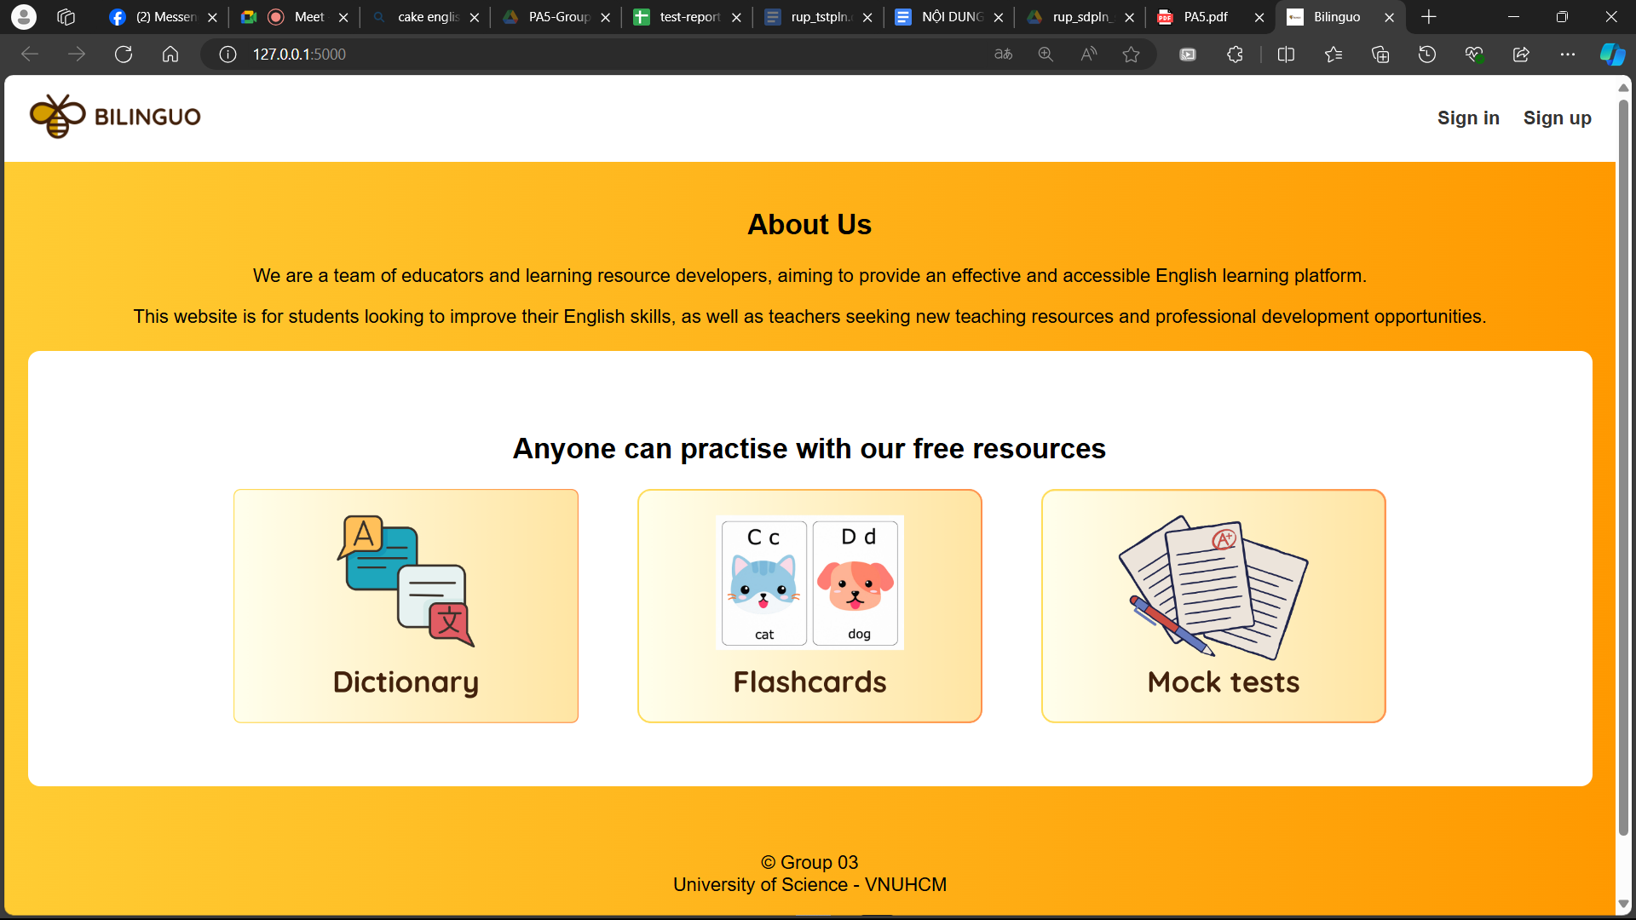
A successful solution would be
Notes:
a website that uses contemporary technology to support games with plenty of material and graphics, makes games available for free play, and encourages a welcoming community. The platform itself must also maintain both the fairness of the rating system and developer equality.

Slide 6





Problem Statement
Learner
Teacher
Notes:
Only a few platforms are available on the market to connect game producers with gamers who enjoy playing games but lack the time or funds to download them.
Hence, people won't be able to create and play enjoyable video games. Slowing down the process of learning how to program, design, etc.

Slide 7


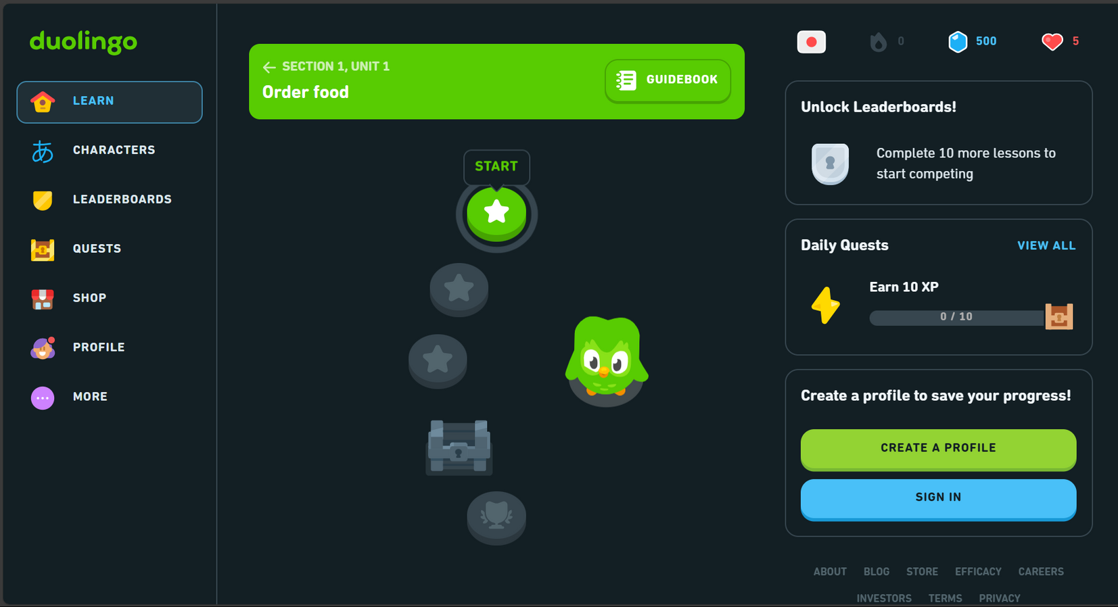


Unlike
Notes:
Our product should have a friendly, interactive user interface. In addition, we strongly focus on both the game-play performance and the user’s experience when visiting our website. Moreover we do care about the rating and visibility equality.

Slide 8



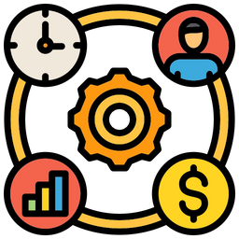


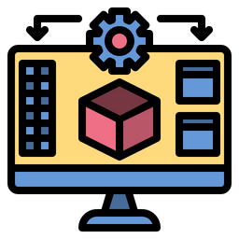
Team Structure
Developers
BA
Tấn Phát
Minh Triết
Minh Triết
Project Manager
Tấn Phát
Designer
Tester
Trọng Phúc
Ngọc Châm
Trường Sinh
Trọng Phúc
Scrum Master
Ngọc Châm

Slide 9
03
SOFTWARE REQUIREMENTS
Use-case model & non-functional requirements

Slide 10




Product Features
Available:
Dashboard
Flashcards
Dictionary
Mocktests

Slide 11

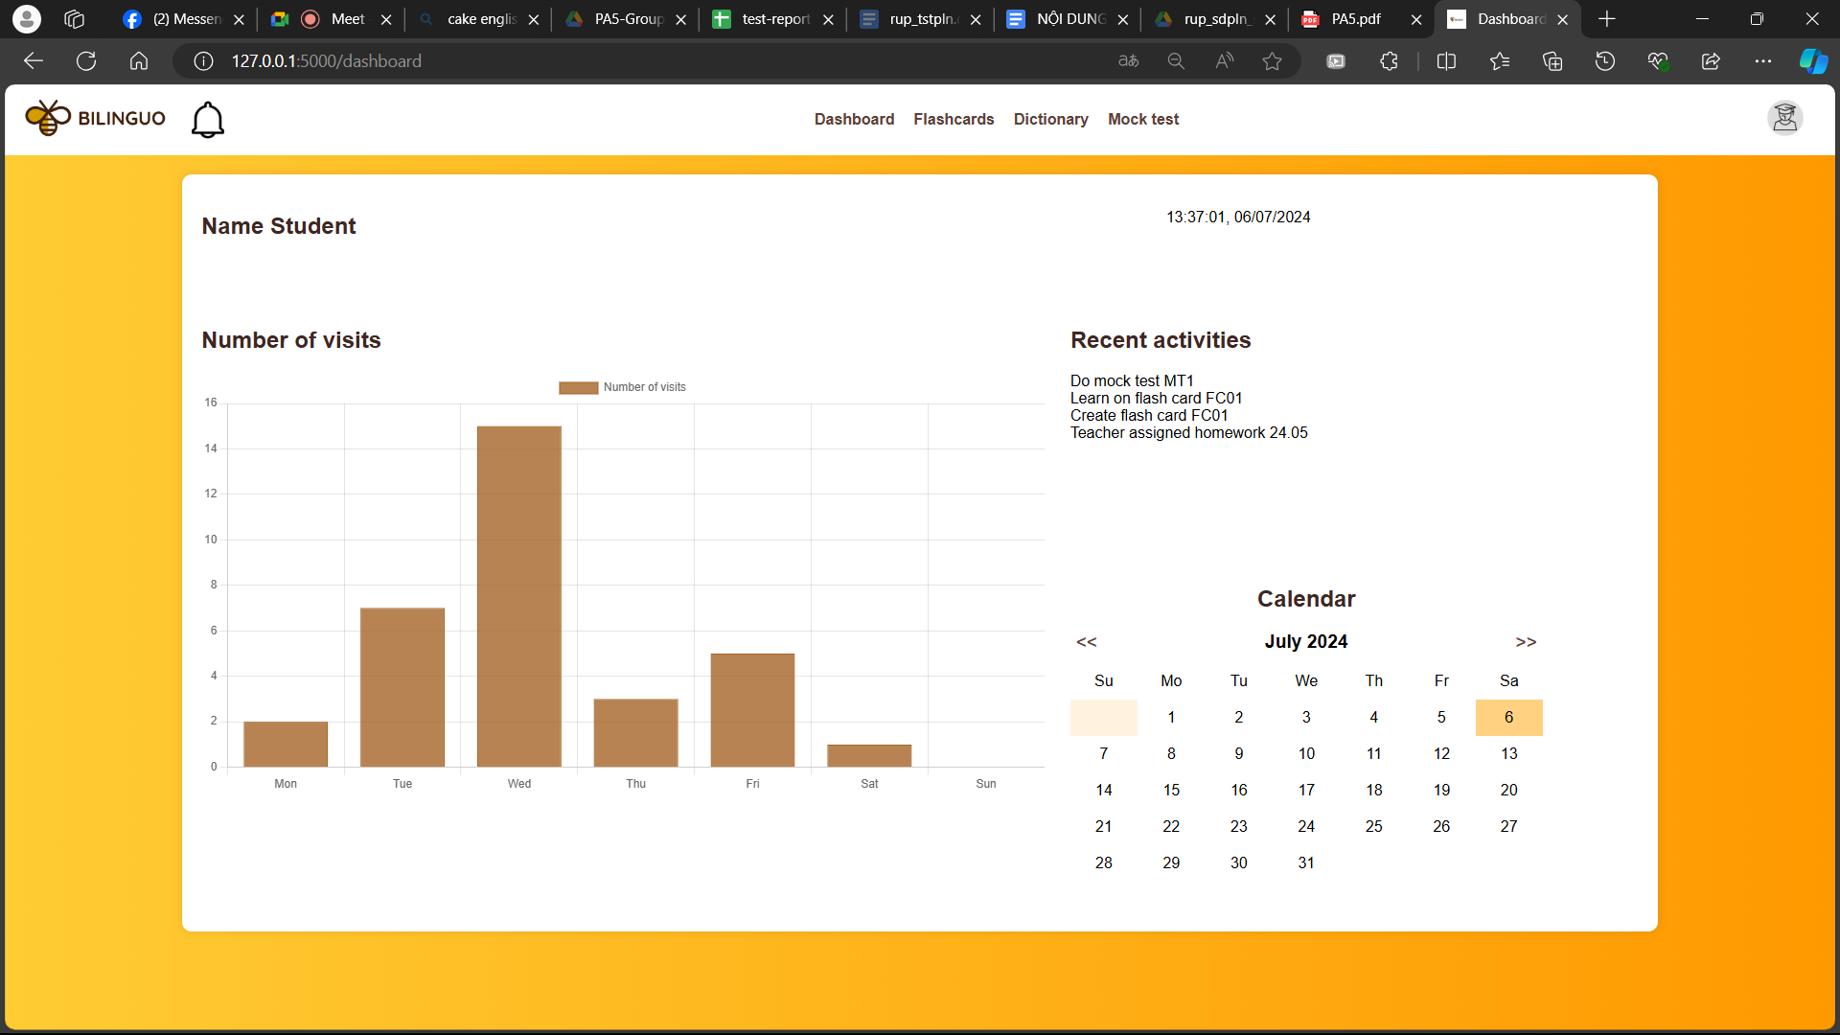



Dashboard

Slide 12
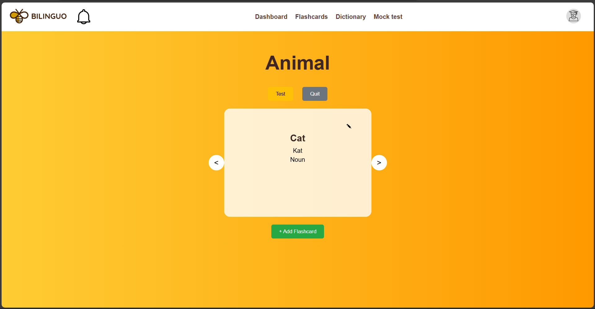
Flashcards

Slide 13
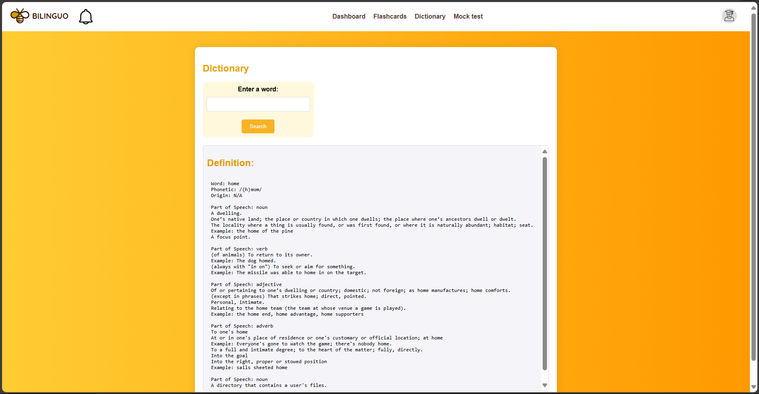
Dictionary

Slide 14
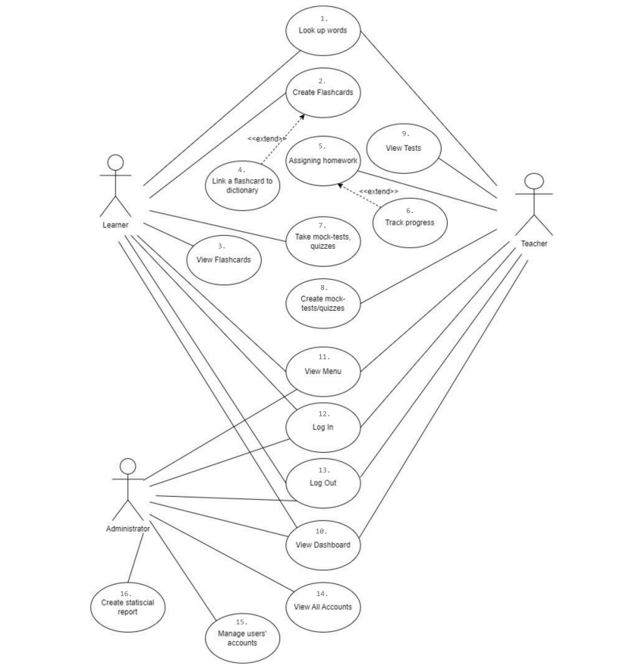
Use-case model

Slide 15



NON FUNCTIONAL REQUIREMENTS

Slide 16




Portability
Hardware: Computers, laptops, tablets, smartphones, and other devices.
Platform: Used in common browsers: Google Chrome, Firefox,...

Slide 17

PERFORMANCE
Dictionary response speed: less than 3s.
Edit, save and review flashcards: under 1s.

Slide 18

SECURITY
Account Information Encoder (password,...)
User logout

Slide 19

ENVIRONMENT REQUIREMENT
Compatible with:
UX/UI: HTML, CSS, JavaScript

Slide 20
Reliability
The probability of causing data loss during manipulation is approximately 0.001%.
Frequency of errors: 2 days/1 error.

Slide 21

Easy of use
Users can use it after 15 minutes of training.

Slide 22
04
Analysis and design

Slide 23
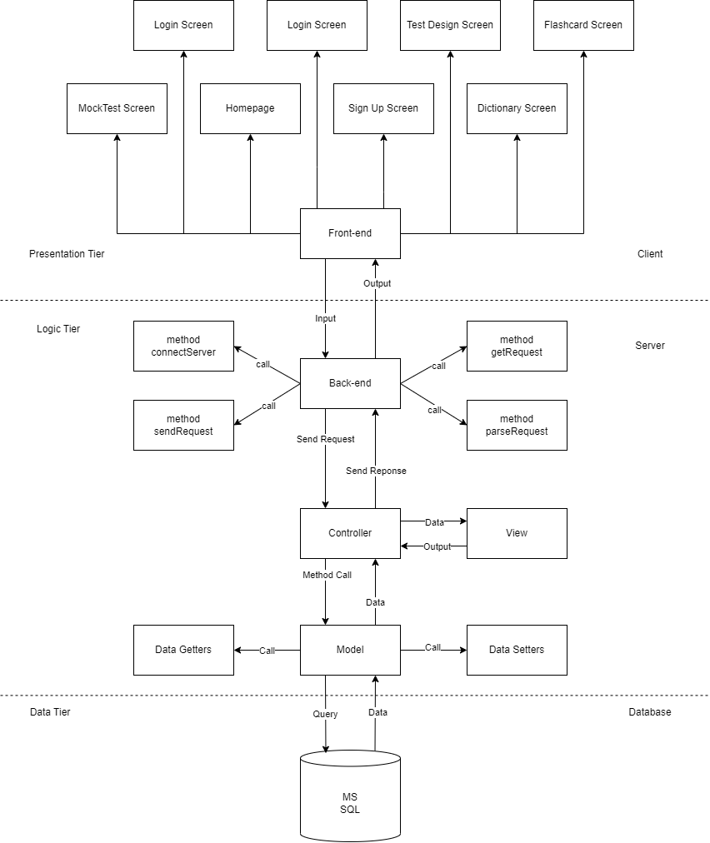
Logical View
Notes:
This explain basic components of the Django web framework and how they fit into the Model-Template-View (MTV) or MVC architectural pattern.
- Models: In Django, models are Python classes that define the structure of your database tables. They represent the data layer of application and are responsible for interacting with the database. My team define the fields of your models and any relationships between them, and Django will automatically generate SQLite to create the corresponding database schema. But my team use PostgreSQL for Django projects for deployment.
- Views: Views in Django are responsible for handling HTTP requests, processing data, and returning HTTP responses. They contain the business logic of our web. Views are also responsible for making queries to the database (using the models) and rendering templates to generate HTML responses.
- Templates: Templates are used to define the presentation layer of your application. They are written in HTML, CSS, and optionally JavaScript. Django provides its templating engine, which allows to include dynamic data from views within your HTML templates. My team integrate Bootstrap Framework v5.0 into your templates to enhance the look and feel of your application.
- URLs: The URLs module in Django is responsible for mapping URLs to views and defining the routing of user requests. It's where you specify the URL patterns for your application and associate them with specific view functions or classes. This allows Django to determine which view should handle a particular URL.
- In summary, Django's MTV architectural pattern separates the concerns of data handling (models), business logic (views), and presentation (templates) to help you build web applications in a structured and maintainable way. By following this pattern and utilizing the following support, you can create robust and user-friendly web applications with Django.

Slide 24
Logical View

Slide 25
Logical View

Slide 26
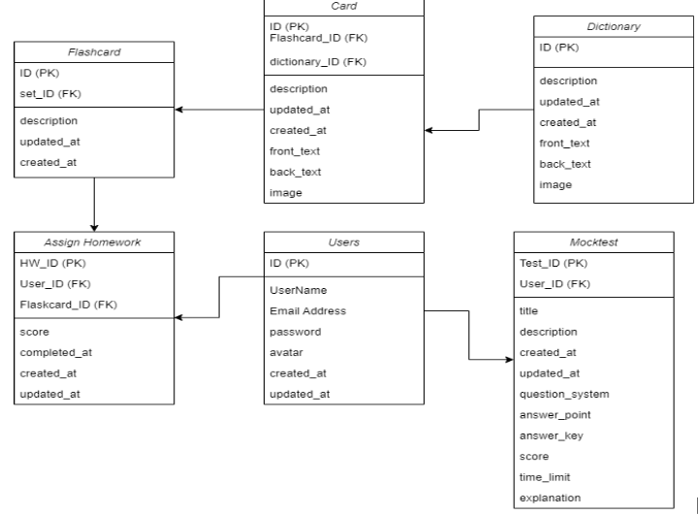
Database Model

Slide 27
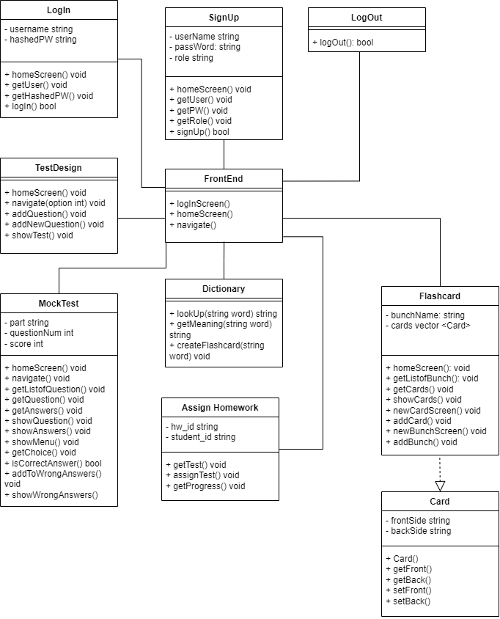
Front-End

Slide 28
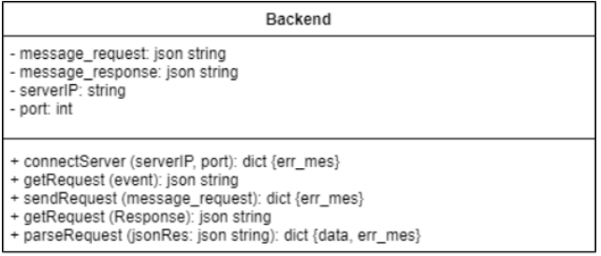
Back-End

Slide 29
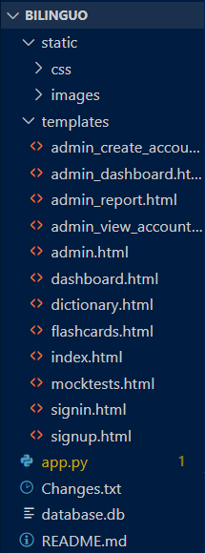
Implementation View

Slide 30

05
SOFTWARE
TESTING

Slide 31







TEST ENVIRONMENT

Slide 32

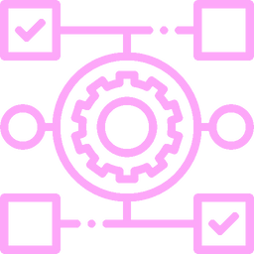
TEST PLAN
User Account
Key features
Platform
Role function

Slide 33

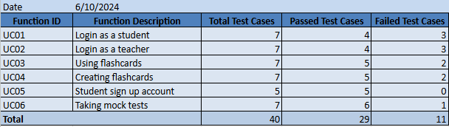
TEST RESULT

Slide 34
PRODUCT DEMO

