Slide 1
PacketMenu

Slide 2
APPLICATION
Scope
Language
Design
Food preferences
Allergy
Custom features

Slide 3
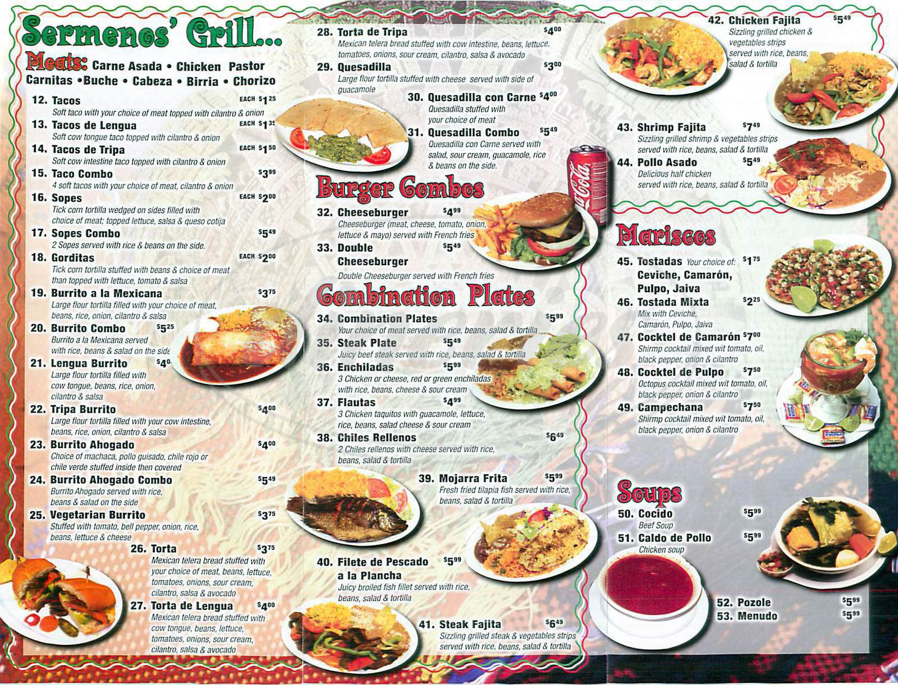
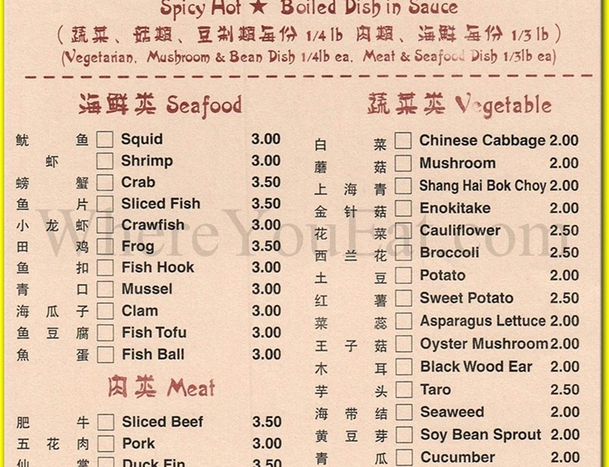
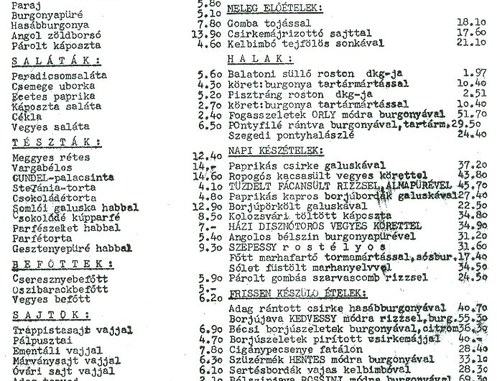
A
WESOME
RESTAURANT
好的菜單
BONA MENUO
JO MENU

Slide 4
APPLICATION
Scope
Language
Design
Food preferences
Allergy
Custom features

Slide 5
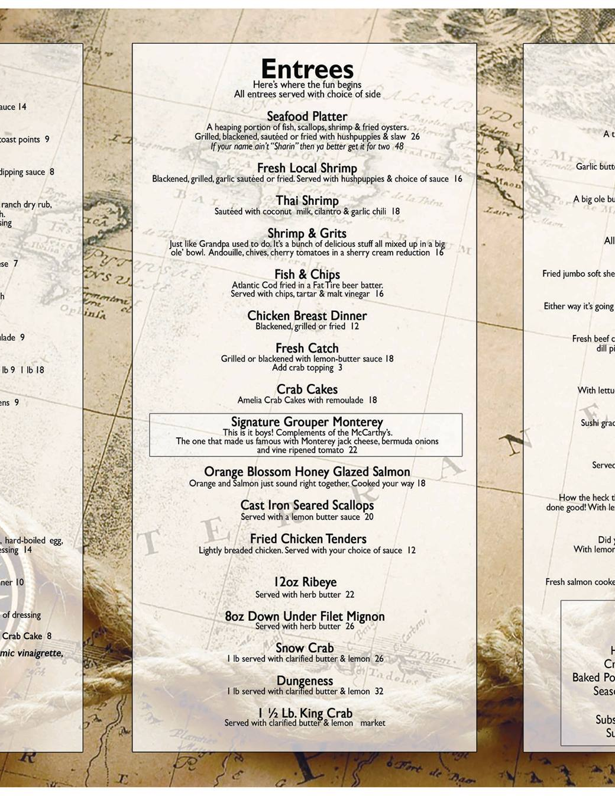
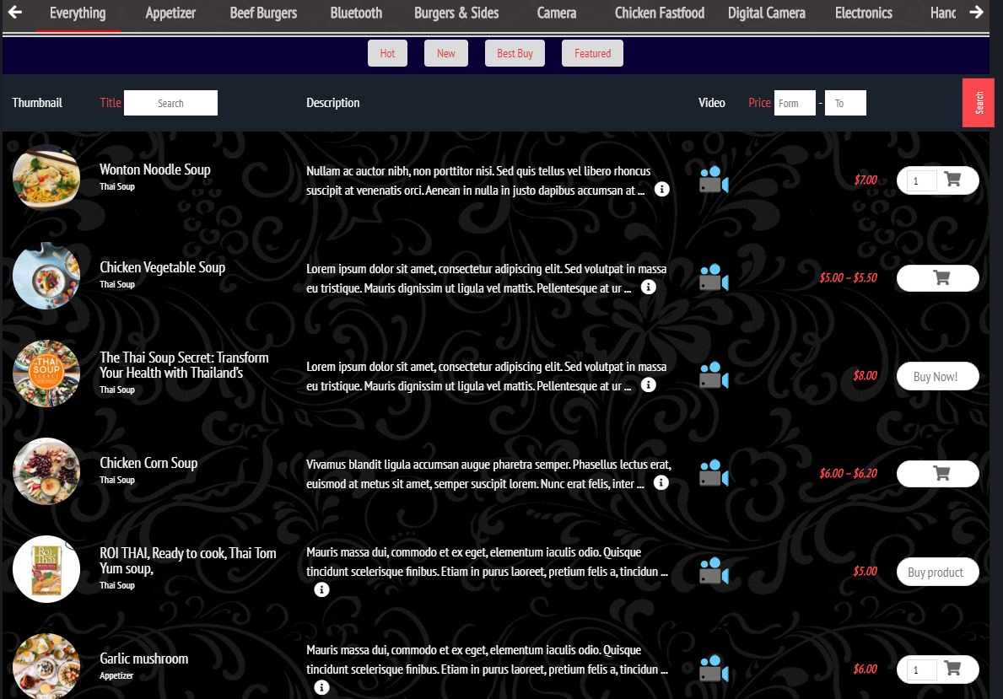

Slide 6
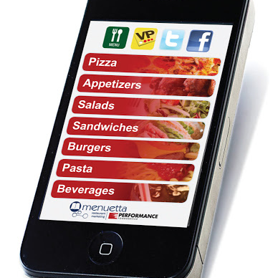
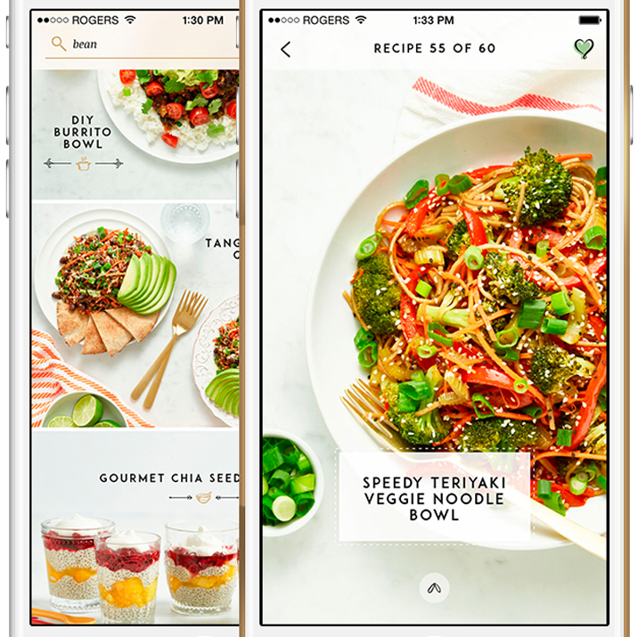
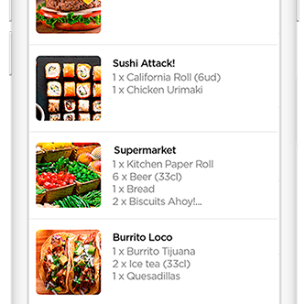
DINNER SPECIAL

Slide 7
APPLICATION
Scope
Language
Design
Food preferences
Allergy
Custom features

Slide 8
Application Recipe
Look
Language
Recipe
Preferences
Food origin
Pictures
Videos
Colors
Translation
Personalized
Easy to modify
Filter on the go
Daily offer
Food history
Add Text
Add Text
Add Tet
Add Text

Slide 9
POCKET MENU
Thank you
By Nikola Srića-Žic

