Slide 1
IOT Trash Solutions
http://www.free-powerpoint-templates-design.com

Slide 2


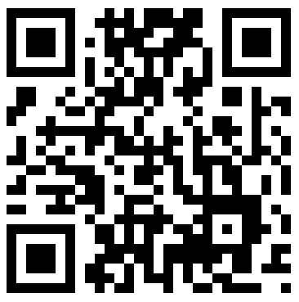
Functions
Spare fuel & collect when you have to .Learn with the BIG data
LEVEL SENSOR
We like the photo of your trash
TRASH
PHOTOSHOOT
Scanning QRCode (Personal data) to Open a TrashCan.
QRCODE

Slide 3
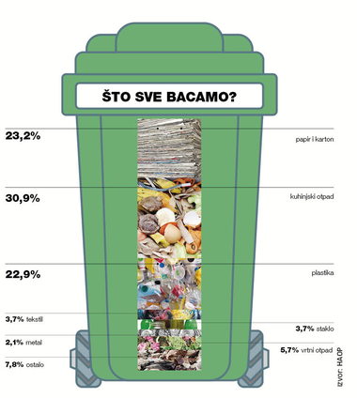
Control people
Protect the world
Educate
Bills
Future
Children
Living

Slide 4


Slide 5

Problem

Slide 6

Solution

Slide 7
THANK YOU

