Slide 1
Smart Restaurant Management
RISHAT, MD. AL-SAMIUL AMIN 17-35746-3
OISHI CHOWDHURY 18-36807-1
RAHMAN,MAHMUDUR 18-36452-1

Slide 2
Introduction
People rapidly moving towards a smarter world with implementation of smart cities, smart classrooms and smart phones then why not a restaurant. Restaurant management can be more efficient with the help of smart technology. The traditional system of a student working is not encouraging a lot of day to day problems with most of the operations done by hands, waiters rushing around with hardboard menus and other things. The smart restaurant takes into account all the small and large scale errors. Providing a very efficient and effective way to system maintenance and delivery.

Slide 3
SUMMARY
User order the food , see the total price and quantity also the print the money receipt and give feedback
Admin see the order and preparing food .He can also see the inventory to check the items are available or not. Add delete in inventory.
Super admin is the owner of this shop .He can add delete admin also can see the daily income of each table.
Status against any other high-level restaurant goals

Slide 4
PROGRESS
The smart restaurant is a concept where a restaurant working is based on using state of the art Technology from reservation to ordering and storing records. The traditional restaurant system working is replaced by use of smartphones, tablets or graphical user interface interactive touch screens. Customers will order their meal through Tablet from the table so that the order is directly rooted to the manager, via a central server. The smart restaurant reduces the staff employed for hospitality services, thus increasing the profit margins. In the manager page there will be an interface where the order will be shown and will be printed by the printer one by one on priority ( First Come First serve ). and the owner known as super admin who can see the total sale total income and total investment. In the system there is no scope to cheat one to another, like Customer to admin( manager) or manager to super admin( owner)

Slide 5
TECHNOLOGY
Using Visual studio
Sql Server Management

Slide 6
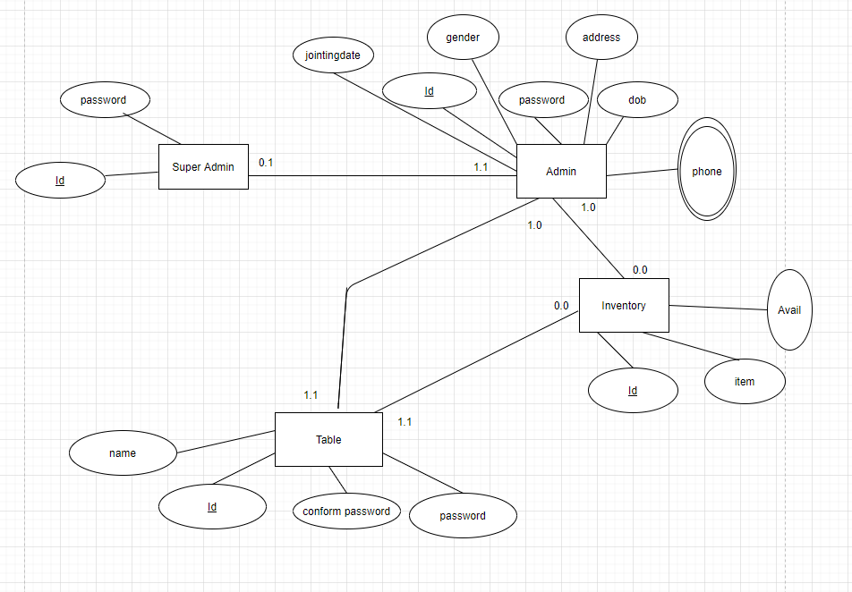
ER Diagram

Slide 7
ER diagram description
The following diagram we have 4 entities Super Admin,Admin,inventory and table relationship.The relationship between Super Admin and Admin is many to one as a superadmin can have many admin .Super Admin entity has attributes such as Id, password and admin entity has attributes such as id,joiningdate, gender,password,dob & address.Also the admin and inventory has a many to one relation ,there can be one and more admin but one inventory .inventory entity has attributes such id,items,avail. admin has also relation with table has many to many relationship. Table has is name, unique id, confformpassword and password. Table and inventory has also many to one relationship .

Slide 8
GOALS
Goals of our project
The project will reduce workload of the servicemen who take orders and hence guarantee more attention towards each and every customer. It will increase the speed of order with real time monitoring along with minimum ambiguity fault or cheat for an instance, no mislead of customers by waiters or change in orders by the customers etc. Even there will not be a calculator required if one’s budget is limited. As an interesting and attractive user interface will attract more customers and with an increasing trend towards a smart world, it will bring a more profitable business.
ACTION PLAN REVIEW
Make sure anyone understand the system action plan

