Slide 1

Global Student Migration AnalysiS
Present By
ojutomori Kehinde Oyin
Date: August 20, 2025
Tools USED: Excel &Power BI

Slide 2

Introduction
This dataset captures the global migration of students pursuing higher education from 2019 to 2023, including their countries of origin, destinations, universities, courses, placement outcomes, and more.
It covers 10 major destination countries with realistic mappings of top universities and cities, reflecting trends and choices students have made over the last five years.

Slide 3

Goal & Objective
Goal:
To analyze global student migration trends, scholarship distribution, university choice, and job placements, with a focus on factors such as field of study, country of origin, and language proficiency.
Objectives:
Migration Patterns;Determine which countries are the most popular for students to migrate to.
Identify trends in student migration based on origin and destination countries/cities,Scholarships and Enrollment.
Analyze the relationship between scholarships and student enrollment. Investigate the reasons students migrate, including higher rankings, job opportunities, scholarships, etc.

Slide 4

Data Overview
Source: Keggle [ Secondary Method Of Collection]
Rows: 5000
Columns: 23
Years: 2019–2023
Key Fields: origin_country, destination_country, field_of_study, scholarship_received, placement_status, starting_salary_usd, gpa_or_score, visa_status, post_graduation_visa

Slide 5

Methodology / Tools
Steps: Import → Clean → Analyze → Visualize
Excel: helper columns using IF and nested IF;
Scholarflag=IF([@scholarship_received]="Yes",1,0)
Placement Success=IF([@placement_status]="Placed","Successful","Unsuccessful")
Salary Category (nested IF)=IF([@starting_salary_usd]=0,"Unemployed",IF([@starting_salary_usd]<30000,"Low",IF([@starting_salary_usd]<60000,"Medium","High")))
Performance Level (Based on GPA)=IF([@gpa_or_score]>=3.5,"Excellent",IF([@gpa_or_score]>=3.0,"Good",IF([@gpa_or_score]>=2.0,"Average","Poor")))
Power BI = Visualization + KPI dashboard (storytelling).

Slide 6
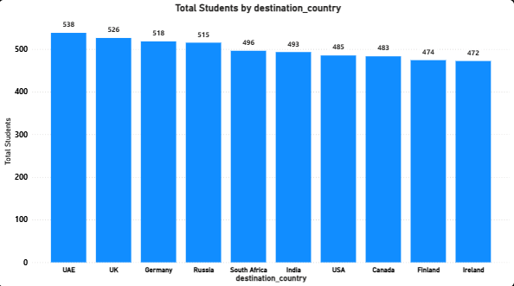
Insight UAE is the leading student destination in this dataset. USA, UK, Canada, and Germany follow as the most attractive higher-education destinations. This highlights strong demand for globally recognized universities and job opportunities in these countries.
Top 10 Destination Countries

Slide 7
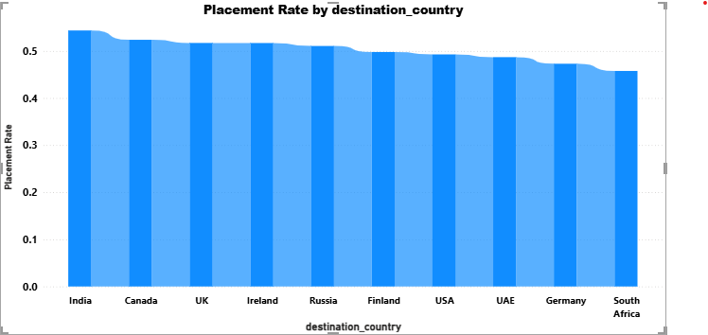
Insight Placement rates are strongest in the India, Canada, UK, and Ireland, reflecting strong graduate employment markets. Destinations with lower placement rates may indicate challenges in work permit policies or limited job markets. Students prioritize destinations that offer both quality education and career opportunities.
Placement Rate by Destination

Slide 8

Key Findings / Insights
Top destination: UAE.
Highest average starting salary: USA.
Scholarship rate overall: 51.5%.
Placement rate overall: 50.2%.

Slide 9

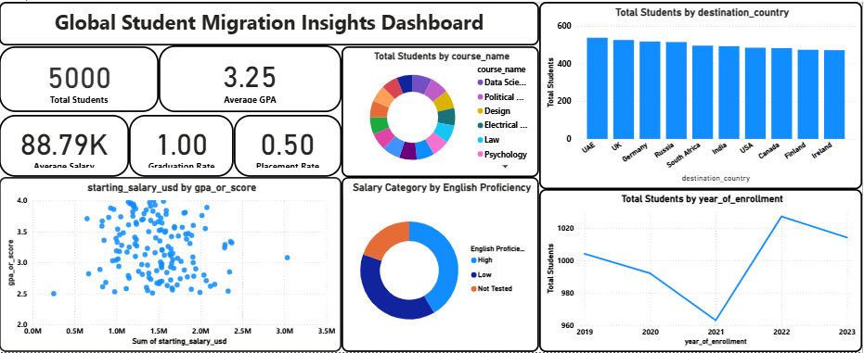
📊 Explanation of KPI, Charts & Dashboard
KPI Cards (Top-Level Insights)
These summarize the most important outcomes at a glance:
Total Students
Shows how many students are in the dataset.
Helps understand the overall scale of migration.
Graduation Rate
% of students who completed their studies.
High graduation rate = successful academic support system.
Placement Rate
% of students who secured jobs after graduation.
Indicates employability of graduates.
Average GPA
Measures academic performance across all students.
Can be compared with placement/salary success.
Average Salary (Placed Students)
Shows earning potential after graduation.
Useful for students choosing destination/courses and for universities to track ROI.

Slide 10

Recommendations
Focus recruitment in top destinations and fields with higher placement/salaries.
Expand scholarship programs where they correlate with higher placements.
Strengthen language-test prep in regions with lower placement rates.
Help shows which countries are most attrative for international students
Helps universities & governments see demand pattern

Slide 11

Conclusion
The analysis of global student migration reveals clear patterns in destinations, fields of study, and career outcomes.
Top destinations like the USA, UK, Canada, and Germany continue to attract the majority of students.
STEM and Business fields dominate enrollment, reflecting global job market demand.
Scholarships and higher GPA significantly improve placement success and starting salaries.
Post-graduation outcomes show that academic performance, financial support, and visa opportunities are key drivers of employability.
🔑 Overall Insight: The journey from enrollment to employment is shaped by destination choice, academic performance, and financial/visa support. Using Excel for preparation and Power BI for visualization provided a clear, data-driven story of international education trends and outcomes.

Slide 12

References & Credits
Data: global_student_migration
Tools: Excel & Power BI
Justices, Development & Peace center (JDPC)
Tutor: Miss Dishaar Agarwal
MySelf: Ojutomori Kehinde Oyin
&

Slide 13
Thank You

